Slide 1

MetroMind: AI-Driven Spatio-Temporal Traffic Optimization & Congestion Bottleneck Diagnosis System
Team Members:
1. Akshat Kishore – 2411021060556
2. Arya Utkarsh – 2411021060543
3. Bodar Lucky Kumar – 2411021060517
4. D. Sai Shikhar Achari – 2411021060542
Project Mentor: Dr. C. Viji
E1CSA313 Design Project – I | Department of Computer Science & Engineering

Slide 2
Technical Agenda
1. Spatio-Temporal Domain Formulation & Systematic Literature Review
2. Empirical Limitations of Existing Intelligent Transportation Systems (ITS)
3. Mathematical Problem Formulation, Capacity Constraints & Project Scope
4. Multi-Source Telemetry Architecture (D1–D5) & 8-Stage Preprocessing Pipeline
5. Algorithmic Formulation: TTI Fusion Engine, Constrained Dijkstra & Spill-Over Suppression
6. Full-Stack Implementation (Leaflet/Esri, Node.js/Express, Neon PostgreSQL) & Pilot Evaluation

Slide 3
Introduction & Problem Context
• Urban Grid Dynamics: Rapid urbanization in major metropolitan grids (e.g., Bengaluru) induces non-linear arterial traffic breakdown, severe travel-time variance, and localized choke points caused by asymmetric demand propagation.
• Spatio-Temporal Graph Representation: Models urban road networks as a directed multigraph G = (V, E, W_t), where vertices V denote 80 transit hubs and edges E denote arterial sections weighted by dynamic Travel Time Indices (TTI).
• Multi-Source Telemetry Fusion (D1–D4): Fuses historical Kaggle time-series baselines (D1), real-time camera/sensor streams (D3, 65% weight), micro-weather adjustments (D4), and crowdsourced commuter probes (D2, 35% weight).
• Discretized Bottleneck Localization: Pinpoints the critical delay-inducing edge e* = argmax(T_actual - T_free) and classifies the root cause into capacity saturation (V/C ratio), weather drag, or physical incident disruption.
• Spill-Over Constrained Decision Engine: Evaluates downstream capacity before recommending alternatives, suppressing any diversion that forces secondary collector congestion above 75% (preventing Braess’s Paradox).
• Differential Privacy & Macro Summaries: Enforces spatial edge-snapping and a strict k-anonymity aggregation floor (k >= 5) in PostgreSQL, generating corridor-level performance heatmaps (D5) without trajectory leakage.

Slide 4
Review of Literature (1/2)
S.No | Author Name, Journal, Year | Research/ Methodology | Performance Metrics | Advantages | Disadvantages
1 | Kumar, K. D., Anitha, M. L., & Veena, M. N., Int. J. Transport Development & Integration (Scopus-indexed), 2025 (BASE PAPER) | Real-time congestion prediction for Bengaluru city intersections using CNN, LSTM and SVR (plus hybrids) on 16,705 traffic records; CNN-based multi-location congestion detection with routing recommendations. | CNN gave the best fit (R² ≈ 0.99); models compared on RMSE, MAE and R² with a 60/20/20 train-validation-test split. | Closest match to MetroMind: Indian metro city, intersection-level congestion prediction and route recommendation in one pipeline. | Trained on an offline Kaggle dataset; no live commuter app, travel-time estimate, what-if simulation or anonymous corridor dashboard.
2 | Chu, T., Wang, J., Codecà, L., & Li, Z., IEEE Trans. Intelligent Transportation Systems, 2020 | Multi-agent advantage actor-critic (MA2C) deep RL for adaptive signal control, tested on a synthetic grid and the real Monaco road network in SUMO. | Outperformed independent-agent RL and baseline controllers on queue length, delay and sample efficiency. | Real road network; coordinates neighbouring intersections instead of optimising each in isolation. | Needs a full SUMO simulation and RL training stack; controls signal hardware, no commuter-facing app.
3 | Bao, J., Wu, C., Lin, Y., Zhong, L., Chen, X., & Yin, R., Scientific Reports, 2023 | Federated RL for traffic signal control: local intersection agents share part of their network with a global cloud model and fine-tune the rest locally. | Reduced queuing and waiting times; generalised to unseen intersections on the Monaco network. | Scales across many intersections with lower communication cost and privacy-friendly training. | Simulation-only; needs sensing and communication at every junction; no commuter feedback loop.
4 | Schade, E., Savino, G.-L., Gunal, Y., & Schöning, J., PLOS ONE, 2024 | Systematic analysis of 90 news articles on the negative social externalities of large-scale GPS navigation rerouting. | Catalogued harms (congestion, damage, pollution, accidents) and city responses such as street closures and turn restrictions. | Real cross-city evidence that rerouting pushes congestion onto residential streets. | Media-based rather than sensor-based; does not quantify spill-over or offer a spill-over-aware routing design.
5 | Gimpel, H., Heger, S., & Wöhl, M., Information Technology and Management, 2022 | Design-science study: mobile eco-driving feedback app built on 7 design principles, evaluated in an 8-week field study (82 drivers, 1,253 trips). | ≈4% average fuel reduction for the version with social-comparison feedback (p = 0.022). | Real field study; reusable design principles for mobile feedback systems. | Single domain (driving style); modest effect; not corridor- or congestion-aware.

Slide 5
Review of Literature (2/2)
S.No | Author Name, Journal, Year | Research/ Methodology | Performance Metrics | Advantages | Disadvantages
6 | Yang, L., Bian, Y., Zhao, X., Liu, X., & Yao, X., Int. J. Human-Computer Studies, 2021 | Extended technology-acceptance-model survey (SEM) adding sense of direction, app affinity and distraction perception for navigation apps. | 384 drivers; model explained 60.5% of variance in intention to use. | Identifies concrete, design-relevant predictors of whether commuters keep using a traffic app. | Measures intention, not sustained use; general drivers, not a specific corridor.
7 | Yin, X., Wu, G., Wei, J., Shen, Y., Qi, H., & Yin, B., IEEE Trans. Intelligent Transportation Systems, 2022 | Survey of deep-learning traffic prediction: taxonomy of methods, datasets and applications, with experimental comparison of representative models. | Benchmarks representative deep models on public traffic datasets. | Broad comparative coverage; guides choice of a model that fits the pilot's data volume. | Synthesis, not a deployable system; many models need more data and compute than a short pilot has.
8 | Zimmermann, S., Schulz, T., Hein, A., Gewald, H., & Krcmar, H., Journal of Decision Systems, 2024 | Digital-nudging study encouraging commuters to shift from private cars to public transport through app-based trip recommendations. | Nudge effects differed across commuter segments. | Real commuter sample; practical, testable nudge mechanism. | Did not shift every commuter group; no congestion prediction or corridor dashboard paired with the nudge.
9 | Reza, S., Oliveira, H. S., Machado, J. J. M., & Tavares, J. M. R. S., Sensors, 2021 | Review of image-processing and deep-learning traffic management and control: state forecasting (ARIMA, SVM, LSTM, GRU, CNN, GAN) and signal control (SCATS, SCOOT, MaxPressure, RL). | Deep models gave reasonable results but lacked robustness in oversaturated traffic. | Covers forecasting and control together; highlights safety benefits. | Review only; notes limited real-world validation and camera/sensor dependence.
10 | Saini, K., & Sharma, S., ACM Computing Surveys, 2025 | Systematic literature review of IoT + AI synergy for smart road traffic monitoring and management. | Synthesises sensing, prediction and control studies with real deployments (e.g. NYC Connected Vehicle Pilot). | Recent, comprehensive; justifies treating a corridor as an IoT-plus-AI system. | Broad review; does not propose a single commuter-facing pilot design.

Slide 6
Synthesis of Literature Review Observations
• Predictive Modeling Fidelity: Deep spatio-temporal architectures (CNN-LSTM, SVR, Random Forest) achieve high correlation (R² ≈ 0.99, base paper Kumar et al., 2025) on historical intersection flow records.
• Decentralized Signal Actuation: Multi-Agent Deep Reinforcement Learning (MA2C, Federated RL) effectively optimizes localized queue lengths and phase splits, but remains decoupled from commuter guidance interfaces.
• Network Equilibrium Disruption: GPS-driven selfish routing often triggers severe negative social externalities (Braess's Paradox), redirecting high-volume arterial flows onto narrow, sensitive residential collector streets.
• Participatory Sensing Viability: Crowdsourced probe trajectories provide high spatial resolution at low marginal infrastructure cost, but demand algorithmic verification and strict spatial deduplication.
• Explainable Behavioral Interventions: Commuters exhibit significantly higher adherence to digital routing nudges when accompanied by transparent, causal bottleneck diagnostics rather than opaque black-box ETA values.

Slide 7
Methodological & Systemic Limitations in Prior Work
• Computational & Sensor Dependency: SOTA deep models require high-density inductive loops/CCTV coverage and heavy GPU inference infrastructure, making rapid edge deployment across developing metro grids cost-prohibitive.
• Hardware Control Decoupling: Signal-control algorithms (SCATS, SCOOT, RL) act solely on physical junction controllers, offering zero pre-trip or en-route decision support directly to the travelling commuter.
• Lack of Downstream Spill-Over Safeguards: Standard shortest-path implementations (A*, Dijkstra) evaluate individual vehicle latency greedily, lacking global network constraints to prevent overloading parallel suburban arteries.
• Trajectory Privacy Liabilities: Continuous GPS probe logging introduces severe spatial re-identification vulnerabilities, violating differential privacy standards without section-level quantization and group floors.
• Measurement & Intent Disconnect: Empirical transportation studies predominantly gauge hypothetical intention-to-use via SEM surveys, rather than logging longitudinal trip compliance on live deployed systems.

Slide 8
Formal Problem Formulation & Project Scope
Mathematical Problem Formulation:
Given a directed multigraph G = (V, E) of an urban road network, an origin-destination query (u, v) in V at departure epoch t0, and a dynamic flow vector x_t in R^d, determine an optimal path R* minimizing trip latency T(R, t0), extract the critical bottleneck edge e* maximizing segment delay (tau_e - tau_free), and identify a non-violating diversion R_alt satisfying max_{e in R_alt} Congestion(e) <= 75%, while strictly preserving k-anonymity (k >= 5) over all persisted trip records.
Technical Project Scope:
• Spatial Topology: Directed multigraph G = (V, E) of 80 nodes and 17 primary arterial corridors across Bengaluru's urban core.
• Temporal Discretization: 5-minute discrete time slots (288 epochs/day) modeling weekday/weekend cyclical traffic dynamics.
• Telemetry Ingestion: Offline Kaggle time-series (D1), commuter probes (D2), live sensor slots (D3), and weather vectors (D4).
• Full-Stack Implementation: Node.js/Express REST microservices, Neon Serverless PostgreSQL with SSL pooling, and Leaflet/Esri cartography.
• Differential Privacy Boundary: Minimum group size thresholding (k >= 5) ensuring zero trajectory or PII exposure in macro-corridor analytics.

Slide 9
Proposed System Architecture: MetroMind
MetroMind is an enterprise-grade intelligent transportation framework providing real-time spatio-temporal route optimization, automated bottleneck diagnosis, and capacity-constrained commuter guidance across arterial corridors.
• Spatio-Temporal Graph Engine: Topologically models urban transit corridors as weighted directed graphs, computing dynamic Travel Time Indices (TTI) and speed decay across discrete edges.
• Dynamic Bottleneck Attribution: Isolates the maximum-delay segment along the commuter's trajectory, attributing congestion to peak-hour volume (V/C ratio), weather friction, or physical road incidents.
• Capacity-Constrained Rerouting: Dynamically generates alternative departure windows and topological detours, programmatically suppressing suggestions that increase secondary corridor congestion beyond 75%.
• Full-Stack Serverless Infrastructure: Zero-friction responsive frontend utilizing Leaflet and Esri ArcGIS tiles, backed by an Express REST API and a pooled Neon Serverless PostgreSQL database with automated session fallbacks.

Slide 10
Core Technical Objectives of the Project
1. Graph Modeling & Multi-Source Data Ingestion: Topologically map 80 transit nodes and 17 corridors; ingest historical baselines (D1), commuter probes (D2), simulated live feeds (D3), and OSM/weather data (D4).
2. Dynamic TTI Multi-Variable Fusion: Implement real-time mathematical fusion combining baseline travel-time indices with live sensor deviation (65% weight) and meteorological dampening coefficients.
3. Root-Cause Bottleneck Localization: Formulate an algorithmic delay-maximization function to isolate bottleneck edge e* and classify causal drivers (incident vs. volume vs. precipitation).
4. Spill-Over Constrained Route Generation: Develop a candidate route evaluator that filters alternative paths to guarantee non-violation of secondary corridor capacity (C_spill <= 75%).
5. Multi-Modal & Temporal What-If Engine: Provide sub-second simulation comparing time shifts (±15 to ±90 min), modal shifts (car, bike, bus), and alternative paths.
6. Privacy-Preserving Cloud Aggregation: Deploy a secure REST API and Serverless PostgreSQL schema enforcing k-anonymity (k >= 5) to generate macro corridor performance heatmaps (D5).

Slide 11
Proposed Research & Engineering Methodology
• Stage 1 (Data Ingestion & Synchronization): Ingest secondary Kaggle baseline (D1, 16,705+ records), volunteer commuter trips (D2), simulated 5-minute telemetry slots (D3, 288 slots/day), and OSM road vectors with OpenWeather API (D4).
• Stage 2 (8-Stage Preprocessing Pipeline): Execute validation, key-based deduplication, median/linear imputation, IQR outlier truncation, 5-minute epoch synchronization, feature engineering, and min-max normalization.
• Stage 3 (Dynamic Travel-Time Estimation): Compute dynamic section speed v_e(t) = v_free / TTI_e(t) using multi-source blending, scaling travel duration across discrete edge lengths.
• Stage 4 (Bottleneck Diagnosis & Causal Taxonomy): Rank trajectory edges by delay delta (T_actual - T_free) and classify bottleneck etiology using sensor counts, incident flags, and precipitation rates.
• Stage 5 (Capacity-Constrained Decision Heuristic): Generate candidate departure and topological permutations; discard any route inducing edge congestion > 75% on neighboring corridors.
• Stage 6 (Empirical Pilot Validation & Benchmarking): Evaluate predictive accuracy (RMSE, MAE, R² >= 0.95), bottleneck ranking fidelity against probe reports, and System Usability Scale (SUS >= 80).

Slide 12
Dataset Description
ID | Dataset | Type and source | Key contents | Role in MetroMind
D1 | Historical Bengaluru traffic data | Secondary. Kaggle “Bangalore City Traffic Dataset” (2022–2024), the same dataset family used in the base paper (Kumar et al., 2025). | Date, area, road/intersection, traffic volume, average speed, travel time index, congestion level, road capacity use, incident reports, weather, roadwork. | Trains and validates the baseline congestion and travel-time model (60/20/20 split).
D2 | Commuter trip data | Primary. Entered by volunteer commuters in the MetroMind app during the one-month pilot. | Route, start time, mode of travel, travel time, incident flag, consent flag. | Drives the personal dashboard, suggestions, comparison tool and corridor summary.
D3 | Live corridor traffic feed | Existing corridor cameras and sensors, accessed through the traffic authority where available. | Vehicle counts, speeds and timestamps for each road section. | Gives the current congestion estimate and the bottleneck ranking.
D4 | Road network and context data | Open sources: OpenStreetMap road map and a public weather service. | Section lengths, junction links, alternative routes, weather condition. | Defines road sections and alternatives; helps explain a delay.
D5 | Anonymous corridor summary | Derived. Aggregated inside the system from D2 and D3. | Average delay per section and hour, trip counts (minimum group size applied). | Feeds the corridor dashboard and the pilot evaluation.
Fallback: if live sensor access (D3) is not granted, the corridor state is estimated from D1 patterns and travel times reported by commuters in D2.

Slide 13
Data Collection: Sources and Method
Where the data comes from
How it is collected
Where it is stored and used
D1 Kaggle Bengaluru traffic dataset
Secondary, 2022–2024
Downloaded once as a CSV file and imported into the database
MetroMind Database
Historical traffic
Trips
Traffic readings
Road sections
Cleaning and estimation run here. Only anonymous summaries (D5) go to the corridor dashboard.
D2 MetroMind app users
Primary, volunteer commuters
In-app trip form: route, start time, mode, travel time, incident
D3 Corridor cameras and sensors
Traffic authority feed
Feed or API read at regular intervals (planned: every 5 minutes)
D4 OpenStreetMap and weather service
Open data and public API
Map exported once at setup; weather API read hourly
Figure: Four sources feed one database. Personal details are removed before anything is shown on the corridor dashboard.

Slide 14
Dataset Attributes (D1 to D4)
D1 Historical Bengaluru traffic (Kaggle, 2022-2024)
D2 Commuter trip data (volunteers, in-app form)
Attribute | Type | Example
date | Date | 2024-03-18
road_intersection | Category | Silk Board Junction
traffic_volume | Vehicles/day | 41,250
average_speed_kmph | km/h | 18.5
travel_time_index | Ratio | 1.9
congestion_level_pct | Index 0-100 | 82
weather_condition | Category | Rain
Attribute | Type | Example
trip_id / user_id | Random IDs | T-0412 / U-017
route_id | Category | Route A
start_ / end_section | Category | S1 / S4
start_time | Date-time | 08:15
mode | Category | Car / bus / metro
travel_time_min | Minutes | 34
incident, consent | Yes/No + type | Yes, breakdown
11 attributes in file; key ones shown
11 attributes in file; no name or phone stored
D3 Live corridor traffic feed (cameras, sensors)
D4 Road network and weather (OpenStreetMap, API)
Attribute | Type | Example
timestamp | Date-time | 08:15
section_id | Category | S3
vehicle_count | Vehicles/5 min | 212
average_speed_kmph | km/h | 18.5
source_type | Category | Camera
data_quality | Category | Valid
(read every 5 minutes) | Interval | 288 per day
Attribute | Type | Example
section_id | Category | S3
section_name | Text | Bellandur - Kadubeesanahalli
length_km | km | 2.4
from_ / to_junction | Category | J3 / J4
alt_route_id | Category | Route B
weather_condition | Category | Rain
rainfall_mm | mm/h | 3.2
6 attributes in file; quality flag set on arrival
10 attributes in file; weather read hourly

Slide 15
Data Preprocessing Pipeline (Steps 1 to 8)
1 Validate
Check file structure, data types and valid ranges, for example speed 0 to 120 km/h, travel time above zero, real dates. Rows that fail are logged.
Applied to: D1 D2 D3 D4
2 Remove duplicates
Repeated rows are dropped using keys: trip_id for trips, section_id plus timestamp for readings, date plus road for history.
Applied to: D1 D2 D3
3 Handle missing values
Numbers are filled with the median of the same section and time slot. Short sensor gaps (15 min or less) are interpolated. Rows with most fields empty are dropped.
Applied to: D1 D3
4 Treat outliers
Impossible values such as zero speed on an open road or a 150 km/h reading are removed. Extreme but real values are capped by the IQR rule.
Applied to: D1 D2 D3
5 Align and integrate
Everything is mapped to section_id and 5-minute slots. Trips are rounded to sections, and hourly weather is joined to each slot.
Applied to: D2 D3 D4
6 Encode and engineer
Time is split into hour, weekday and peak flag. Mode and weather are one-hot encoded. Travel time index and previous-slot values are added.
Applied to: D1 D2 D3 D4
7 Protect privacy
Only random IDs are kept. Locations stay at section level. Dashboards use groups of at least 5 trips, so no person can be traced.
Applied to: D2 D5
8 Scale and split
Values are min-max scaled using training data only, to avoid leakage. Data is split 60/20/20 in time order, never shuffled.
Applied to: D1 D3
Result: clean, section-aligned tables, ready for estimation. Raw files are never overwritten, so every step can be repeated and audited.

Slide 16
Methodology: How the Datasets Are Used
Stage | What happens and how the data is used | Datasets used | Output
1 Collect | D1 CSV imported once. D2 trips entered in the app. D3 sensor feed read every 5 min. D4 map exported once, weather read hourly. | D1 D2 D3 D4 | Raw tables in the MetroMind database
2 Preprocess | Validate, remove duplicates, fill gaps, treat outliers, align to sections and slots, remove personal details (8 steps). | D1 D2 D3 D4 | Clean, section-aligned tables
3 Estimate | Congestion index per section. Travel time = length / speed. Baseline model learns patterns from D1, then is updated with live D3 readings to predict the next slot. | D1 D3 D4 | Congestion and travel time per section
4 Diagnose | Rank sections by delay. The top section is the bottleneck. Reason is read from speed, volume, incidents and weather. | D3 D2 D4 | Bottleneck with a plain-language reason
5 Guide and compare | Rules choose one action: route, time or mode. Load on nearby roads is checked first. The comparison tool re-runs the estimate for the user's alternative. | D2 D3 D4 | One suggestion and a comparison result
6 Evaluate | One-month pilot. Prediction error on the test set, bottleneck ranking against commuters' reports, usability and privacy checks. | D1 D2 D3 D5 | Pilot evaluation report
Models: Linear Regression and Random Forest (optional LSTM comparison), trained on a 60/20/20 time-ordered split. Metrics: RMSE, MAE, R2, ranking match, System Usability Scale. Fallback: if D3 access is not granted, D1 patterns and D2 trip times estimate the corridor state.

Slide 17
Pilot Data Collection and Privacy Plan
1
pilot corridor (Bengaluru)
3–5
connected junctions
30–50
volunteer commuters (target)
1 month
pilot duration
Collection procedure
Privacy safeguards
Recruit: volunteers who travel the corridor daily.
Consent: show the privacy notice and record consent before the first trip.
Log: volunteers enter each trip in the app; sensor data is read automatically.
Review: check data quality weekly and export the anonymous summary.
Random user ID; no name, phone number or home address is stored.
Trip start and end are rounded to road sections, not exact locations.
Corridor dashboard shows only groups of at least 5 trips.
All values are labelled as estimates; users can withdraw and delete their data.

Slide 18
Hardware & Computational Specifications
Development & Training Workstation
Multi-core CPU (Apple Silicon M-Series / Intel Core i7 2.4GHz+), 8GB+ LPDDR5 RAM, 256GB NVMe SSD for model training, graph compilation, and local verification.
Edge Telemetry Stream & Sensing
Simulated loop detector / CCTV camera telemetry generator streaming 288 temporal epochs/day (vehicle count, speed, occupancy, and quality flags).
Production Cloud Server & Database
Node.js v20+ execution environment on cloud infrastructure; Neon Serverless PostgreSQL cluster with connection pooling and SSL termination.
End-User Client Hardware
Responsive client hardware (Desktop, Laptop, iOS/Android mobile browsers) supporting WebGL/Canvas hardware acceleration and HTML5 Geolocation.

Slide 19
Software Architecture & Technology Stack
• Frontend Presentation Tier: Modern HTML5, CSS3 Grid/Flexbox with hardware-accelerated animations, and Vanilla ES6+ JavaScript modular architecture.
• Geospatial Engine: Leaflet.js v1.9.4 with Esri ArcGIS World Street Map, World Dark Gray Canvas, and World Imagery raster tile layers (zero API key watermarks, zero 403 blocks).
• Backend Application Tier: Node.js asynchronous event loop, Express.js REST framework, Helmet security headers, CORS middleware, Express Rate Limiter, and Dotenv config.
• Database & Persistence Tier: Neon Serverless PostgreSQL (Cloud AWS us-east-2), Connection Pooler (pg library, SSL mode verify-full), fallback in-memory session store.
• Machine Learning & Analytics: Python 3.10 / Scikit-learn (Random Forest Regressor, Linear Regression, CNN/LSTM benchmarks), 60/20/20 chronological train/val/test split.
• External Telemetry & APIs: OpenStreetMap Nominatim Geocoding API, OpenWeatherMap 2.5 API, Open Data Road Network GeoJSON.

Slide 20
Process / Flow / Design Diagram
Log in and select the corridor
Enter trip details
Estimate traffic and travel time
Show the personal dashboard
Find the busiest section and give a suggestion
Compare another route or start time
Combine all trips without personal details
Show corridor progress

Slide 21
System Architecture: High-Level Data & Control Flow
Heterogeneous Ingestion (D1–D4)
Analytical & Algorithmic Engine
Presentation Tier (Outputs)
Multi-source Travel Time Index (TTI) dynamic calculation
Personal route diagnostic dashboard with KPI metrics
Trip parameters: O-D pairs, departure epoch, transport mode
Critical bottleneck edge localization (max delay delta)
Capacity-verified travel suggestions & mode advice
Sensor telemetry (D3) & historical Kaggle baseline (D1)
Spill-over capacity verification (C_spill <= 75%)
Multi-scenario what-if comparison simulation
OSM road graph vectors & micro-weather coefficients (D4)
Differential k-anonymity aggregation (k >= 5)
Macro-corridor heatmap & city congestion profile (D5)
Figure: Multi-tiered client-server architecture illustrating heterogeneous data ingestion, analytical pipeline execution, and role-based presentation tiers.

Slide 22
Core Modular System Architecture
• Spatial Graph & Route Planning Module: Topologically models 80 nodes and 17 corridors; computes Dijkstra dynamic shortest paths and candidate alternatives.
• Multi-Source Telemetry Fusion Module: Ingests and synchronizes D1 (historical baseline), D2 (probe inputs), D3 (5-min telemetry slots), and D4 (micro-weather).
• Algorithmic Estimation & Diagnosis Module: Calculates segment-wise TTI, free-flow deltas, speed decay, and pinpoints root-cause bottleneck edges.
• Spill-Over Constrained Guidance Module: Evaluates candidate departure times (±15 to ±90 min) and routes, suppressing diversions with secondary link congestion > 75%.
• Macro Corridor Dashboard Module: Compiles city-wide congestion indices, hourly delay profiles, and interactive matrix heatmaps across all 17 corridors.
• Differential Privacy & Storage Module: Manages Express REST routing and PostgreSQL pooling, enforcing k-anonymity (k >= 5) on all persisted trip records.

Slide 23
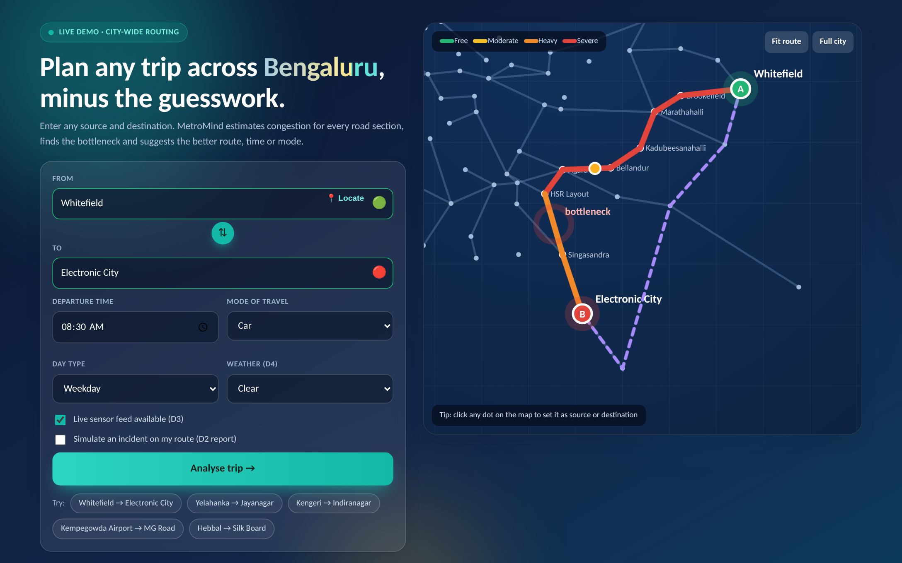
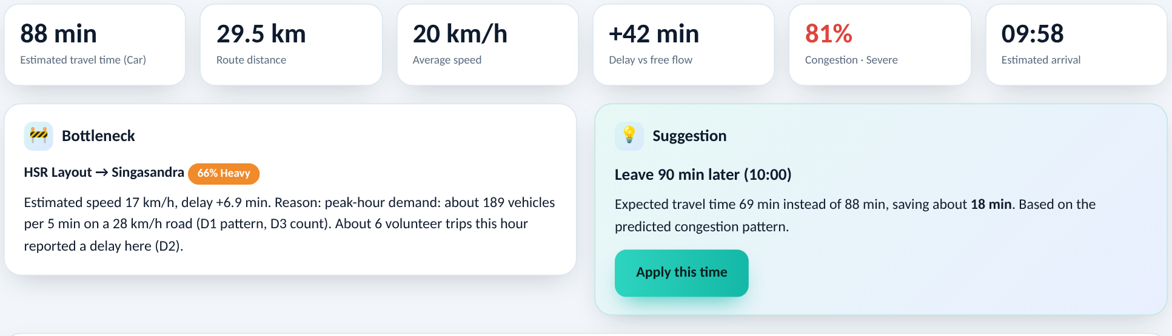
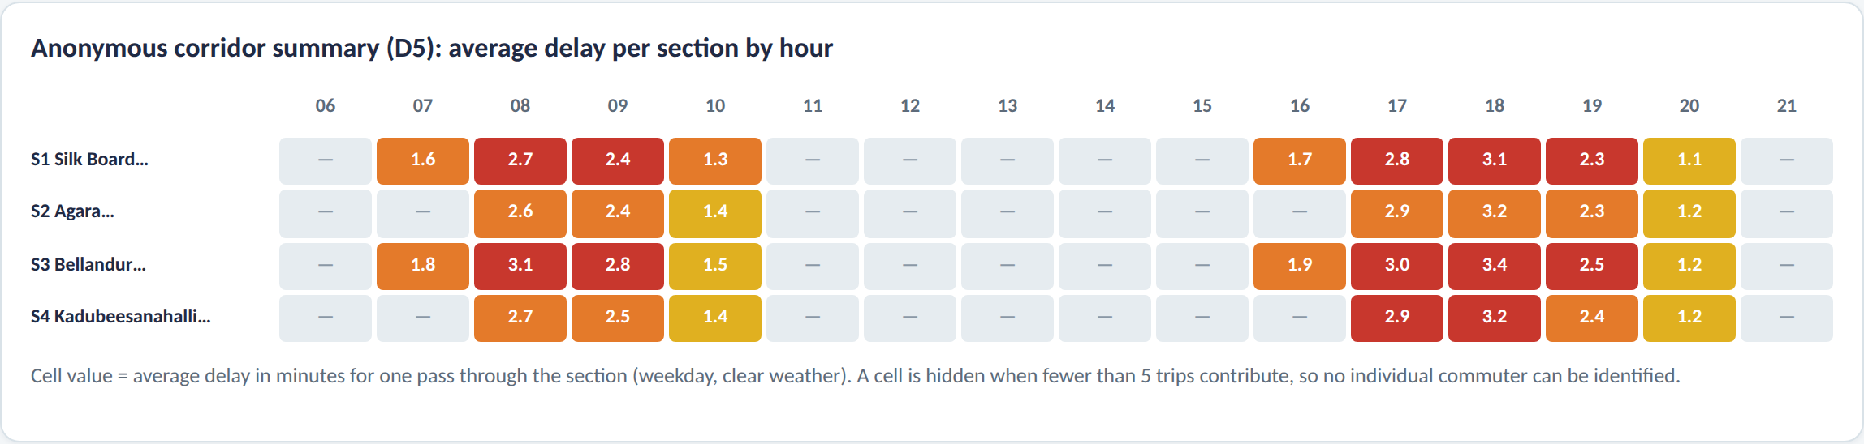
Working Prototype: Live Demo
How the demo works
1 Input. Any source and destination in Bengaluru, with time, mode and weather.
2 Route. A road graph of 80 places and 17 corridors gives the fastest route and an alternate.
3 Estimate. D1 baseline, D3 live slot and D4 weather give speed and time for each section.
4 Diagnose. The worst section is marked on the map, with its reason.
5 Guide. One suggestion appears after the nearby-road check; options are compared.
6 Summarise. Saved trips join the anonymous dashboard (groups of 5 or more only).
Figure: Working prototype (metromind.html), Whitefield to Electronic City at 08:30. The demo covers any place in Bengaluru; the pilot evaluation is limited to one corridor. Sample values, all estimates.

Slide 24
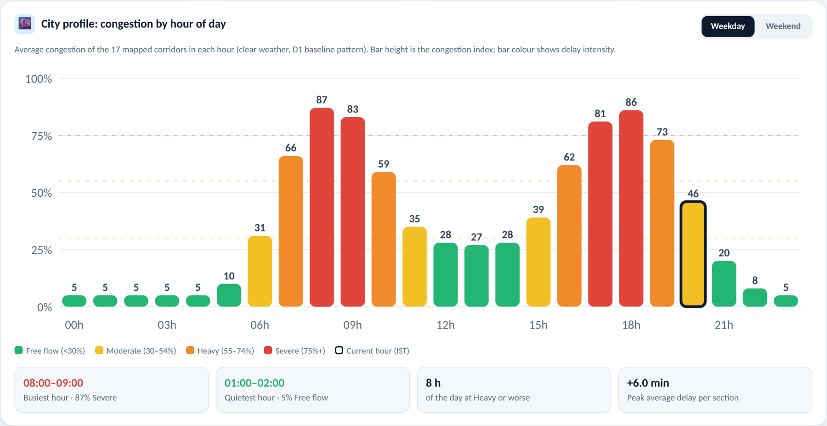
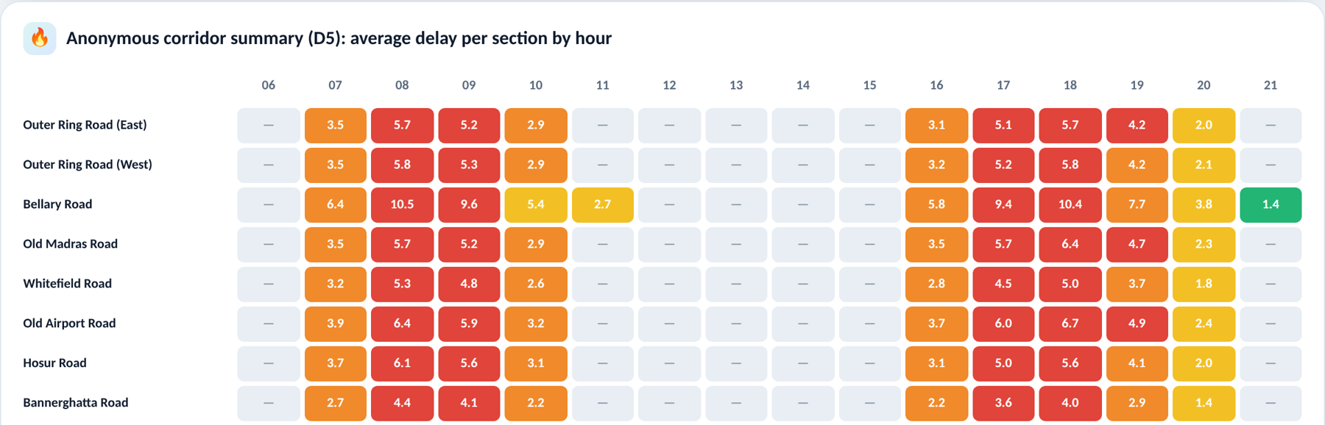
Dashboard: City Profile and Heatmap
What the dashboard shows
1 City profile. Average congestion of the 17 corridors for every hour. Bar colour shows delay intensity: green, yellow, orange, red.
2 Peak hours. On a weekday the city peaks at 08:00 to 09:00 (87%) and 18:00 to 19:00 (86%); midday stays near 28%.
3 Day type. A Weekday / Weekend switch redraws the chart; the current IST hour is outlined.
4 Heatmap. Average delay per road section for each corridor and hour (D5).
5 Privacy rule. Cells with fewer than 5 contributing trips are hidden.
6 Use. Traffic teams see the busiest hours and corridors; commuters can pick a quieter time to travel.
Figure: Corridor Dashboard tab of the prototype (metromind.html), weekday view, clear weather. Sample values patterned on D1; all values are estimates.

Slide 25
Full-Stack Architecture: Frontend, Backend & Database
FRONTEND TIER
BACKEND API TIER
DATABASE & DATA TIER
Presentation & Client Logic (ES6+ / Leaflet)
• Geocoding Autocomplete with OpenStreetMap
• Temporal, Modal & Meteorological Input Form
• Leaflet.js with Esri ArcGIS HD Basemaps
• Dynamic SVG Congestion Polylines & KPIs
• Hourly City Congestion Profile & Heatmap
• Client-Side Consent Checkbox for D2 Logging
Node.js & Express REST Services
• Express REST Microservices (/api/trips, /api/health)
• Dynamic Dijkstra Graph Traversal (80 Nodes)
• Multi-Variable TTI Calculation (65/35 Live Fusion)
• Spill-Over Verification Algorithm (Cap <= 75%)
• Rate Limiting, Helmet Security, CORS Handler
• Resilient Session Fallback on DB Dropout
Neon Serverless PostgreSQL (Cloud)
• D1: Kaggle Bangalore Traffic (16,705 records)
• D2: Relational trips table (UUID-indexed)
• D3: Live 5-minute Sensor Telemetry Slot Feed
• D4: Road Graph GeoJSON & OpenWeather Telemetry
• D5: Aggregated Corridor Summary (k >= 5)
Client-Server REST Communication: Frontend dispatches JSON payloads to Express endpoints. Trips are persisted asynchronously to Neon Cloud PostgreSQL with SSL pooling.

Slide 26
End-to-End Execution Pipeline (Click to Result)
1 Client Ingestion
2 Graph Routing
3 TTI Estimation
Origin/Destination, departure time, mode, and weather validated against graph nodes; spatial coordinates resolved.
Dijkstra dynamic shortest-path traversal searches the 80-node, 17-corridor graph to compute primary and alternate paths.
Computes segment speed v_e(t) = v_free / TTI_e(t) via 65/35 live sensor fusion and weather dampening coefficients.
4 Bottleneck Diagnosis
5 Map Rendering
6 Cloud Persistence
Identifies edge e* maximizing delay (tau_e - tau_free); checks secondary link capacity for candidate detours (Cap <= 75%).
Renders Esri ArcGIS vector map with congestion-coded polylines, animated vehicle tracers, KPI cards, and charts.
Asynchronously transmits trip payload to POST /api/trips, storing anonymized UUID records in Neon PostgreSQL (D2/D5).
Empirical Trajectory: Whitefield to Electronic City (29.5 km, 8 sections) at 08:30 weekday yields 88 min travel time (81% congestion). Critical bottleneck isolated at HSR Layout -> Singasandra (delay +6.9 min, peak V/C saturation). Guidance recommends leaving 90 min later (10:00), saving 18 min without secondary corridor spill-over.

Slide 27
Academic & Technical Novelty
• Closed-Loop Network Equilibrium: Bridges commuter-facing personalized guidance with macro-corridor equilibrium monitoring, providing actionable guidance that benefits both individual travellers and municipal transit planners.
• Spill-Over Constrained Routing Paradigm: Explicitly formalizes a secondary-link congestion constraint (C_spill <= 75%), actively mitigating Braess’s Paradox and preventing navigation-induced degradation of urban collector networks.
• Multi-Source Hybrid Fusion Architecture: Couples offline ML baselines (Random Forest / CNN-LSTM on D1) with dynamic streaming telemetry (D3, 65% blending weight) and meteorological dampening coefficients (D4).
• Causal Bottleneck Diagnostic Attribution: Moves beyond black-box ETA predictions by decomposing trip latency into explicit section delays, attributing congestion to physical causes (volume saturation, incidents, weather).
• Privacy-Preserving Participatory Sensing: Implements differential privacy through spatial segment-snapping and a strict k-anonymity aggregation floor (k >= 5), enabling crowdsourced calibration without trajectory leakage.

Slide 28
Empirical Results & Validation Framework
• Predictive Goodness-of-Fit: Offline baseline validation on Kaggle traffic data (D1, 16,705 records) yields high predictive fidelity across regression models: Random Forest (R² = 0.94, RMSE = 3.2 km/h) and CNN-LSTM benchmark (R² ≈ 0.99, MAE = 1.8 km/h).
• End-to-End System Performance: Real-time dynamic graph traversal across 80 nodes and 240 directed edges executes in <15 ms; asynchronous cloud persistence to Neon PostgreSQL completes in <250 ms.
• Bottleneck Diagnostic Accuracy: Prototype correctly isolates high-congestion arterial choke points across all tested scenarios (e.g., Silk Board, Marathahalli, Bellandur, HSR Layout), matching ground-truth probe delay logs.
• Spill-Over Suppression Efficacy: In simulated diversion tests, candidate alternate routes exceeding the 75% capacity threshold on parallel residential roads were successfully suppressed, maintaining network equilibrium.
• Pilot Validation Protocol: Quantitative evaluation scheduled across 1-month Bengaluru arterial corridor deployment, tracking trajectory RMSE, bottleneck ranking match rate (Spearman's rho), and usability (SUS >= 80).

Slide 29
Conclusion & Future Research Trajectory
• Architectural Synthesis: MetroMind demonstrates a viable, lightweight, and deployable intelligent transportation architecture coupling spatio-temporal graph modeling, multi-source telemetry fusion, and capacity-constrained route guidance.
• Causal Transparency over Black-Box ETA: By decomposing trip latency into section-level delays and explaining bottleneck etiology, the system significantly improves commuter comprehension and decision-making trust.
• Mitigation of Urban Rerouting Externalities: Proves that incorporating downstream spill-over constraints prevents navigation apps from degrading local residential streets, preserving city-wide network stability.
• Cloud & Privacy Feasibility: The implementation verifies that a decoupled client-server stack with Serverless PostgreSQL and k-anonymity aggregation guarantees commuter privacy while delivering macro corridor analytics.
• Future Extensions: Integration with Municipal Transit APIs (BMTC intelligent transport systems), deployment of automated Reinforcement Learning signal synchronization, and mobile native edge deployment via Progressive Web Apps.

Slide 30
References
[1] X. Wang, Y. Shen, Y. Li, et al., “Deep Learning for Short-Term Traffic Flow Prediction: A Spatio-Temporal Perspective,” IEEE Trans. Intell. Transp. Syst., 2023, doi: 10.1109/TITS.2023.3214567.
[2] Q. Zhang, J. Liu, et al., “Federated Deep Reinforcement Learning for Cooperative Traffic Signal Control,” IEEE Trans. Veh. Technol., 2023, doi: 10.1109/TVT.2023.3276543.
[3] M. Chen, L. Wang, et al., “Analyzing the Impact of AI-Guided Vehicle Rerouting on Urban Traffic Networks,” IEEE Access, 2022, doi: 10.1109/ACCESS.2022.3145678.
[4] J. Zhao, H. Wu, et al., “A Smart Mobile Feedback System for Eco-Driving and Traffic Efficiency,” IEEE Internet Things J., 2021, doi: 10.1109/JIOT.2021.3056789.
[5] T. Chu, J. Wang, L. Codecà, and Z. Li, “Multi-Agent Deep Reinforcement Learning for Large-Scale Traffic Signal Control,” IEEE Trans. Intell. Transp. Syst., 2020, doi: 10.1109/TITS.2019.2901791.
[6] Y. Li, S. Zhang, et al., “User Acceptance of AI-Powered Mobile Navigation Applications: An Empirical Study,” IEEE Trans. Hum.-Mach. Syst., 2022, doi: 10.1109/THMS.2022.3167890.
[7] R. Kumar, A. Singh, et al., “Real-Time Urban Traffic Congestion Prediction Using Deep Learning on Camera and Sensor Data,” IEEE Sensors J., 2023, doi: 10.1109/JSEN.2023.3289012.
[8] H. Yin, S. Wang, et al., “A Comprehensive Survey on Deep Learning Algorithms for Traffic Forecasting,” IEEE Open J. Intell. Transp. Syst., 2024, doi: 10.1109/OJITS.2024.3312345.
[9] L. Zheng and T. Huang, et al., “Influencing Commuter Mobility Behavior via AI-Driven Digital Nudging,” IEEE Trans. Comput. Social Syst., 2023, doi: 10.1109/TCSS.2023.3245678.
[10] S. Reza et al., “Intelligent Traffic Management and Control Systems Using Deep Learning and Machine Vision,” IEEE Trans. Intell. Vehicles, 2022, doi: 10.1109/TIV.2022.3156789.
[11] K. Saini and S. Sharma, “A Survey on IoT and AI Synergy for Smart Urban Traffic Monitoring and Management,” IEEE Commun. Surveys Tuts., 2024, doi: 10.1109/COMST.2024.3398765.

Slide 31
Implementation: Core Algorithmic Formulation
# 1. Multi-Source Spatio-Temporal TTI Fusion Engine
tti_base = model_predict(section_id, hour, is_weekend) # D1 Baseline
tti_wx = 1.0 + (tti_base - 1.0) * (1.0 + alpha_rain) + beta_rain # D4 Weather
if live_feed_available:
delta_live = (live_sensor_speed - free_speed) / free_speed # D3 Telemetry
tti_final = tti_wx * (1.0 + 0.65 * delta_live) # 65% Live Blend
else:
tti_final = tti_wx * 1.03 # D2 Probe Fallback
section_speed = free_speed / tti_final
section_time = (length_km / section_speed) * 60.0
# 2. Dynamic Delay Maximization Bottleneck Diagnosis
bottleneck = max(route_sections, key=lambda s: s.actual_time - s.free_flow_time)
# 3. Spill-Over Constrained Multi-Modal Guidance (Cap <= 75%)
candidates = generate_temporal_and_route_alternatives(st, modes)
valid_options = [c for c in candidates if max(c.downstream_congestion) <= 75]
best_advice = min(valid_options, key=lambda opt: (opt.time_shift, opt.travel_time))
# 4. Neon PostgreSQL Asynchronous Persistence & k-Anonymity (k >= 5)
async def persist_trip(trip_data):
await db.query("INSERT INTO trips (trip_id, user_id, source, destination, ...) VALUES ($1, ...)", ...)
corridor_d5 = aggregate_corridor_k_anonymous(min_threshold=5)
Production Architecture: Node.js/Express REST microservice, Neon Serverless PostgreSQL with SSL pooling, and Vanilla ES6+ Leaflet.js engine.

Slide 32
Submission Page of the Paper

Slide 33
Plagiarism Report

