Slide 1

CREATING A BURGER ORDER CHATBOT USING AWS SERVICES AND INTEGRATING WITH THE WEBSITE

Slide 2

TABLE OF CONTENTS :
INTRODUCTION
OVERVIRE OF SERVICES
LEX,LAMBDA,IAM
INTEGRATION OF SEVICES
TESTING
CONCLUSION

Slide 3
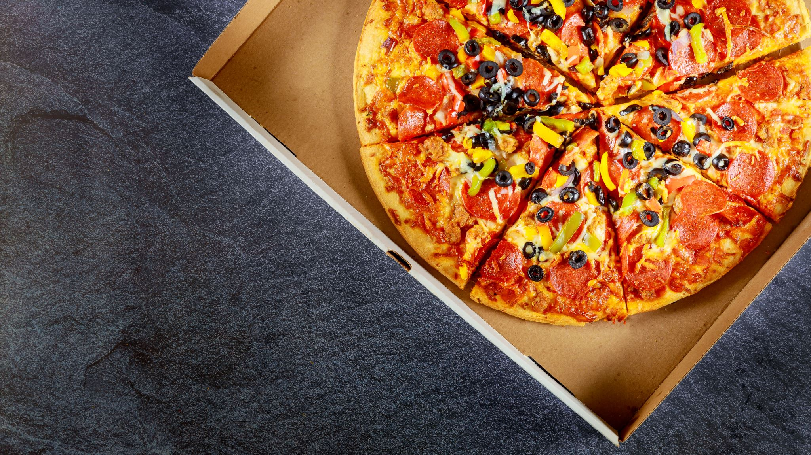
Introduction to Burger Order Chatbot
In today's digital age, the demand for convenient and efficient online services continues to rise. With this in mind, the creation of a pizza order chatbot presents an opportunity to streamline the process of placing and customizing pizza orders. This innovative solution leverages Amazon Lex, AWS Lambda, IAM, and Kommunicate to offer users a seamless and engaging experience. The chatbot will enable users to interact naturally via chat, make customized selections, and have a smooth ordering process. Let's dive into the various components that make this chatbot a sophisticated and user-friendly tool for pizza enthusiasts.

Slide 4
Objective
Enhance
Enhance customer experience by providing a seamless and interactive ordering system.
Streamline
Streamline order processing and improve business efficiency using AWS services.
Integrate
Integrate the chatbot with the website using Kommunicate for a unified user experience.

Slide 5

List of serverless services utilized
AMAZON LEX
AWS LAMBDA
AWS IAM
KOMMUNICATE

Slide 6

Overview of Amazon Lex
Natural Language Processing
Intent Recognition
Integration with AWS Services
It allows for the creation of custom conversation flows through the recognition of user intents, which enables the chatbot to guide users through the pizza ordering process with precision.
Amazon Lex provides advanced Natural Language Processing (NLP) and automatic speech recognition capabilities. These features enable the chatbot to understand and interpret the user's input, whether it's in text or spoken form.
Amazon Lex seamlessly integrates with various AWS services, making it possible to extend the chatbot's functionality and incorporate additional features and capabilities as needed.

Slide 7
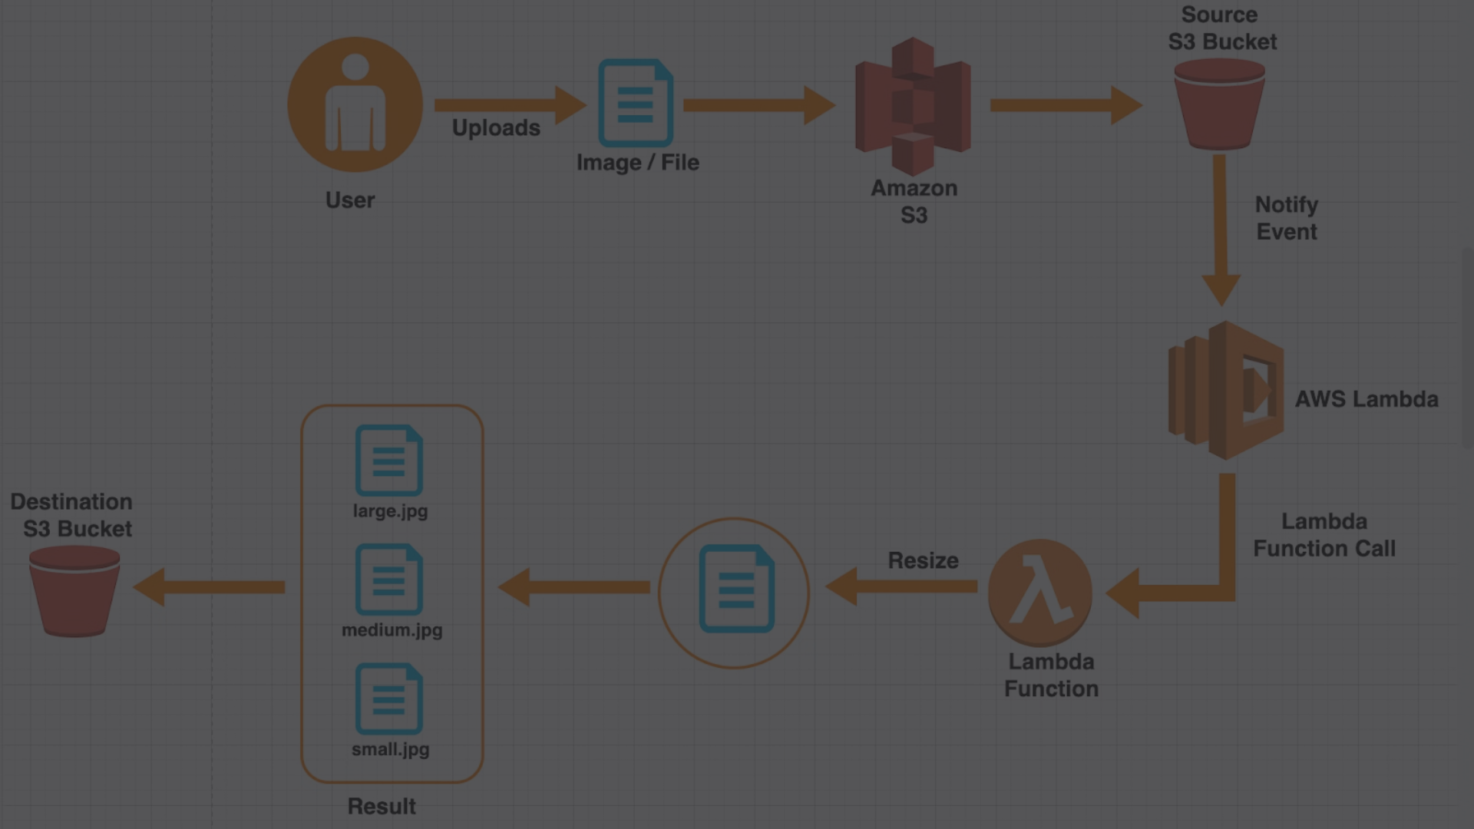



AWS Lambda and Its Role in the Chatbot
Serverless Computing
Scalability and Flexibility
Integration with Amazon Lex
AWS Lambda plays a pivotal role in the burger order chatbot architecture by facilitating serverless computing. It allows for the execution of code in response to specific events, such as user requests, without the need to provision or manage servers.
With AWS Lambda, the chatbot's functionality can seamlessly scale based on demand, ensuring optimal performance during peak ordering periods and maintaining cost-effectiveness during quieter times.
AWS Lambda integrates effortlessly with Amazon Lex, enabling the chatbot to execute custom business logic and connect with external systems, contributing to a dynamic and comprehensive burger ordering experience.

Slide 8
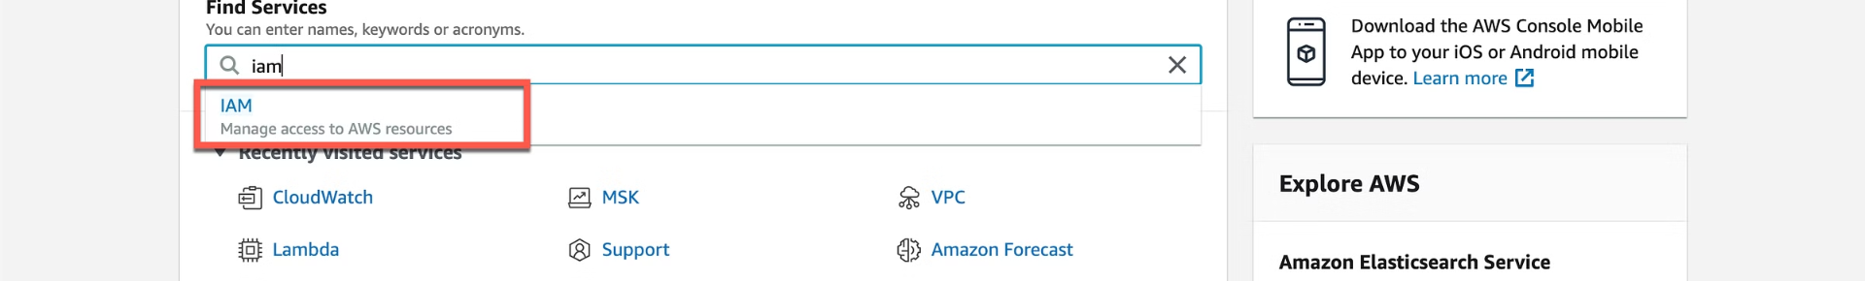
Understanding IAM (Identity and Access Management)
1
Granular Access Control
2
Secure Access Management
3
Integration with AWS Services
IAM allows for precise control over who is authenticated and authorized to use the chatbot, ensuring that the appropriate levels of access and permissions are enforced throughout the system.
It provides secure management of identities, including users, groups, and roles, as well as the configuration of policies and permissions to safeguard the chatbot's sensitive data and resources.
IAM seamlessly integrates with various AWS services, offering centralized control and visibility into the chatbot's access to other AWS resources.

Slide 9



Integrating the Chatbot with a Website Using Kommunicate
Seamless Integration
Enhanced User Experience
Efficient Communication
The integration of the pizza order chatbot with Kommunicate enables seamless communication and interaction between users and the chatbot directly within the website environment.
With Kommunicate, the chatbot can efficiently handle user requests and inquiries, offering real-time, personalized assistance to website visitors seeking to place burger orders.
Kommunicate provides tools to enhance the user experience by offering customization options and multi-platform support, ensuring an intuitive and engaging interaction for all users.

Slide 10
Detailed Procedural Steps:
Step 1: Designing the chatbot intents, slots, and utterances in AWS Lex
1
Step 2: Creating Lambda functions to process Lex requests
2
Step 3: Setting up Kommunicate for chatbot integration with the website
3
Step 4: Testing the chatbot functionality and website integration
4
Step 5: Deploying the chatbot and website integration to production

Slide 11
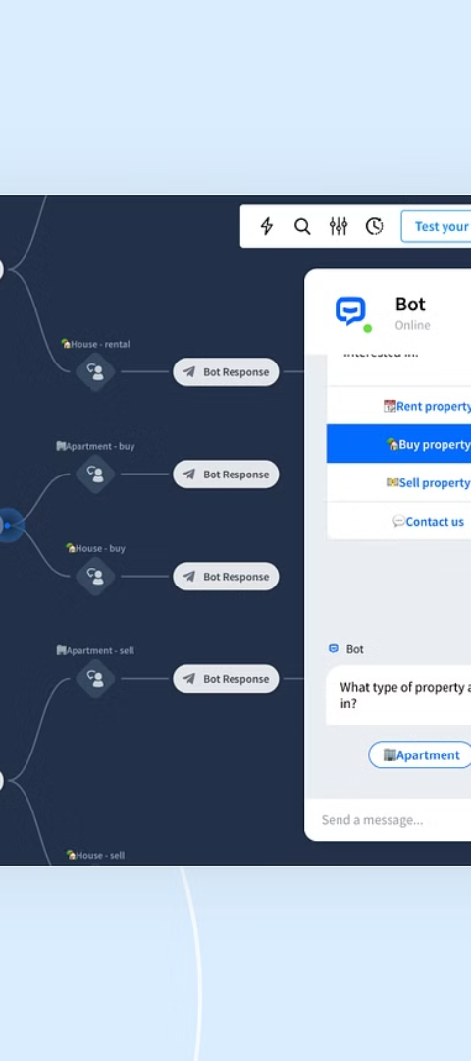
Testing and Refining the Chatbot
1
Unit Testing
Unit testing ensures that individual chatbot components function correctly and meet the specified requirements, offering early detection and resolution of potential issues.
2
User Feedback
Gathering user feedback provides valuable insights into the chatbot's performance and user satisfaction, enabling iterative improvements to refine the chatbot's functionality and user experience.
3
Performance Optimization
Continuous performance optimization focuses on enhancing the chatbot's speed, responsiveness, and accuracy through data-driven adjustments and refinements.

Slide 12
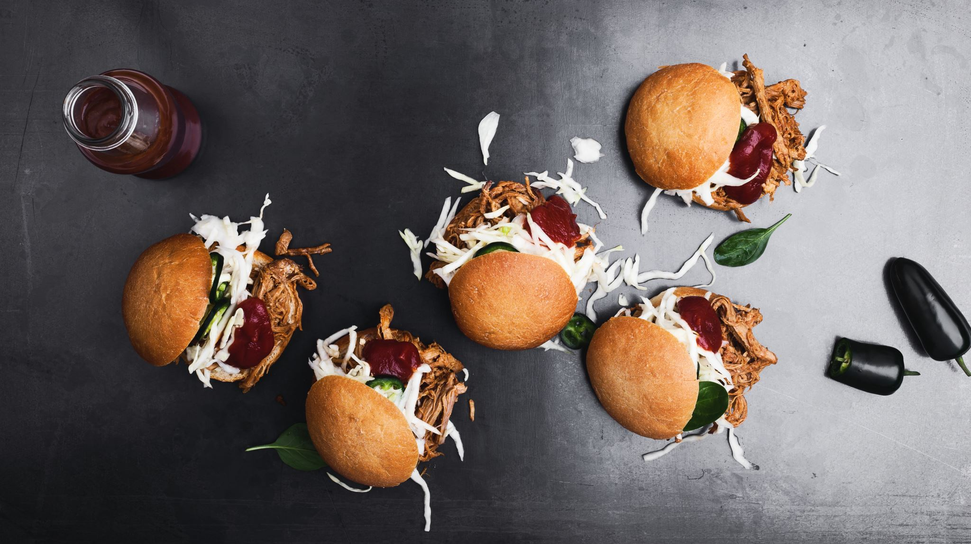
Output:
Live Demonstration of the Burger Order Chatbot:
Placing an order through the website
Interacting with the chatbot to place and cancel orders

Slide 13
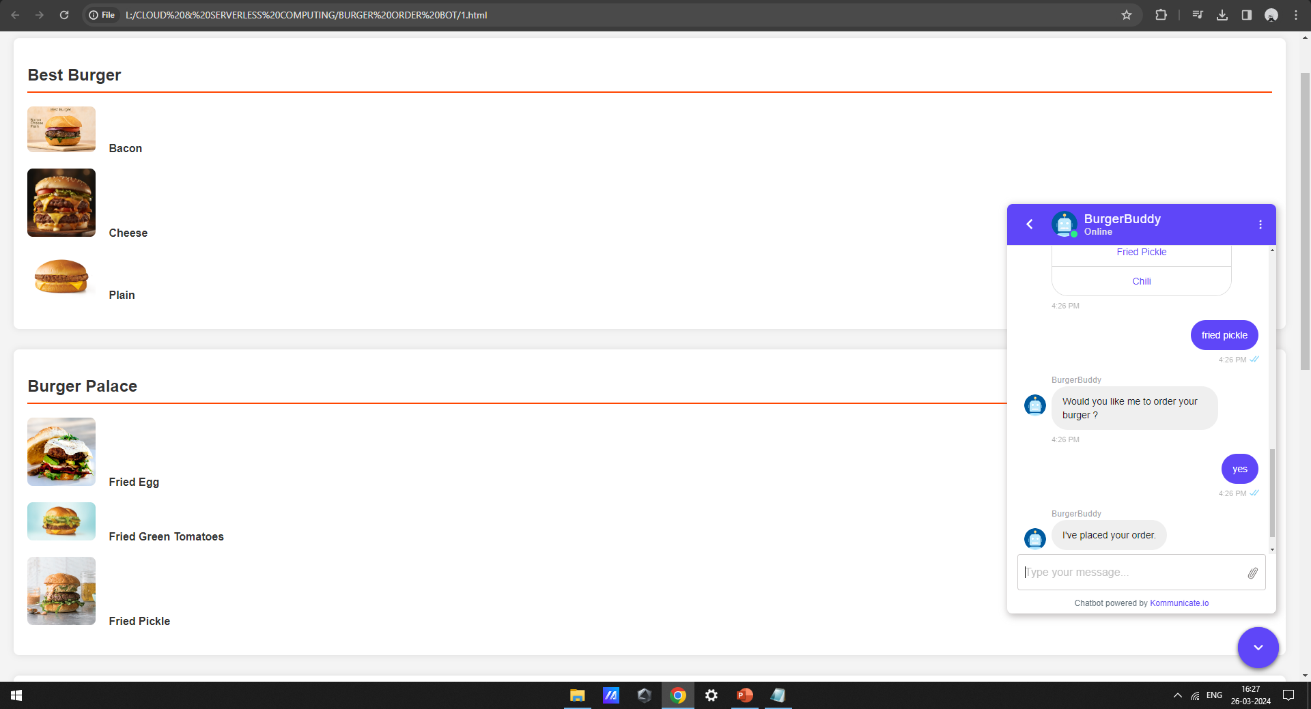

Slide 14

Conclusion
Successfully implemented a Burger Order Chatbot using AWS services and Kommunicate
Integrated the chatbot with the website for seamless user experience
Achieved the objectives of enhancing customer experience and streamlining order processing
Future opportunities for expanding the chatbot capabilities and integrations

