Slide 1

SHELL SHARE
By,
Lucky Pathan S. - 210303105790
Swet Patel R. - 210303105787
Vasu Raknoliya S. – 210303105794
Project Guide:
Assit. Prof. Shreya Dholaria

Slide 2
OUR TEAM
Lucky Pathan
Swet Patel
Vasu Rakholiya
Create a Python commond line interface for custom commonds,
Front-end development for shell and server request
Create the Backend of the server and Generate Log files with user DataLinks

Slide 3
Objective
Aim of out project is create a python tool which can help cyber security teams to clear a network with less hassle and form a super easy to communicate with other group members.
First we need to create a manual command line code for the special commands that we will implement in this project for ease of report generation and bug found list.

Slide 4
Introduction
Shell Share is a python based project, which helps us to connect the cybersecurity team of a company with a local network (LAN) and help them find problem in the network.
As a member finds the bug he can make an announcement to the rest of the group.
Each member network data is been tracked and a detail log file is generated with a 15 min backup of the network stream, when a bug is found we can retrieve the log and network file for detail report about the bug.
As the automate testing not ensure full protection of the network, this tool for manual scanning of the network helps user to form a proper report with communicating with other users.

Slide 5
Motivation Of Project
We were motivated by this project because of our curiosity in cyber security.
John Hammond is a well-known cybersecurity researcher, educator and content creator. As part of the Threat Operations team at Huntress, one of this podcast was about this particular topic.
We got a similar idea by the podcast and we tried to find a solution for it.

Slide 6
Abstract Of Project
We need to create a faster way to test the system to secure them. Our tool SHELL SHARE will help company’s cyber security team to coordinate in a better way. This tool help’s a team to connect in a single network in which they can share their progress, bug’s, file’s, and a logs of every step of each user.

Slide 7
Tools And Technology To Be Used In Project
HTTP.server
Argparse
Python
Log File Generator

Slide 8
Some Features
SECURITY
COMPANY
Log Creation
Network Packet Tracer
Host Custom Commands
Easy Python Deployment
Secure Python Environment
LAN Server For Connection

Slide 9
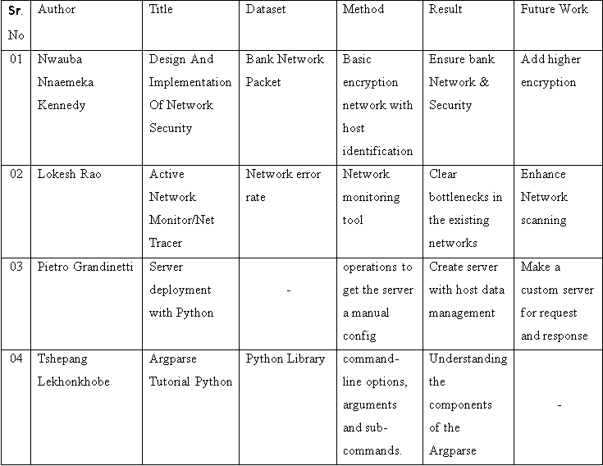
Literature Review

Slide 10
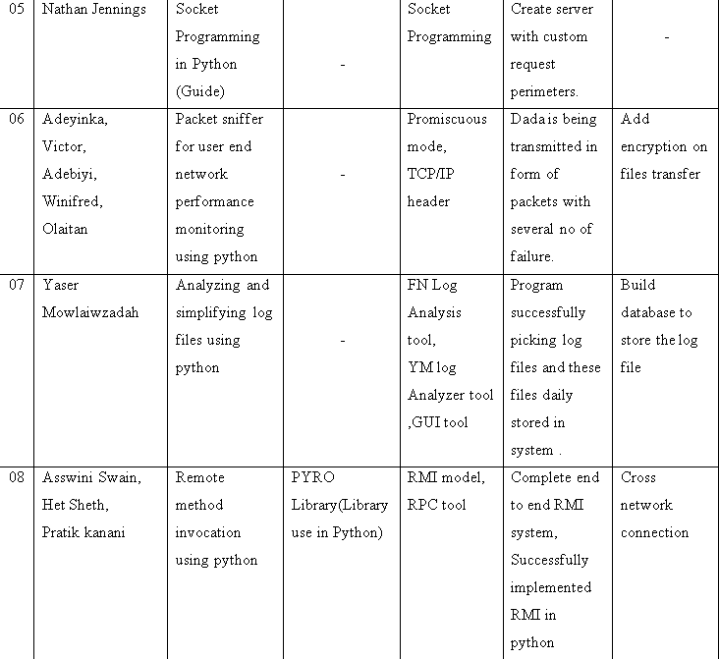

Slide 11
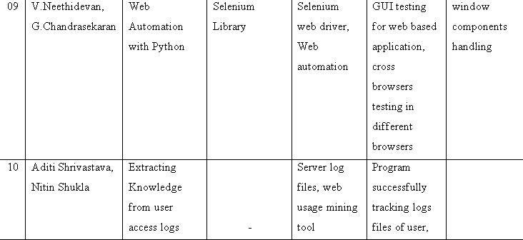
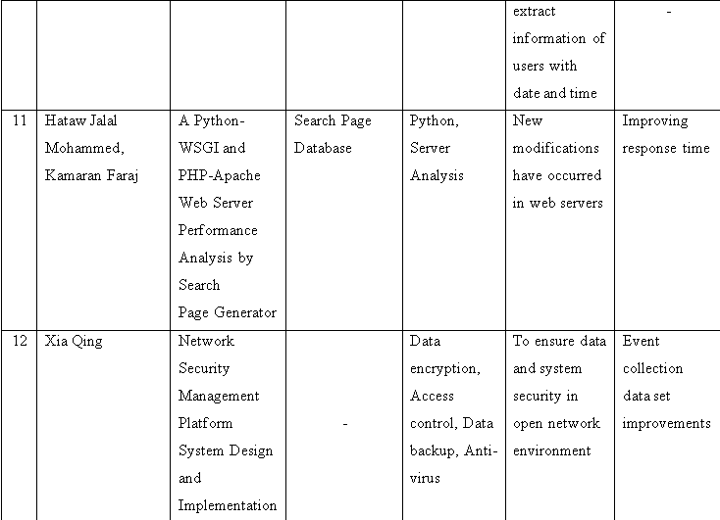

Slide 12
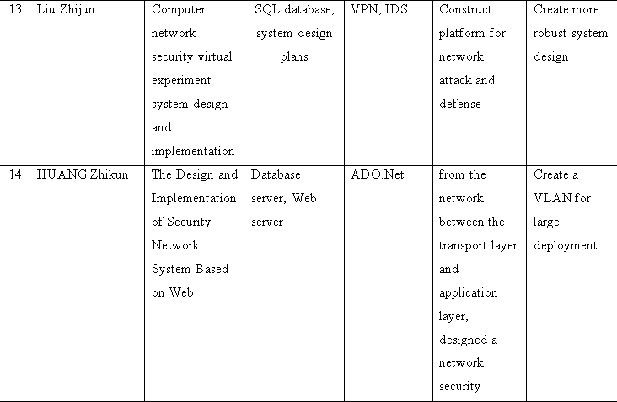
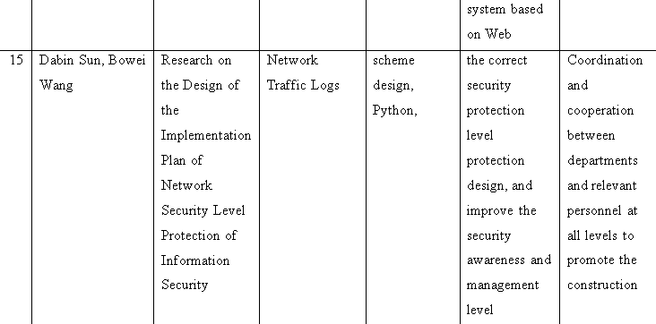

Slide 13
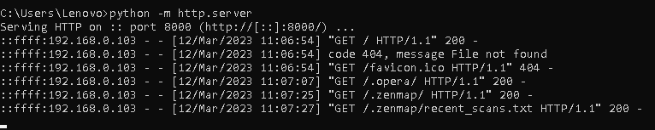
Implementation
Server Creation in Python
(I) Local Server
In this server client machine act as server ,we can make local server using one line code. your system becomes the server to the client that is your browser, and the files are stored locally on your system. The module you’ll be using to create a web server is Python’s http server. it can only be used as a static file server. You’ll need a Python web framework, to run dynamic web servers.

Slide 14
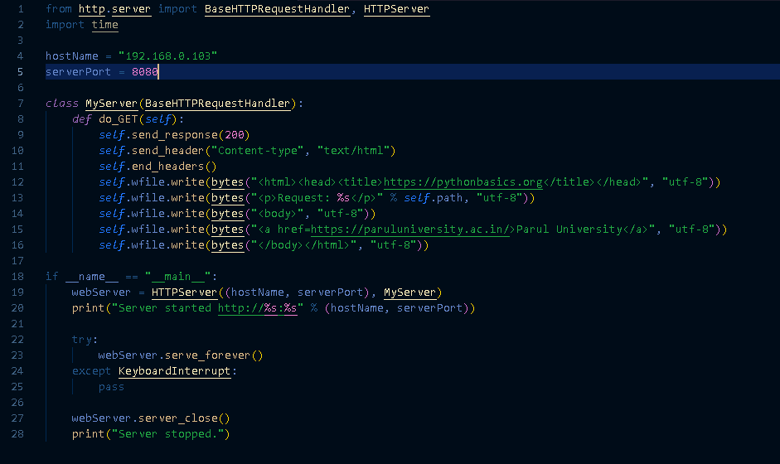

Implementation
(II) Custom Server
In this custom server we use local machine IP Address as host name and use port no 8080

Slide 15
Implementation
Module & classes use in server creation
HTTP.SERVER
The HTTP server is a standard module in the Python library that has the classes used in client-server communication. it is a simple, zero-configuration command-line static HTTP server. It is powerful enough for production usage, but it's simple and hackable enough to be used for testing, local development and learning.
BaseHTTPRequestHandler and HTTPServer
This two classes derived from HTTP. server library. This class is used to handle the HTTP requests that arrive at the server. By itself, it cannot respond to any actual HTTP requests, it must be subclass to handle each request method . BaseHTTPRequestHandler provides a number of class and instance variables, and methods for use by subclasses.

Slide 16
Implementation
It also provide some methods like:
Handle()
send_error()
send_response()
send_header()
end_header()
log_error()
log_message()

Slide 17


THANKS!
Do you have any questions?

