Slide 1
Project-ontwerpen Soldering Station
Made by: Lucas Cosemans

Slide 2
Contents
Goals
How to realize
Results
Q&A

Slide 3
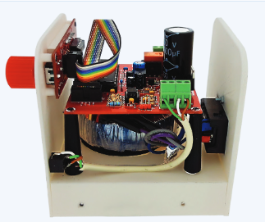
Goals
Elektor Magazine
Soldering station
Making PCB
Making Case
Result

Slide 4
How to realize
Elektor Magazine -> Schematics
Altium Disigner -> PCB
Autodesk Fusion 360 -> 3D drawing
3D printer -> Case

Slide 5
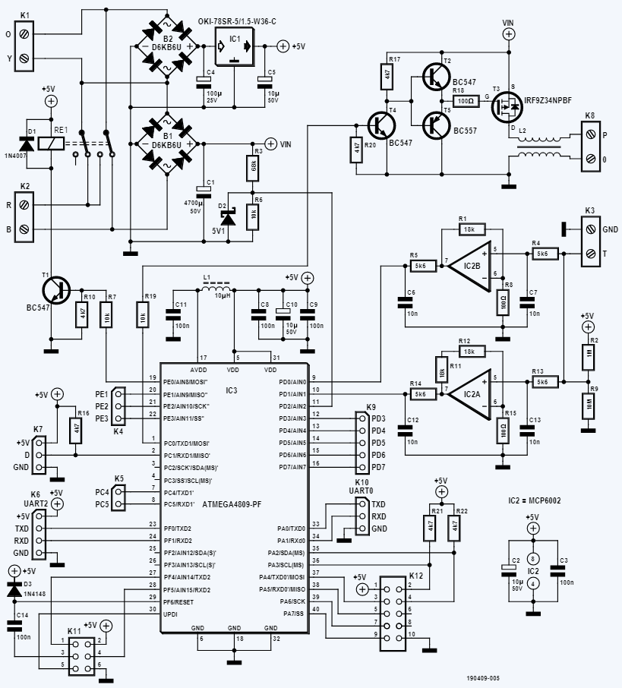
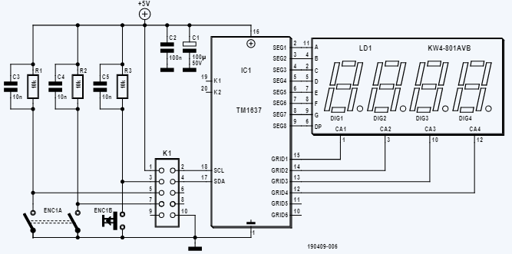
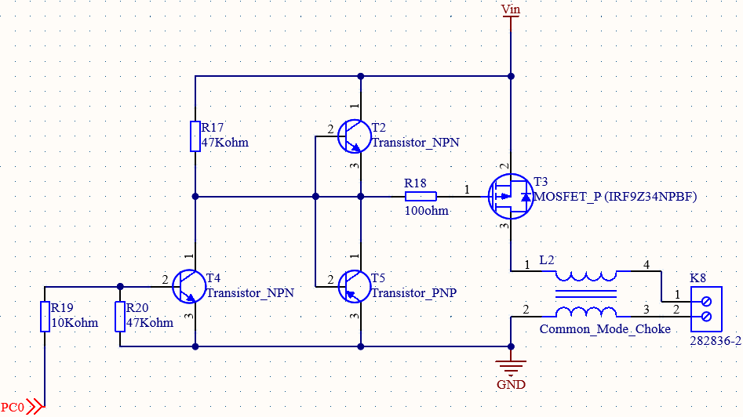
How to realize – Schematics

Slide 6
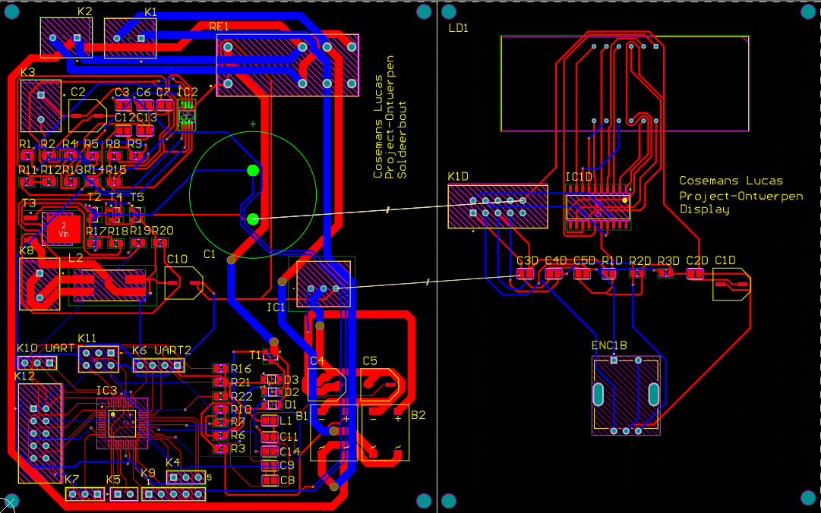
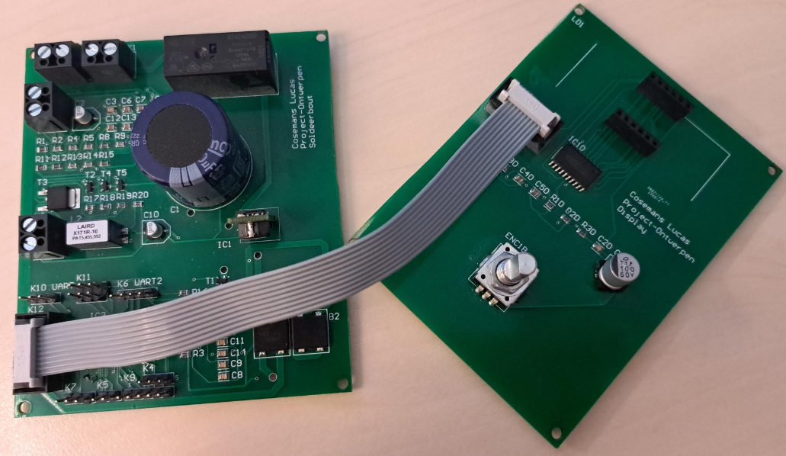
How to realize – PCB

Slide 7
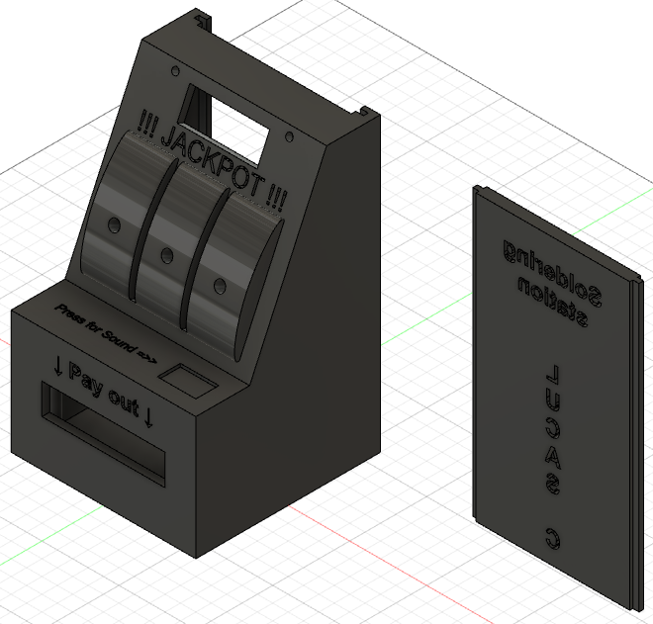
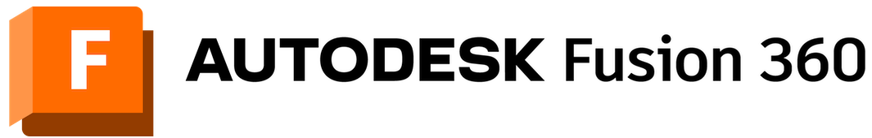
How to realize – 3D drawing

Slide 8
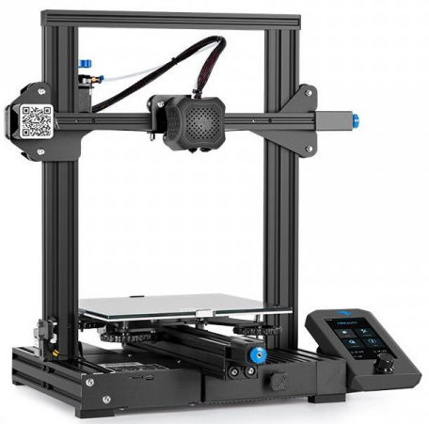
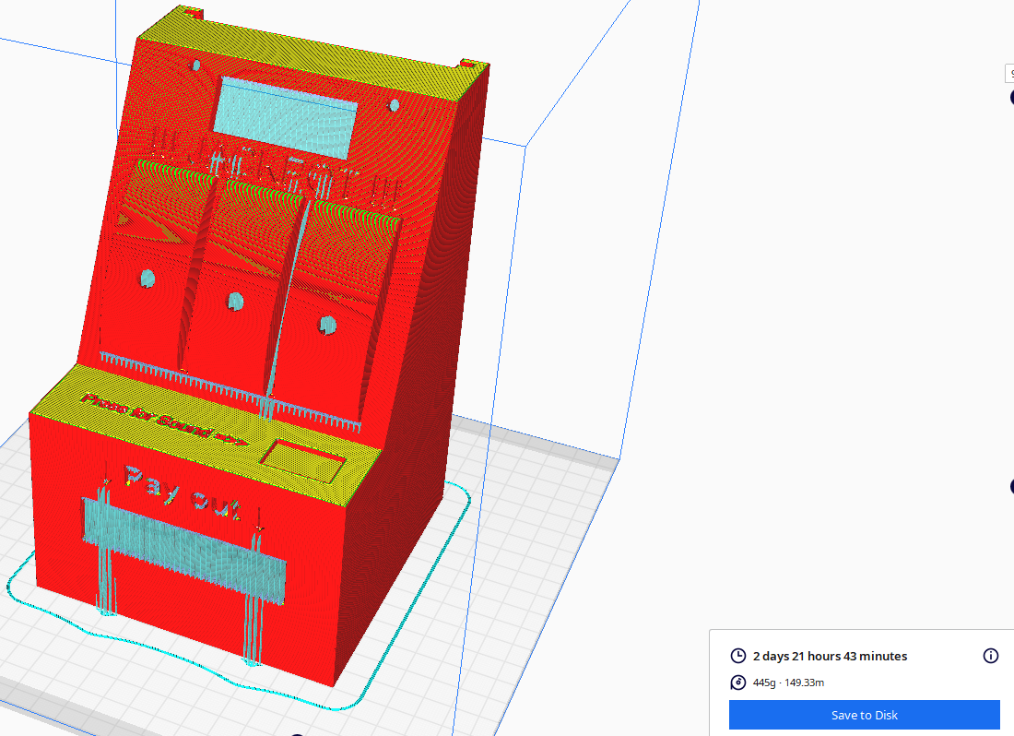
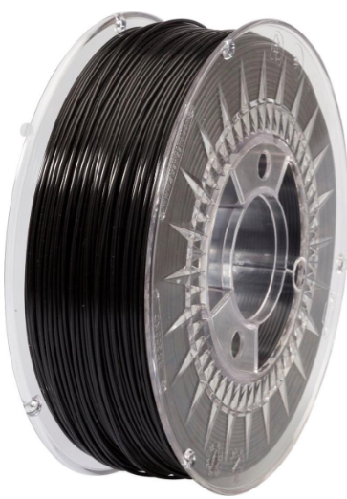
How to realize – Case
3D printing
Ender 3 V2
Cura slicer-Ultimaker
Supports
Print time
Fillament

Slide 9
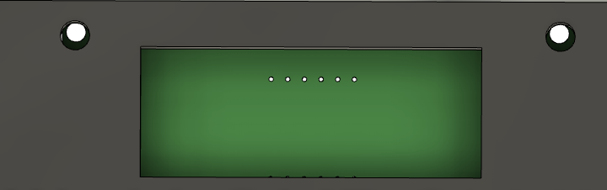
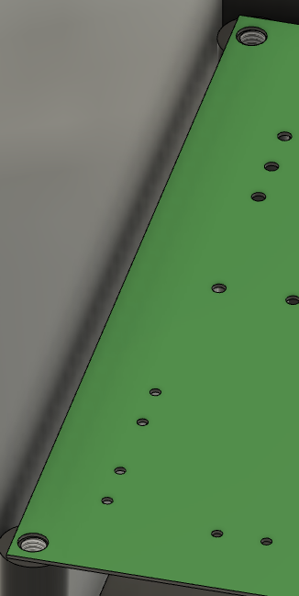
Results
Not working PCB
Defect microprocessor
Perfectly line up
Learnt a lot!

Slide 10


