Slide 1
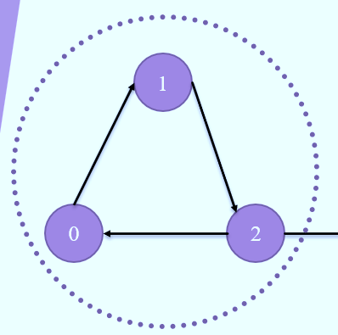
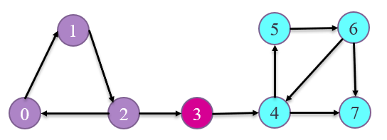
2 SATISFIABILITY PROBLEM
x
~x
Made By:
Lakshay Chandra

Slide 2
Introduction:
SAT (Boolean satisfiability problem) is the problem of assigning Boolean values to variables to satisfy a given Boolean formula. The Boolean formula will usually be given in CNF, which is a conjunction of multiple clauses, where each clause is a disjunction of literals (variables)
Conjunctive Normal Form
CNF expresses formulas as conjunctions of clauses with an AND or OR. Each clause connected by a conjunction, or AND, must be either a literal or contain a disjunction, or OR operator.
(..∨..∨.....∨..)∧…∧(..∨..∨.....∨..)

Slide 3
2 SAT Problem
Instance: A 2-CNF formula F
Problem: To decide if F is satisfiable
F = (¬x ∨ y )∧(¬y ∨ z )∧( x ∨ ¬z)∧( z∨ y)
2 SAT is a special case of General Satisfiability Problem
Theorem: 2SAT is polynomial-time solvable viz, 2 SAT is in P
We will show how to solve this problem efficiently using path searches in graphs…

Slide 4
Transforming The CNF
Consider the following CNF expression:
(¬x∨y) ∧ (¬y∨z) ∧ (x∨¬z) ∧ (z∨y)
We can express this using -> operator in either of the two forms:
(x -> y) ∧ (y -> z) ∧ (¬x -> ¬z) ∧ (¬z -> y)
(¬ y -> ¬ x) ∧ (¬ z -> ¬ y) ∧ (z -> x) ∧ (¬y -> z)
Now we can use Graph theory to solve the satisfiability problem:
Concepts used: Strongly Connected Component

Slide 5
Graph Construction
We create a vertex for each literal and the negation of the literal; hence the total number of vertices in our graph would be 2 x (the number of literals)
If a clause is of the form p v q, we first we create the vertices : p, ~p , q , ~q
Now p v q can be expressed as ¬p-> q or -q->p
So draw an edge directed from ¬p to q and another from –q to p
(
)
->
P Q
~
~
V
~Q -> P
Contrapositive
~P
Q
~Q
P

Slide 6
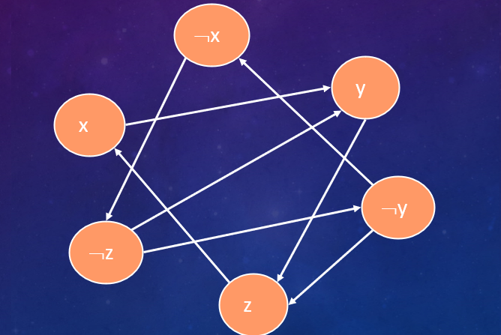
Graph Construction
(¬x∨y)∧(¬y∨z)∧(x∨¬z)∧(z∨y)
1) (x -> y) ∧ (y -> z) ∧ (¬x -> ¬z) ∧ (¬z -> y)
2) (¬ y -> ¬ x) ∧ (¬ z -> ¬ y) ∧ (z -> z) ∧ (¬y -> z)

Slide 7
Claim:
a 2-CNF formula F is unsatisfiable iff
there exists a variable x, such that:
there is a path from x to ¬x in the graph
there is a path from ¬x to x in the graph
X
¬ X

Slide 8
STRONGLY CONNECTED COMPONENTS
A digraph is called strongly connected if there is a path in each direction between each pair of vertices of the graph.
P
Q
R

Slide 9
Finding SCC- KOSARAJU ALGORITHM
1
5
6
0
2
3
4
7
Component 1: 0,1,2
Component 2: 3
Component 3: 4,5,6
Component 4: 7

Slide 10
1
5
6
0
2
3
4
7
0
0 1 2 3 4 5 6 7
0
0
0
0
0
0
0
0
1
Visited
1
1
1
1
1
1
1
1
0 1 2
2
3
3
4,6,5
1
5
6
7
4
5
0
2
3
4
7
6
0 1 2 3 4 5 6 7
VisitedInv
7
0
0
0
0
0
0
0
0
0
1
1
1
1
1
1
1
1
10

Slide 11
Let F be the CNF expression, and the corresponding graph be G
Condition for unsatisfiability :
for any vertex p_{i} ∈ G, if
p_{i} and ~p_{i} lie in the same SCC then F is unsatisfiable
Condition for satisfiability :
∀ p_{i} ∈ G, if
p_{i} and ~p_{i} do not lie in the same SCC, then F is satisfiable
x
y
~y
z
~x
~z

Slide 12
Example (Discussed in Code)
F : (~A V B)∧(~B V ~A)∧(A V C)∧(B V C)∧(A V A)
(A->B) V (B->~A) V (~A->C) V (~B->C) V (~A->A)
(~B->~A) V (A->~B) V (~C->A) V (~C->B) V (~A->A)
A
~A
C
B
~B
~C

