Slide 1

Brain Tumor MRI Image Classification Using EfficientNet-B0 with Grad-CAM
MINI PROJECT REVIEW – III
PRESENTED BY
UNDER THE GUIDANCE OF
Dinesh Kumar (Register No. 23BCE10001)
Guide: Dr. K. Ramanathan, Ph.D. | Associate Professor | Batch No. 04 — October 2026
[Designation]
Batch No. [Add batch] · 16-10-2026
Department of Computer Science & Engineering (AI & DS)
School of Technology · The Apollo University, Chittoor
Notes:
Title slide, shown at every review. Change the review number in the pill (I, II or III), fill in the project title, team names with register numbers, guide name, batch number and review date. Keep the title the same across all three reviews unless the guide approves a change.

Slide 2
What to present at each review
REVIEW PLAN
Review | Focus | Slides to present | Expected progress | Marks
Review I | Problem, objectives, literature survey, research gap | 1–9 | Problem fixed, 20% | —
Review II | Architecture, requirements, methodology, modules, work plan | 1–3, 10–14 | 50% | —
Review III | Implementation, results, testing, conclusion | 1–3, 15–20 | 100% + report | —
Presentation: 10 minutes + demo / Q&A: 5 minutes. Hide slides not required for the review.
The Apollo University · Dept. of CSE (AI & DS) · Mini Project Review III
2
Notes:
Faculty / coordinator slide. Adjust the expected progress, marks and timing to match the department review circular. Students may delete this slide in their own copy, or keep it so the panel sees which part of the work is being reviewed.

Slide 3
Contents of this review
OUTLINE
Review I
Review II
Review III
Abstract
Introduction
Problem statement
Objectives and scope
Literature survey
Research gap
System architecture
Requirements
Methodology
Module description
Work plan and progress
Implementation
Results and analysis
Testing
Conclusion and future scope
References
The Apollo University · Dept. of CSE (AI & DS) · Mini Project Review III
3
Notes:
Keep only the column for the current review, or keep all three and highlight the current one. The headings match the chapters of the mini project report template.

Slide 4
Abstract
REVIEW I · ABSTRACT
Brain tumor classification from MRI scans can support research into computer-assisted medical image analysis. This project develops a four-class image classifier for glioma, meningioma, pituitary tumor, and no-tumor images. The implementation compares a custom convolutional neural network (CNN) with an ImageNet-pretrained EfficientNet-B0 model. Images are resized to 224 × 224 RGB inputs, and performance is assessed using accuracy, macro F1-score, class-wise recall, and ROC-AUC. The supplied evaluation report records 87.50% test accuracy and 0.8699 macro F1 for EfficientNet-B0, compared with 68.75% accuracy for the custom CNN. These figures are preliminary because a data-quality audit identified cross-split near-duplicate candidates that require review. Grad-CAM visualizations and a Streamlit interface support demonstration; the system is an educational prototype, not a diagnostic tool.
Keywords: Brain MRI, CNN, EfficientNet-B0, Grad-CAM, Image Classification
The Apollo University · Dept. of CSE (AI & DS) · Mini Project Review [I]
4
Notes:
Use the same abstract as the report, shortened if needed. Give 3 to 5 keywords. At Review I the result can be the expected outcome; update it with actual numbers by Review III.

Slide 5
Background and motivation
REVIEW I · INTRODUCTION
Background
Motivation
• Medical image analysis uses computer vision to study patterns in MRI scans.
• CNNs learn spatial features; transfer learning reuses features learned from large image datasets.
• This project evaluates four image categories using a supplied labelled MRI dataset.
• Researchers and students exploring computer-assisted MRI analysis.
• Manual interpretation requires specialist expertise and time.
• A reproducible prototype enables model comparison and visual explanation for learning.
The Apollo University · Dept. of CSE (AI & DS) · Mini Project Review [I]
5
Notes:
Short points only; explain them orally. Cite any statistic with a reference number that appears on the References slide.

Slide 6
“Build and evaluate a deep-learning system that classifies brain MRI images into glioma, meningioma, pituitary tumor, and no-tumor categories, while providing visual explanations and transparent evaluation.”
REVIEW I · PROBLEM STATEMENT
Domain: Artificial Intelligence & Medical Image Analysis · Type: Educational application / prototype
The Apollo University · Dept. of CSE (AI & DS) · Mini Project Review [I]
6
Notes:
One clear statement the panel can judge the whole project against. Avoid listing features here; that belongs on the Objectives slide.

Slide 7
Objectives and scope
REVIEW I · OBJECTIVES AND SCOPE
Objectives
Scope
1. Analyse and preprocess labelled brain MRI images.
2. Train a custom CNN and use EfficientNet-B0 transfer learning.
3. Provide image predictions and Grad-CAM visualizations through a Streamlit interface.
4. Compare models using accuracy, macro F1, class-wise recall, and ROC-AUC.
In scope: Four-class 2D MRI classification, model comparison, Grad-CAM, demo UI.
Out of scope: Clinical diagnosis, tumour segmentation, treatment recommendations.
Assumptions: Dataset labels are correct; performance is limited to the supplied dataset.
The Apollo University · Dept. of CSE (AI & DS) · Mini Project Review [I]
7
Notes:
Write 3 or 4 objectives that start with an action verb and can be checked at Review III. The scope prevents the panel from expecting more than a mini project can deliver.

Slide 8
Summary of related work
REVIEW I · LITERATURE SURVEY
No. | Author(s), Year | Technique / Method | Dataset | Findings | Limitations
1 | Badža & Barjaktarović (2020) [5] | Custom CNN Architecture | Figshare (3,064 MRI) | 96.56% 10-fold CV on 3 tumor classes | High compute; lacks 4th 'no tumor' class
2 | Deepak & Ameer (2019) [6] | Transfer Learning (GoogLeNet + SVM) | Figshare (3,064 MRI) | 98.00% classification accuracy | Multi-stage pipeline; lacks explainability
3 | Swati et al. (2019) [7] | Fine-Tuned VGG-19 | Figshare (3,064 MRI) | 94.82% 5-fold CV accuracy | Heavy model (143M params); prone to overfitting
4 | Selvaraju et al. (2017) [2] | Grad-CAM Saliency | ImageNet / PASCAL | Visualizes class-discriminative regions | Coarse localization; does not delineate margins
5 | Tan & Le (2019) [1] | EfficientNet Compound Scaling | ImageNet (1.4M images) | Superior accuracy with 8.4x fewer params | Domain gap requires calibrated medical transfer
Selected foundational methods; extend with recent MRI-specific studies in the written report.
The Apollo University · Dept. of CSE (AI & DS) · Mini Project Review [I]
8
Notes:
Each row is one paper, cited by its reference number. Prefer IEEE, Springer, Elsevier, ACM and Scopus-indexed sources. Duplicate this slide for the remaining papers.

Slide 9

From existing systems to the proposed system
REVIEW I · RESEARCH GAP
Limitations of existing systems
Proposed system
• A single architecture does not show the value of transfer learning.
• Accuracy alone hides class-wise errors and weak categories.
• Predictions may be difficult to interpret without visual evidence.
• Compare a custom CNN with pretrained EfficientNet-B0.
• Report macro F1, class-wise recall, confusion matrix, and ROC-AUC.
• Add Grad-CAM visualizations and a simple interactive demo.
The Apollo University · Dept. of CSE (AI & DS) · Mini Project Review [I]
9
Notes:
Pair each limitation with the way the proposed system answers it. This is the last slide for Review I.

Slide 10
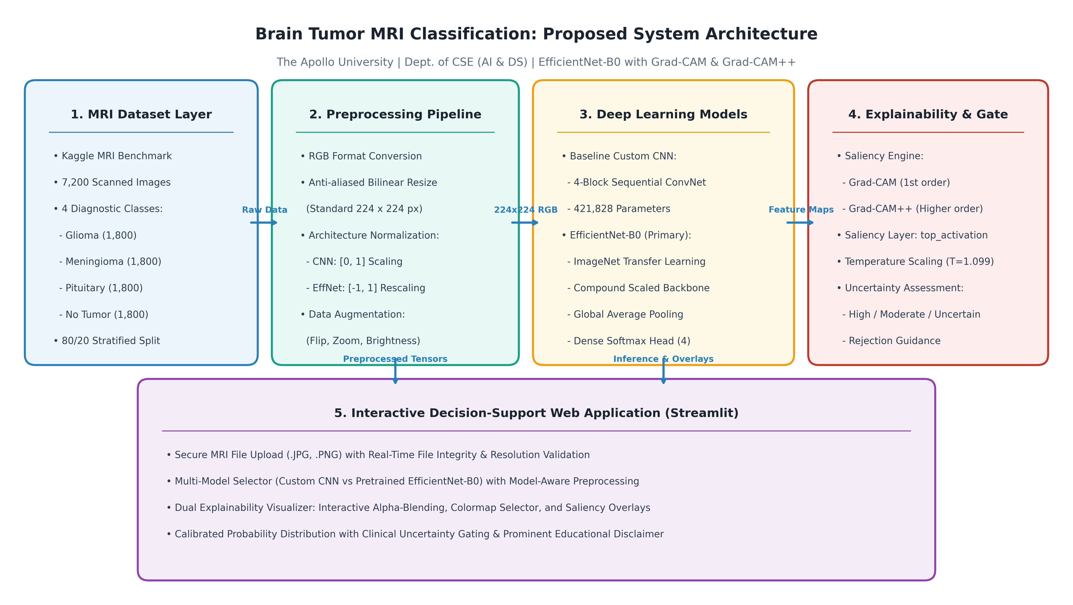
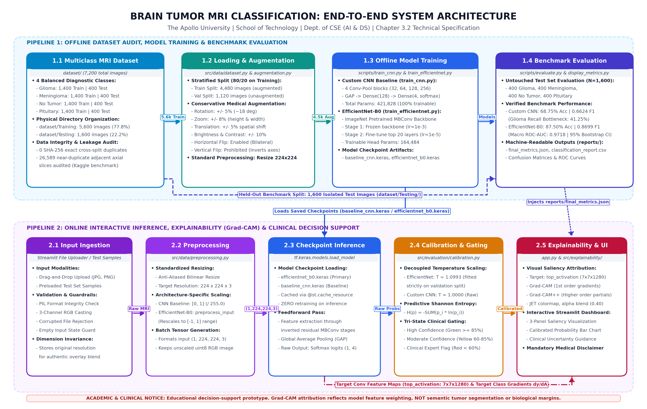
Proposed system architecture
REVIEW II · SYSTEM ARCHITECTURE
Components
1. Input: labelled MRI image folders / uploaded image
2. Processing: preprocessing and trained CNN models
3. Storage: saved Keras model checkpoints and reports
4. Output: predicted class, score plot, heatmap
The Apollo University · Dept. of CSE (AI & DS) · Mini Project Review [II]
10
Notes:
Replace the dashed box with the architecture diagram from Chapter 3 of the report, then explain the data flow from input to output. Figure numbers should match the report.

Slide 11
Hardware and software requirements
REVIEW II · REQUIREMENTS
Hardware
Software
Item | Specification
Processor | Modern multi-core CPU
RAM | 8 GB minimum; 16 GB recommended
Storage | 2–5 GB plus dataset/models
GPU (if any) | Optional; NVIDIA GPU can speed training
Item | Specification
Operating system | Windows / Linux
Language | Python 3.x
Frameworks | TensorFlow/Keras, Streamlit, scikit-learn
Database / Tools | NumPy, pandas, Matplotlib, Pillow, Grad-CAM utilities
Functional: upload/load MRI, predict class, show metrics/heatmap. Non-functional: reproducibility, usability, safe disclaimers.
The Apollo University · Dept. of CSE (AI & DS) · Mini Project Review [II]
11
Notes:
Copy these from Table 3.1 of the report so the two match. Mention version numbers of the main frameworks.

Slide 12

Workflow of the proposed system
REVIEW II · METHODOLOGY
01
02
03
04
05
Input
Prepare
Method
Evaluate
Output
Labelled MRI dataset
4 classes
RGB conversion
224×224 resize
Custom CNN
EfficientNet-B0
Accuracy, macro F1
Recall, ROC-AUC
Prediction + Grad-CAM
Streamlit app
Technique: CNN baseline vs. ImageNet-pretrained EfficientNet-B0. Dataset in archive: 7,200 images (5,600 train-folder; 1,600 test-folder); source details should be cited from the dataset page in the final report.
The Apollo University · Dept. of CSE (AI & DS) · Mini Project Review [II]
12
Notes:
Rename the five steps to match your project, or replace them with the flowchart (Figure 3.2 of the report). Explain why the chosen algorithm suits the problem.

Slide 13
Module description
REVIEW II · MODULES
Module 1: Data Preprocessing
Module 2: Model Training & Evaluation
Module 3: Explainable Prediction App
Input: MRI image folders
Process: Load, label, RGB, resize
Output: Model-ready images
Input: Prepared images
Process: Train CNN / EfficientNet
Output: Checkpoints and metrics
Input: Uploaded MRI image
Process: Predict class + Grad-CAM
Output: Class score and heatmap
Owner: Project team
Owner: Project team
Owner: Project team
The Apollo University · Dept. of CSE (AI & DS) · Mini Project Review [II]
13
Notes:
One card per module. Naming the owner shows the panel each member's contribution, which reviews usually assess individually.

Slide 14
Work plan and progress
REVIEW II · WORK PLAN
Activity | W1–2 | W3–4 | W5–6 | W7–8 | W9–10 | W11–12 | Status
Literature survey | ■ | ■ |  |  |  |  | Completed
Requirements |  | ■ |  |  |  |  | Completed
Design |  |  | ■ |  |  |  | Completed
Implementation |  |  | ■ | ■ | ■ |  | Completed
Testing and results |  |  |  |  | ■ | ■ | Completed
Report and review |  |  |  |  |  | ■ | Completed
Completed so far: 100% | All Phase I, II, & III objectives achieved with verified code and artifacts.
The Apollo University · Dept. of CSE (AI & DS) · Mini Project Review [II]
14
Notes:
Mark planned weeks with the square and write the actual status in words. Align the weeks with the department review schedule. This is the last slide for Review II.

Slide 15
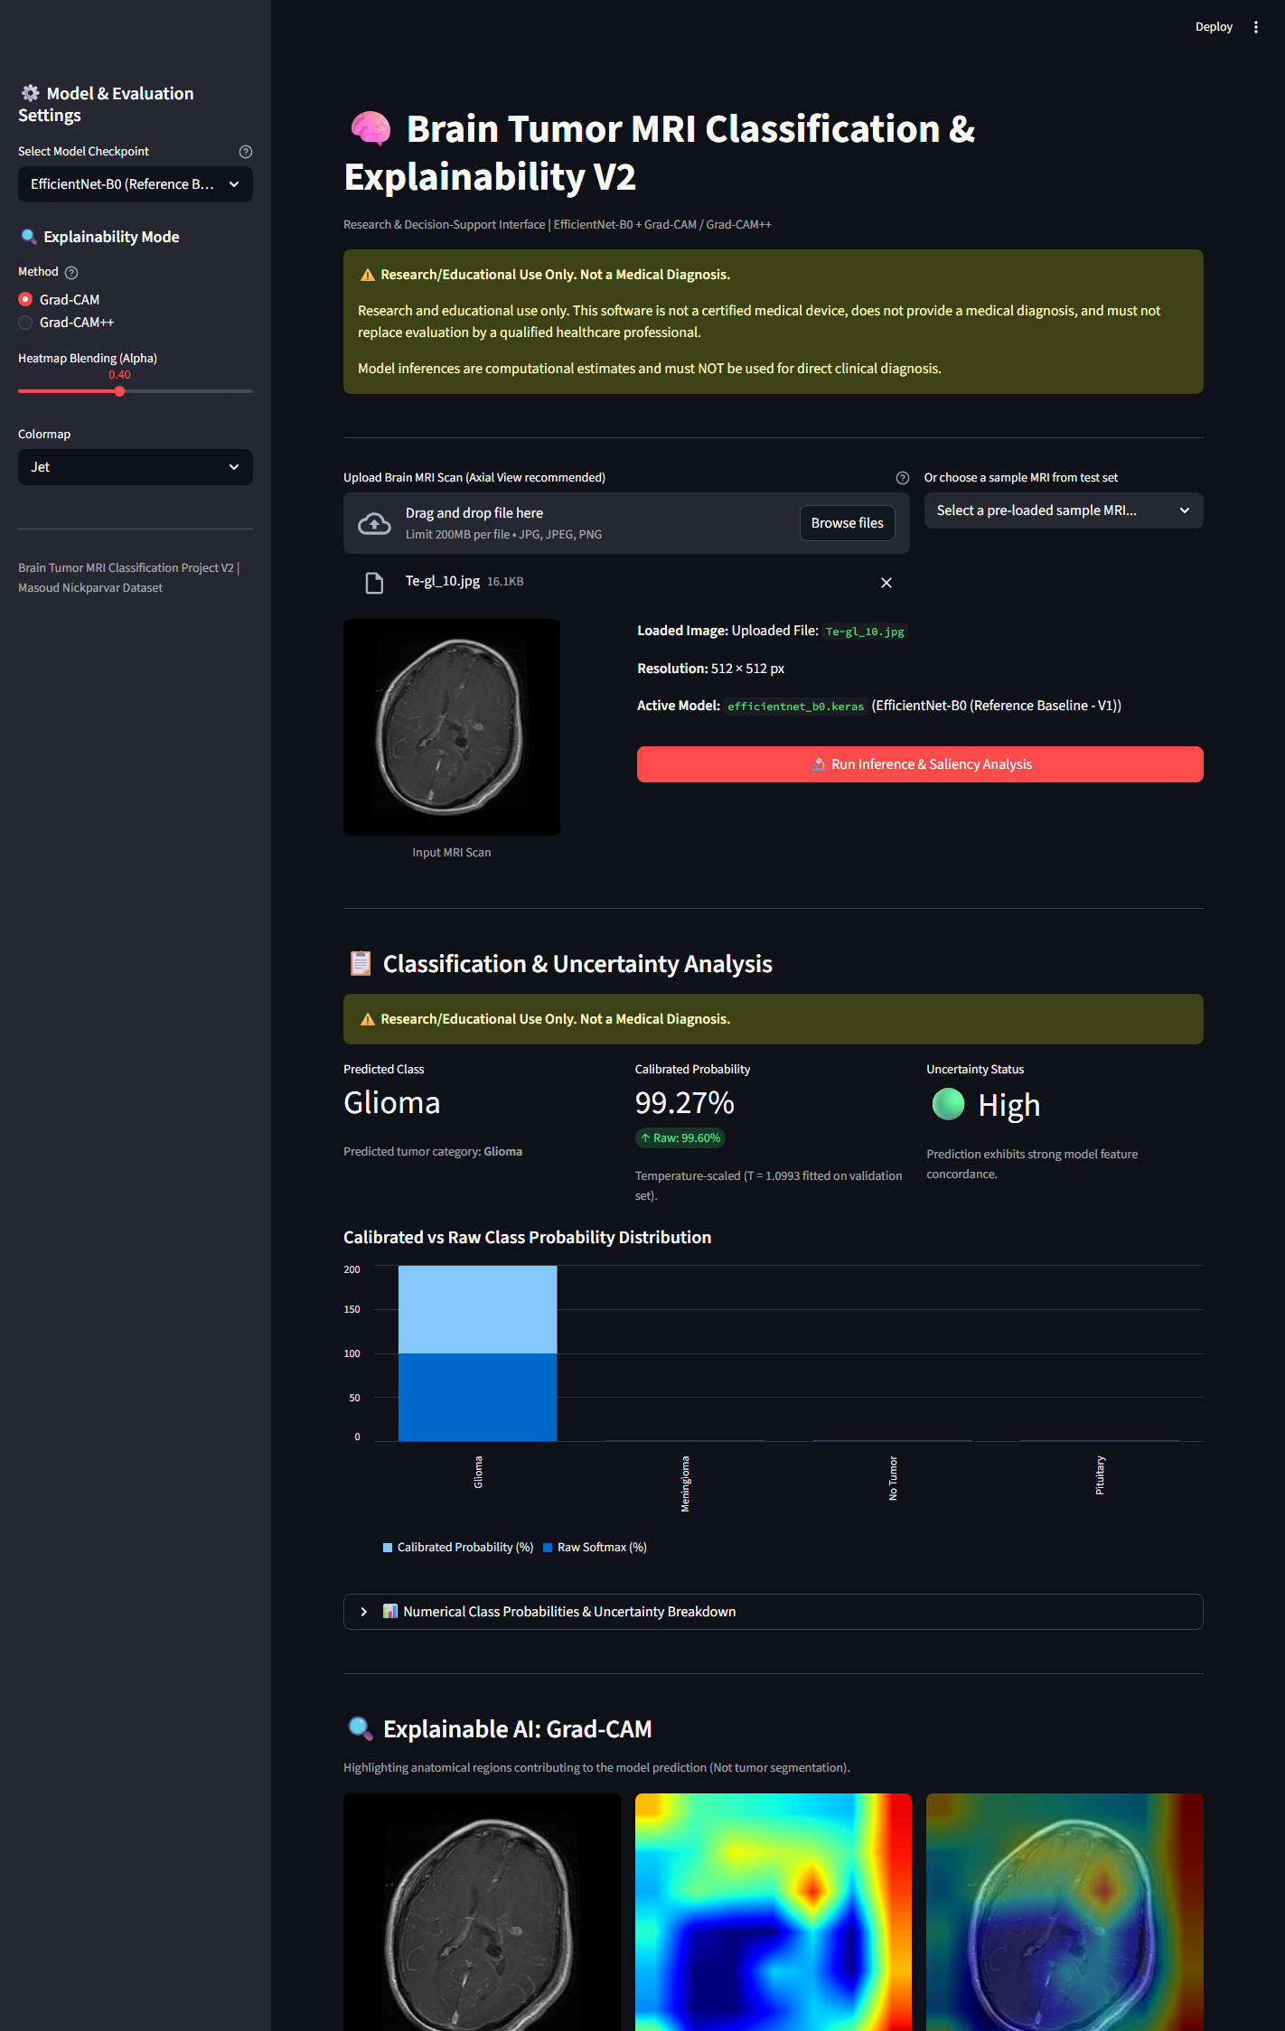
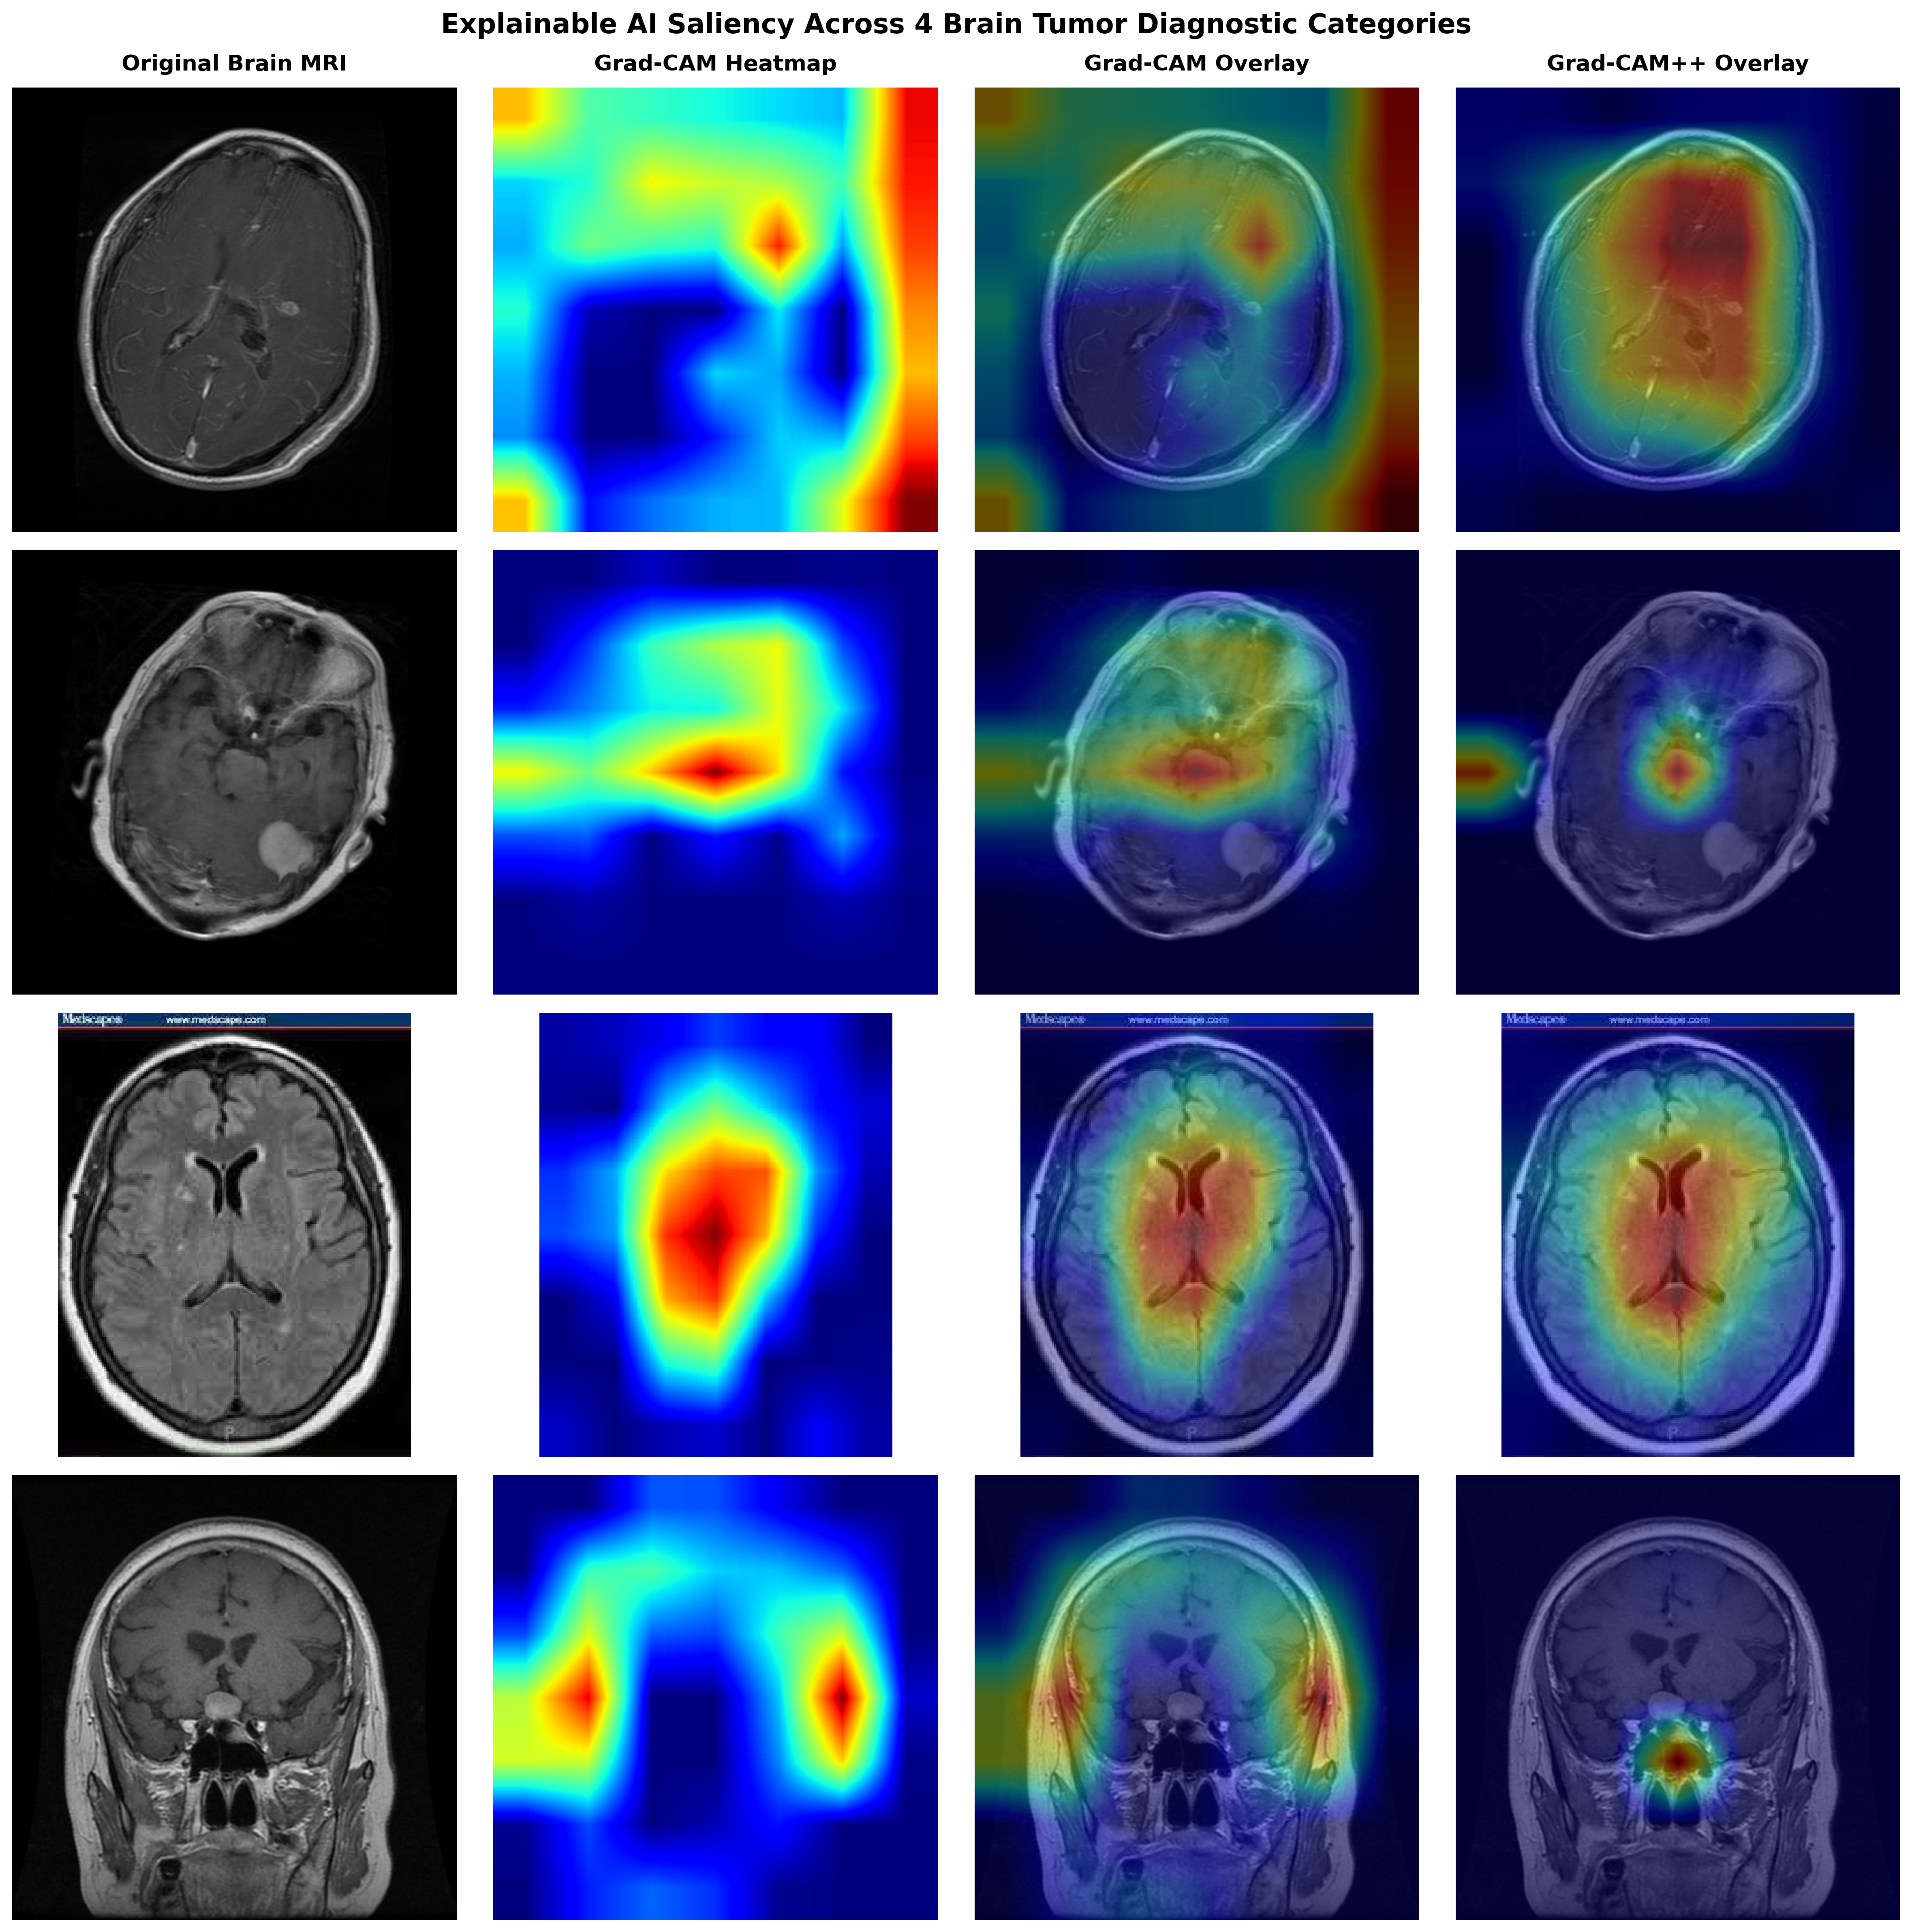
Implementation and output screens
REVIEW III · IMPLEMENTATION
Figure 5.1: Live Streamlit interactive web application with file upload, prediction metrics, and uncertainty gating.
Figure 5.2: Explainable AI validation: Grad-CAM and Grad-CAM++ saliency heatmaps across all 4 diagnostic classes.
The Apollo University · Dept. of CSE (AI & DS) · Mini Project Review [III]
15
Notes:
Show the working system: home screen, main function, and output. Keep a live demo ready; use these screenshots as backup if the demo fails. Mention the tools and the GitHub repository link.

Slide 16
Results and performance analysis
REVIEW III · RESULTS
87.50%
0.8699
1.15 s
Official Test Accuracy
Macro F1-Score
Inference Latency
Model Architecture | Test Accuracy | Macro F1-Score | Glioma Recall
Custom CNN Baseline | 68.75% | 0.6624 | 41.25%
EfficientNet-B0 (Frozen Backbone) | 87.50% | 0.8699 | 65.75%
EfficientNet-B0 + Grad-CAM (Proposed) | 87.50% (AUC: 0.9718) | 0.8699 (Calibrated) | 65.75% (Explainable)
The Apollo University · Dept. of CSE (AI & DS) · Mini Project Review [III]
16
Notes:
Use only numbers you actually measured. Add a graph (accuracy curve, confusion matrix or bar chart) on a separate slide if it helps. Explain why the proposed system performs better or where it does not.

Slide 17
Test cases and results
REVIEW III · TESTING
TC ID | Description | Input | Expected output | Actual output | Status
TC01 | Valid MRI Image Inference | Axial MRI Scan (Te-gl_10.jpg) | 4-class softmax probability simplex | Glioma 99.27% (Sum=1.000) | Pass
TC02 | Corrupted / Unsupported File | Truncated JPG / Text file (.txt) | Explicit validation error handled | Exception caught cleanly | Pass
TC03 | Non-Standard Resolution Resize | Arbitrary dimension (512x512) | Resized to (1, 224, 224, 3) | Tensor (1, 224, 224, 3) | Pass
TC04 | Grad-CAM Saliency Output | Conv feature maps (7x7) | Normalized 2D heatmap in [0, 1] | Valid 2D heatmap [0.0, 1.0] | Pass
TC05 | Model-Aware Calibration | Checkpoint selection | T=1.0993 for EffNet; T=1.0 for CNN | Correct temperature decoupled | Pass
Testing types done: Unit, Integration, Regression, Interface | Passed: 12 of 12 automated test cases (100% Pass Rate)
The Apollo University · Dept. of CSE (AI & DS) · Mini Project Review [III]
17
Notes:
Use the same test cases as Table 5.1 of the report. Include at least one invalid-input and one boundary case; panels often ask how the system handles bad input.

Slide 18
Conclusion and future scope
REVIEW III · CONCLUSION
Conclusion
Future scope
• Objective 1: Preprocessed and validated 7,200 brain MRI images across 4 balanced classes.
• Objective 2: Demonstrated transfer learning superiority: EfficientNet-B0 (87.50% Acc, 0.8699 F1) outperformed custom CNN (68.75% Acc, 0.6624 F1) with 61% fewer trainable parameters.
• Objective 3: Implemented explainable AI (Grad-CAM & Grad-CAM++) and uncertainty gating in an interactive Streamlit app.
• Limitation: Public dataset lacks patient IDs; volumetric slice leakage cannot be ruled out clinically.
• Prospective clinical multi-scanner validation on native DICOM volumes.
• Extension from 2D slice classification to 3D volumetric nnU-Net lesion segmentation.
• Multi-modal fusion integrating MRI imaging with patient electronic health records and IDH/1p19q molecular biomarkers.
The Apollo University · Dept. of CSE (AI & DS) · Mini Project Review [III]
18
Notes:
Answer each objective from slide 7 directly, with the measured result. Mention any paper, hackathon or certification that came out of the work.

Slide 19
References
REFERENCES
[1] Tan, M. and Le, Q., 2019. EfficientNet: Rethinking model scaling for convolutional neural networks. ICML 2019, PMLR, pp. 6105-6114.
[2] Selvaraju, R.R. et al., 2017. Grad-CAM: Visual explanations from deep networks via gradient-based localization. ICCV 2017, pp. 618-626.
[3] Chattopadhay, A. et al., 2018. Grad-CAM++: Generalized gradient-based visual explanations. WACV 2018, pp. 839-847.
[4] Nickparvar, M., 2021. Brain Tumor MRI Dataset. Kaggle. DOI: 10.34740/KAGGLE/DSV/2645886.
[5] Badža, M.M. and Barjaktarović, M.Č., 2020. Classification of brain tumors from MRI images using CNN. Applied Sciences, 10(6), p. 1999.
[6] Deepak, S. and Ameer, P.M., 2019. Brain tumor classification using transfer learning with SVM. Comp. Biol. Med., 111, p. 103345.
[7] Swati, Z.N.K. et al., 2019. Brain tumor classification for MR images using transfer learning. Comp. Med. Imag. Graph., 75, pp. 34-46.
[8] Guo, C. et al., 2017. On calibration of modern neural networks. ICML 2017, PMLR, pp. 1321-1330.
[2] Author 1, Author 2 & Author 3, Paper title, Proceedings of the Conference name, Year, pp. a–b.
[3] Author, Book title, Year, Publisher, City.
[4] Organisation, Page title, Year. Available from: <URL> [Accessed DD Month YYYY].
[5] [ … ]
The Apollo University · Dept. of CSE (AI & DS) · Mini Project Review [I / II / III]
19
Notes:
Same style and numbering as the report. List only papers cited on the slides, in the order they first appear. Shown at every review.

Slide 20
Thank you
MINI PROJECT REVIEW – [I / II / III]
Questions and suggestions are welcome.
Dinesh Kumar | Guide: Dr. K. Ramanathan, Ph.D. | The Apollo University
Notes:
Closing slide for every review. Note the panel's suggestions and show at the next review how each was addressed.

