Slide 1


Lemon Academic Knowledge Platform
时间：2019.3.10
Group 10
Bian Weizhen

Slide 2

Introduction
The Lemon academic recommendation search platform is specially designed for students preparing to study for PhD. It improves the shortcomings of the existing functions of Google Scholar and adds article recommendation, article summary, term optimization and other functions to help students quickly find the research direction they are interested in. , enter the academic field.

Slide 3

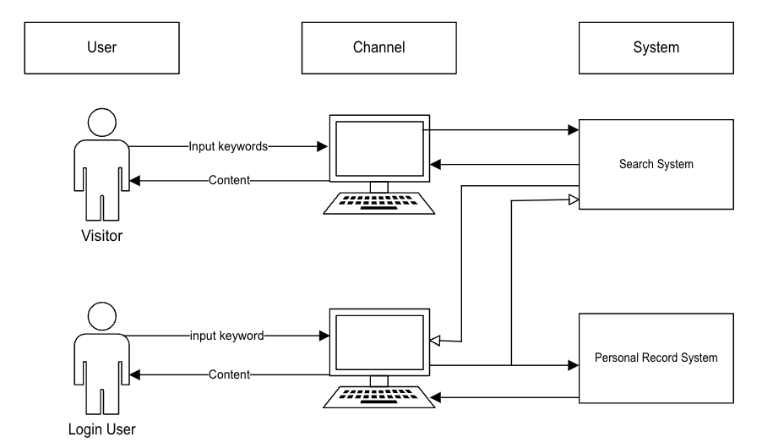
Business Pain
Pain Point
Google Scholar cannot provide active article recommendations for students preparing to pursue a PhD.
2. Google Scholar does not provide search term optimization for users.
3, Google Scholar lacks intuitive word cloud display and article summary functions, and users cannot quickly understand the core content of the search results.
Notes:
Google Scholar, despite being widely used by a wide range of researchers and academics, still has some business pain points. First, Google Scholar cannot provide active article recommendations for students preparing to pursue a PhD, especially those who are not familiar with academic fields and research directions. This makes it difficult for these users to find materials that are introductory or relevant to their interests. Secondly, Google Scholar does not provide search term optimization for users who are new to a certain academic field, making it difficult for them to conduct effective searches for unfamiliar professional terms. In addition, although Google Scholar provides users with a large amount of literature, it lacks intuitive word cloud display and article summary functions, and users cannot quickly understand the core content of the search results. These problems hinder users from obtaining academic information efficiently and in a targeted manner.

Slide 4
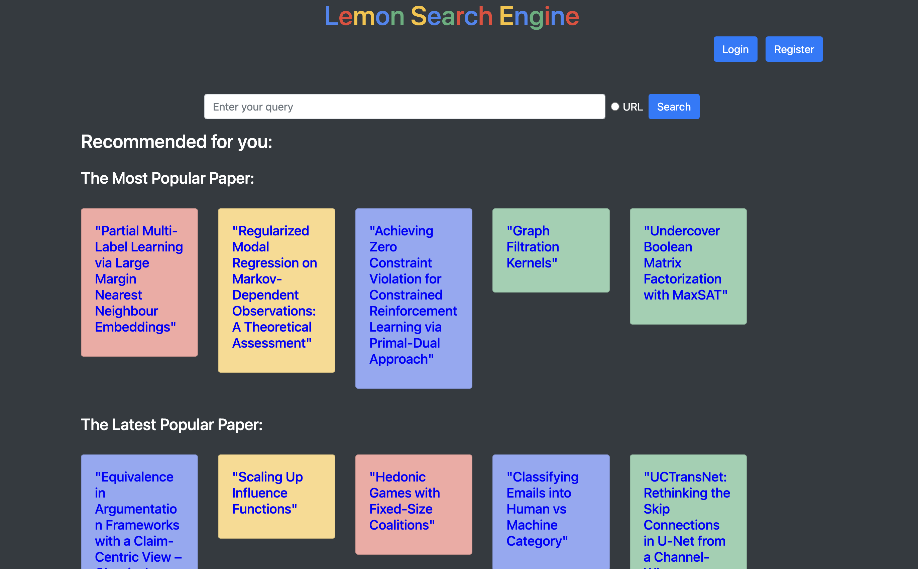
Business Pain
Value Point
My academic search engine is specially designed for doctoral students, providing personalized recommendations, term optimization chatbots, word cloud visualizations, user interaction tools and condensed summaries to meet their needs for in-depth research.
Notes:
My academic search engine is specially designed for doctoral students, providing personalized recommendations, term optimization chatbots, word cloud visualizations, user interaction tools and condensed summaries to meet their needs for in-depth research. Next I will introduce these features in detail.

Slide 5




Features Overview
Recommended System
Term Optimization
Paper Summary
On my platform, the system will recommend some academic articles based on user preferences. There are various recommendation methods, including user-based, item-based, popular-based, year-based and mixed-based.
On my platform, users can talk to the robot and let the robot help find similar terms and provide search suggestions.
In order to reduce reading time and help students quickly screen papers, my platform can further summarize the abstract and know the content of the article in one sentence. 。

Slide 6
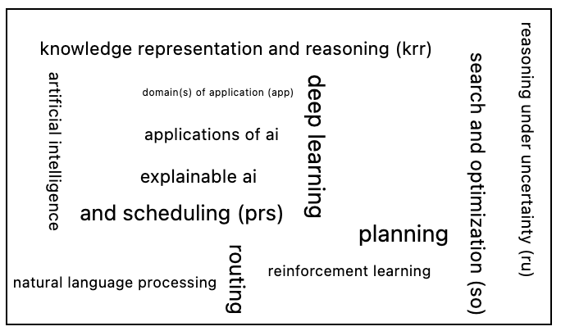


Features Overview
Word Cloud
Interaction
Others
For each search, our platform will create a word cloud diagram of the core words of the search results, allowing users to quickly determine whether their search is accurate.
My platform will provide records of likes, stars, clicks and other events. Users can organize papers, and the system can also be used to analyze users' preferences.
In the future, I will develop more functions to meet the new needs of users.

Slide 7
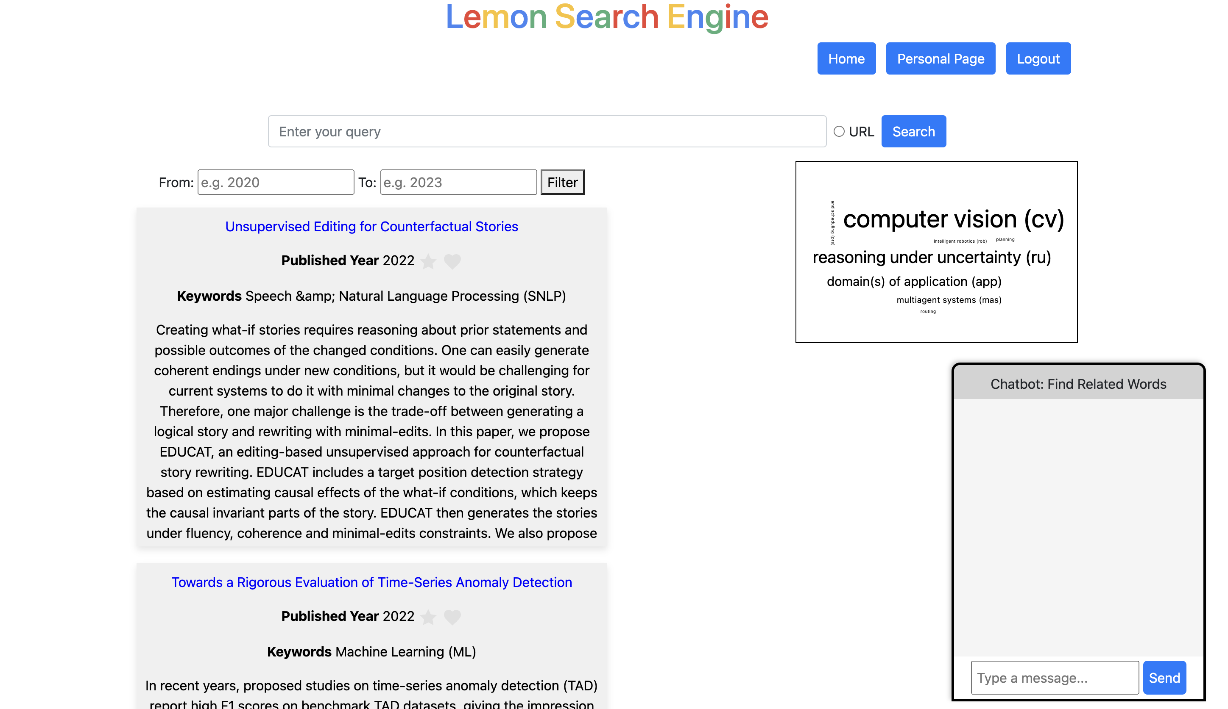
Demo

Slide 8

Pricing
Price Plan
Our platform is ready for a freemium model. All users can use basic functions, such as article search, word cloud chart, article recommendation, etc. Premium members can enjoy more exclusive advanced features such as unlimited entry optimization and unlimited article content summarization. In addition, to encourage early subscribers, we offer special initial discounts.

