Slide 1


Lemon Academic Knowledge Platform
时间：2019.3.10
Group 10
Bian Weizhen

Slide 2

Introduction
The Lemon academic recommendation search platform is specially designed for students preparing to study for PhD. It improves the shortcomings of the existing functions of Google Scholar and adds article recommendation, article summary, term optimization and other functions to help students quickly find the research direction they are interested in. , enter the academic field.

Slide 3

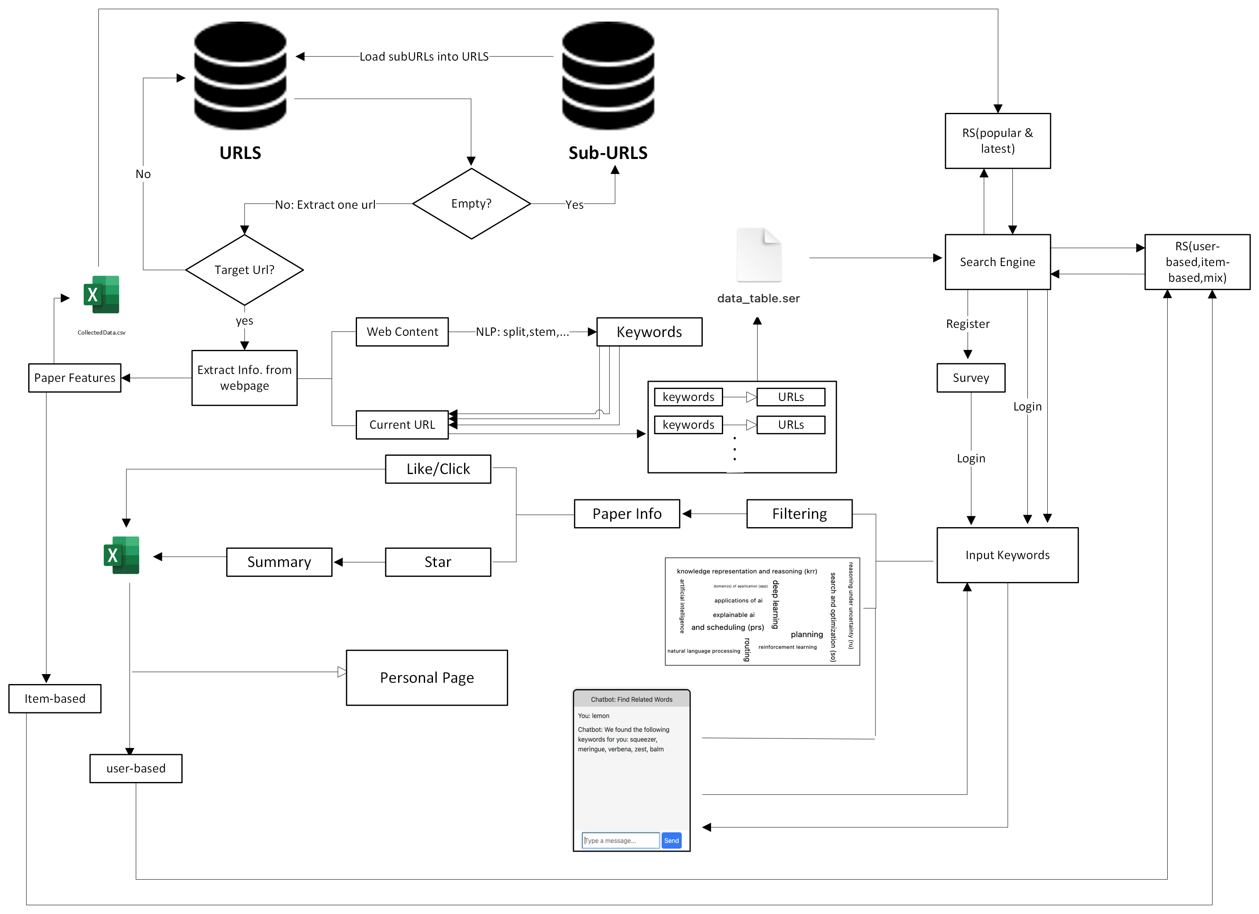
System Overview
Data Collection
Search Engine
Recommender System

Slide 4
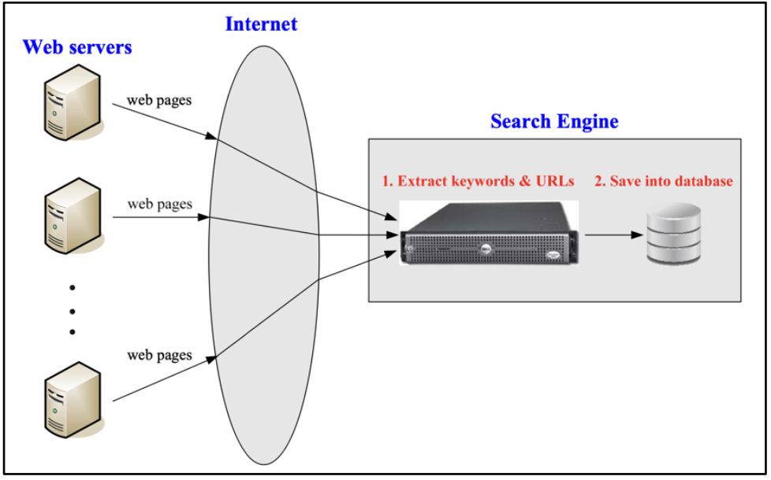
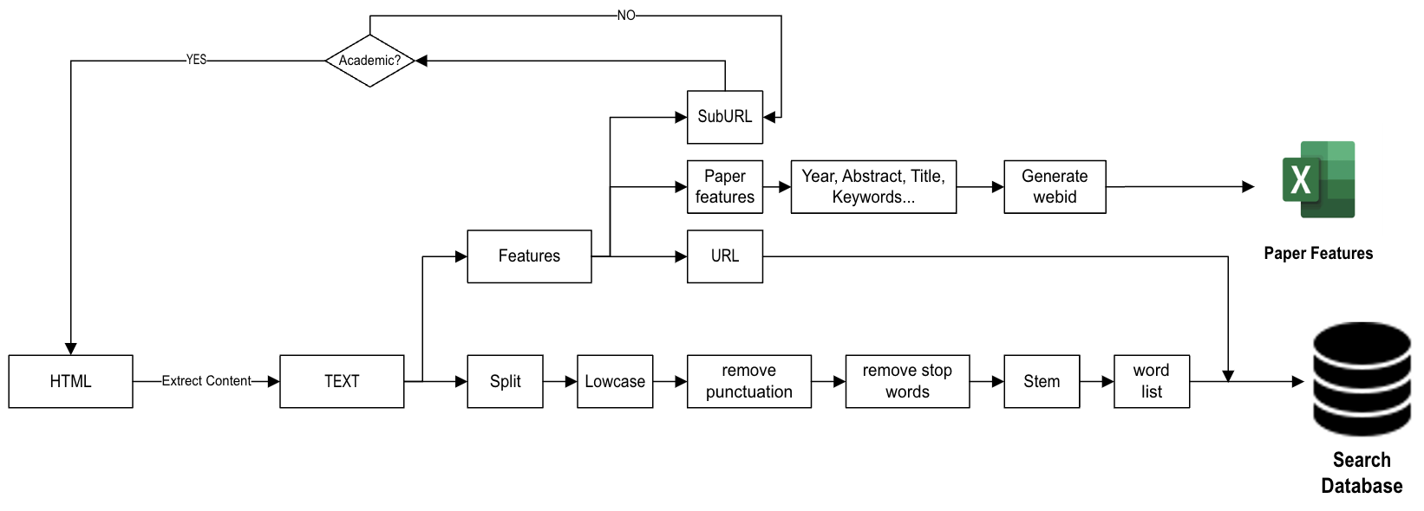
Core Technology
Data Collection
In order to ensure data security, all data is collected and stored locally by myself without relying on any third-party tools.
Multithreading
Pointing
Data Cleaning
Notes:
My academic search engine is specially designed for doctoral students, providing personalized recommendations, term optimization chatbots, word cloud visualizations, user interaction tools and condensed summaries to meet their needs for in-depth research. Next I will introduce these features in detail.

Slide 5
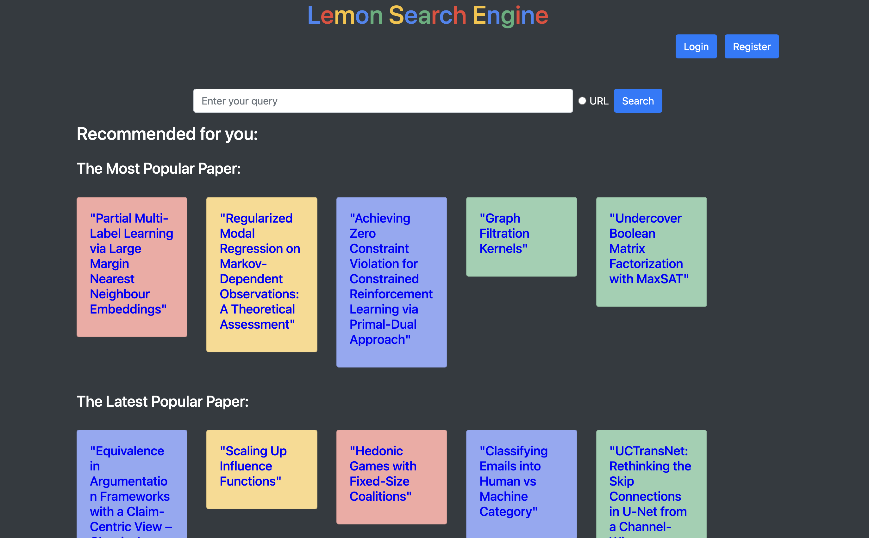
Core Technology
Recommender System
Popular-based
Year-based
User-based
Item-based
Mix-based
Notes:
My academic search engine is specially designed for doctoral students, providing personalized recommendations, term optimization chatbots, word cloud visualizations, user interaction tools and condensed summaries to meet their needs for in-depth research. Next I will introduce these features in detail.

Slide 6
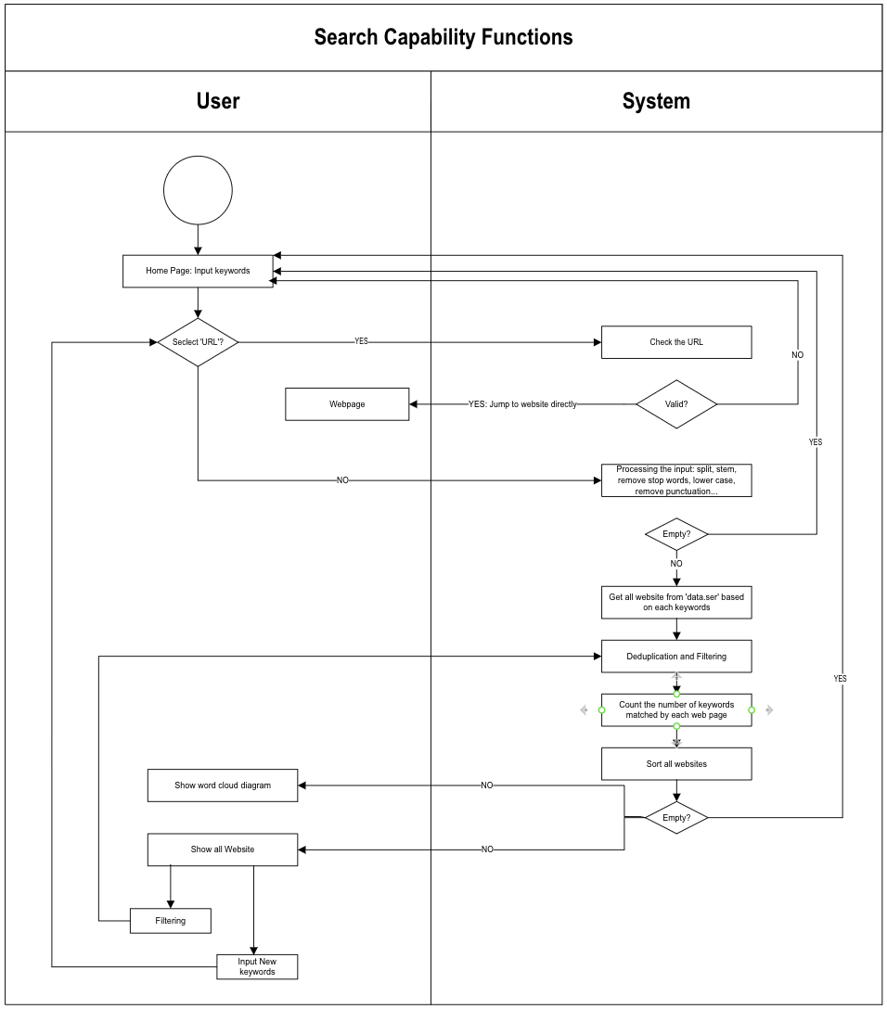
Core Technology
Search Engine
Chat Robot
Paper Summary
Interaction
Word Cloud
Filtering
Notes:
My academic search engine is specially designed for doctoral students, providing personalized recommendations, term optimization chatbots, word cloud visualizations, user interaction tools and condensed summaries to meet their needs for in-depth research. Next I will introduce these features in detail.

Slide 7


Use Case
Tom is a newcomer to the academic field and is unfamiliar with some professional terms. When searching, he first roughly judged the relevance of the search results through the word cloud diagram. To gain a deeper understanding, he used a chatbot to refine search terms. After finding and collecting some relevant articles, the article summary provided by the system allowed him to quickly select the information that met his needs and provided clear guidance for his research direction.
Alice has found her research direction, but she faces a problem: she doesn't know which articles to read to further study it. At this time, her academic search engine provided her with some article recommendations based on her past clicks, likes, and collections. These suggestions directly address Alice's needs, allowing her to no longer search blindly, but to read articles closely related to her research direction in a targeted manner, thereby conducting in-depth research more efficiently.

