Slide 1
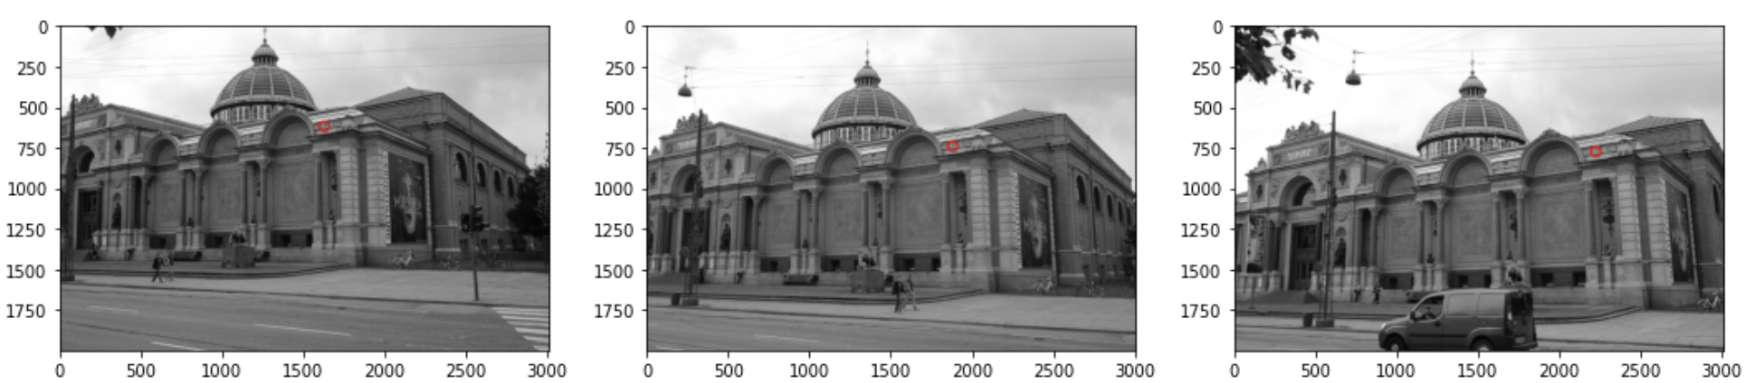
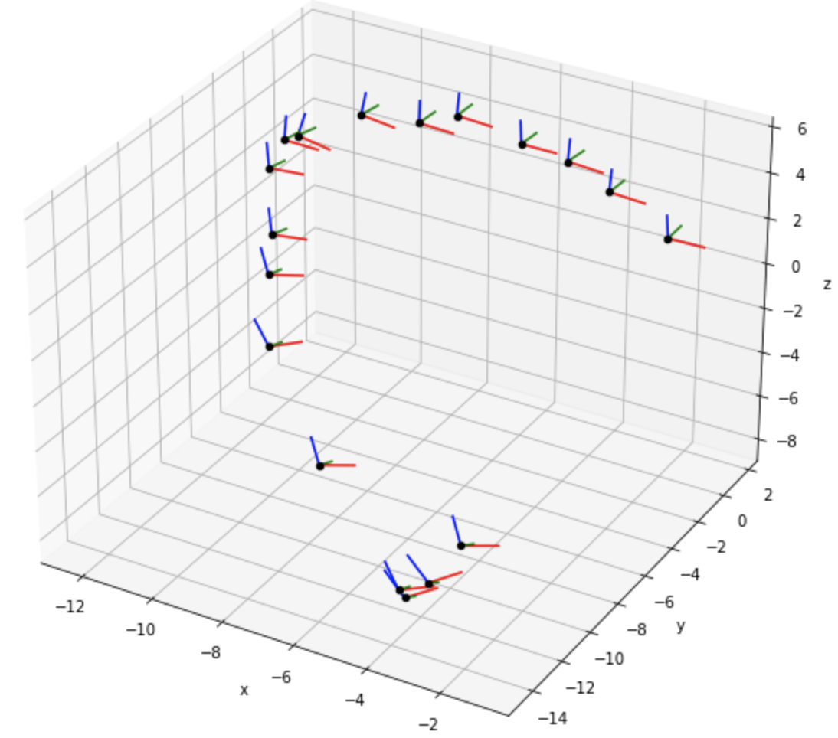
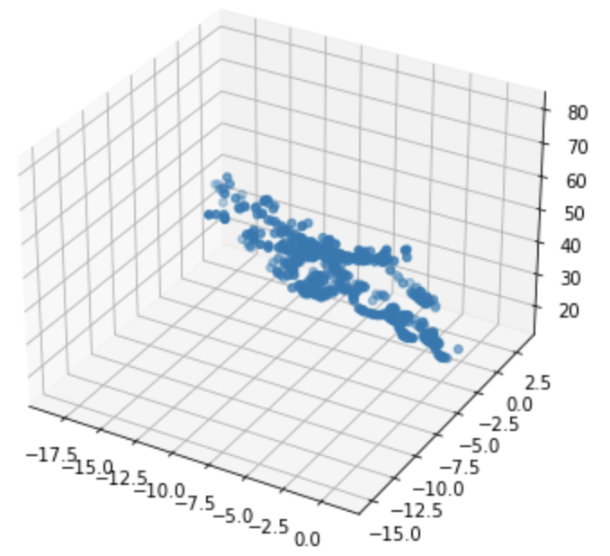
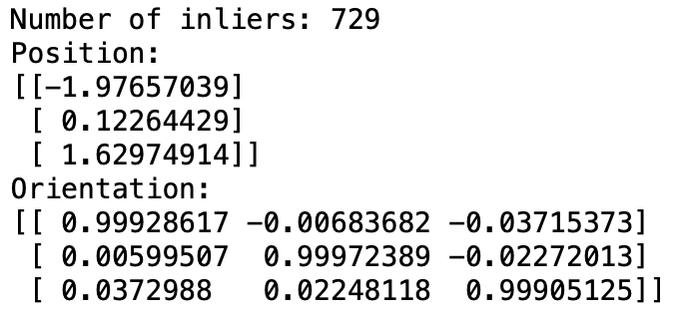
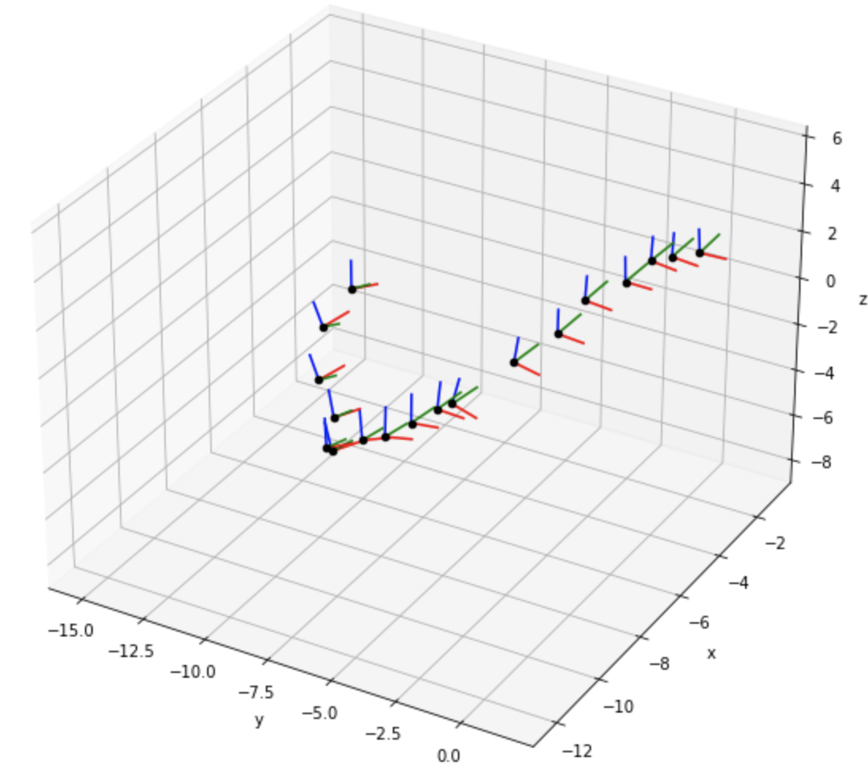
Exercise 11
11.1 ~ 11.3 Find Common Key-Points in First Three Images
11.5 Iterate Through All Images
11.4 Inliers and Position of the Third Image
Exam Presentation

