Slide 1
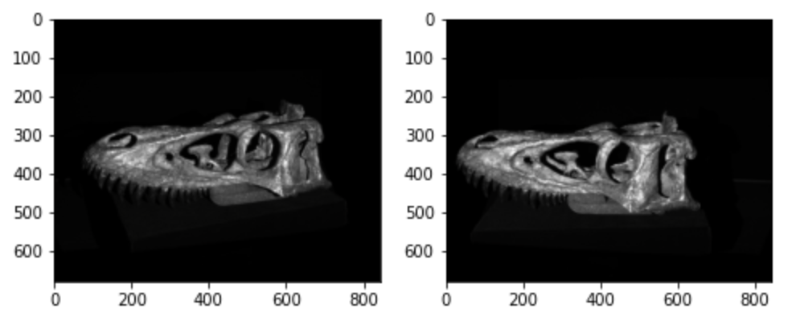
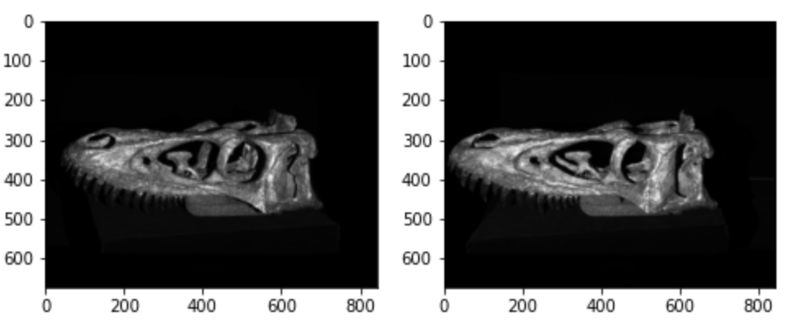
Exercise 13
13.1 Calibration
Zhang’s Method to get Intrinsic Matrix and Extrinsic Matrix
13.2 Rectification
Image pair without rectification
Rectified image pair
Exam Presentation

Slide 2
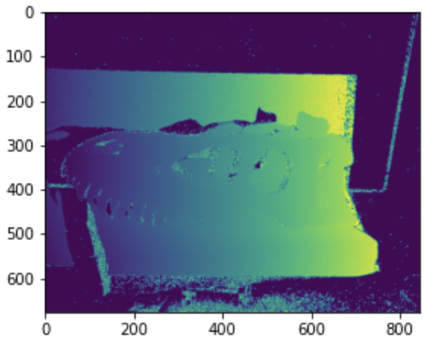
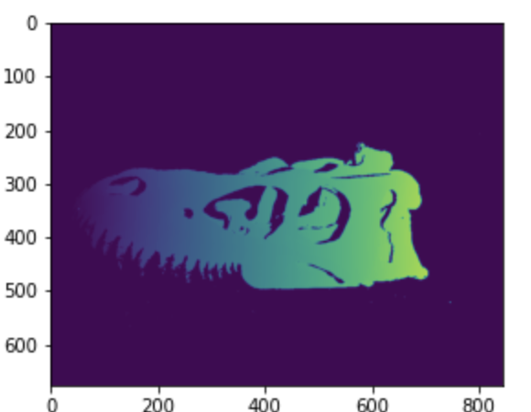
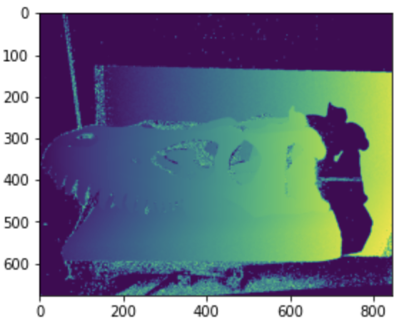
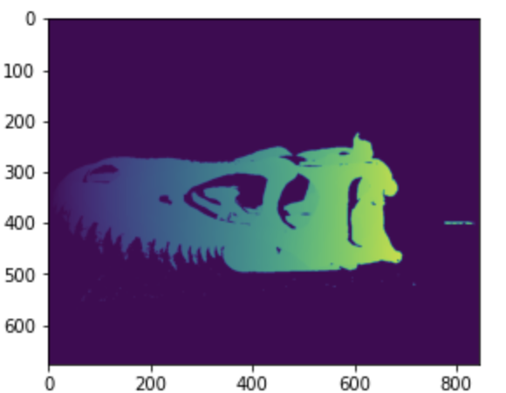
Exercise 13
13.3 Compute Phase of Each Camera
13.4 Create Mask to Illuminate Projector Area
Phase of Camera0
Phase with mask of Camera0
Phase of Camera1
Phase with mask of Camera1
Exam Presentation

Slide 3
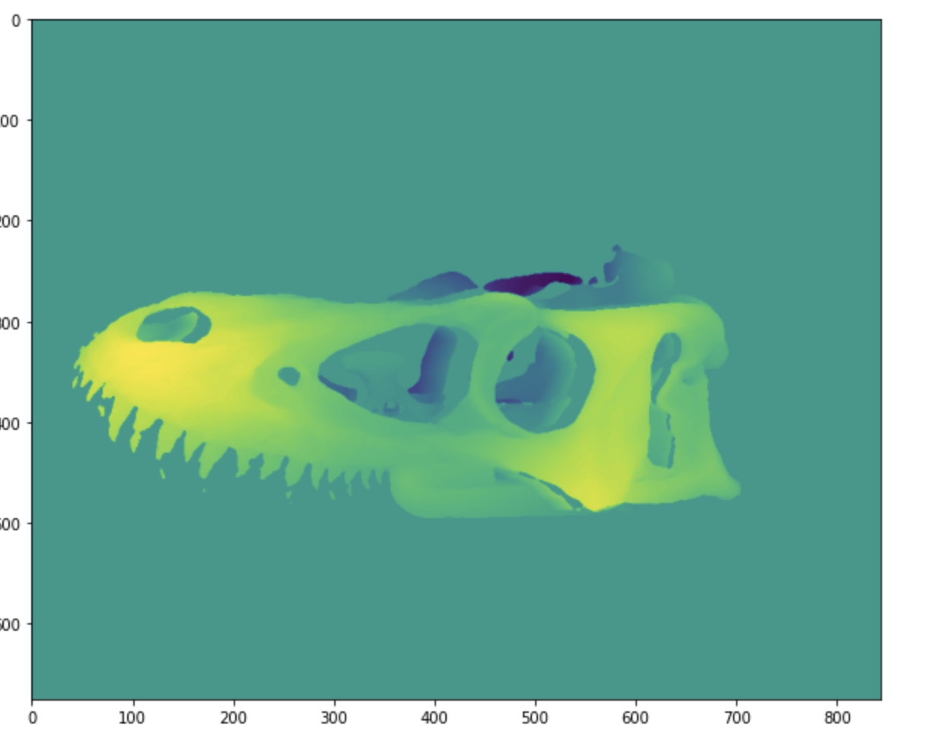
Exercise 13
13.5 Match Points Between Two Cameras and Create Disparity Image
Exam Presentation

Slide 4


Exercise 13
13.6 & 13.7 Get Point Clouds and Set Colors in Terms of Matches
Exam Presentation

