Slide 1

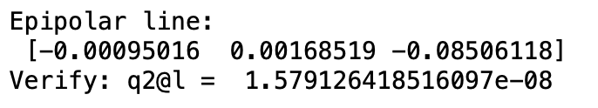

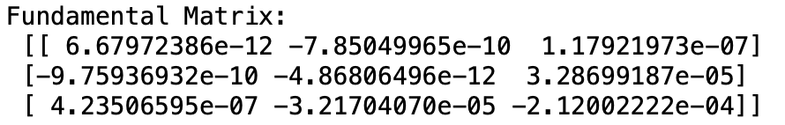
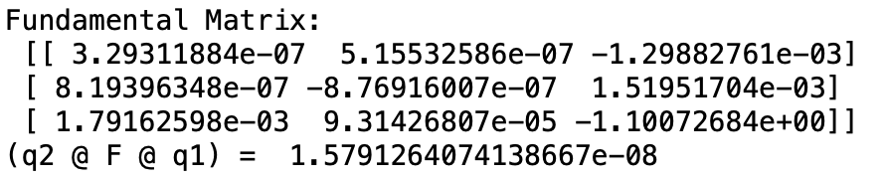
Exercise 3
3.1 Projection Points
3.4 & 3.5 Epipolar line of q1 in camera 2
3.2 CrossOp and verify
3.8 Fundamental Matrix
3.3 Fundamental Matrix
Exam Presentation

Slide 2
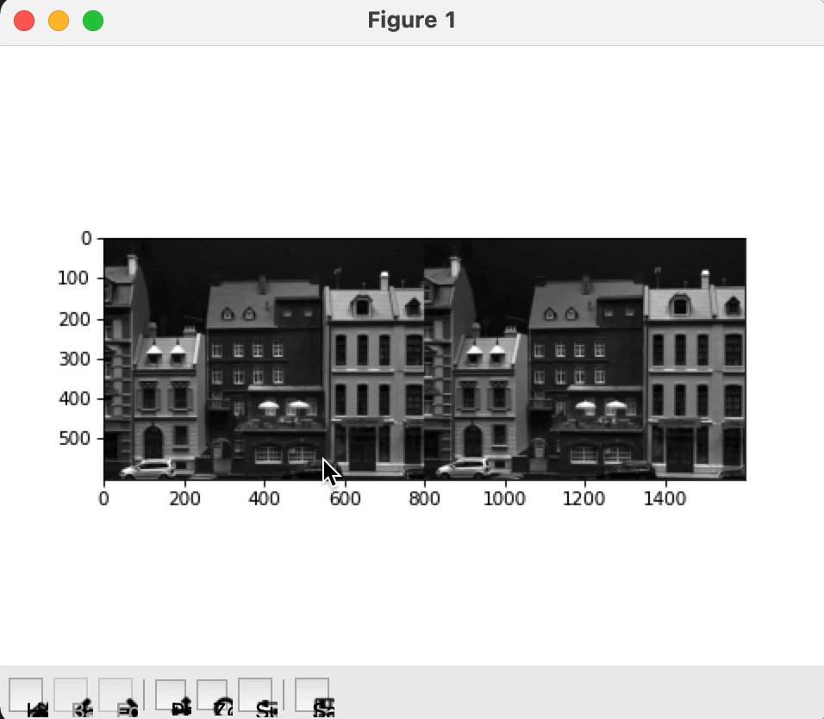
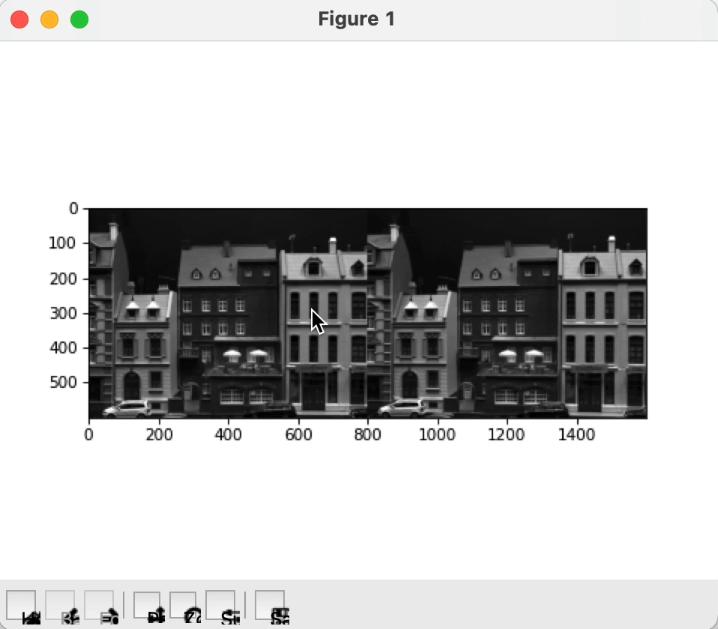
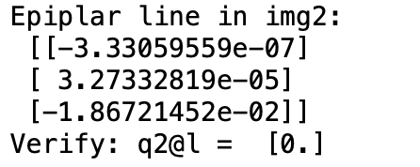
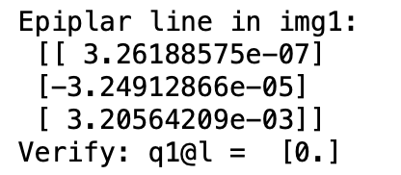
Exercise 3
3.9 & 3.10 Select a point in one image and show its corresponding epipolar line in another image
Exam Presentation

Slide 3
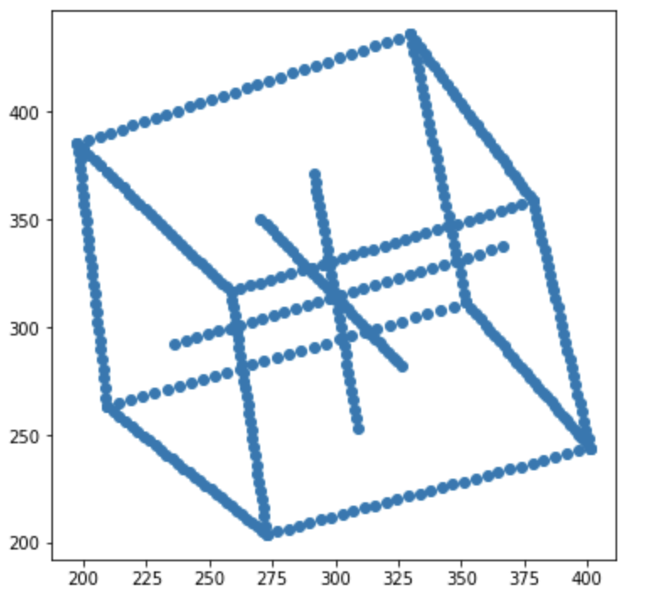
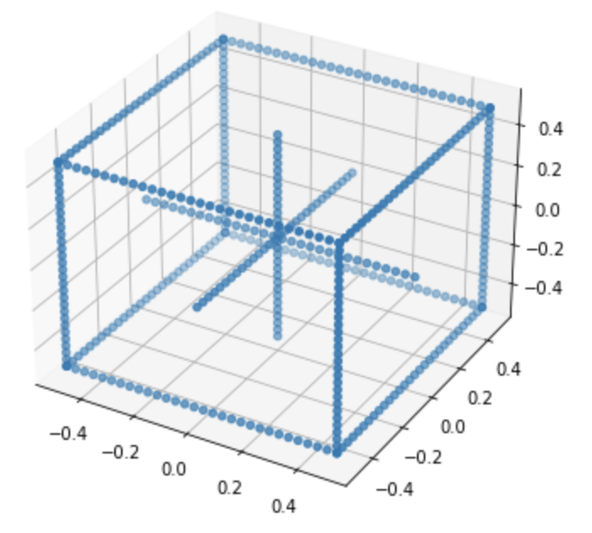
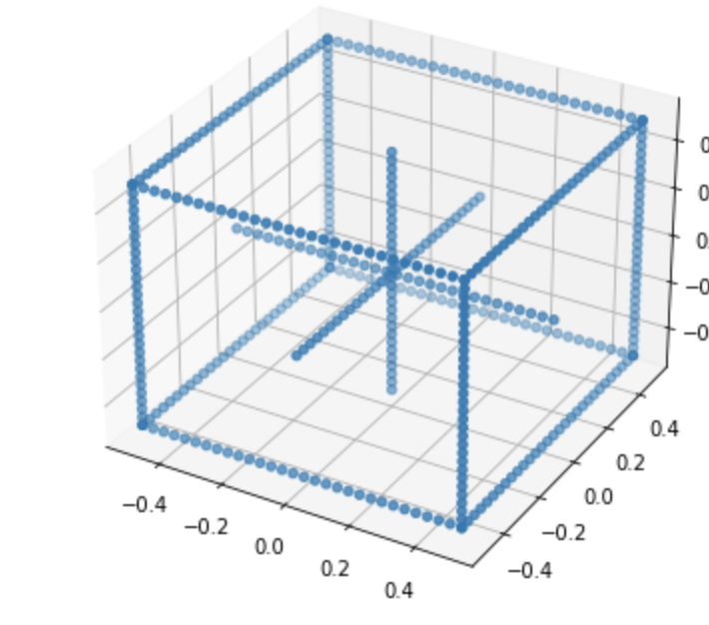
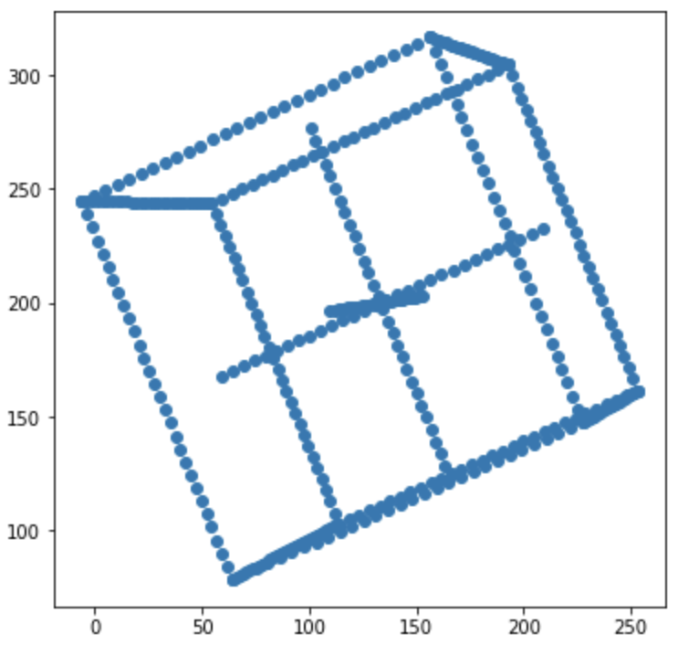
Exercise 3
3.11 Triangulate
Triangulation
Projection in two Camera
Triangulation
Exam Presentation

