Slide 1
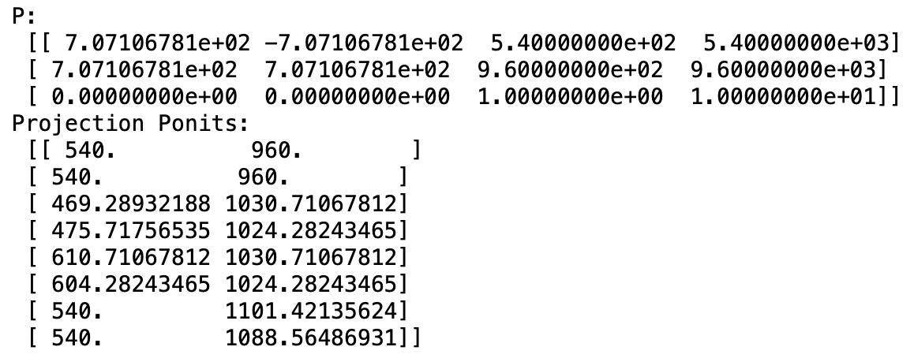
Exercise 4
4.1 Projection Matrix and Points
Exam Presentation

Slide 2
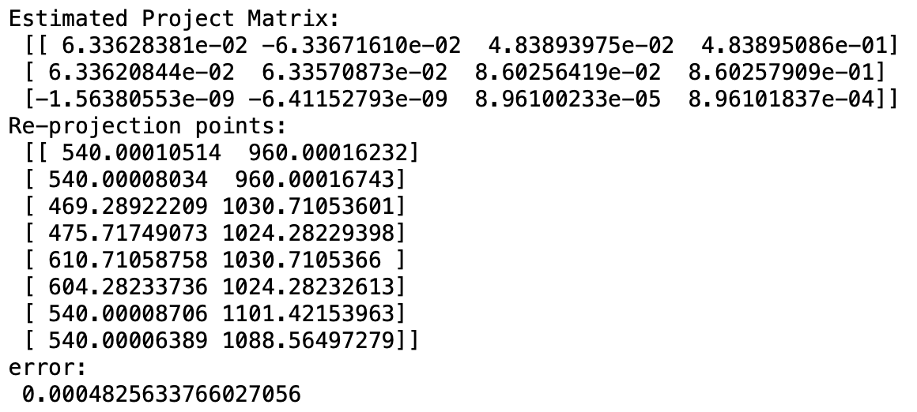
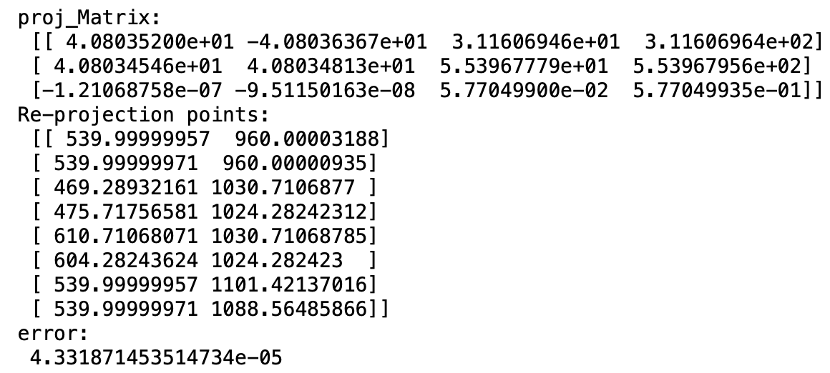
Exercise 4
4.2 Get Estimated Projection Matrix by DLT and Re-project points
4.2.1 Without normalization
4.2.1 With normalization
Exam Presentation

Slide 3
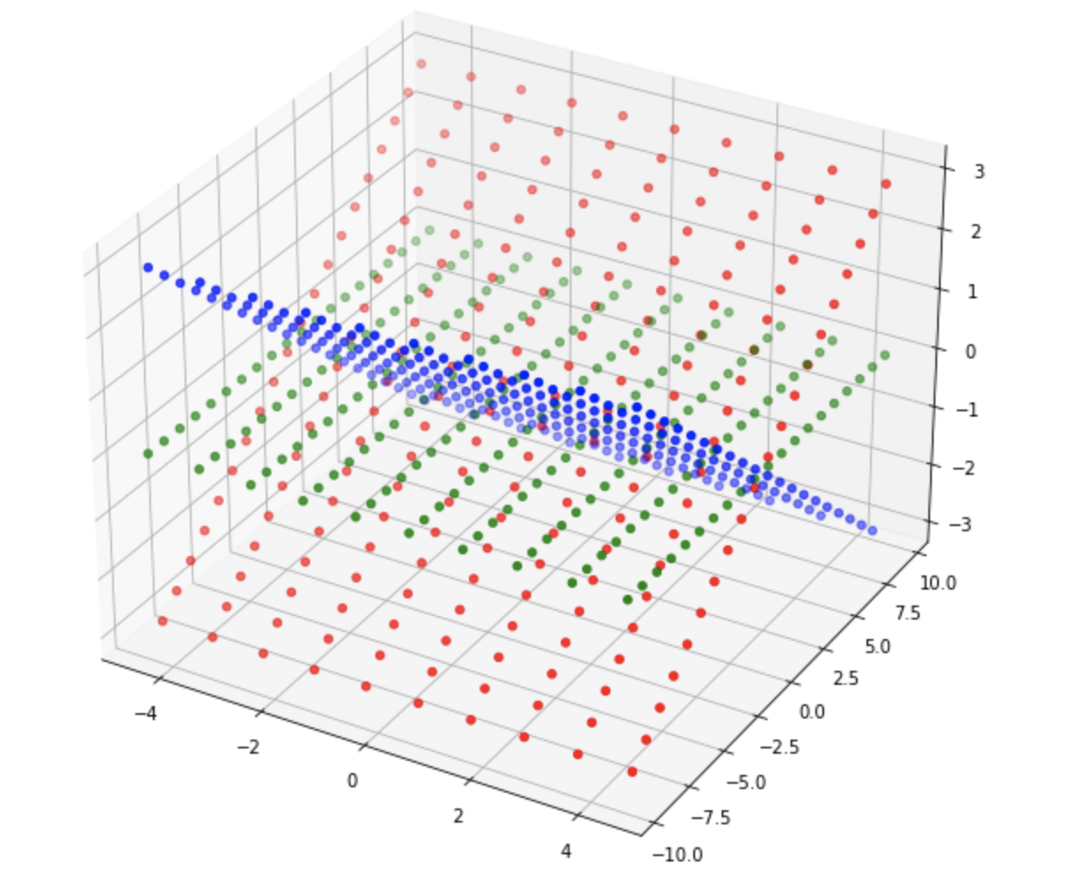
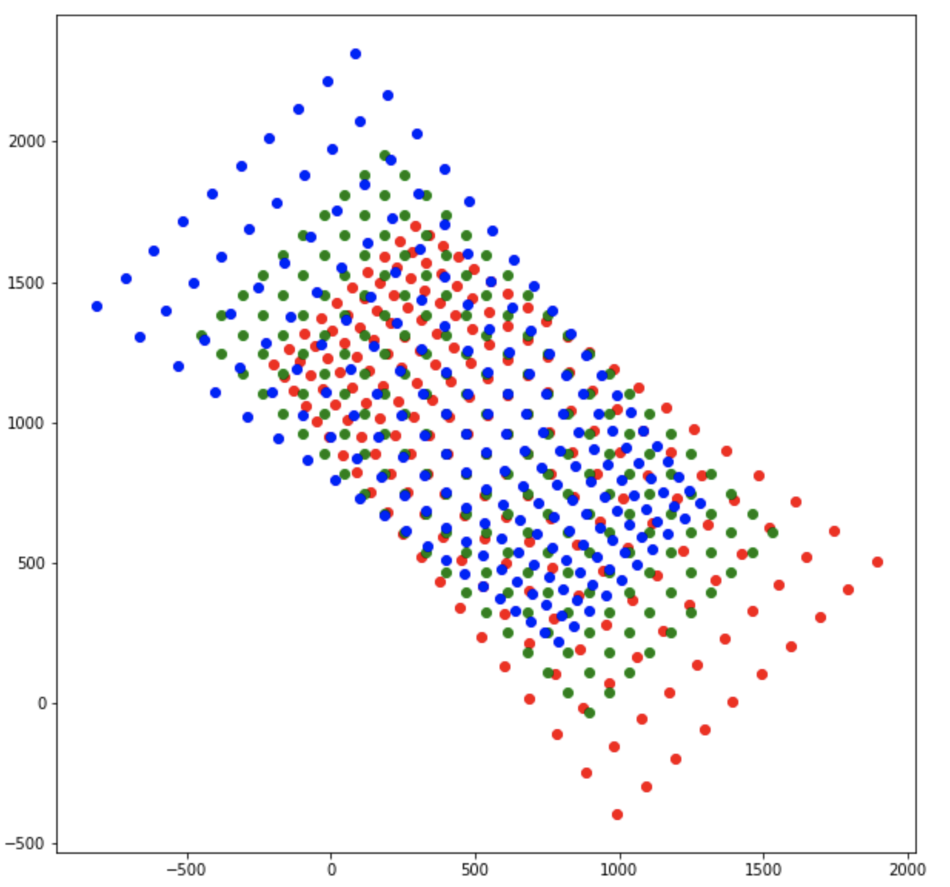
Exercise 4
4.3 & 4.4 Define Checker-Board Points and their Projection Points
Corners in 3D
Projection of corners
Exam Presentation

Slide 4
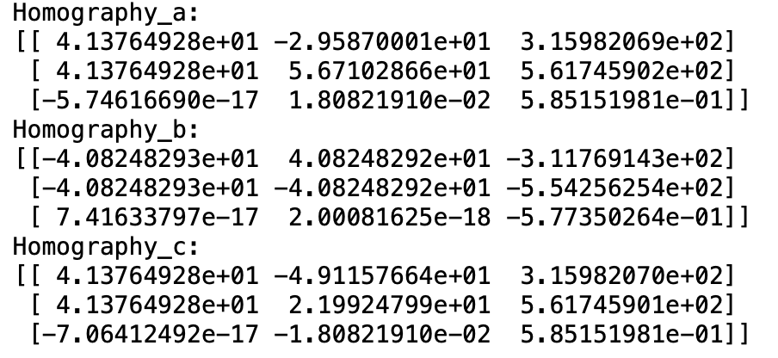
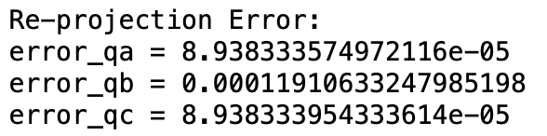
Exercise 4
4.5 Compute Homography in Zhang’s method
Exam Presentation

Slide 5
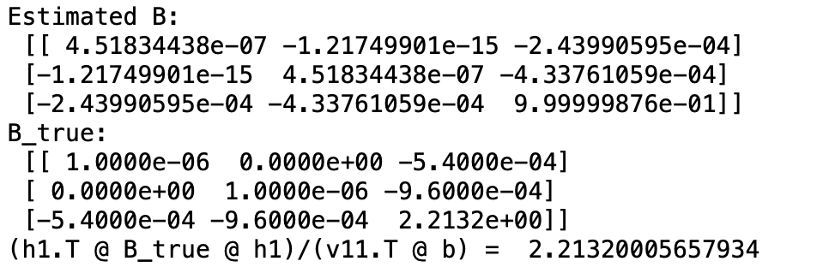
Exercise 4
4.6 Estimate B in Zhang’s Method
The estimated B is a scale version of B_true
Exam Presentation

Slide 6
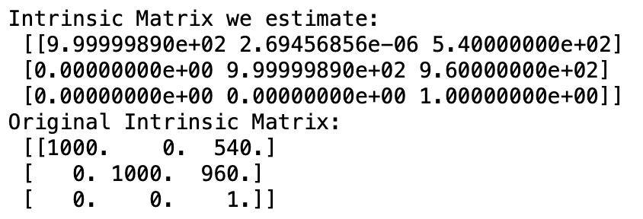
Exercise 4
4.7 Estimate Camera Intrinsic Matrix
Exam Presentation

Slide 7
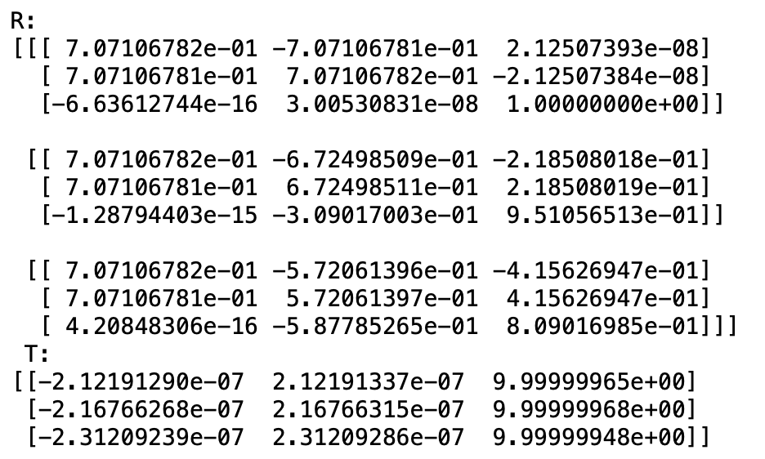
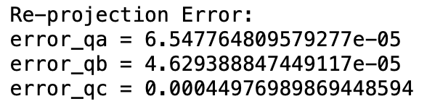
Exercise 4
4.8 Estimate Camera Extrinsic Matrix
Exam Presentation

Slide 8
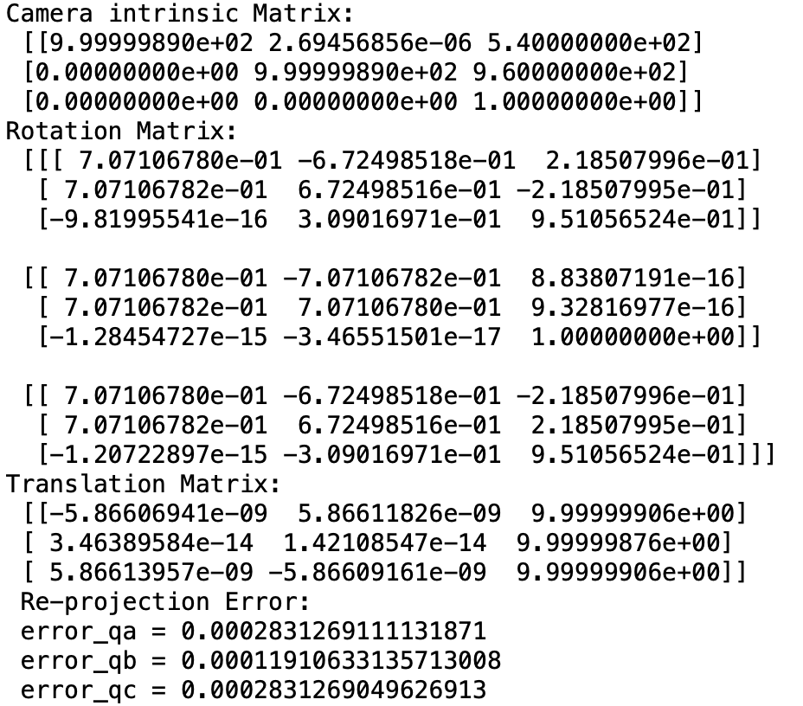
Exercise 4
Put All Things Together into a Larger Function
Exam Presentation

