Slide 1
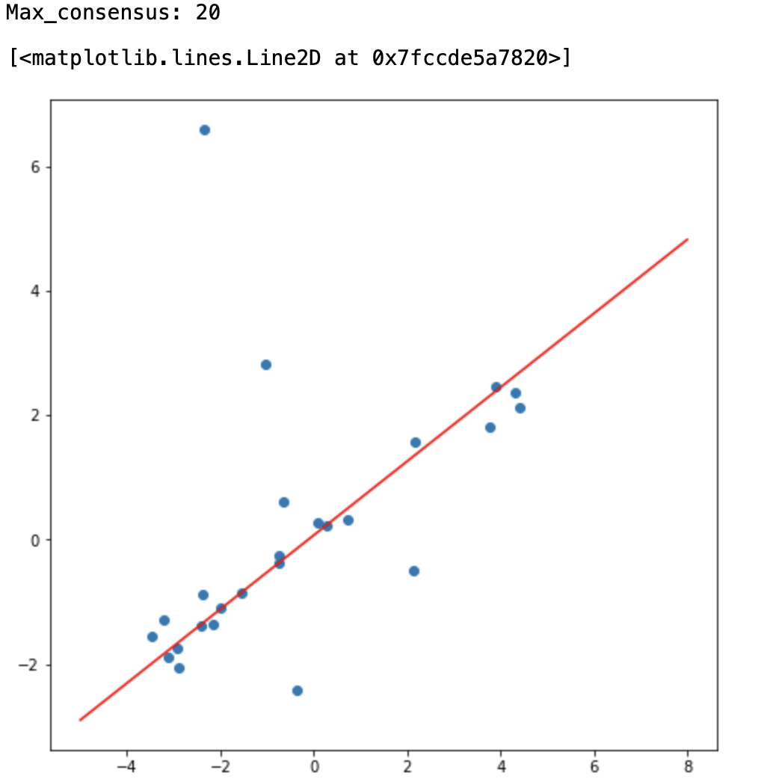
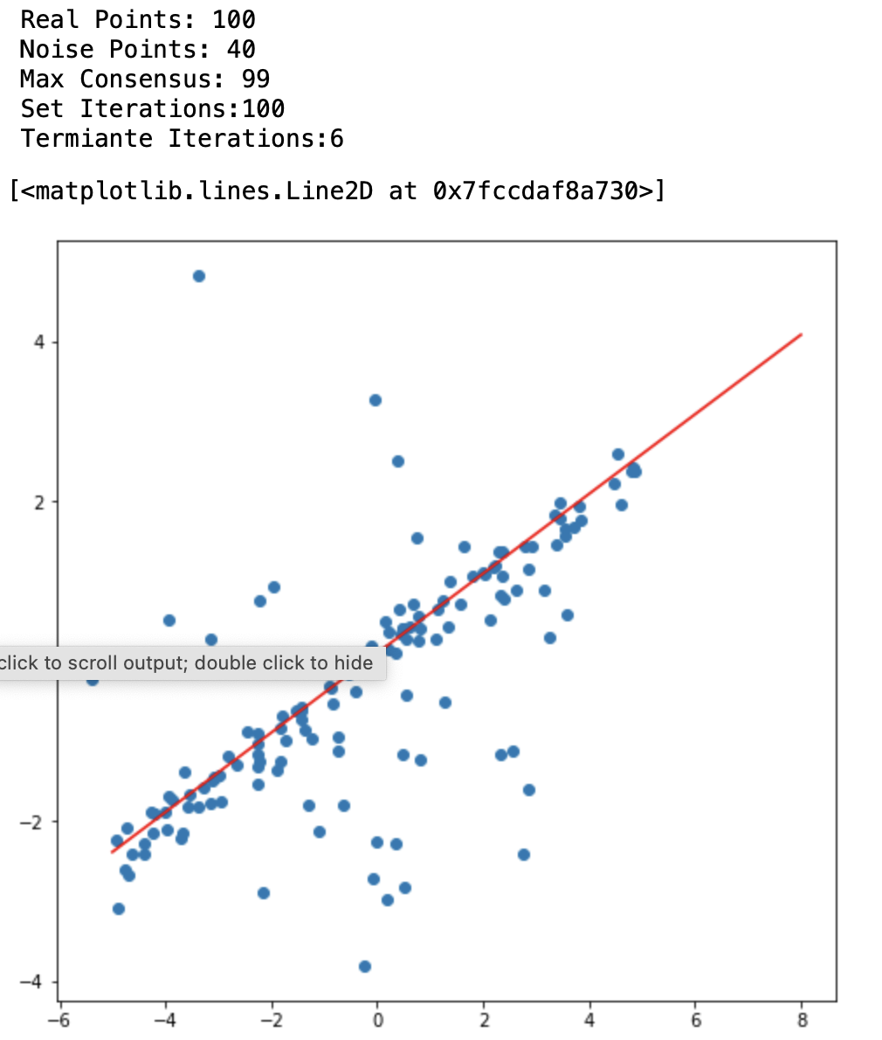
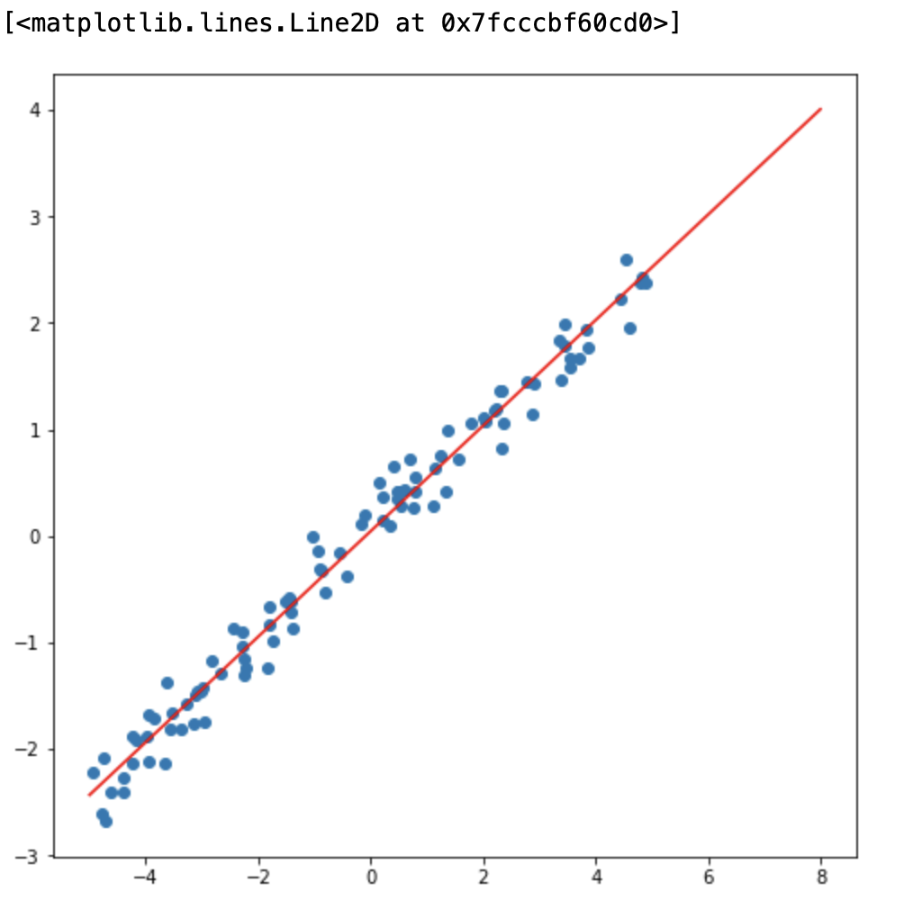
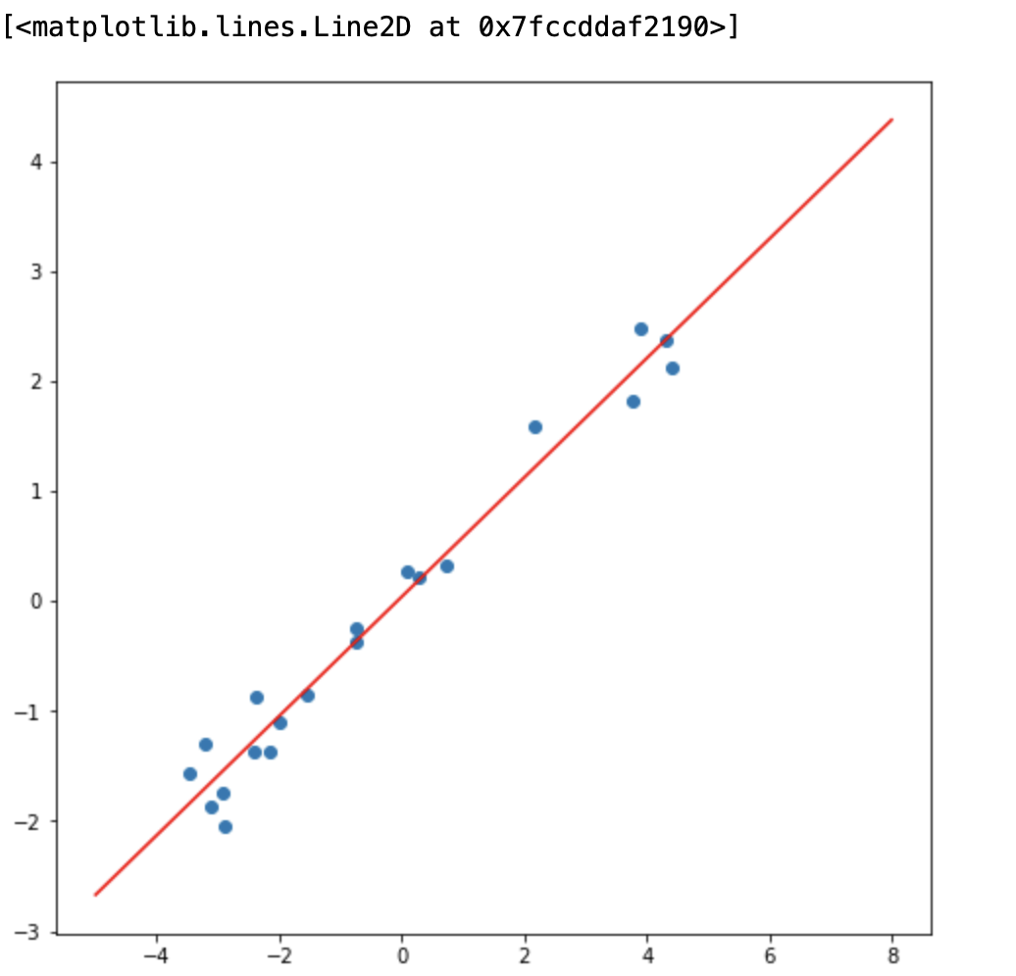
Exercise 7
7.1 ~ 7.6 Using RANSNC to Fit Line
7.7 Apply PCA to inliers to Fit Line
7.7 Implement Stopping Criteria
Exam Presentation

