Slide 1
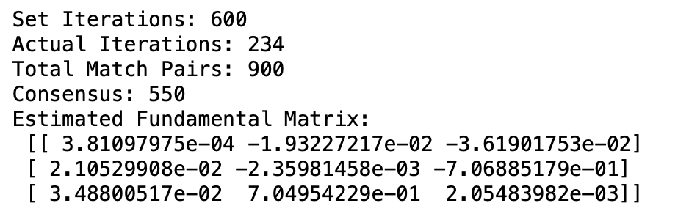
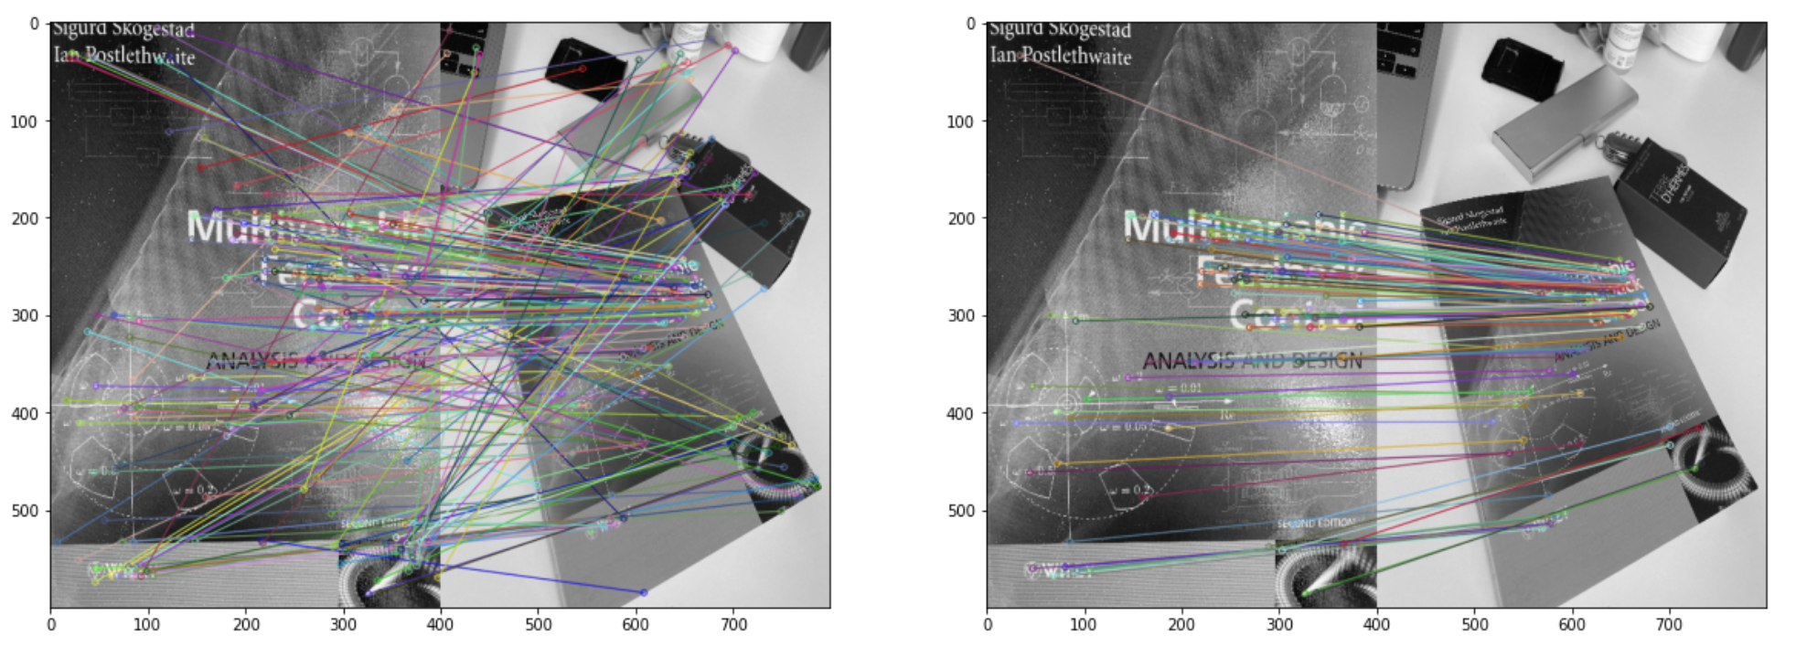
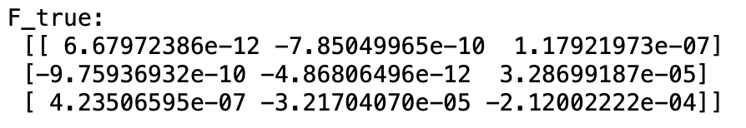
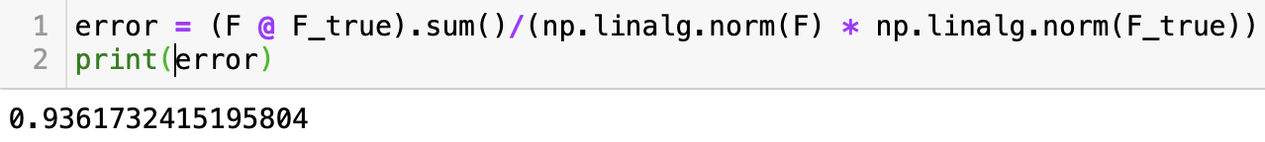
Exercise 9
Estimate Fundamental Matrix by 8-Points Method
Verify
Check the result of this formula:
(F*F_true).sum() / (np.linalg.norm(F)*np.linalg.norm(F_true))
Exam Presentation

