Slide 1
Marriage support letters often start messy.
Scattered drafts, copied language, vague claims, unclear personal knowledge.
Draft from client
Copied template language
Vague relationship claim
Unclear authorship
Different formats · late arrival
Generic character letter
Not personal knowledge
Who wrote what?
Case file
fragments

Slide 2
ASN gives each person clear instructions.
The firm sets the matter frame; the applicant and witnesses see what to do next.
Firm
Applicant
Witness
Set matter frame
Choose witnesses
Write observations
Choose signing path
Add contact details
Avoid conclusions
Review before signing
Track status
Know next steps
Clear roles before the statement is drafted.

Slide 3
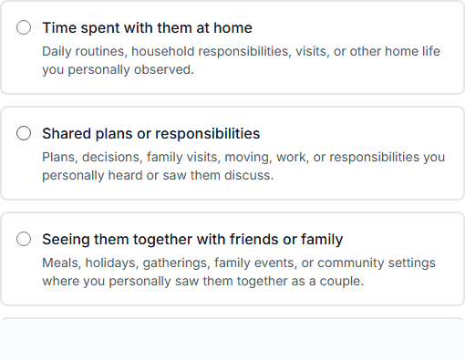
Witnesses answer from personal knowledge.
Witnesses are guided on what to write about and what not to claim.
Specific observations, not legal conclusions
Demo workflow · Not legal advice

Slide 4
Each witness keeps a separate statement.
The firm can compare what each person actually observed.
PERSONAL OBSERVATIONS OF THE RELATIONSHIP
Witness-authored facts
Separate witness statement
Firm compares observations

Slide 5
Attorney judgment stays at the center.
Review, request revision, approve when ready — firm-controlled.
Attorney review queue
Demo · two witness statements · same case
Clara Johnson
Witness supplies facts.
Relationship statement · Needs review
Pending
Michael Turner
Firm reviews readiness.
Attorney judgment stays with the firm.
Relationship statement · Needs review
Pending
No auto-approval
Review
Request revision
Approve
Timeline

Slide 6
The firm keeps the review trail.
Who submitted, what changed, and why the statement moved forward.
Relationship statement review record
Witness input
Submitted by the witness · Personal observations
Revision trail
Timeline / revision / review record
Attorney review
What it covers · Author control · Review readiness
Internal record before signing — not an outcome guarantee.

Slide 7


A cleaner path before signing.
Guide applicants and witnesses. Keep statements separate. Review the package before signing.
Email the pilot team
Request professional pilot access
No obligation. Pilot fit is reviewed before onboarding.
Demo workflow · Not legal advice

