Slide 1


Marriage support statements should not arrive as email chaos.
When a firm needs more than one relationship statement, ASN gives the review process a clean structure.
Synthetic demo · Not legal advice

Slide 2
Two witnesses. Two separate statements. One review workflow.
Witness 1
separate path
→
Couple
same case
→
Attorney review
before signing
→
Witness 2
separate path
→
Separate statements · firm decides evidence fit
Synthetic demo · Not legal advice

Slide 3
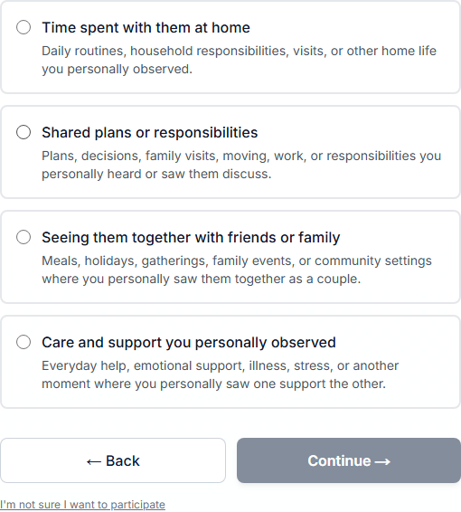
Witnesses answer relationship-focused questions.
Personal observations, not legal conclusions.
Gateway-B scope cards — synthetic demo screenshot
Synthetic demo · Not legal advice

Slide 4
Each witness keeps a separate statement.
The firm decides how each statement fits the evidence package.
Heading only — body redacted in demo asset
Synthetic demo · Not legal advice

Slide 5
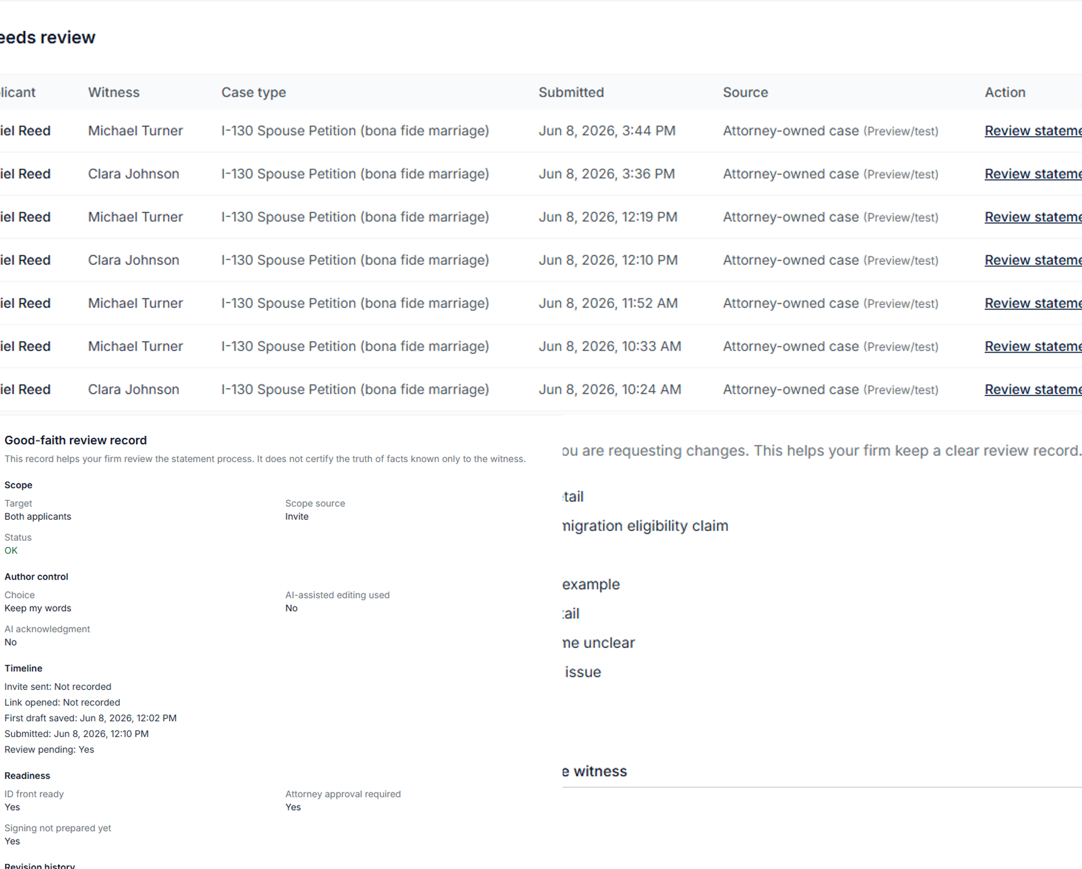
The firm reviews both statements before signing.
Tasks, review pages, revision reasons, and timeline stay organized.
Review before signing — demo data
Synthetic demo · Not legal advice

Slide 6
A cleaner workflow before signing.
ASN helps firms collect and review multiple relationship support statements for the same couple.
Collect
→
Review
→
Revise
→
Approve
Reply if a short walkthrough would be useful
Synthetic demo · Not legal advice

