Slide 1


Relationship support statements are a workflow problem.
Collect · review · revise · approve — before signing.
Synthetic demo · Not legal advice

Slide 2
Workflow infrastructure for support statements.
Not a law firm.
Not legal advice.
Not a referral service.
No outcome promises.
Attorney review stays
with the firm.
Synthetic demo · Not legal advice

Slide 3
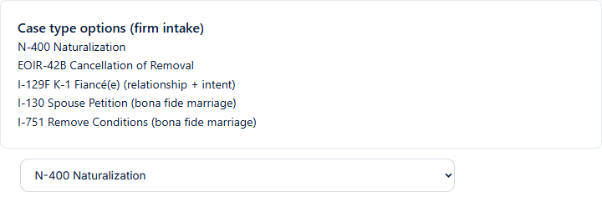
The firm starts from its case type.
Relationship-support workflows around the selected matter type.
ASN uses the selected workflow; the firm decides case strategy.
Synthetic demo · Not legal advice

Slide 4
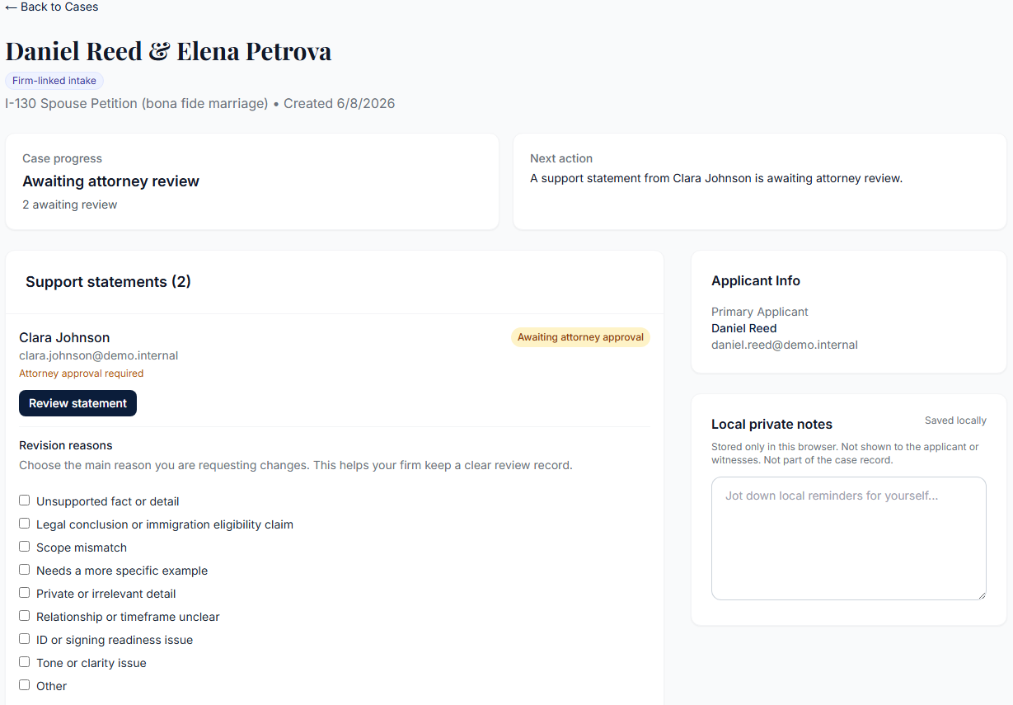
One couple. Two witnesses. Separate paths.
Synthetic demo — statements remain separate.
Demo data — not one merged document
Synthetic demo · Not legal advice

Slide 5
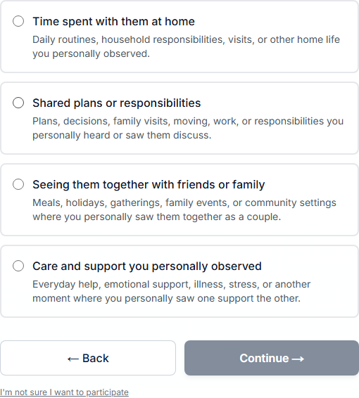
Questions focus on personal observations.
Relationship scope — not legal conclusions.
No legal conclusions about bona fide marriage
Synthetic demo · Not legal advice

Slide 6
A relationship statement, not a character-letter template.
Personal Observations of the Relationship.
No generic character-essay framing
Synthetic demo · Not legal advice

Slide 7
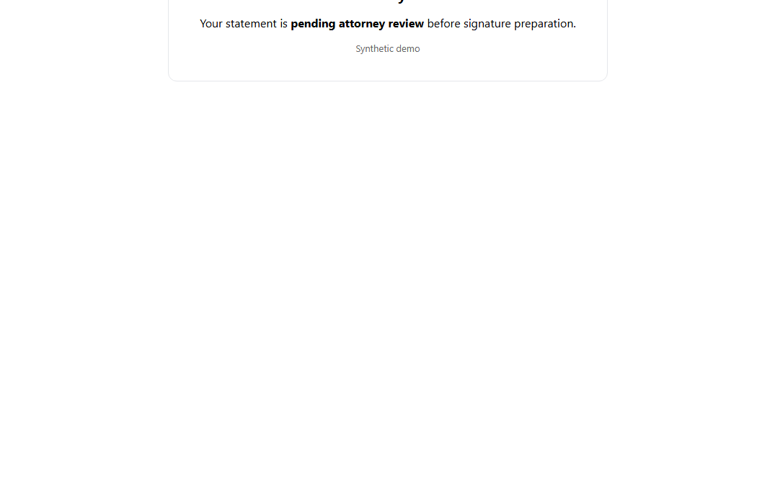
Submission stops for attorney review.
Witness may see pending review before signature preparation.
Illustrative demo composite — no signing provider call
Synthetic demo · Not legal advice

Slide 8
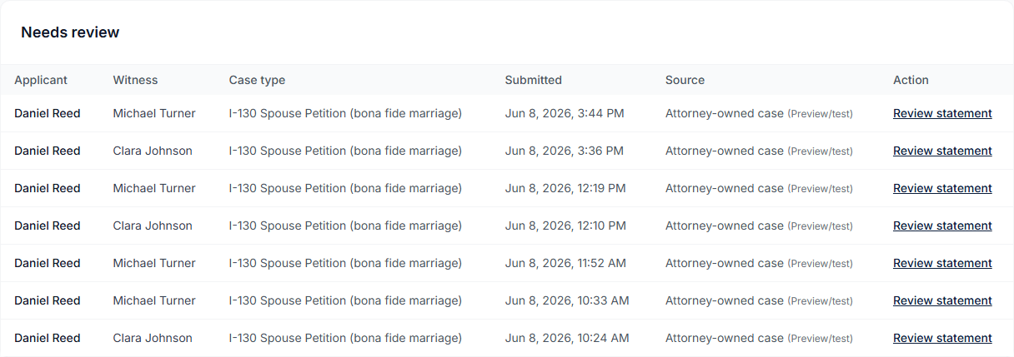
The firm sees the review work in one place.
Submitted statements in the attorney review queue.
Two submitted witnesses · one review queue · demo data
Synthetic demo · Not legal advice

Slide 9
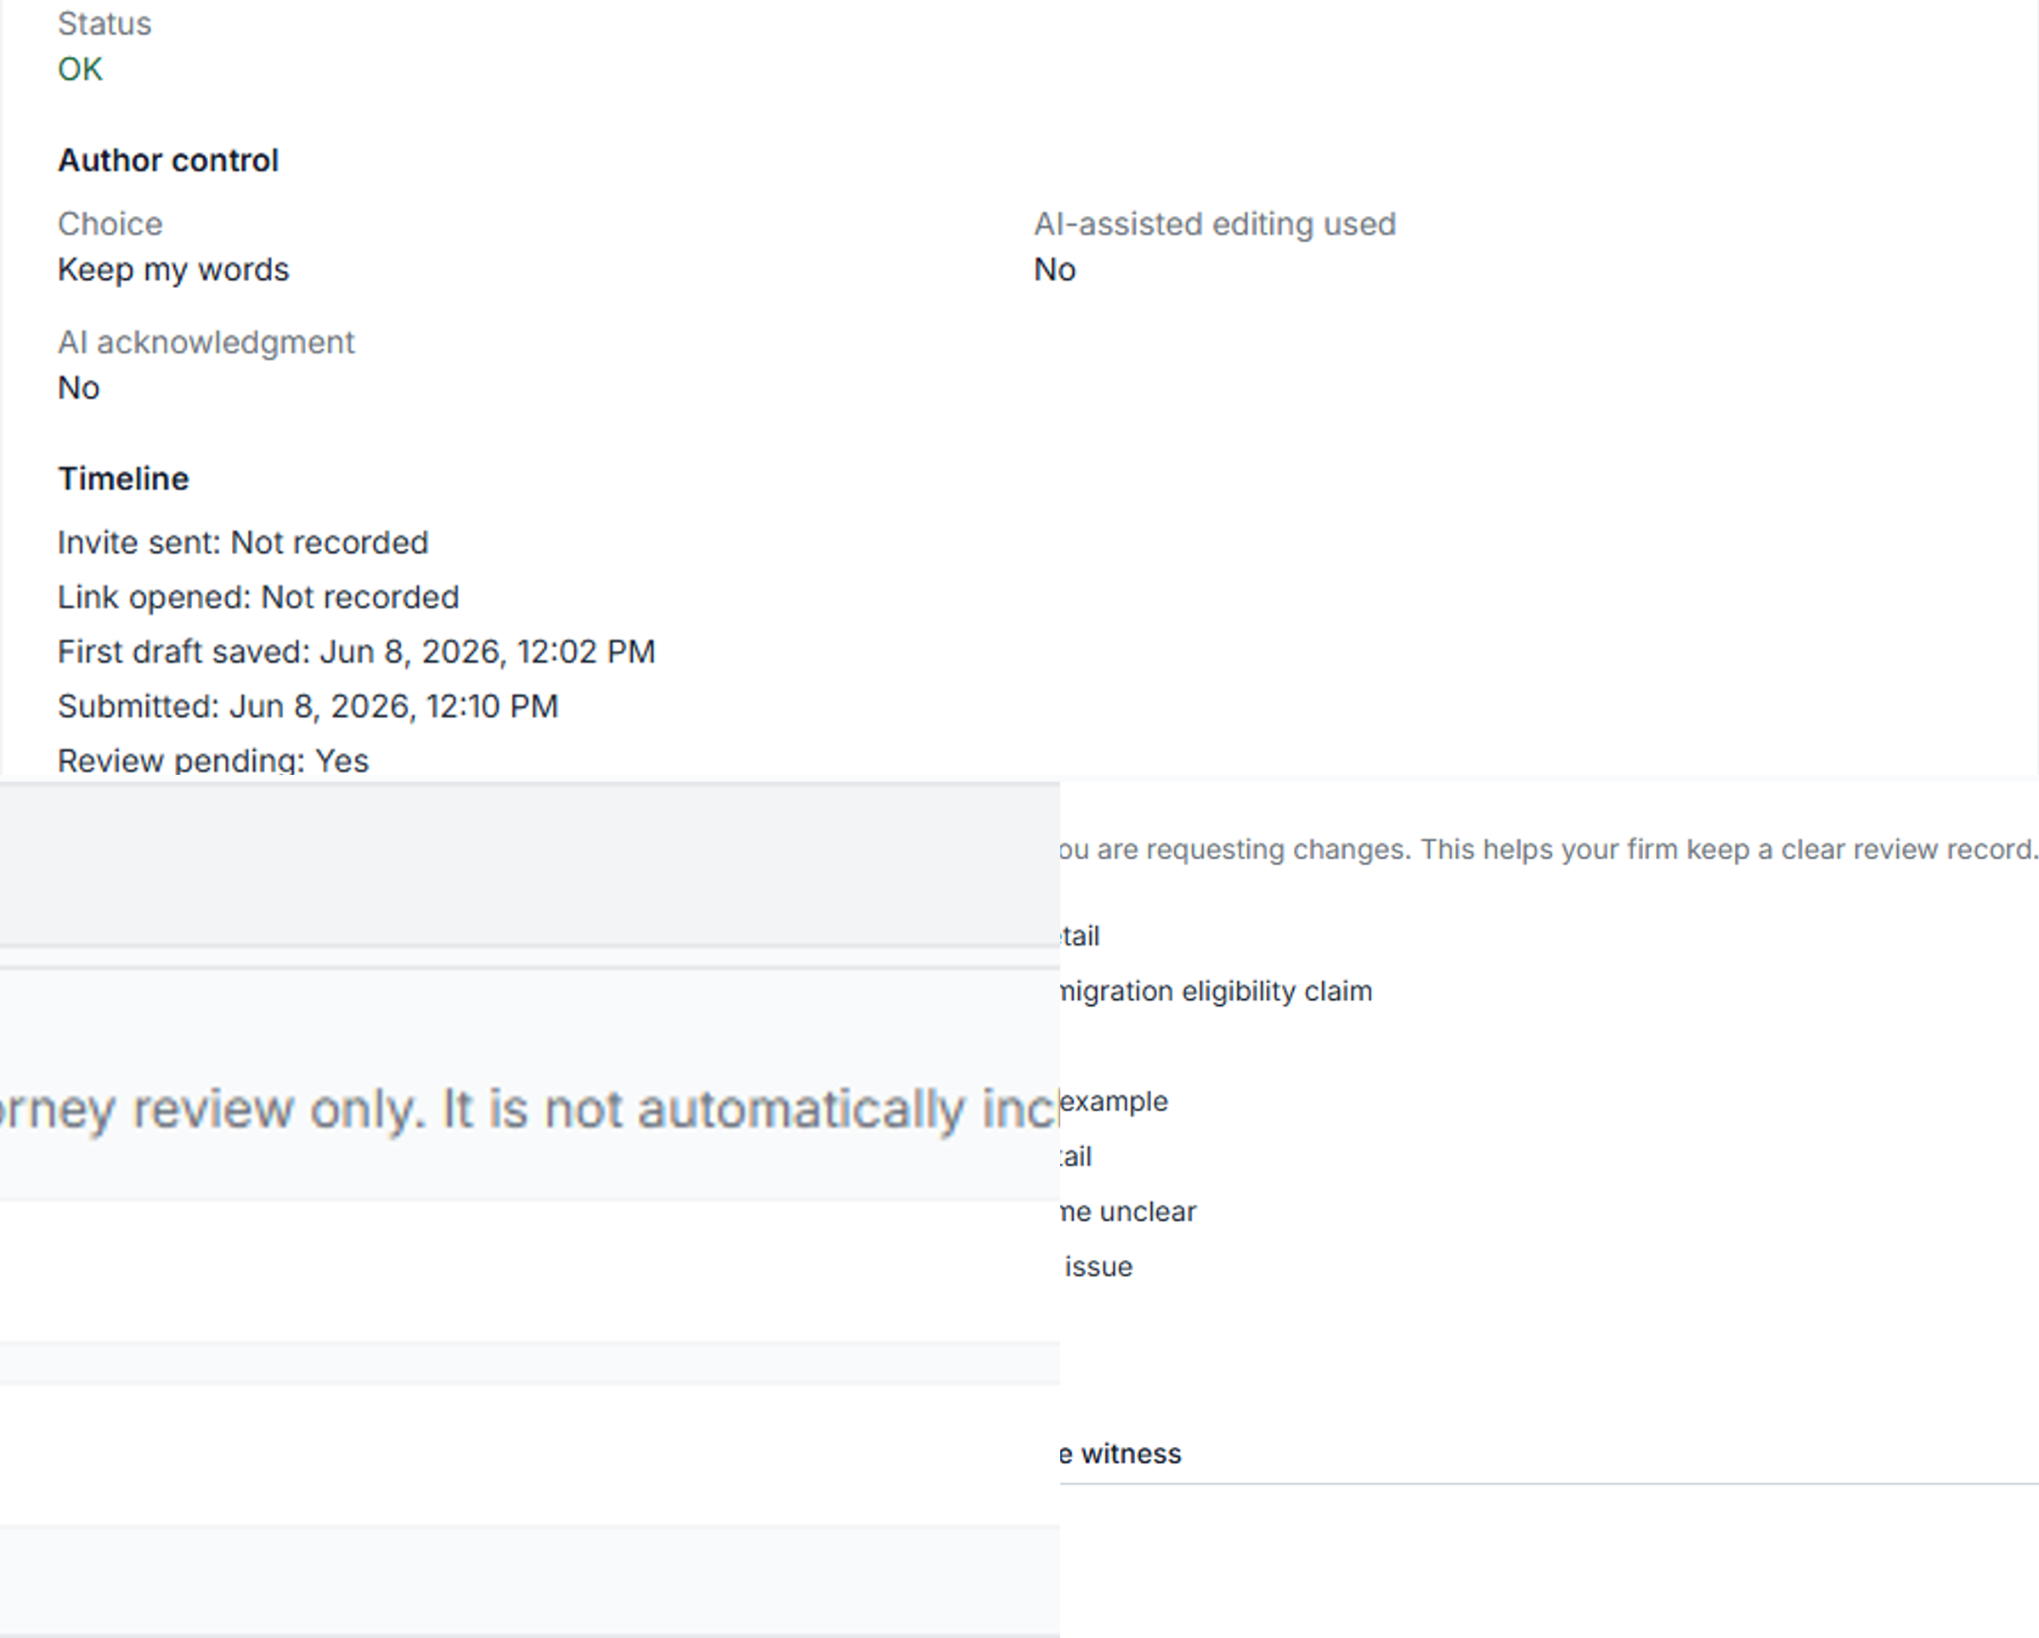
Timeline, revision reasons, and good-faith review.
Process record for internal review — not an outcome guarantee.
Reply if a short walkthrough would be useful
Synthetic demo · Not legal advice

