Slide 1


Relationship support statements are a workflow problem.
Collect · review · revise · approve — with a clear process record.
Synthetic demo · Not legal advice

Slide 2
Workflow infrastructure for support statements.
Not a law firm.
Not legal advice.
Not a referral service.
No outcome promises.
Attorney review stays
with the firm.
Synthetic demo · Not legal advice

Slide 3
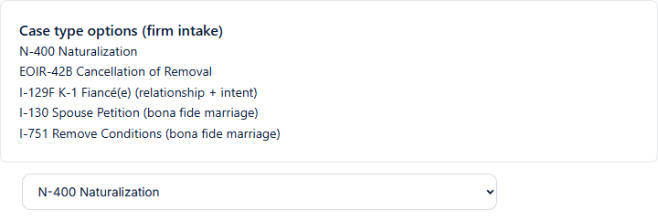
The firm starts from its case type.
Relationship-support workflows around the selected matter type.
The firm decides case strategy
Synthetic demo · Not legal advice

Slide 4
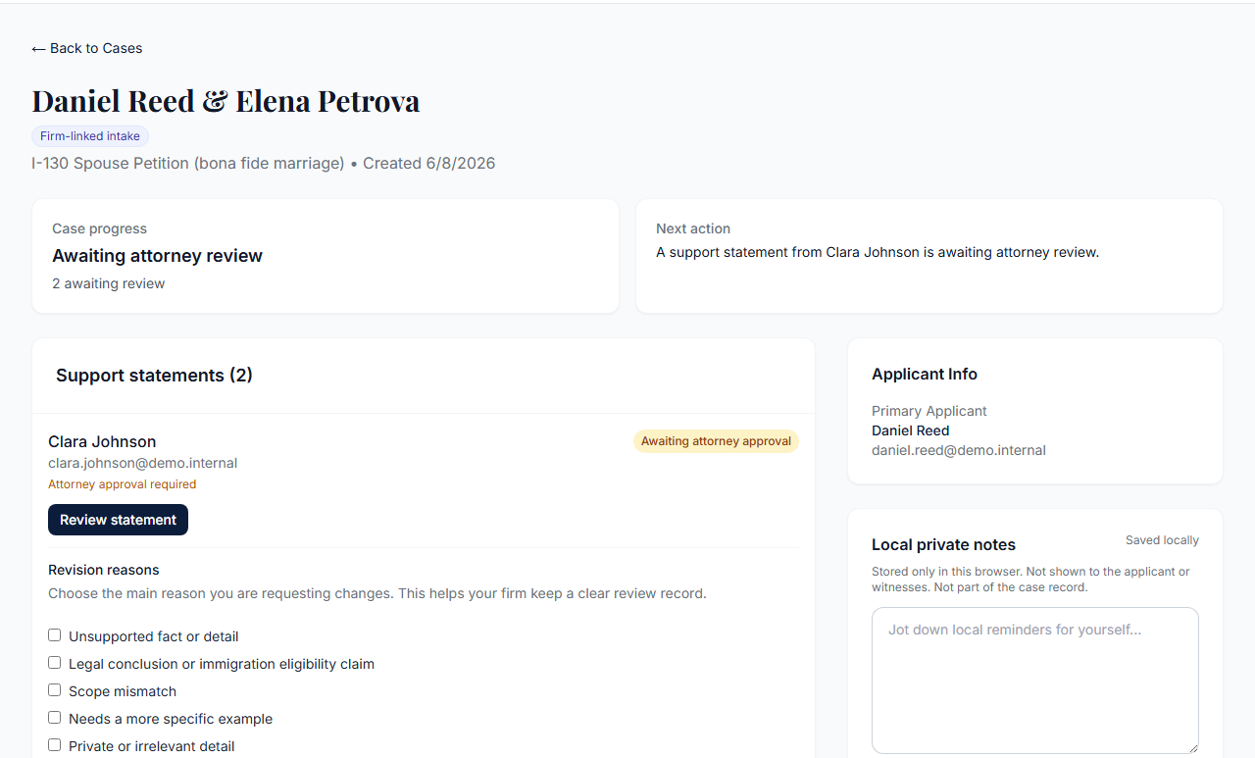
One couple. Two witnesses. Separate paths.
Each witness completes a separate guided flow.
Statements remain separate
Synthetic demo · Not legal advice

Slide 5
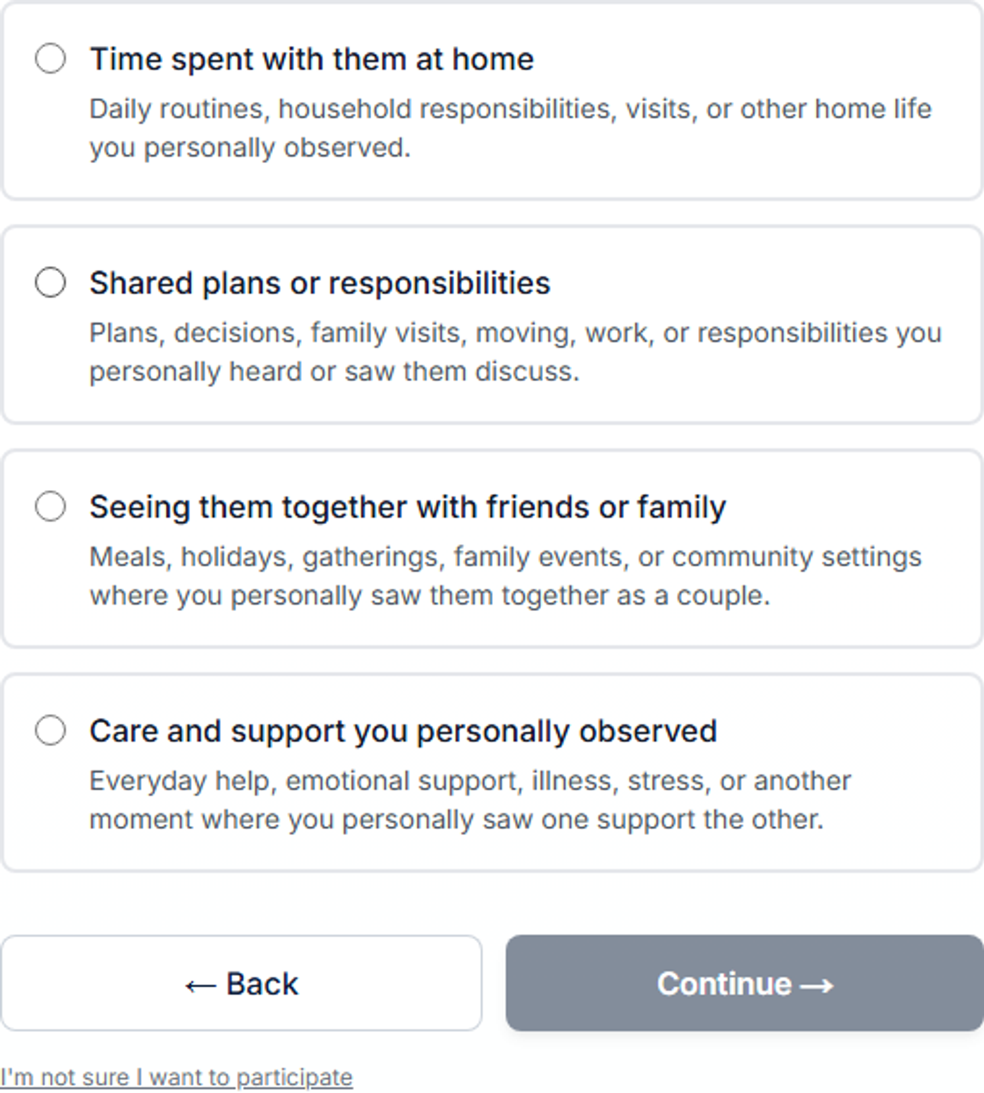
Questions focus on personal observations.
Relationship scope — not legal conclusions.
Personal observations of the relationship
Synthetic demo · Not legal advice

Slide 6
A relationship statement, not a character-letter template.
Personal Observations of the Relationship.
Relationship-focused statement
Synthetic demo · Not legal advice

Slide 7
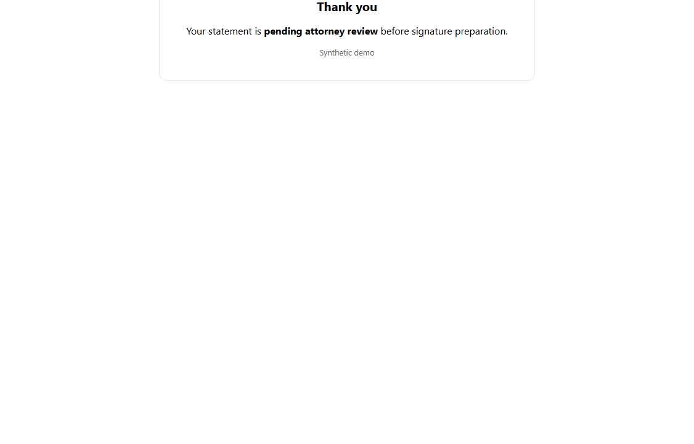
Submission stops for attorney review.
Witness sees pending review before signature preparation.
Attorney review before signing
Synthetic demo · Not legal advice

Slide 8
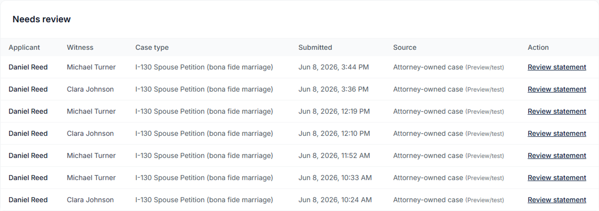
The firm sees the review work in one place.
Submitted statements in the attorney review queue.
Two witnesses · one review queue
Synthetic demo · Not legal advice

Slide 9
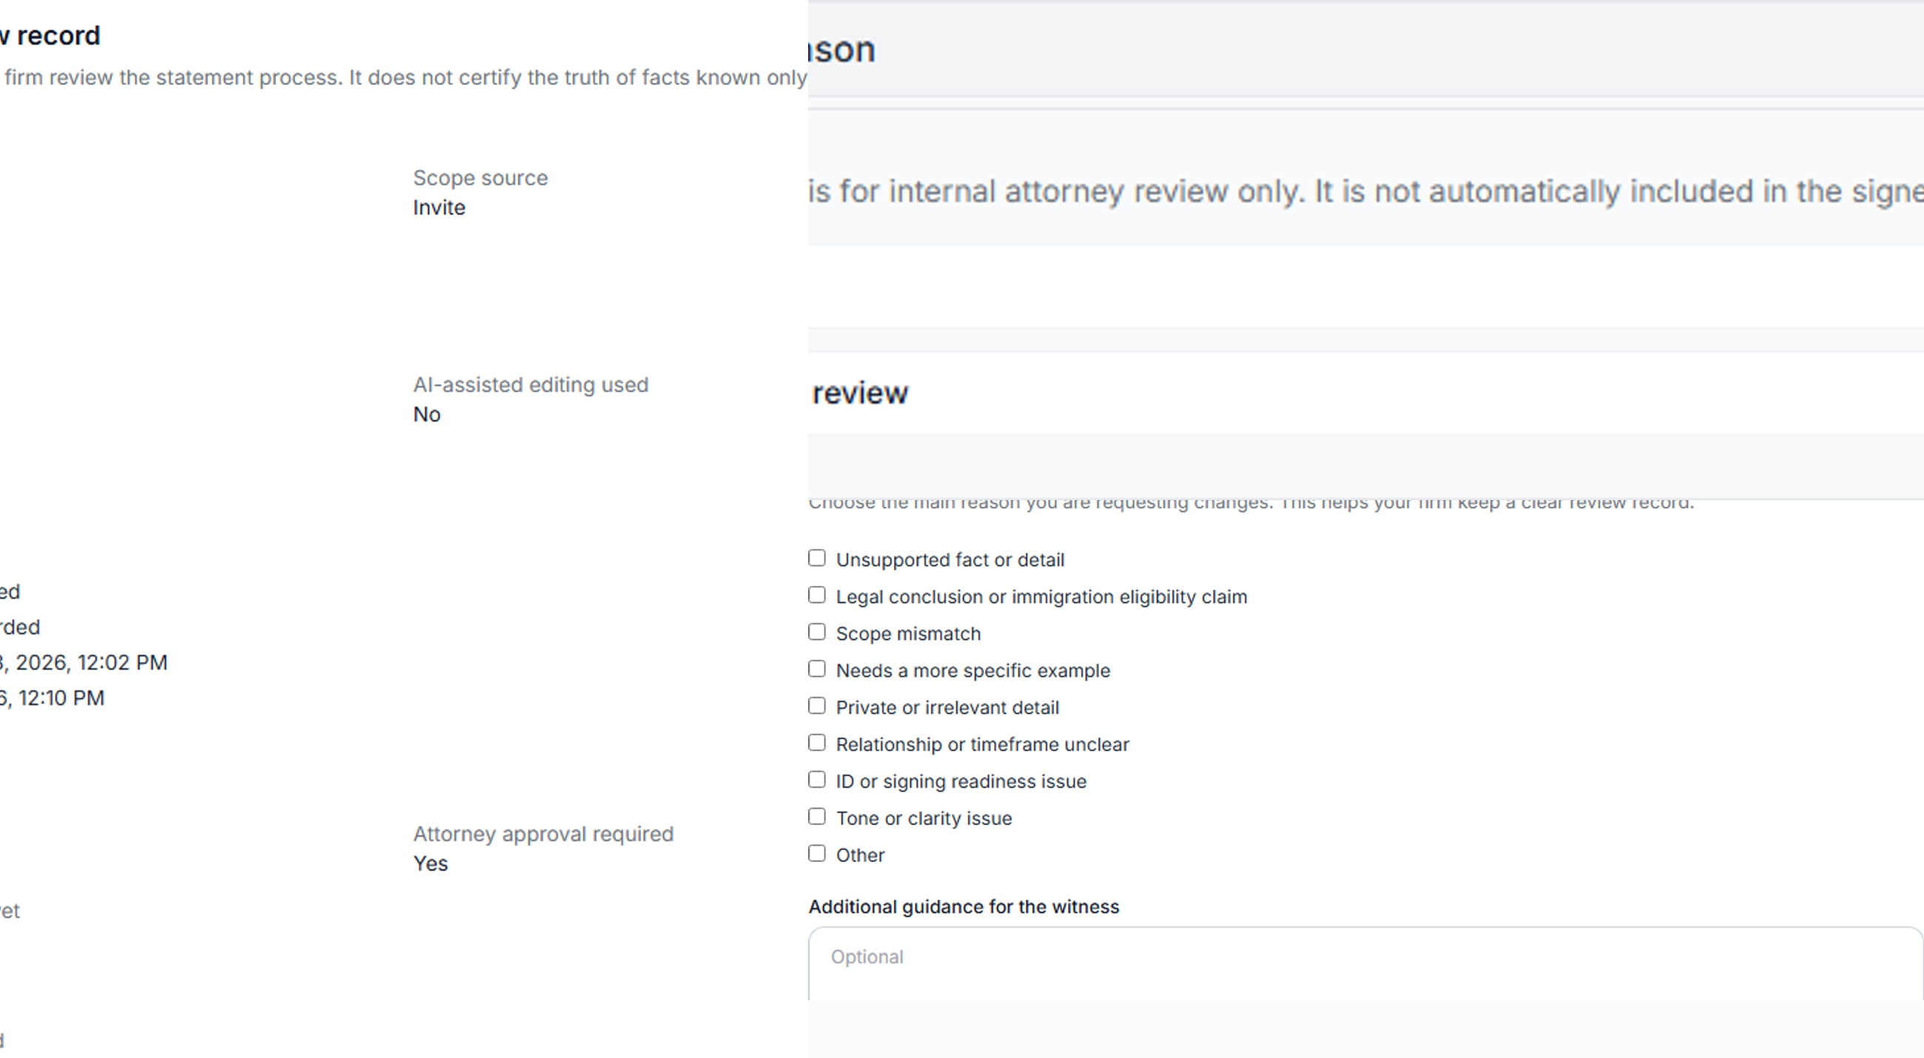
Timeline, revision reasons, and good-faith review.
Process record for internal review
Structured revision reasons and review history when multiple people touch the file.
Reply if a short walkthrough would be useful
Synthetic demo · Not legal advice

