Slide 1

Final presentation T3-ShareList
Adrian Schauer, Raymond Ermler, Mirac Fidanci, Fabian Lasser, Luka Grgic
Fabian
1/19

Slide 2
Table of Contents
Introduction
The Product
Project Management
Lessons learned
2/19
Fabian

Slide 3
Introduction Team
Adrian Schauer
Project Leader
Raymond Ermler
Frontend & Backend
Fabian Lasser
Frontend
Mirac Fidanci
Frontend & Backend
Luka Grgic
Frontend
Robert Kofler Commissioner
Peter Bierbamer Supervisor
Mirac
3/19

Slide 4

Introduction The Problem
Did you ever want to make a list without having or wasting paper and share it with as many people as you want?
Mirac
4/19

Slide 5

Introduction The Solution
ShareList is the answer. You can make lists for absolutely anything and share them with people of your choice!
Mirac
5/19

Slide 6
Introduction - Market Size
The website is accessible by anybody
Shopping lists, goals, milestones and many more things can be created
Therefore a lot of people fit our target group
6/19
Luka

Slide 7
Introduction Competition
Messengers
Elements can not be marked as completed
Made for communication and not lists
Microsoft ToDo
Similar concept. Sharing does not work that well.
ShareList is not a new idea but it targets the problems of the competition and that is how it stands out.
Luka
7/19

Slide 8
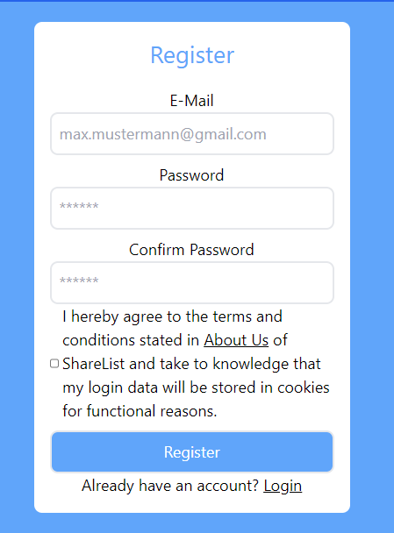
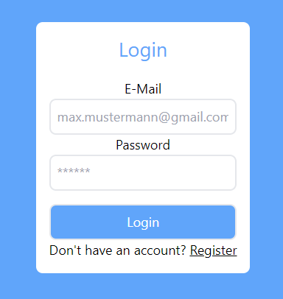
The Product Functions
Raymond
8/19

Slide 9
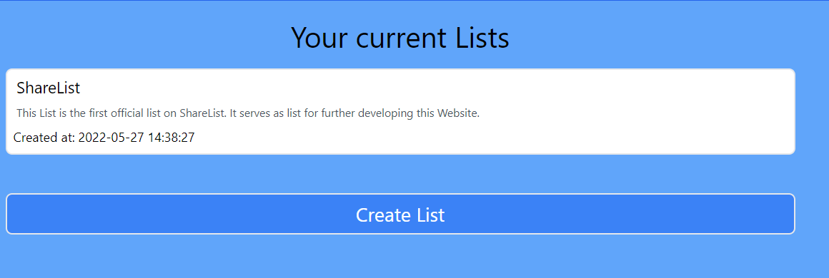
The Product - Functions
Create lists and see already created ones
Raymond
9/19

Slide 10
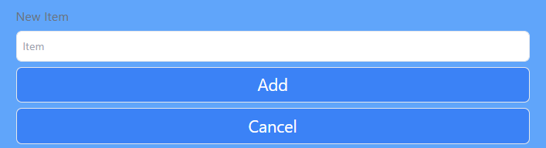
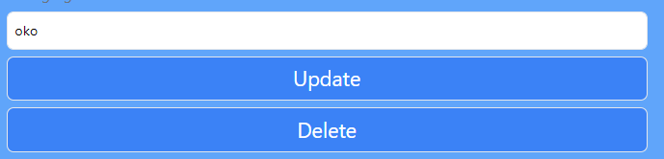
The Product – Functions
Listelements can be deleted or added
10/19
Raymond

Slide 11
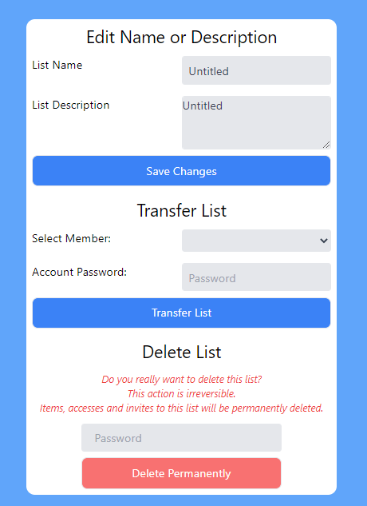
The Product Functions
Fabian
11/19

Slide 12
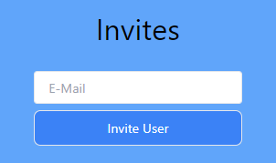
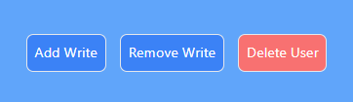
The Product – Functions
You can invite members to your list and also edit member settings
12/19
Fabian

Slide 13
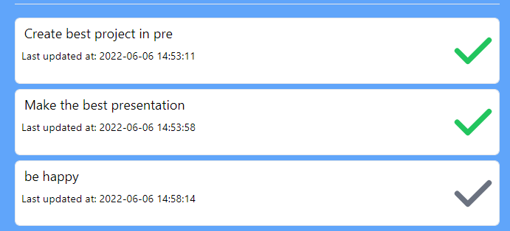
The Product – Functions
You can mark elements as done and incomplete
13/19
Fabian

Slide 14
Project Management – Milestones
PSP-Code | Milestones | Target Date | Estimated Date | Factual Date | Goals Fullfilled/ Unfullfilled
1.1.1 | Kick-off | 08.03.2022 | 08.03.2022 | 08.03.2022 | Fullfilled
1.2.1 | Database implemented | 01.04.2022 | 01.04.2022 | 15.03.2022 | Fullfilled
1.2.4 | API-Anfragen Handling implemented | 20.04.2022 | 20.04.2022 | 17.04.2022 | Fullfilled
1.3.2 | Frontend implemented | 01.05.2022 | 12.05.2022 | 12.05.2022 | Fullfilled
1.2.2 | API-Integration implemented | 05.05.2022 | 05.05.2022 | 05.05.2022 | Fullfilled
1.4.3 | Final testing finished | 28.05.2022 | 28.05.2022 | 28.05.2022 | Fullfilled
1.1.4 | Project finished | 31.05.2022 | 31.05.2022 | 31.05.2022 | Fullfilled
14/19
Adrian

Slide 15

Project Management – Tools
Github
MySQL
Discord
Visual Studio Code
15/19
Adrian

Slide 16
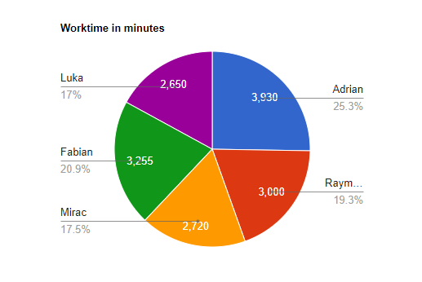
Project Management – Resources
Planned: Atleast 25h (1500min) each
16/19
Adrian

Slide 17

Project Management Explanation
Stress from school
Some of us worked during holidays
Some were absent more often during lessons
17/19
Adrian

Slide 18

Lessons learned
Communication
Teamwork
Time management
A lot of new frameworks and languages
Luka
18/19

Slide 19

Thank you for your attention!
https://sharelist.adrian-schauer.at/ (ShareList)
https://github.com/LuckyForce/ShareList
(github)
Luka
19/19

