Slide 1
Final presentation ShareList
Adrian Schauer, Raymond Ermler, Mirac Fidanci, Fabian Lasser, Luka Grgic

Slide 2
Table of Contents
Introduction
The Product
Project Management
Lessons learned

Slide 3

Introduction The Problem
Did you ever want to make a list without having or wasting paper and share it with as many people as you want?

Slide 4

Introduction The Solution
ShareList is the answer. You can make lists for absolutely anything and share them with people of your choice!

Slide 5
Introduction - Market Size
The website is accessible by anybody
Shopping lists, goals, milestones and many more things can be created
Therefore a lot of people fit our target group

Slide 6
Introduction Competition
Messengers
Elements can not be marked as completed
Made for communication and not lists
ShareList is a new and innovative idea so the competition is quite limited

Slide 7
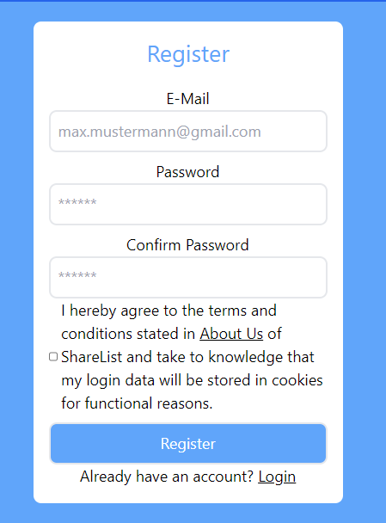
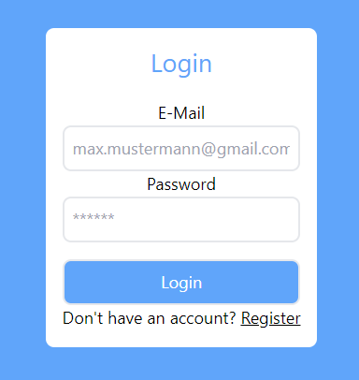
The Product Functions

Slide 8
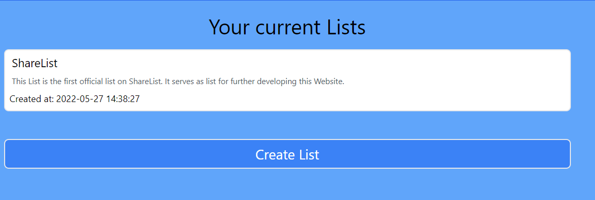
The Product - Functions
Create lists and see already created ones

Slide 9
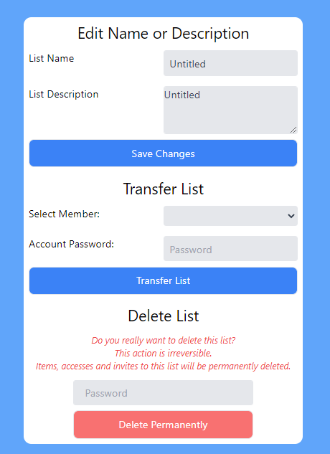
The Product Functions

Slide 10
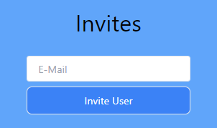
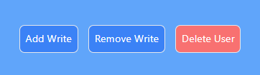
The Product – Functions
You can invite members to your list and also edit member settings

Slide 11
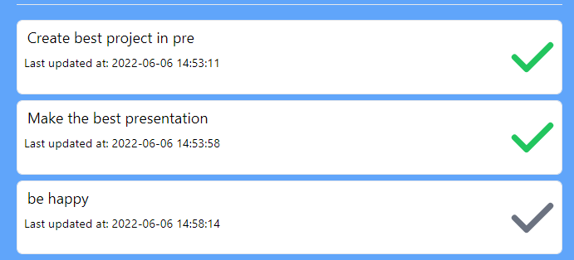
The Product – Functions
You can mark elements as done and incomplete

Slide 12
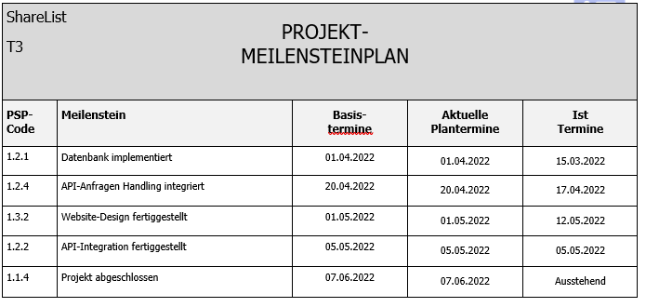
Project Management – Milestones

Slide 13

Project Management – Ressources
Github
MySQL
Discord
Visual Studio 2022

Slide 14
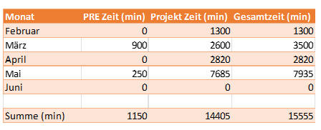
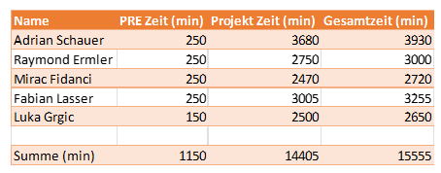
Project Management – Time

Slide 15

Lessons learned
Communication
Teamwork
Time management

Slide 16

Thank you for your attention!
https://sharelist.adrian-schauer.at/ (ShareList)
https://github.com/LuckyForce/ShareList
(github)

