Slide 1

PicturePerfect
Documentation

Slide 2
images
id | custom_name | name | subfolder | file_type | date_taken | size | camera | iso | f-stop | exposure_time | exposure_bias | focal_length | notes
int | string | string | string | string | string | double | string | int | double | int | double | double | string

Slide 3
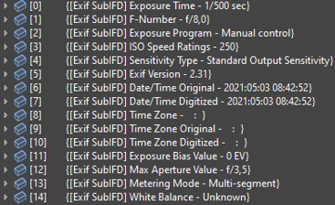
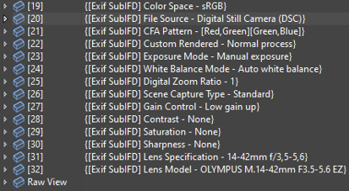
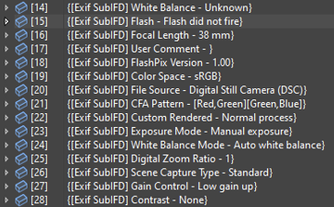
Meta data tags for orf

Slide 4
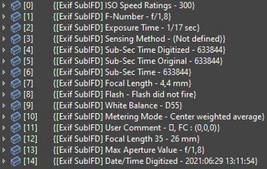
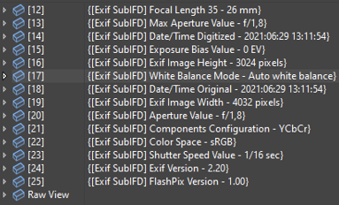
Meta data tags for jpg

Slide 5
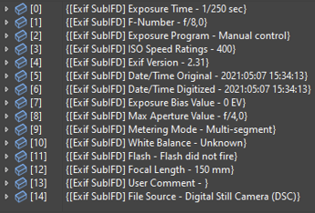
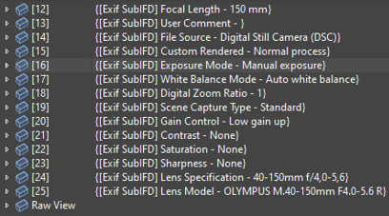
Meta data tags for tif/tiff

