Slide 1
Introduction to Verilog

Slide 2
Overview of Verilog
Resemblance to C: case sensitive, same style comments, operators, etc.
Two standards: Verilog-1995, Verilog-2001, both supported by ISE
Easy to write, and easy to make mistakes

Slide 3
Behavioral vs Synthesizable code
Historically Verilog has always served two functions:
Describe your digital logic design in a high-level way instead of using schematics (synthesizable code).
Model elements that interact with your design (behavioral models/testbenches)
You should always have a clear conscience of whether you are writing behavioral or synthesizable code.
Better yet, know what your synthesizable code translates to in physical hardware.

Slide 4
Data Values
Values: 1, 0, x/X (unknown), z/Z (high impedance)
Radices: d(decimal), h(hex), o(octal), b(binary)
Format: <size>’<radix><value>
123 // default: decimal radix, unspecified width
‘d123 // ‘d = decimal radix
8‘h7B // ‘h = hex radix
‘o173 // ‘o = octal radix
‘b111_1011 // ‘b = binary radix, “_” are for readability
Signed number (rarely used):
8’shFF (8-bit twos-complement representation of -1)

Slide 5
Operators
Bitwise: ~a, a&b, a|b, a^b, a~^b
Reduction: bitwise operation on a single operand and produces one bit result.
&a, ~&a, |a, ~|a, ^a, ~^a
Example: ^4’b1001 = 1’b0
Logical: output one bit result
!a, a&&b, a||b, ==/!=, ===/!== (also compares x/z)
Arithmetic: +,-,*,/,% (mod, takes the sign of operand 1)

Slide 6
Operators, ctd.
Can you tell the difference between the following expressions? What are the sizes of each expression and what do they mean?
Declaration: wire [31:0] a,b
a & b
a && b
(&a) & (&b)
(&a) && (&b)
&(a && b)
a && (&b)

Slide 7
Operators, ctd.
Shift: <<, >>(logical)
<<<, >>> (arithmetic)
Conditional: sel ? a : b
Concatenation: {a, b}
Replication: {n{m}}
Assignment: =(blocking), <= (non-blocking)
Good reference: http://www.asic-world.com/verilog/operators2.html

Slide 8
Basic building block: modules
port: input / output / inout
Signal declarations: wire [3:0] a;
Rule-of-thumb: stick to [MSB:LSB]
Concurrent logic blocks, one of the following:
continuous assignments
initial blocks (only used in behavioral modeling)
always blocks (either sequential or combinational)
forever blocks (only used in behavioral modeling)
Instantiations of sub-modules
module top(a, b, ci, s, co
);
input a, b, ci;
output s, co;
wire s;
reg g, p, co;
assign s = a ^ b ^ ci;
// combinatorial always
// block using begin/end
// always @* is Verilog-2001
always @* begin
g = a & b;
p = a | b;
co = g | (p & ci);
end
endmodule

Slide 9
Always Block: Sensitivity list
Level sensitive: changes to any signals on the sensitivity list will invoke the always block. Used in combinational circuits.
always @ (a or b) / always @* (verilog-2001, recommended)
Edge sensitive: invoke always block on specified signal edges. Used in sequential circuits.
always @ (posedge clk or posedge reset)

Slide 10
Always Block: case, if/else
case (sel)
val0: statements
val1: statements
…
default: statements
endcase
if (condition)
statements
else if (condition)
statements
…
else
statements

Slide 11
Always Blocks: case, if/else ctd.
module ALU(a, b, f, z
);
input [3:0] a, b;
input [1:0] f;
output reg [3:0] z;
always @(*)
z = 4’bx; (#1)
case (f)
0: z = a + b;
1: z = a * b;
2: z = a & b;
3: z = a | b;
default: z = 4‘bx; (#2)
endcase
endmodule
if/else or case statement fails to cover all cases → inferred latch
Example:
if (x == 2’b00)
z = a;
else if (x == 2’b01)
z = b;
What about other cases? The circuit will hold previous value
To avoid: add #1 or #2

Slide 12
Always Block: Looping (while, for, repeat)
while (condition)
statements
for (initialization; condition; increment)
statements
repeat (n)
statements

Slide 13
Data types: wire, reg
Variables must be declared before used; wire/reg are the most common data types.
wire:
models basic wire that holds transient values
only wires can be used on the LHS of continuous assign statement
input/output port signals default to wire
reg:
anything that stores a value
can appear in both combinational and sequential circuits
only regs can be used on the LHS of non-continuous assign statement
Reference: http://www.asic-world.com/tidbits/wire_reg.html

Slide 14
Wire vs. reg
When to use wire:
Left hand side of “assign”
wire s;
assign s = a ^ b ^ ci;
When to use reg:
Left hand side of “=” or “<=” in “always” blocks
reg g, p, co;
always @* begin
g = a & b;
p = a | b;
co = g | (p & ci);
end

Slide 15
Sequential circuit example: modulo 64 counter
module counter(clk, rst, out
);
input clk, rst;
output [5:0] out;
reg [5:0] out;
always @(posedge clk or posedge rst)
begin
if (rst)
out <= 6'b000000;
else
out <= out + 1;
end
endmodule

Slide 16
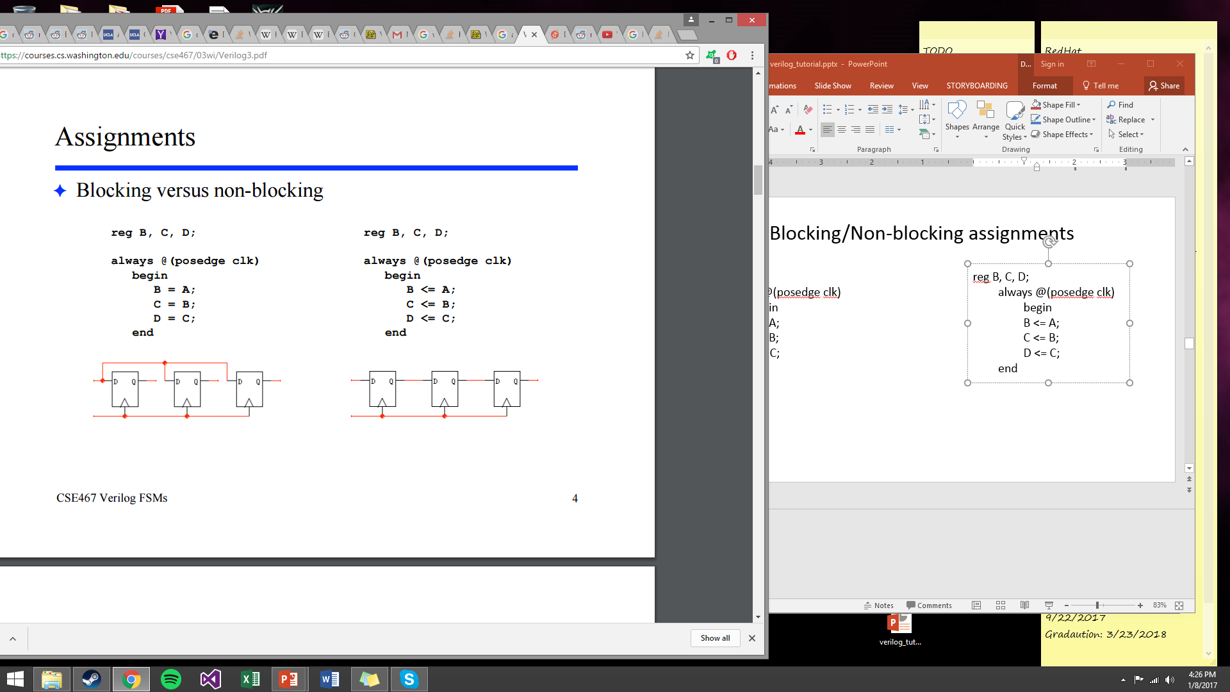
Blocking/Non-blocking assignments
reg B, C, D;
always @(posedge clk)
begin
B = A;
C = B;
D = C;
end
reg B, C, D;
always @(posedge clk)
begin
B <= A;
C <= B;
D <= C;
end

Slide 17
Assignment operator guidelines
Sequential logic: use nonblocking (<=)
Pure combinational logic in “always” block: use blocking (=)
Do not mix blocking/non-blocking in the same “always” block
Both sequential and “combinational” logic in the same “always” block: use non-blocking (<=)
y <= a ^ b;
Recommendation: in complex sequential circuit, use two always blocks, one for combinational circuit, one for state update.

Slide 18
Module instantiation
Achieve hierarchical design by using other modules inside one module.
Recommended format:
type name (.port1(w1),.port2(w2)......);
Port order doesn’t matter
Unused output port allowed
Name must be unique within module

Slide 19
Example
module half_adder(a, b, x, y
);
input a, b;
output x, y;
assign x = a & b;
assign y = a ^ b;
endmodule
module full_adder(a, b, ci, s, co
);
input a, b, ci;
output s, co;
wire g, p, pc;
half_adder h1(.a(a), .b(b), .x(g), .y(p));
half_adder h2(.a(p), .b(ci), .x(pc), .y(s));
assign co = pc | g;
endmodule

Slide 20
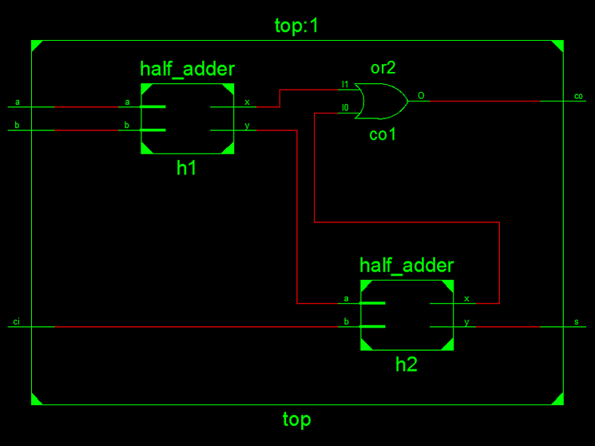
Schematics output

Slide 21
Testbench
Testing is important and engineers spend more time testing for complex digital circuits.
Procedures for creating testbench:
Instantiate unit under test (uut)
Provide input for uut: clk, rst, data...
Simulate and verify behavior

Slide 22
Initial block
initial begin
// Initialize Inputs
clk = 0;
rst = 0;
// Wait 100 ns for global reset to finish
#100;
// Add stimulus here
rst = 1;
#20 rst = 0;
// add verification routine here
#1000 $finish;
end
Initial block starts execution at time 0.
#n : wait n time units
$finish: stop simulation

Slide 23
Parameter
module ALU #(parameter W=4)(a, b, f, z);
input [W-1:0] a, b;
input [1:0] f;
output reg [W-1:0] z;
always @(*)
case (f)
0: z = a + b;
1: z = a * b;
2: z = a & b;
3: z = a | b;
default: z = {(W){1'bx}};
endcase
endmodule

Slide 24
Instantiation of parameterized module:
Default parameter W=4. Instantiate a 16-bit ALU:
Format:
type #(params) name (ports);
Example:
ALU #(.W(16)) alu16 (.a(a), .b(b), .f(f), .z(z));

Slide 25
References
MIT 6.111 course notes,
http://web.mit.edu/6.111/www/f2013/index.html
Verilog in one day,
http://www.asic-world.com/verilog/verilog_one_day.html
Wire vs. Reg,
http://inst.eecs.berkeley.edu/~cs150/Documents/Nets.pdf
Sunburst Design (Read on assignment operators)
http://www.sunburst-design.com/papers/
5. ISE Quick Start Guide
http://cseweb.ucsd.edu/classes/wi11/cse141L/Media/Quick-Tutorial-11.pdf
6. Washington CSE 467 Notes
https://courses.cs.washington.edu/courses/cse467/03wi/Verilog3.pdf

