Slide 1


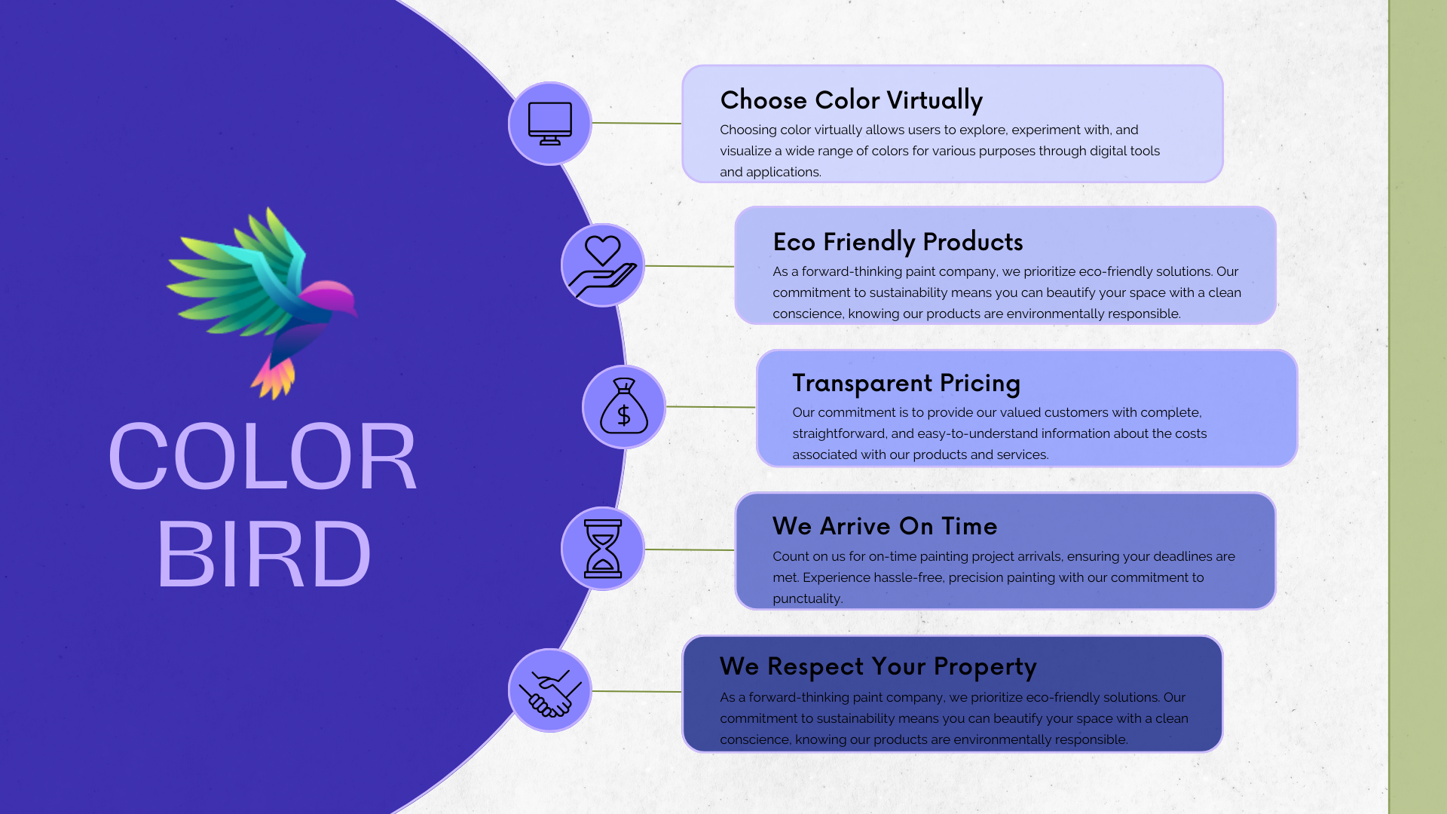
ColorBird
HTML,CSS,JS,BOOTSTRAP
Mohit Sharma ,Mamtesh Gehlot

