Slide 1
Job Manager App
Requirements

Slide 2
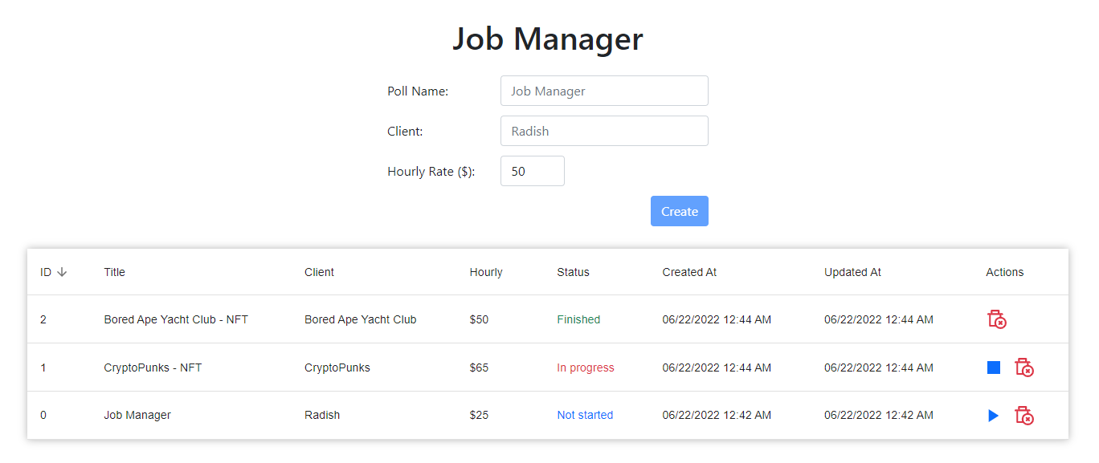
Sketch

Slide 3
Functions
Create
Start
Finish
Remove
Keep items remain when Refresh.
Use all the hooks below in appropriate parts.
useState(), useReducer(), useMemo(), useCallback(), useEffect(), useContext(), useRef()
Do not use Redux!

Slide 4
Create
Put form controls within a form element.
Disable create button when either Job Name or Client is empty.
Clear input boxes after creating a new item.
Set the focus on Poll Name input box at the first load and after creating a new item.
Add created items into the table.
Items should be displayed with their Title, Client, Hourly Rate, Status, Timestamps and Actions Buttons.
useState(), useEffect(), useMemo(), useCallback(), and useRef() are required in this part.

Slide 5
Start, Finish, Remove
Change the status from “Not started” to “In progress” when click Start.
Change the status from “In progress” to “Finished” when click Finish.
Remove the corresponding item from the table when click Remove.
Show confirm dialog for each action.
Place appropriate buttons on Actions column according to the status.
Items should be able to be sorted by all columns.
useState() and useCallback() are required in this part.

Slide 6
Keep items remain when Refresh
Save items to the local storage when any changes.
Load from local storage when Refresh.
useCallback() and useEffect() are required in this part.

Slide 7
Context
Use React Context instead of Redux.
useState(), useReducer(), useCallback(), and useContext() are requied in this part.

Slide 8
Styles and Components
Use react-bootstrap-v5 and @material-ui components.
Use bootstrap classes and @material-ui makeStyles() to style the components.

Slide 9
URL
https://jobman.netlify.app

