Slide 1
Data Fusion
Group 4
Athanasios Athanasopoulos
Chrysanthi Foti
Eleftherios Tetteris
Athanasopoulos Nikolaos
Vasileios Chaidas

Slide 2
Motivation-Introduction

Slide 3
Motivation
Vital to see if plants are healthy or not (e.g. know which fertilizer leads to healthier plants)
Correct classification could lead to higher profit
If we could build model that replaces Experts, the whole process would be automated

Slide 4
Data

Slide 5
Data Structure
Each plant has 2 types of photos: the top view RGB and the side view Grayscale
Each of the 4 Experts gives opinion on whether plant is healthy or not
8 total locations (RFID)
Highly imbalanced dataset (75% healthy-25% unhealthy => Oversampling)

Slide 6
Methods-Approach

Slide 7
Methods
Our axes of fusion were:
Expert Fusion (Low-Level and High-Level)
Image Fusion (Low-Level and Mid-Level)

Slide 8
Expert Fusion
High Level Expert Fusion: Train 1 model for each Expert and then use Majority Voting for final single prediction
Low Level Expert Fusion: Average Experts’ opinions before training any model, and then training a single model (compare with individual models)

Slide 9
Image Fusion
Mid Level Fusion: Extract features from both RGB and Grayscale Images and then concatenate them as final used features (tutorial from PlantCV and then KernelPCA)
Low Level Fusion: Use simple concatenation of RGB and Grayscale Images and use this concatenation as final features

Slide 10
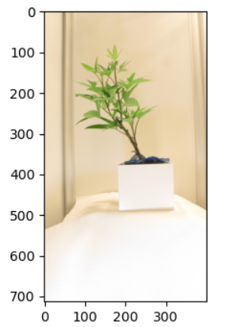
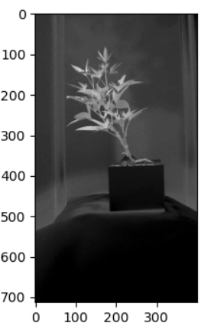
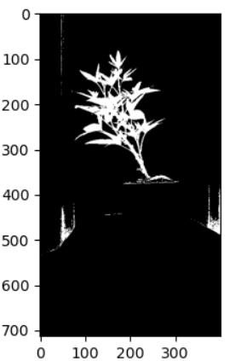
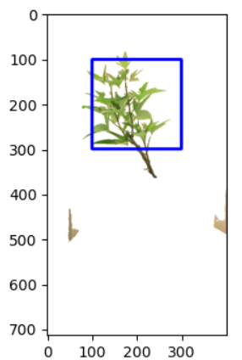
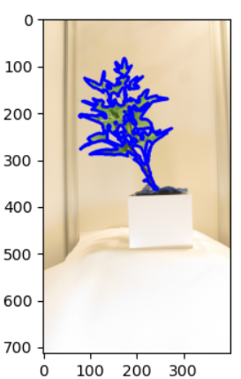
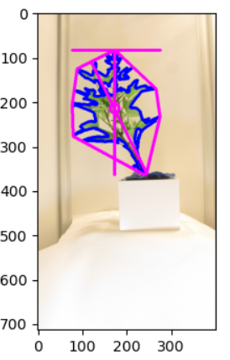
Examples of Feature Extraction

Slide 11
Results

Slide 12
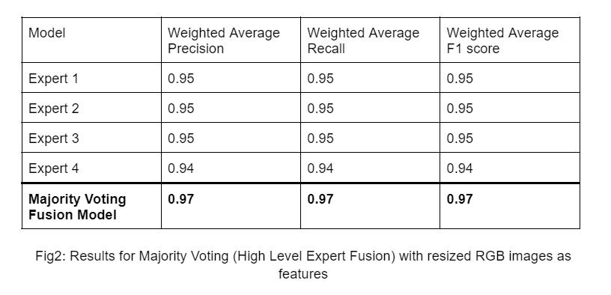
Results-High Level Expert, RGB Image

Slide 13
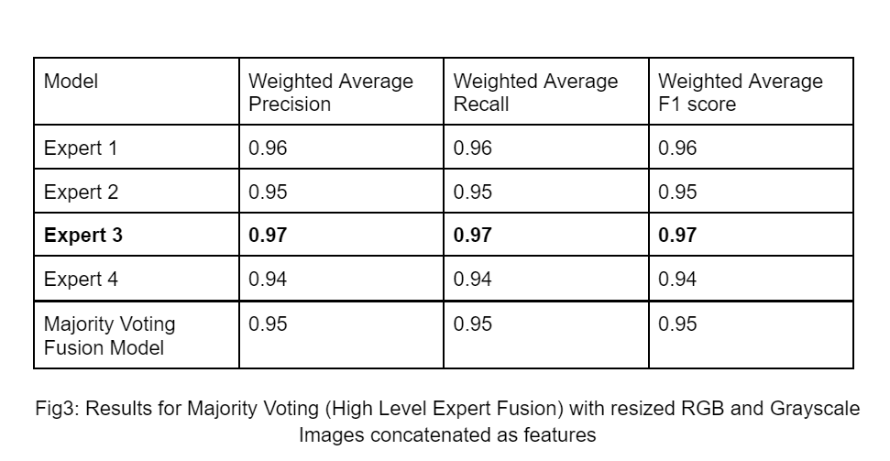
Results-High Level Expert, Low Level Image

Slide 14
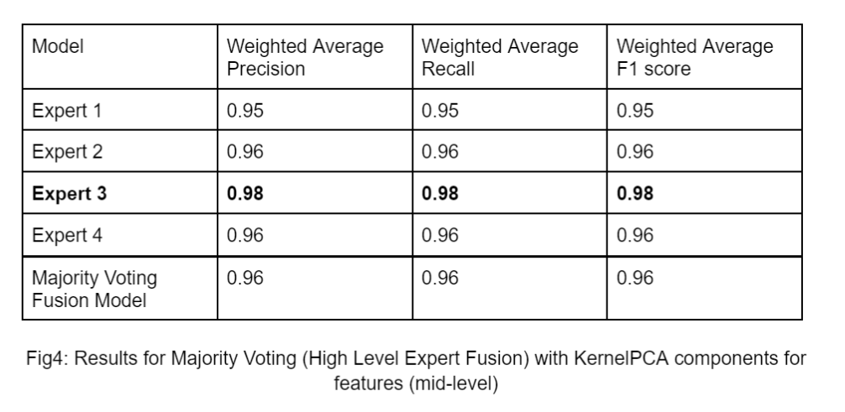
Results-High Level Expert, Mid Level Image

Slide 15
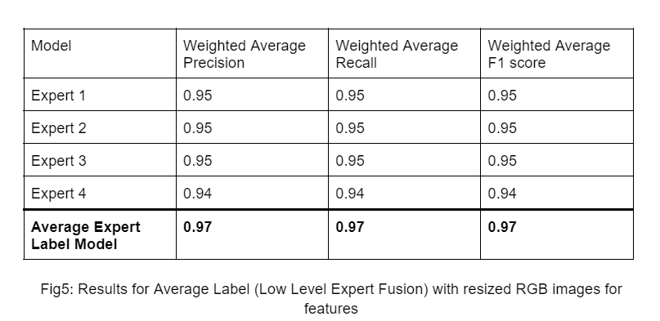
Results-Low Level Expert, RGB Image

Slide 16
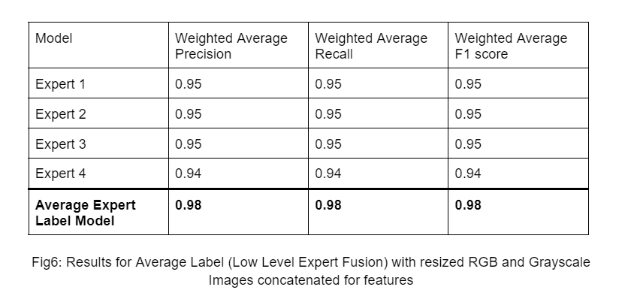
Results-Low Level Expert, Low Level Image

Slide 17
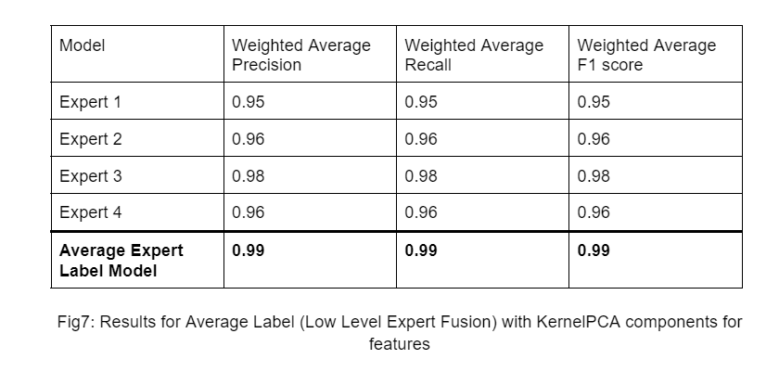
Results-Low Level Expert, Mid Level Image

Slide 18
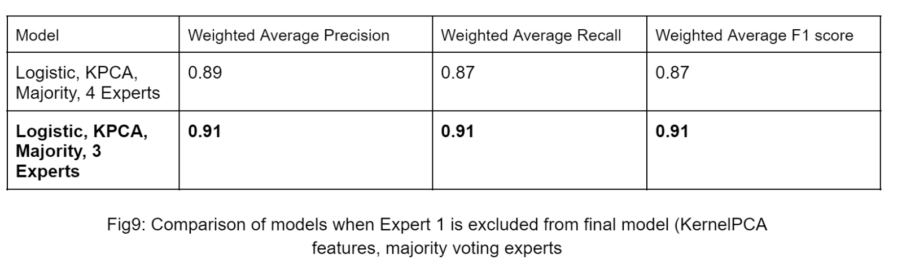
Results-Bonus (excluding Expert 1)

Slide 19
Conclusions

Slide 20
Conclusions
Best overall model is produced by averaging experts’ labels, using 100 KernelPCA features from every pair of images and then building a single model
In most cases, the fusion model outperforms the individual models. When it does not, the difference is at most 1%

Slide 21
Conclusions
This means that to predict the health of a new plant, we need to extract all the features from both its RGB and Grayscale Images, then perform KernelPCA for 100 components, and then feed these features to the model (99%)
If this is too time costly (or complex), the simple average model that uses just the resized image is also good (97%)

Slide 22
Conclusions
So for new predictions, we now do NOT need expert opinions, just the images => cost is reduced
Data Fusion techniques worked great

Slide 23
Future Work
Use more axes of fusion (more complex models)
Probably no point since we already have 99% AUC

Slide 24
Thank you.

