Slide 1
SpaceX Falcon 9 Landing Prediction
IBM Applied Data Science Capstone Project
Prepared by Lucky Singh

Slide 2
Executive Summary
Analyzed SpaceX Falcon 9 launch data using the complete data science lifecycle.
Collected data using API and web scraping techniques.
Performed EDA, SQL analysis, dashboards, and machine learning.
Predicted first-stage landing success using classification models.

Slide 3
Introduction
SpaceX reduces launch costs using reusable rockets.
Landing success prediction helps estimate mission reliability.
Objective: Predict Falcon 9 first-stage landing outcomes.

Slide 4
Data Collection – SpaceX API
Collected launch records using the SpaceX REST API.
Used Python Requests and Pandas for extraction.
Retrieved payload, orbit, launch site, and booster data.
GitHub Repository: Add your GitHub link here.

Slide 5
Data Collection – Web Scraping
Used BeautifulSoup for extracting launch history.
Parsed HTML tables and mission details.
Cleaned and converted scraped data into DataFrames.
GitHub Repository: Add your GitHub link here.

Slide 6
Data Wrangling Methodology
Handled missing values and formatted columns.
Selected important features for analysis.
Converted categorical variables for ML processing.
Prepared cleaned dataset for predictive analysis.

Slide 7
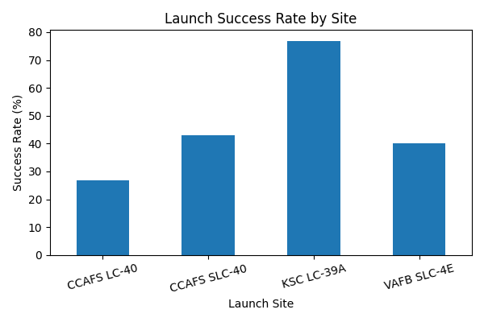
EDA with Visualization
Analyzed launch success across launch sites.
Studied payload impact on launch outcomes.
Visualized trends using bar charts and scatter plots.
Identified operational improvements over time.

Slide 8
EDA with SQL
Performed SQL queries on launch records.
Calculated success rates and payload statistics.
Compared launch sites and mission counts.
Identified top-performing launch locations.

Slide 9
Interactive Visual Analytics
Created Folium maps for launch site visualization.
Developed Plotly Dash dashboard for interactive analysis.
Users can filter launch sites and payload ranges.
Interactive charts improve decision-making and exploration.

Slide 10
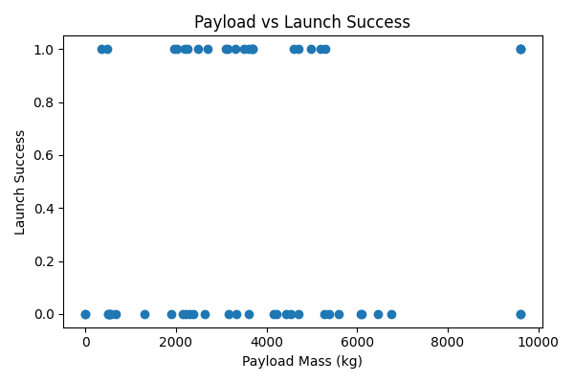
EDA Results – Payload Analysis
Moderate payload ranges achieved better success rates.
Payload mass influences landing outcomes.
Higher payloads may increase mission complexity.

Slide 11
Plotly Dash Dashboard Results
Dashboard includes success pie charts.
Scatter plots compare payload and launch success.
Dropdowns and sliders allow dynamic filtering.
Interactive dashboards simplify exploratory analysis.

Slide 12
Predictive Analysis Methodology
Applied Logistic Regression, SVM, Decision Tree, and KNN.
Used train-test split and feature engineering.
Compared model accuracy and classification performance.
Decision Tree achieved the best overall performance.

Slide 13
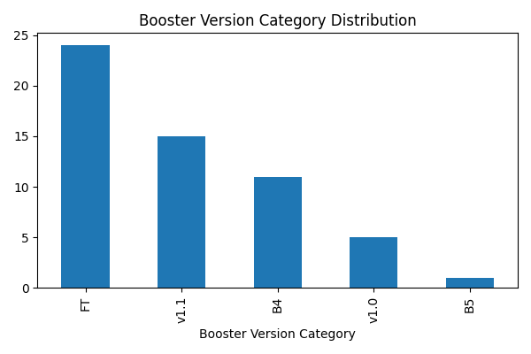
Predictive Analysis Results
Machine learning models successfully predicted landing outcomes.
Decision Tree and SVM showed strong accuracy.
Launch site and payload mass were important predictors.
ML can support mission planning and reliability analysis.

Slide 14
Innovative Insights
Launch success improved significantly over time.
Certain launch sites demonstrated higher reliability.
Payload mass affects landing probability.
Interactive analytics improve user-driven exploration.

Slide 15
Conclusion
Successfully completed end-to-end data science workflow.
Combined data collection, wrangling, EDA, SQL, dashboards, and ML.
Generated meaningful insights into Falcon 9 landing success.
Future work can include real-time prediction systems.

