Slide 1

Produced By,
Shrijt Pandey
Parminder Singh Badwal
Ashish Mahajan
K.C.COLLEGE OF ENGINEERING,THANE

Slide 2
PROBLEM STATEMENT
Designing and developing a method for processing vision data into commands for motion control for autonomous soccer playing robot.
Autonomous robots are robots that can perform various designated tasks by understanding the environment without continuous human guidance.
There will be 2 Spark V robots, one goal-keeper and one striker.
The striker will be human controlled whereas, goal keeper would be fully autonomous.
The striker will try to make a goal and the goal-keeper will try to defend it by moving in the way of the striker.

Slide 3
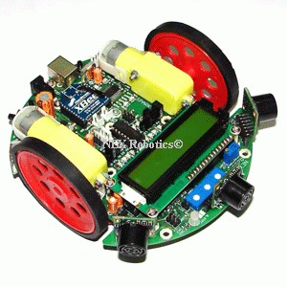
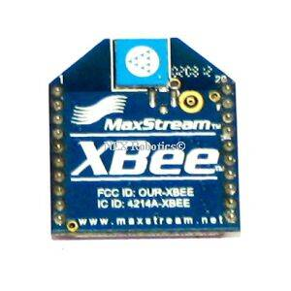

REQUIREMENTS
Hardware requirements
Spark V robots
XBEE modules for wireless communication between robots and computer.
Camera to taking images of the arena.
Software requirements
Win-AVR
OpenCV library
Windows XP or higher

Slide 4
PROJECT PLAN
Study of Spark V robot.
Study of ZigBEE and Image Processing using OPENCV.
Setting up the soccer arena.
Implement and testing of strategies for identification of robot and ball.
Implementation and testing of wireless communication for the robot.
Implementation and testing of motion control strategy.
Implementation and testing of defend algorithm.
Testing the robots together in the soccer arena.

Slide 5
WORK DIVISION
MOTION CONTROL BY PARMINDER SINGH BADWAL.
COMMUNICATION BY ASHISH MAHAJAN.
IMAGE PROCESSING BY SHRIJIT PANDEY.

Slide 6
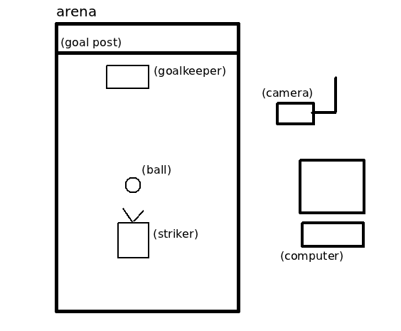
BLOCK DIAGRAM

Slide 7
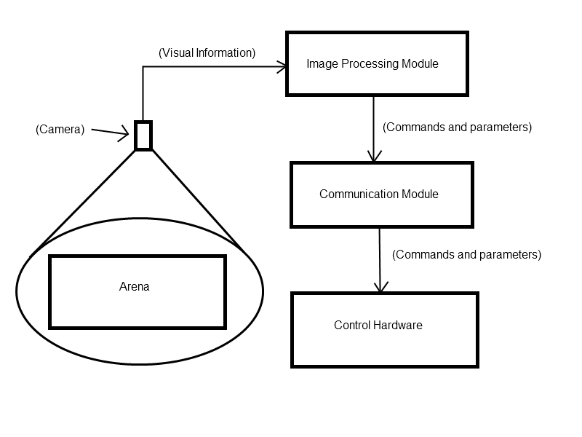
INFORMATION FLOW

Slide 8
TECHNICAL CHALLENGES
Identification of arena, robot and ball.
Tracking ball.
Movement of robot from one point to another point.
Implementing defend algorithm.

Slide 9
IDENTIFICATION OF ARENA, ROBOT AND BALL
Identification is done on the basis of color.
Arena is kept black in color, robot is kept blue and the ball is pink in color.
In order to extract regions corresponding to arena, robot and ball, image from camera is thresholded for colors black, blue and pink.
Input image from camera is in RGB color space. So it is converted to HSV as HSV provides better immunity to noise.
Once thresholding has been done, we perform connected component labeling to identify regions in the image and then extract properties such as area, centroid, bounding box, etc.
These properties are used by the algorithm for decision making.

Slide 10
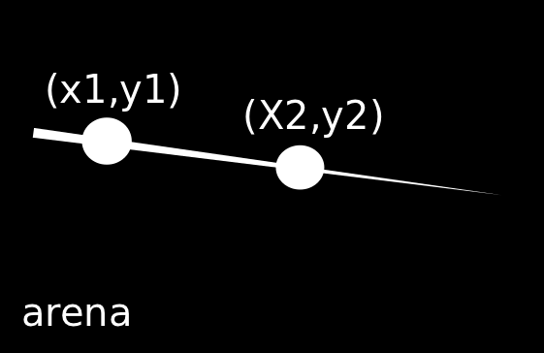
TRACKING THE BALL

Slide 11
MOVING ROBOT FROM ONE POINT TO ANOTHER
There is a limitation in our hardware that at most only one byte of information can be transmitted at one time via the xbee module.
Robot moves by a fixed distance (5 cm) each time it receives a move command.
If we want to move by 15 cm we send move command 3 times.

Slide 12
DEFEND ALGORITHM
Detect the position of ball at time T1.
Sleep for some time.
Detect position of ball again (at time T2).
Calculate slope and intercept for the line passing through the detected positions.
Knowing the x co-ordinate of the goal, we can substitute it in the line equation to get the y- co-ordinate along the goal line or the goal point
If the ball position is within the error range, don’t move the goal keeper robot.
If goal point is greater than the goal keeper position move forward else move backward.

Slide 13
Test Cases
1. | Check whether blobs are detected |  | undetected blobs due to ambient light
2. | Check whether the color of blobs is detected |  | undetected blobs due to ambient light
3. | Check whether centroid of blob is accurately detected or within margin of error |  | undetected blob centroid due to ambient light
4. | Check whether centroid of ball is detected. |  | undetected ball centroid due to ambient light
5. | Check whether centroid of robot marked with colored circles is detected or not |  | undetected blobs due to ambient light

Slide 14
Test Cases Continued…
6. | Check whether XBEE communication between robot and PC takes place |  | serial communication error
7. | Check whether motion control commands are sent via XBEE from PC to robot |  | unsent commands and communication error
8. | Check whether motion control code is burnt properly on robot memory and robot does motion control accordingly |  | serial communication error
9. | Check whether Soccer Defend Algorithm properly detects the goal points. |  | improper goal point out of goal range
10. | Check whether Goalkeeper robot moves towards the goal point and blocks the ball from entering the goal |  | robot moves in wrong direction

Slide 15
Reusability features
We have tried to make each class as generic as possible ensuring reusability in future projects.
Example: our Image processing class (ImageProcessing) has got generic functions which can be used by anyone to get thresholded and smoothed image.

Slide 16
Future Enhancements
The Project can modified for various applications including the following:
Soccer playing swarm with additional intercept states
Teams can be scaled to higher number of robots
A mechanism to hold the ball and push it

Slide 17
THANK YOU

