Slide 1
Password Manager
Secure and Efficient Password Management Solution
Name – Lucky Singh Rawat
University Roll-no. - 2319044

Slide 2
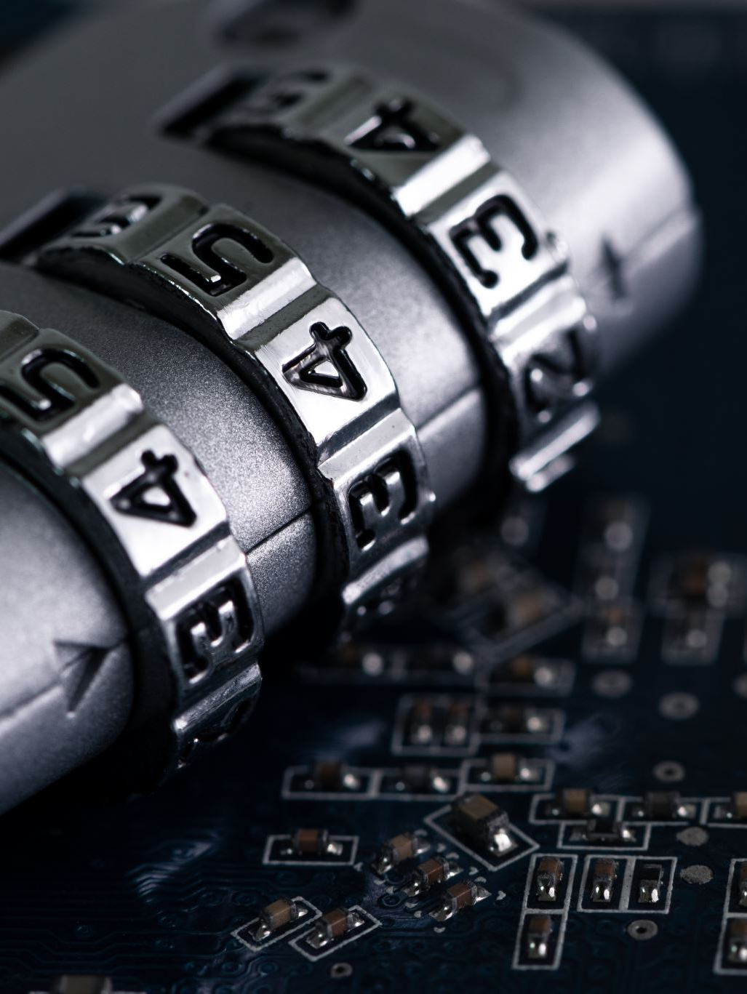
Introduction
Overview of the need for secure password management.
Importance of unique and strong passwords for online security.

Slide 3

Problem Statements
Weak Passwords
Difficulty in Remembering Multiple Passwords
Duplicate Website Names
Vulnerability to Unauthorized Access
Inconsistent Password Policies

Slide 4
Project Goals and Objective
Generate strong passwords
1
Securely store passwords
2
Verify stored passwords
3
Ensure unique website names
4

Slide 5
Password generator module
Functionality to generate strong passwords
Use of random characters, digits, and special characters

Slide 6

Encryption generator module
Use of the cryptography library
Functions for encryption and decryption
Secure storage using symmetric key encryption

Slide 7
Result and discussion
Password Generation: Strong and random passwords
Secure Storage: Encrypted passwords
User Interface: Easy to use and intuitive
Reliability and Usability

Slide 8

Future work
Multi-Factor Authentication
Password Strength Analysis
Cloud Storage Integration
Auto-Fill Capabilities
Mobile Application Development
User Authentication System

Slide 9

Reference
Python Documentation
Cryptography Library
“tkinter” Library
“pyperclip” Library
Other relevant resources

Slide 10
Conclusion
Emphasis on security and usability
Future enhancements and ongoing development

Slide 11
Thank you for watching
..

