Slide 1
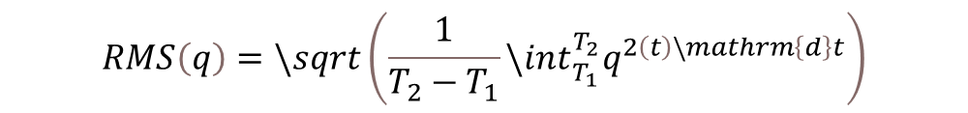
$$RMS\left(q\right)=\backslash sqrt\left(\frac{1}{T_{2}−T_{1}}\backslash int_{T_{1}}^{T_{2}}q^{2\left(t\right)\backslash mathrm\left\{d\right\}t}\right)$$

