Slide 1
WATER LEVEL INDICATOR

Slide 2
INTRODUCTION
What is Water level indicator?
The Water Level Indicator employs a simple mechanism to detect and indicate the water level in an overhead tank or any other water container.

Slide 3
THE SITUATION
• The house where we live in has an overhead tank which is about 30 feet from the ground level.
• We were getting bored going up the rooftop to check whether the tank has filled or the water level was below to start the pump.
• We had to do this again and again. Then we sought for a solution.
• We always used to think of the possibilities of how can this problem be tackled in an electronic way.
• After years of research and by trial and error, we found one and wanted to put whatever we have done out here so that it may be helpful to someone who has a overhead water tank at their homes.
• So we have tried our best efforts to optimise all the resources and have come up with a bright project that could enlighten the future generations

Slide 4
FEATURES
• Easy installation.
• Low maintenance.
• Compact elegant design.
• Avoid seepage of roofs and walls due to overflowing tanks.
• Consume very little energy, ideal for continuous operation
• Shows clear indication of water levels in the overhead tank.

Slide 5
COMPONENTS
FOLLOWING ARE THE REQUIRED COMPONENTS FOR MAKING WATER LEVEL INDICATOR CIRCUIT:
1. RESISTORS
2. TRANSISTOR
3. BUZZER
4. LED
5. CONNECTING WIRES
6. 9V DC BATTERY

Slide 6
RESISTORS
A resistor is a passive two-terminal electrical component that implements electrical resistance as a circuit element. Resistors act to reduce current flow, and, at the same time, act to lower voltage levels within circuits. In electronic circuits resistors are used to limit current flow, to adjust signal levels, terminate transmission lines among other uses. Fixed resistors have resistances that only change slightly with temperature, time or operating voltage. Variable resistors can be used to adjust circuit elements such as a volume control or a lamp dimmer or as sensing devices for heat, light, humidity, force, or chemical activity.

Slide 7
TRANSISITOR
A transistor is a semiconductor device used to amplify and switch electronic signals and electrical power. It is composed of semiconductor material with at least three terminals for connection to an external circuit. A voltage or current applied to one pair of the transistor's terminals changes the current through another pair of terminals. Because the controlled power can be higher than the controlling power, a transistor can amplify a signal. Today, some transistors are packaged individually, but many more are found embedded in integrated circuits.

Slide 8
BUZZER
A buzzer or beeper is an audio signaling device, which may be mechanical, electromechanical, or piezoelectric. Typical uses of buzzers and beepers include alarm devices, timers and confirmation of user input such as a mouse click or keystroke.  Piezoelectric A piezoelectric element may be driven by an oscillating electronic circuit or other audio signal source, driven with a piezoelectric audio amplifier. Sounds commonly used to indicate that a button has been pressed are a click, a ring or a beep.

Slide 9
LED
A light-emitting diode (LED) is a two-lead semiconductor light source. It is a pn-junction diode, which emits light when activated. When a suitable voltage is applied to the leads, electrons are able to recombine with electron holes within the device, releasing energy in the form of photons. This effect is called electroluminescence, and the colour of the light corresponding to the energy of the photon is determined by the energy band gap of the semiconductor.

Slide 10
CONNECTING WIRES
A wire is a single, usually cylindrical, flexible strand or rod of metal. Wires are used to bear mechanical loads or electricity and telecommunications signals. Wire is commonly formed by drawing the metal through a hole in a die or draw plate. Wire gauges come in various standard sizes, as expressed in terms of a gauge number. The term wire is also used more loosely to refer to a bundle of such strands, as in 'multi thread wire', which is more correctly termed a wire rope in mechanics, or a cable in electricity.

Slide 11
DC POWER BATTERY
An electric battery is a device consisting of one or more electrochemical cells that convert stored chemical energy into electrical energy. Each cell contains a positive terminal, or cathode, and a negative terminal, or anode. Electrolytes allow ions to move between the electrodes and terminals, which allows current to flow out of the battery to perform work.
◆ A battery consists of some number of voltaic cells. Each cell consists of two half-cells connected in series by a conductive electrolyte containing anions and cations. One half-cell includes electrolyte and the negative electrode, the electrode to which anions migrate; the other half-cell includes electrolyte and the positive electrode to which cations migrate. Redox reactions power the battery. Cations are reduced at the cathode during charging, while anions are oxidized at the anode during discharge. The electrodes are electrically connected by the electrolyte. A separator allows ions to flow between half-cells, but prevents mixing of the electrolytes

Slide 12
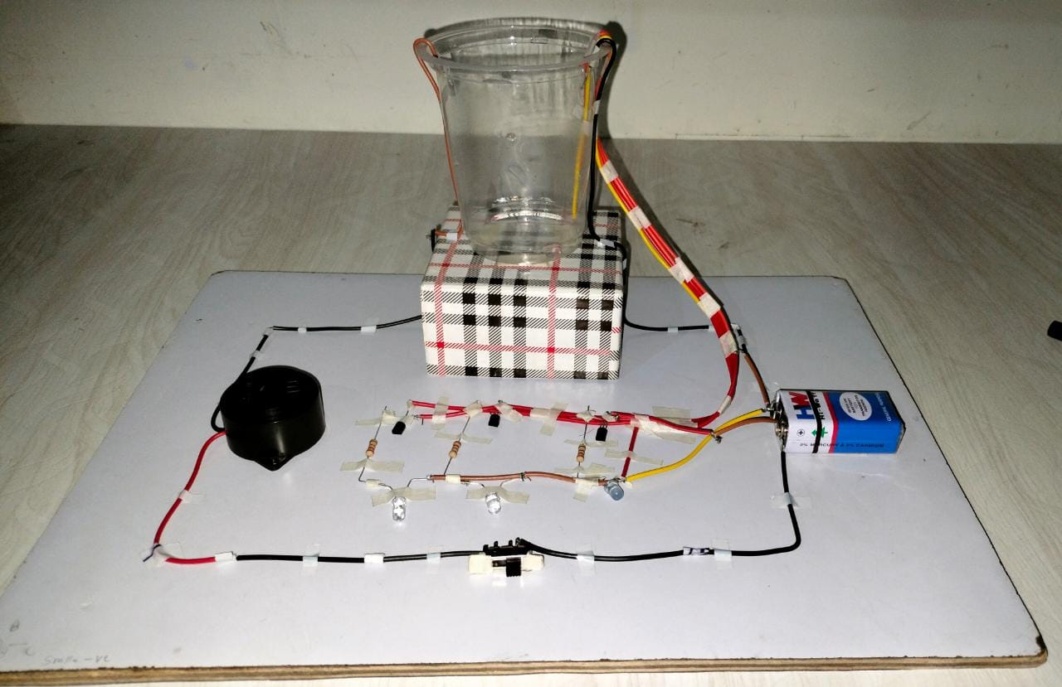
Proto-type :

Slide 13
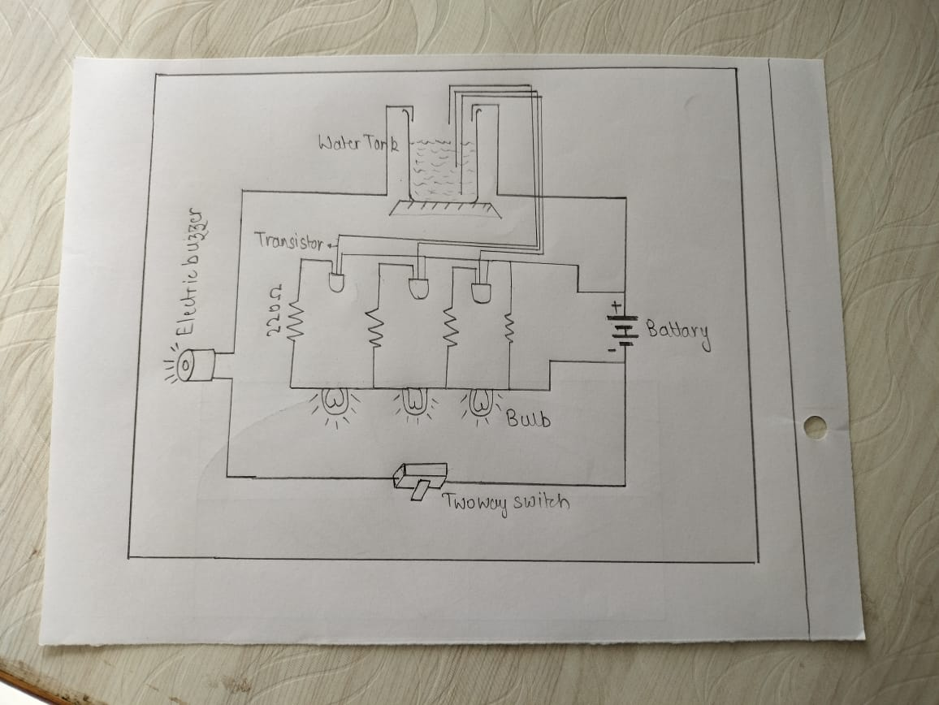
Circuit :

Slide 14
WORKING
The water level indicator employs a simple mechanism
to detect and indicate the water level In an overhead
tank or any other water container.
The operation of this project is very simple and can be
understood easily. In our project there are 3 main
conditions.
(i) when 10% of tank is filled.
(ii) when 50% tank id filled.
(iii) when tank is full.

Slide 15
When 10% tank filed
When then tank is empty there
is no conductive part between any of the 3 indicating
probes and the common probe . So the transistor
emitter region will not have sufficient biasing voltage
hence it remain in cut off region and the output across
its collector will be Vc approximately max and thus
indicate, the tank is empty.

Slide 16
When 50% tank is filled
Now as the water starts filling in the tank a conductive
Path is established between the sensing probes and the
Common probe and the corresponding transistor get
Sufficient biasing at their base.
So , when water reaches 50 % , the transistor get activated
And it is indicated by second LED.

Slide 17
When Tank is full
When , the tank becomes full , the top level probe
get the conductive path through water and the
corresponding transistor gets into conduction not
only displays the level through the third LED but
also activates the continuous buzzer by which user
can understand that tank is full.

Slide 18
Need of water level indicator:
Overflow problems
To Indicate Level of water in any container
To prevent wastage of energy
To prevent wastage of water
To Monitor Liquid Pressure
Observation

Slide 19
Applications
▪ Now no need to go on the roof to check the water level.
▪ Can be used to measure underground storage of water.
▪ Water level Indicator works to maintain a constant water level. (Used in different Plants and Industries)
▪ Alarm starts ringing as soon as tank becomes full.
▪ It helps to check overflow and wastage of water by warning the person when the tank is about to brim.
▪ It can also be used to calculate incoming and out going water in large reservoirs.
▪ It is used to predict the arrival of floods.

Slide 20
PROJECT BY:
LUCKY VISHWAKARMA
-THANK YOU

