Slide 1

NAME :- Lucky Chaurasiya
DATE: 29/04/2026
FINANCIAL CRIME ANALYTICS

Slide 2



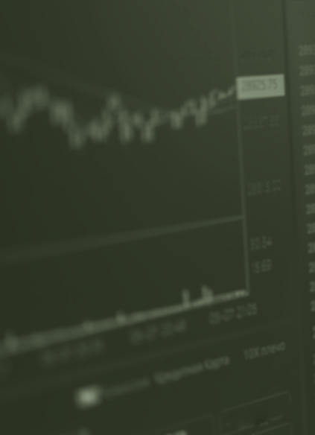
FINANCIAL CRIME ANALYTICS
DATE: 29| 04 |26
1.
2.
3.
4.
Introduction
Our Projects
About Us
Conclusion
Financial crime is a major global issue
Built an end-to-end Financial Crime Analysis Project
Using Python , MySQL and Power BI
Data Analytics helps in identifying financial crime patterns
02

Slide 3

FINANCIAL CRIME ANALYTICS
DATE: 29| 04 |26
PROJECT INTRODUCTION
Financial crime analysis using data analytics.
Bulit with Python ,MySQL and Power Bi.
Identifies high-risk transactions and patterns.
Converts data into actionable insights
03

Slide 4
FINANCIAL CRIME ANALYTICS
DATE: 29| 04 |26
Data Collection & Cleaning
Collected Financial transaction dataset
Handled missing values and inconsistencies
PROJECT OVERVIEW
Data Storage (My SQL)
Designed structured database schema.
Created tables for transactions ,countries and risk data
This project analyzes global financial transactions to identify money laundering risks. Using Python , MySQL , and Power BI ,we built a system that detects high-risk patterns and visualizes key insights
Data Analysis (Python)
Analysis money laundering risk patterns
Compared risk scores across countries and transaction types
Data Visualization (Power BI)
Build interactive dashboard
Key KPIs :Total Money Flow , High-Risk Transaction , Avg Risk Score
04

Slide 5
FINANCIAL CRIME ANALYTICS
DATE: 29| 04 |26
ABOUT THE PROJECT
During this project, we faced multiple challenges while working with real-world financial data. The dataset was initially unstructured, with missing values and inconsistent formats, especially in the date column. This caused errors during analysis, which we resolved by cleaning the data using Python (Pandas) and converting all date values into a proper format.
Another major issue was that raw data did not provide clear insights. To solve this, we applied grouping and aggregation techniques to analyze patterns such as country-wise risk, transaction types, and shell company involvement. Managing a large dataset was also difficult, so we stored the data in MySQL, which allowed us to perform efficient queries and structured analysis.
Finally, understanding the results in raw form was not practical. To address this, we built an interactive dashboard in Power BI that visually represents key metrics like total money flow, high-risk transactions, and risk distribution across countries. This made the data easy to interpret and helped in identifying suspicious patterns effectively.
05

Slide 6
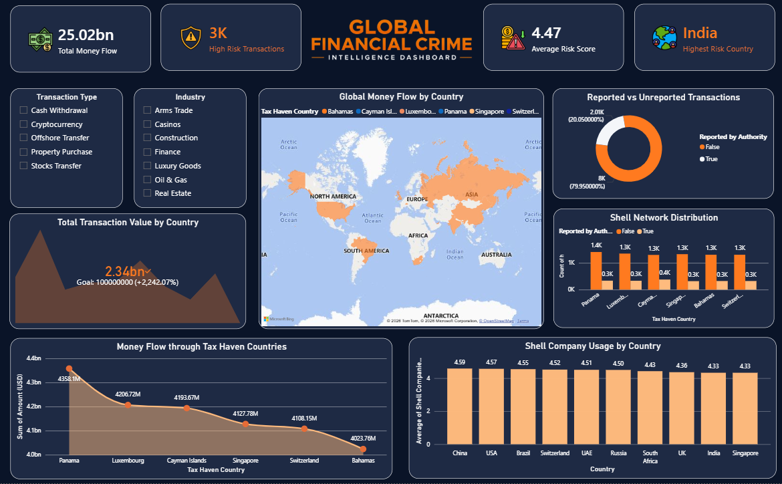
DASHBOARD

Slide 7
WHAT I LEARND
DATA CLEANING WITH PYTHON
DATA VISULIZATION SKILLS
SQL FOR DATA ANALYSIS
PATTERN IDENTIFICATION USING AGGREGATION
07

Slide 8
CHALLENGES
DATA CLEANING ISSUES
LARGE DATA HANDLING
SQL QUERY CHALLENGES
DATA CONVERSION ERRORS
08

Slide 9

CONCLUSION
Data-driven analysis enables faster and smarter detection of financial crime

Slide 10





FINANCIAL CRIME ANALYTICS
DATE: 29| 04 |26
CONTACT US
https://github.com/LuckyWa3957T
6264321059
chaurasiyalucky241@gmail.com
luckychaurasiyaji@gmail.com
www.linkedin.com/in/lucky-chaurasiya-b46986392
10

