Slide 1




CONCURRENT PROGRAMMING · CT074-3-2
Smart Laundry Facility
Simulation
Modelling safe concurrent access to 6 washers, 4 dryers, and 2 payment kiosks across 50 independent customer threads.
6 Washers
4 Dryers
2 Kiosks
50 Customers
Lucky Rajkarnikar · NP070226 · Techspire College

Slide 2
01 · INTRODUCTION & BACKGROUND
A facility built for contention
A self-service laundromat with only 12 total machines must serve 50 arriving customers — deliberately far more demand than supply.
Each customer is modelled as an independent thread that must safely acquire a washer, a dryer, and a kiosk in turn without corrupting shared state.
The program must distribute machines fairly — never handing the same washer to two customers at once, and never skewing the recorded statistics.
6
4
Washing
machines
Drying
machines
2
50
Payment
kiosks
Customer
threads
SMART LAUNDRY FACILITY SIMULATION
02

Slide 3
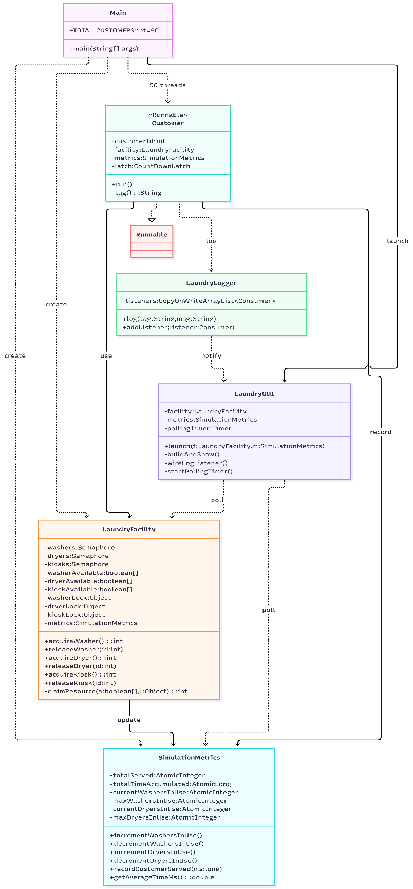






01 · INTRODUCTION & BACKGROUND
Nine classes, one clean pipeline
Main
Creates the pool, staggers arrivals, awaits the latch.
Customer
Runnable carrying one customer through wash → dry → pay.
LaundryFacility
Central resource monitor: fair semaphores + locked ID claims.
SimulationMetrics
Lock-free statistics via Atomic counters and CAS.
FailureSimulator
Generates the 5% washer / kiosk failure events.
LaundryLogger
Synchronized, timestamped logging; notifies GUI listeners.
LaundryGUI
Swing dashboard confined to the Event Dispatch Thread.
SMART LAUNDRY FACILITY SIMULATION
Fig. Class relationships & data flow
03

Slide 4
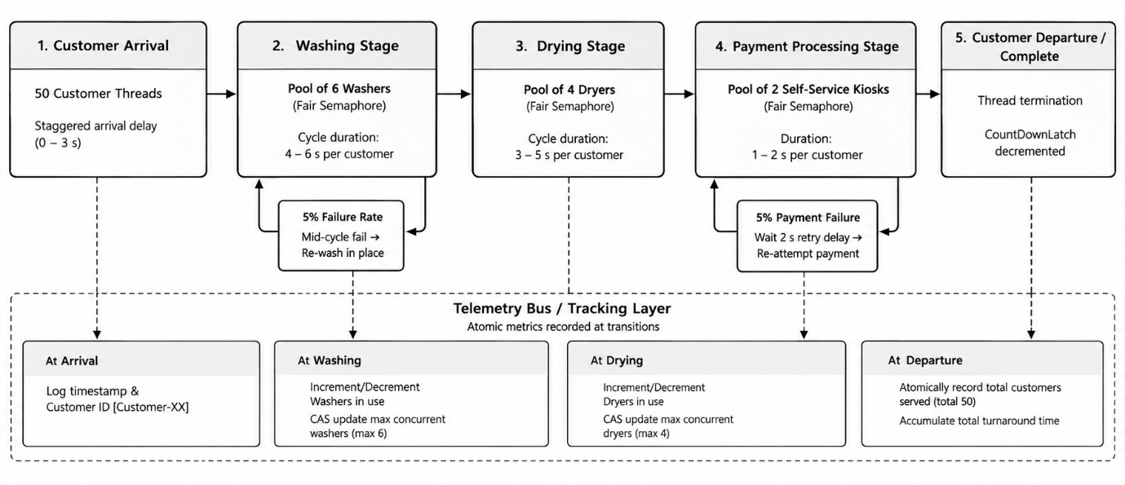
01 · INTRODUCTION & BACKGROUND
The customer pipeline
Every one of the 50 customer threads follows the same five-stage journey, with atomic telemetry recorded at each transition.
SMART LAUNDRY FACILITY SIMULATION
04

Slide 5





01 · INTRODUCTION & BACKGROUND
Key design assumptions
Single thread per customer
No dual machine occupancy
Each customer runs as one isolated task in an ExecutorService — readable as ordinary sequential code.
A washer is released before a dryer is requested, and a dryer before a kiosk — never two machines at once.
50 customers vs. 12 machines
Fair (FIFO) semaphores
The imbalance is deliberate: it guarantees contention and queueing rather than idle, uncontested machines.
Every semaphore is created fair, so the longest-waiting customer is always served next.
Uniform random timing
Mechanical failure model
Arrivals (0–3s) and service times follow the brief exactly — simple, and it still stresses the semaphores.
5% independent failure chance per attempt; the same machine is retried rather than abandoned.
SMART LAUNDRY FACILITY SIMULATION
05

Slide 6
02 · SAFETY ASPECTS
Shared resources & the risks they carry
Shared resource
Risk without protection
Protection used
Availability arrays
Two threads read the same machine as free and both claim it.
Dedicated lock object around every claim / release.
Counters (served, time)
Read-increment-write is not atomic — concurrent updates overwrite each other.
AtomicInteger / AtomicLong.
Peak marks (max in-use)
A check-then-set on the maximum can act on a stale value.
Compare-and-swap (CAS) retry loop.
System.out logging
Characters and lines from different threads interleave.
Single synchronized logging method.
SMART LAUNDRY FACILITY SIMULATION
06

Slide 7
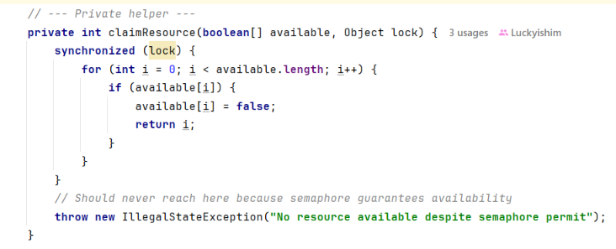
02 · SAFETY ASPECTS
Preventing races & interference
Small, dedicated locks: washers, dryers, and kiosks each guard their own index array — a single facility-wide lock would force every customer to wait on every other.
java.util.concurrent.atomic classes handle all statistics, backed directly by hardware atomic instructions rather than manual locking.
Permits (via Semaphore) and machine-ID selection are handled as two separate steps — the semaphore enforces the population limit, then a short synchronized block hands out a free index.
Fig. Synchronized critical section — machine-ID assignment
SMART LAUNDRY FACILITY SIMULATION
07

Slide 8
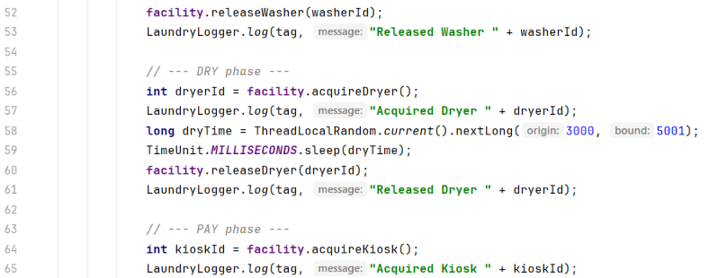
02 · SAFETY ASPECTS
Removing hold-and-wait
A deadlock needs all four conditions at once: mutual exclusion, hold-and-wait, no preemption, circular wait.
Mutual exclusion and no-preemption can't be removed — a washing machine can't be shared or interrupted mid-cycle.
So the design removes hold-and-wait instead: releaseWasher() runs before acquireDryer(), and releaseDryer() before acquireKiosk().
A customer therefore never holds one machine while blocked waiting for another — and deadlock cannot occur without hold-and-wait.
Fig. Release-before-acquire resource ordering
SMART LAUNDRY FACILITY SIMULATION
08

Slide 9

02 · SAFETY ASPECTS
No one waits forever
Fig. Fair semaphore construction — Semaphore(n, true)
FIFO fairness
Fair-mode semaphores queue waiting threads in FIFO order, so the longest-waiting customer always receives the next free permit — preventing starvation.
Retry loops never spin: after a failed payment, the customer thread sleeps 2 seconds via TimeUnit.SECONDS.sleep(2), freeing the CPU for other threads and preventing livelock.
Oldest customer in the queue → next permit released, every time.
2s
Sleep-based retry delay on payment failure — CPU stays free for other threads.
SMART LAUNDRY FACILITY SIMULATION
09

Slide 10
03 · CODING TECHNIQUE JUSTIFICATION
Choosing the right tool for each job
Semaphore(n, true)
synchronized block
ReentrantLock + Condition
Fixed pool of N identical permits, with a built-in fair queue.
Simple mutual exclusion & memory visibility on a single object.
Explicit lock, tryLock, and true condition variables.
USED FOR
USED FOR
USED FOR
Washers, dryers, kiosks
Machine-index claim & release
Owner-arrival bonus scenario
Best fit for resource pools
Poor fit — needs manual wait/notify
Used where semaphores aren't enough
SMART LAUNDRY FACILITY SIMULATION
10

Slide 11
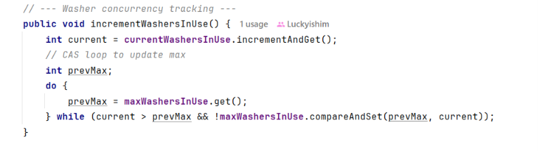
03 · CODING TECHNIQUE JUSTIFICATION
Lock-free statistics with CAS
SimulationMetrics uses AtomicInteger / AtomicLong so recording a statistic never blocks a customer thread.
Peak-usage counters need a read, a compare, and a write — done lock-free with a compare-and-swap loop.
If another thread updates the maximum first, compareAndSet() simply fails and retries with the fresh value — the stored peak can only increase, and always settles correctly.
Fig. Compare-and-swap retry loop in Washer
SMART LAUNDRY FACILITY SIMULATION
11

Slide 12
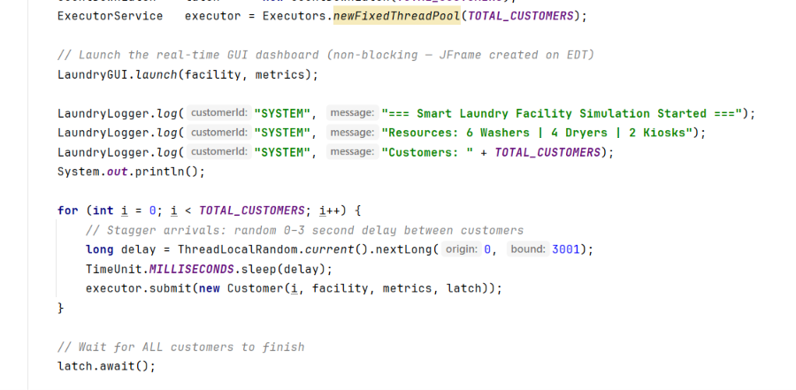
03 · CODING TECHNIQUE JUSTIFICATION
Thread pool & clean shutdown
All 50 customers are submitted to Executors.newFixedThreadPool(50) rather than created as raw Thread objects — the pool offers shutdown() and awaitTermination() for a clean exit.
Main creates a CountDownLatch(50) and calls await(); each customer calls countDown() in a finally block, so the latch releases even if a customer throws.
The alternative — a polling loop like while(served < 50) sleep(100) — wastes CPU and can delay completion by up to one polling period.
Fig. Latch creation & await in Main
SMART LAUNDRY FACILITY SIMULATION
12

Slide 13
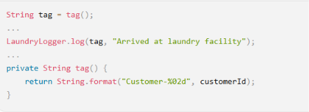

03 · CODING TECHNIQUE JUSTIFICATION
Thread-safe logging & the EDT
One synchronized log() method
Every event is timestamped and printed in a single shot, so lines from different threads never interleave.
Observer pattern
A CopyOnWriteArrayList<Consumer<String>> holds listeners; the GUI registers itself without customer threads knowing Swing exists.
Event Dispatch Thread confinement
Fig. Per-thread tag — no thread logs for another
Swing components are built and updated only via SwingUtilities.invokeLater() — a javax.swing.Timer polls atomics every 500ms on the EDT.
SMART LAUNDRY FACILITY SIMULATION
13

Slide 14
04 · REQUIREMENTS FULFILMENT
Requirements met
BASIC REQUIREMENTS — ALL MET
ADDITIONAL REQUIREMENTS — ALL MET
✓
Customer arrival
✓
Mutual exclusion
50 tasks, random 0–3,000ms staggered delay
Fair semaphores + synchronized ID claims
✓
Washing stage
✓
Error handling
Semaphore(6, true); 4–6s per cycle
5% washer / 5% kiosk retry via FailureSimulator
✓
Drying stage
✓
Statistics
Semaphore(4, true); 3–5s per cycle
Atomic counters, printed by MetricsReporter
✓
Payment stage
✓
Concurrency visibility
Semaphore(2, true); 1–2s per cycle
Thread-tagged logs show simultaneous use
SMART LAUNDRY FACILITY SIMULATION
14

Slide 15
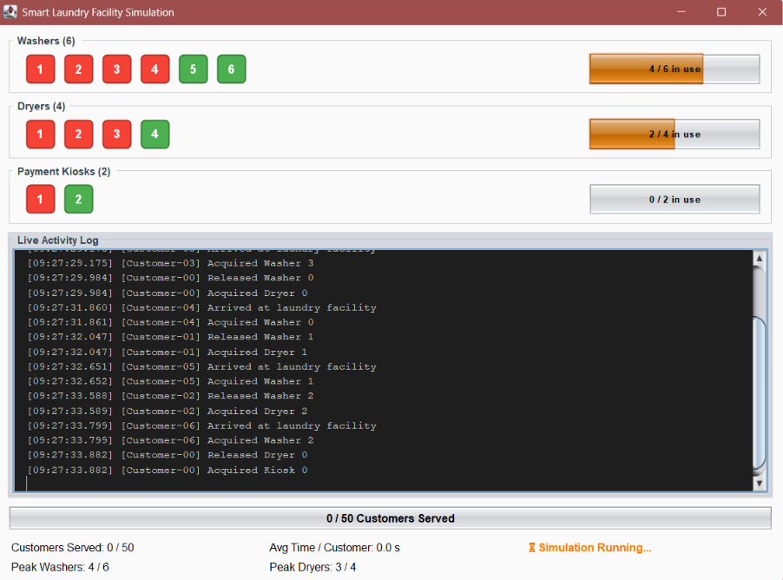
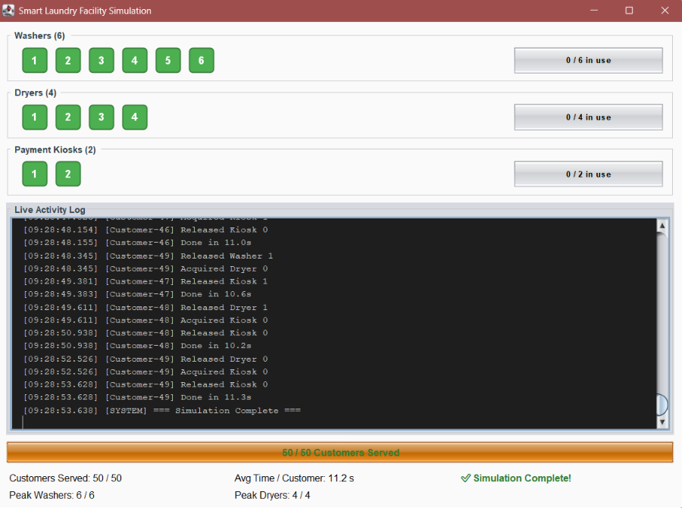
04 · REQUIREMENTS FULFILMENT
Bonus dashboard & live results
50/50
Customers served
11.2s
Avg turnaround
6/6, 4/4
Peak concurrency
~87s
Total run time
Fig. Mid-run — washers/dryers in active use
Fig. 50/50 served — simulation complete
SMART LAUNDRY FACILITY SIMULATION
15

Slide 16
CONCLUSION
A verified, deadlock-free simulation
50 autonomous customer threads move through washing, drying, and payment using fair counting semaphores for each resource pool.
Dedicated synchronized sections allocate machine IDs; lock-free CAS operations record telemetry without ever blocking a customer.
Hold-and-wait is eliminated by releasing each machine before the next is requested — deadlock cannot occur by design.
50/50
served
11.2s
avg time
6/6 · 4/4
peak use
~87s
duration
Lucky Rajkarnikar · NP070226 · Concurrent Programming CT074-3-2
16

