Slide 1
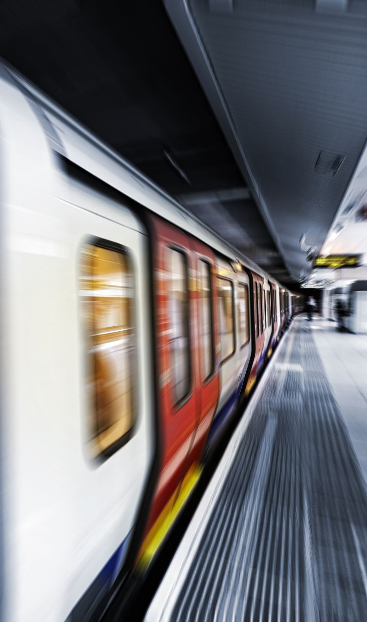
Railway Chatbot Website
Developed by:Lucky Kesharwani
Technology: HTML, CSS, IBM Watsonx Assistant

Slide 2
Problem Statement
Railway passengers often face difficulty getting quick information about train schedules, booking help, and support.
Traditional support systems are slow or unavailable at all times.

Slide 3

Project Objective
• Create a simple railway information website
• Integrate an AI chatbot for instant assistance
• Provide user-friendly interface for passengers
• Deploy the system on cloud using AWS

Slide 4
Technologies Used
• HTML – Website structure
• CSS – Website styling
• IBM Watsonx Assistant – AI chatbot

Slide 5
System Architecture
User → Web Browser → Railway Website
Website → Watsonx Assistant API
Chatbot processes user queries and returns responses.

Slide 6

Working of the System
User opens railway website
User interacts with chatbot
Chatbot processes query using NLP
Response is generated and displayed to the user

Slide 7
Chatbot Integration
• IBM Watsonx Assistant used to build chatbot
• Intents and entities created for user queries
• Chatbot embedded into website using Web Chat script

Slide 8

Features of the Project
• Train schedule display
• Ticket booking interface
• AI powered chatbot support
• Simple and user-friendly interface

Slide 9
Future Scope
• Connect real railway API for live train data
• Add user authentication
• Mobile responsive design
• Advanced AI chatbot with more features

Slide 10

Conclusion
This project demonstrates integration of web development, AI chatbot technology, and local deployment to provide a simple railway support system.

