Slide 1
Rising Rates and housing Impact
Justin Bernier, Ankita Sarkar, Kimberly Sernett

Slide 2
Introduction
Objective:
See if the changes in the federal funds rates and mortgage rates are having an impact on the real estate markets in the Austin area.
Impacts we focused on included housing sale prices, inventory, and whether homes are being sold above or below listing price.

Slide 3
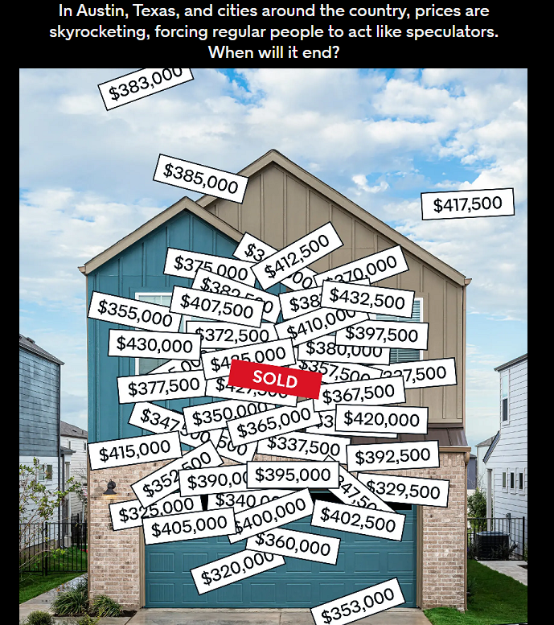
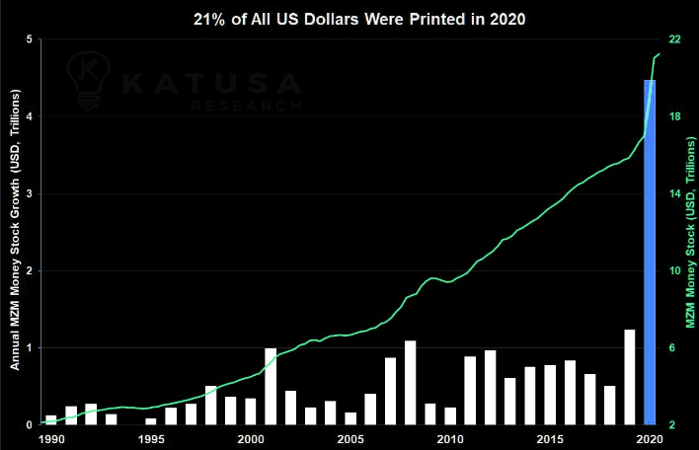
Austin, TX
Known as a hot real estate market
Fed set lending rates to near 0% in 2020
~4 trillion US Dollars printed in reaction to Covid

Slide 4
Hypothesis
Fed rate increases are impacting the Austin real estate market by slowing it down.

Slide 5
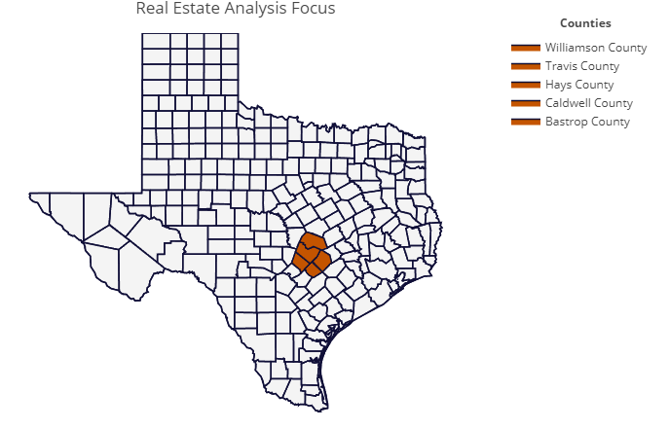
Geographic focus

Slide 6
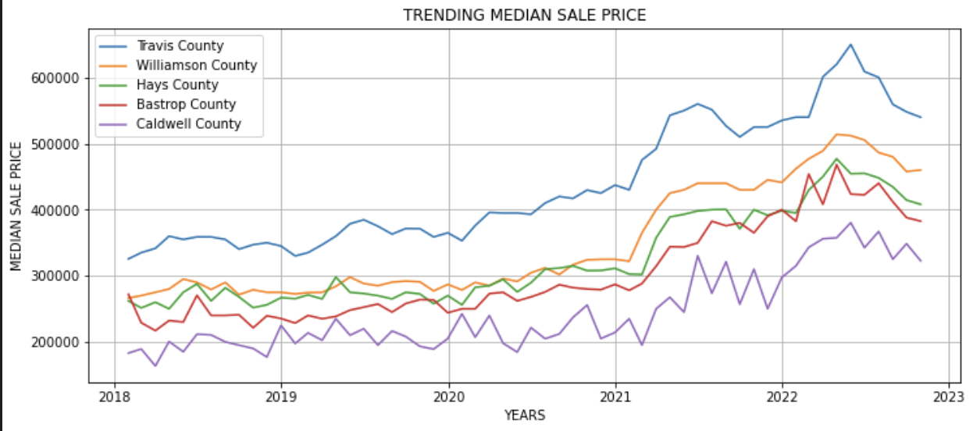
Trending median sale price

Slide 7
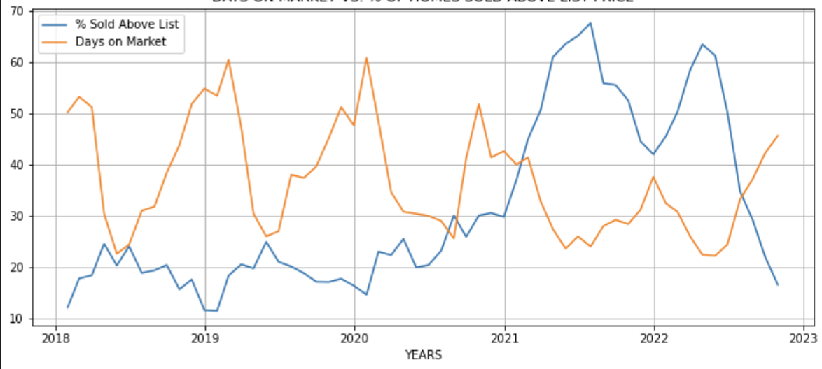
Days on market vs. % of homes sold above list price

Slide 8
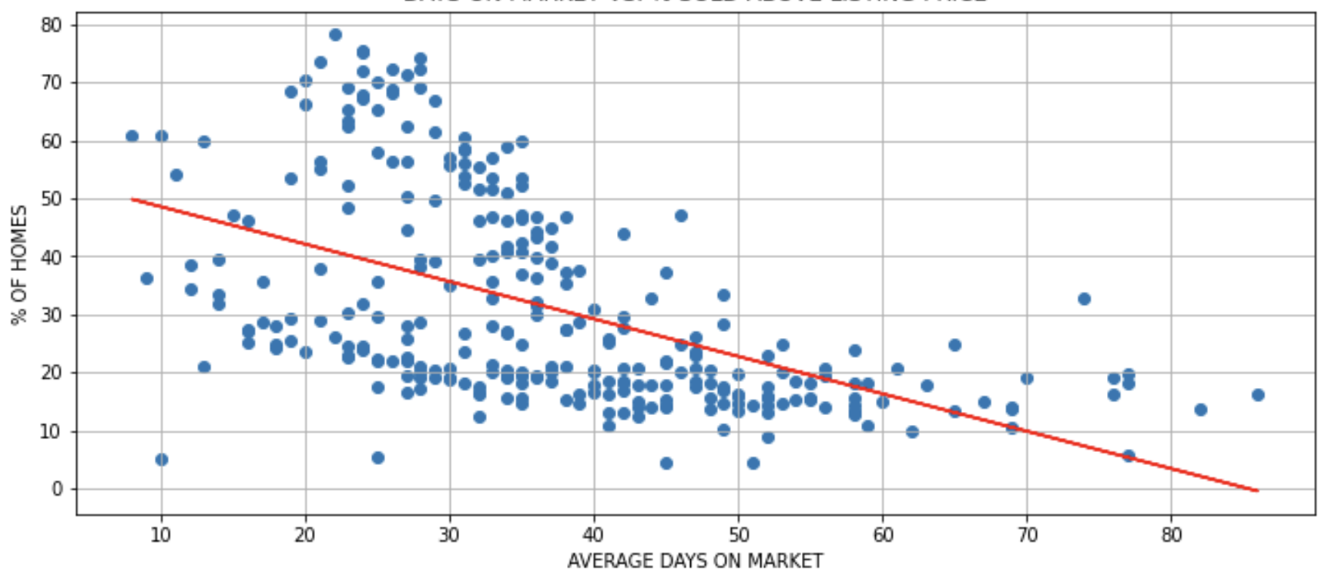
Days on market vs. % sold above listing price

Slide 9
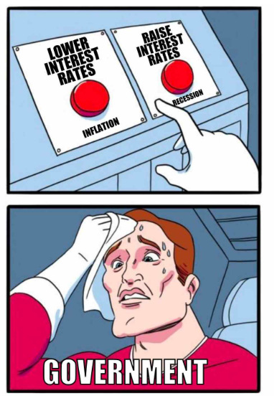
What is FED RATE?
Fiscal tool to regulate flow of money in the economy.
Rate at which commercial lenders/banks borrow.
Affects mortgage loan rates.
Pic source
Notes:
Pic source
We wanted to delve deeper into why there was such a sudden swing in home sale prices. Naturally, we looked at the Fed Rate data for last five years and found a negative correlation between fed rate and home prices. So what exactly is Fed Rate? Fed rate is the rate at which financial institutions borrow from the federal reserve to further lend to people. It is a fiscal tool which helps our government control flow of money in an economy. So, when the Fed Rate is high consequently different mortgage rates are higher as lenders pay more to reserve bank to borrow.

Slide 10
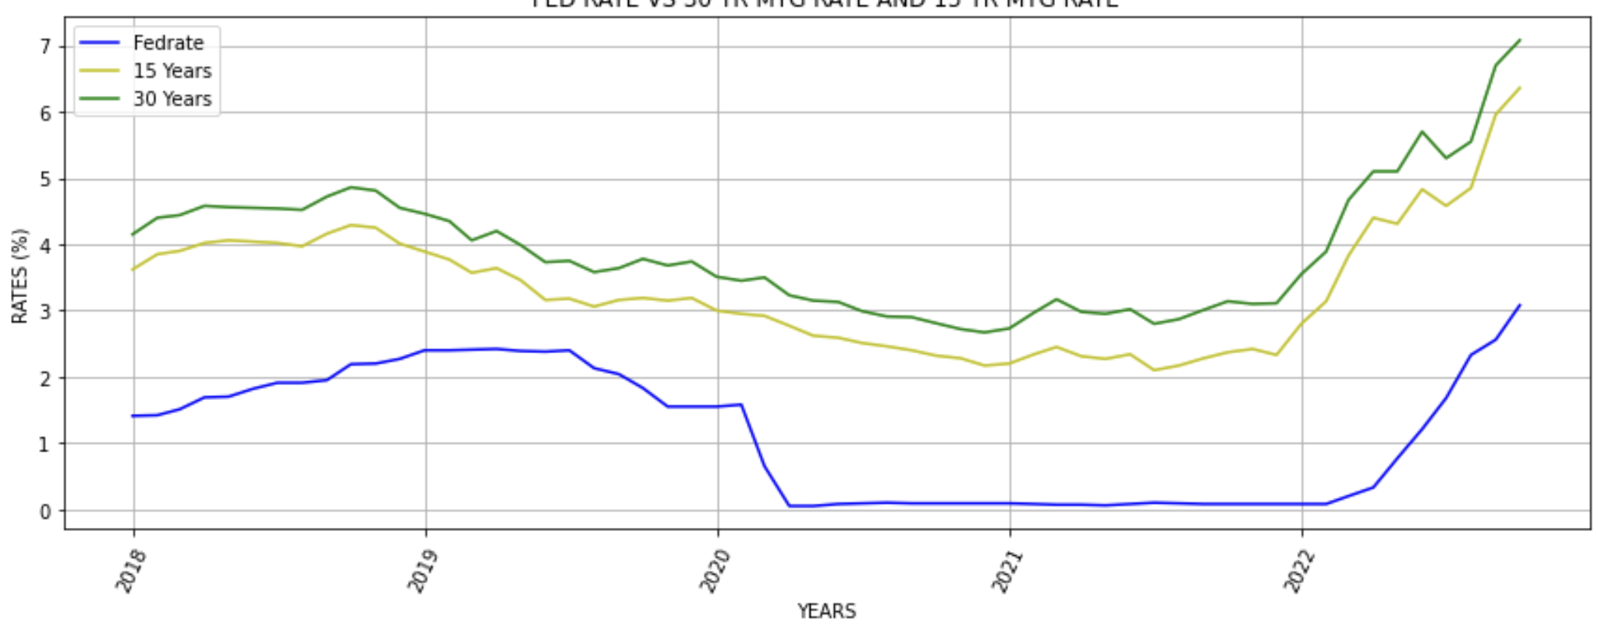
Fed rate vs. 30-year mtg rate and 15-year mtg rate
Notes:
We did a data analysis of how the fed rates impacted the mortgage rates. We focused on two main rate products - 30 yr and 15 yr fixed conventional mortgage rate. And here is the time series analysis for last five years. This shows right that at the start of the pandemic, the federal reserve, dropped the rate drastically to almost near zero therefore the mortgage lenders dropped the rates to an all-time low of under 3% region for both products as well. And in two years, by March 2022, the fed rate started rising consequently mortgage rates rose as well.

Slide 11
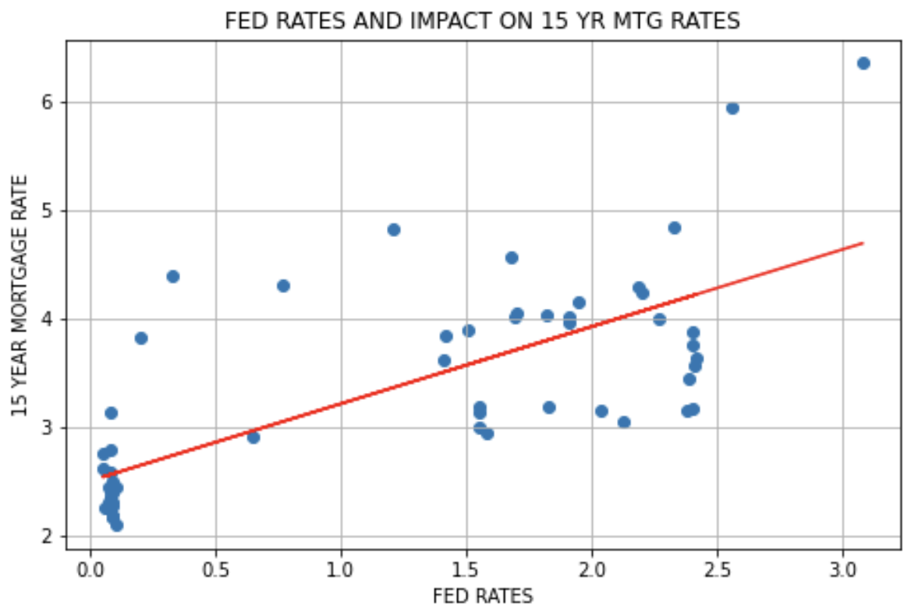
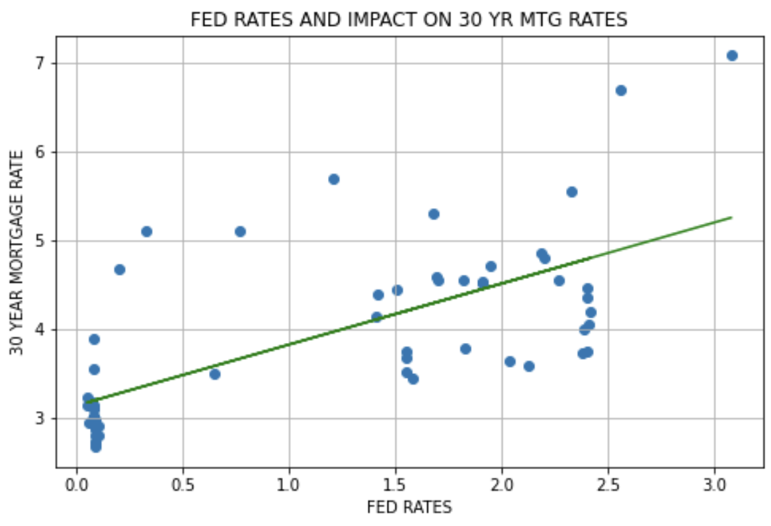
R = 0.73
R = 0.69
Notes:
Here is the regression analysis of the two types of rates. This shows a positive correlation coefficient both types of loan however the 15 year rose higher as compared to a 30 year.

Slide 12
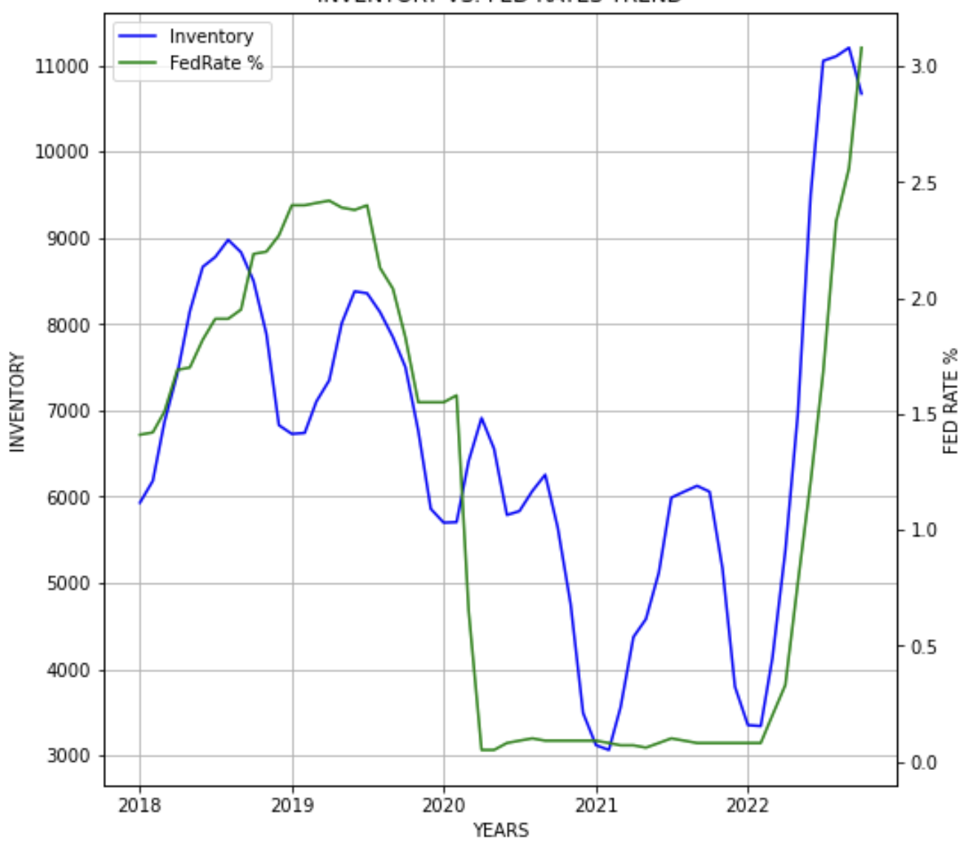
Inventory vs. fed rates trend

Slide 13
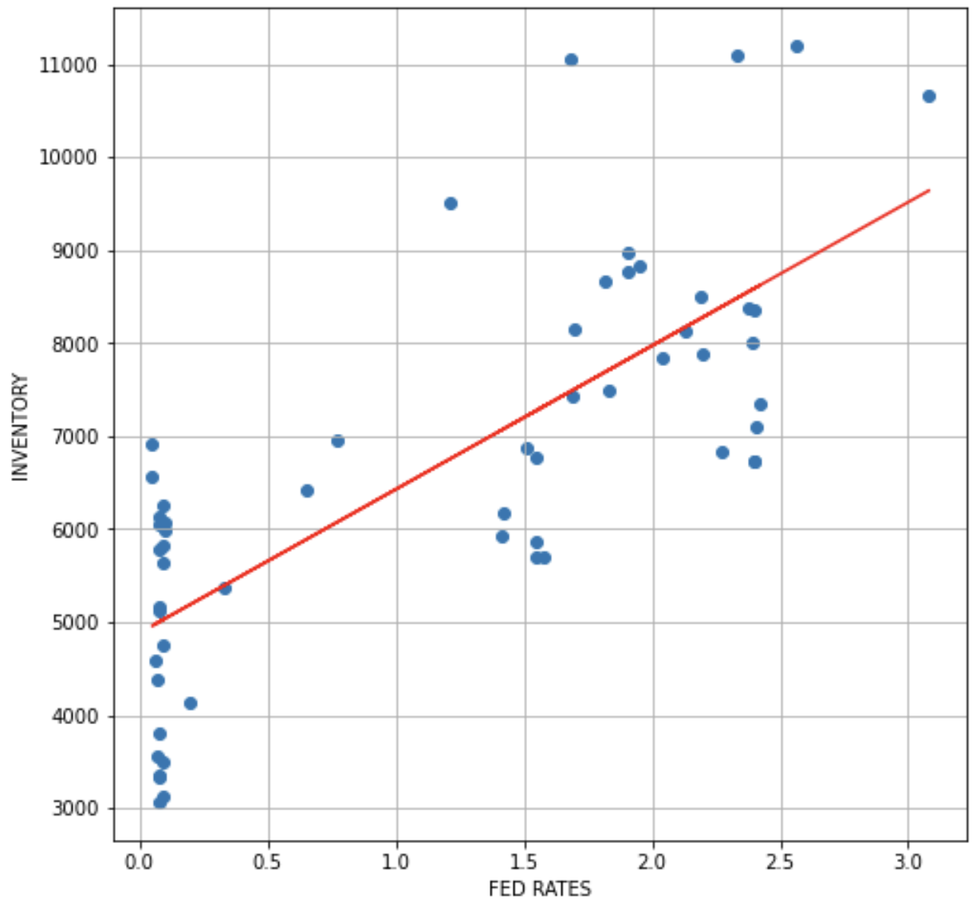
Inventory vs. fed rates correlation

Slide 14
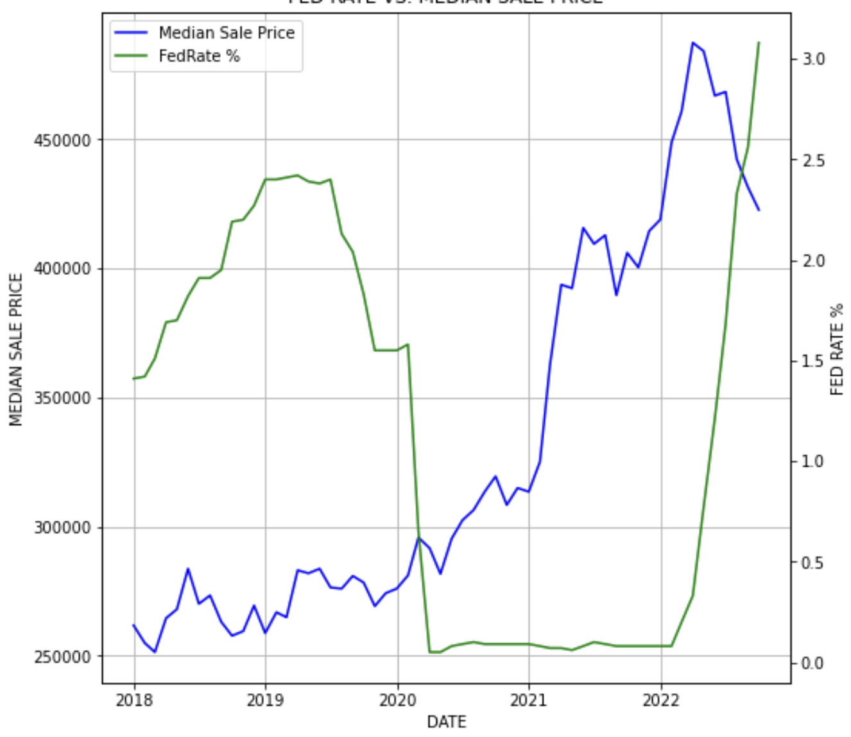
Fed rate vs. median sale price

Slide 15
SUMMARY
Summary 1
Summary 2
Summary 3

Slide 16
Thank you!

