Slide 1
VEHICLE RENTAL MANAGEMENT SYSTEM
DBMS CORNERSTONE PROJECT
TEAM MEMBERS
G.LAKSHMI GANESH - 25B11CS287
Y.SIVA SAINATH - 25B11CSA56
Y.GANESH PAVAN - 25B11CSA57
P.RAVI SHANKAR - 25B11CSA77

Slide 2
1. Problem Statement
• Vehicle rental businesses need to maintain customer, vehicle, booking, payment and return information.
• Manual records or separate spreadsheets can cause duplicate bookings, incorrect availability information and data-entry errors.
• Finding rental history, payment details and vehicle status can be time-consuming.
• A centralized database can make rental operations more accurate, organized and efficient.
DBMS
Vehicle Rental Management System
2

Slide 3
2. Objectives
• Maintain accurate customer and vehicle records.
• Manage vehicle availability and rental bookings.
• Record pickup, return and payment information.
• Reduce duplicate records and manual errors.
• Provide quick access to rental history and reports.
• Improve data consistency, security and overall efficiency.
DBMS
Vehicle Rental Management System
3

Slide 4
3. End Users
• Admin – manages vehicles, customers, bookings, payments and reports.
• Customer – views available vehicles, makes bookings and checks rental history.
• Staff – verifies documents, handles vehicle pickup and return, and updates vehicle status.
DBMS
Vehicle Rental Management System
4

Slide 5
4. Requirements
• Functional Requirements
– Admin login and vehicle management
– Customer registration and record management
– Vehicle search and availability checking
– Booking, cancellation and return processing
– Payment recording and report generation
• Non-Functional Requirements
– Security and authentication
– Reliability and data consistency
– Fast response time and usability
– Scalability and backup/recovery
DBMS
Vehicle Rental Management System
5

Slide 6
5. ER Design – Entities & Attributes
• CUSTOMER: Customer_ID (PK), Name, Phone, Email, Address, Driving_License_No.
• VEHICLE: Vehicle_ID (PK), Vehicle_Name, Brand, Model, Registration_Number, Rental_Price_Per_Day, Availability_Status.
• BOOKING: Booking_ID (PK), Booking_Date, Pickup_Date, Return_Date, Booking_Status, Customer_ID (FK), Vehicle_ID (FK).
• PAYMENT: Payment_ID (PK), Payment_Date, Amount, Payment_Method, Payment_Status, Booking_ID (FK).
• RETURN: Return_ID (PK), Return_Date, Fuel_Level, Damage_Charges, Booking_ID (FK).
• ADMIN: Admin_ID (PK), Name, Username, Password, Contact_Number.
DBMS
Vehicle Rental Management System
6

Slide 7
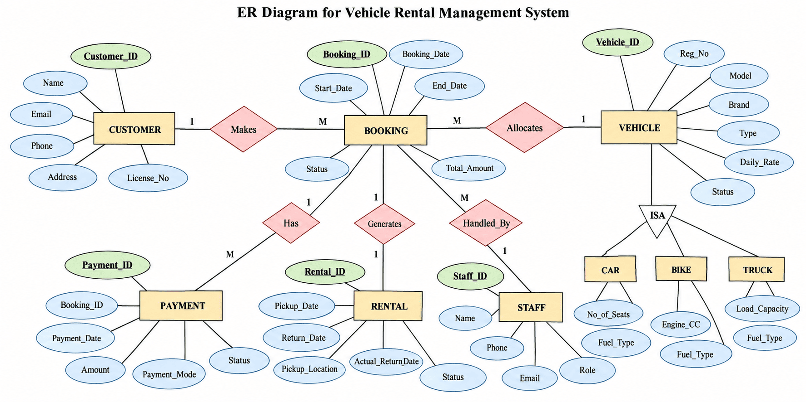
6.ER DIAGRAM

Slide 8
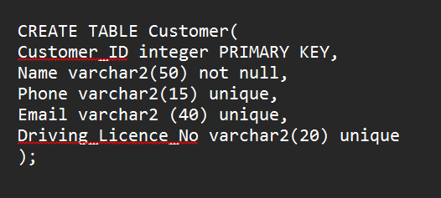
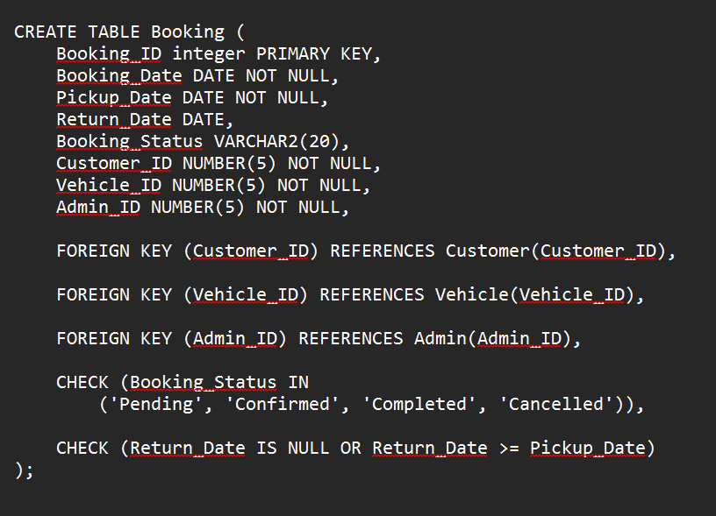
CUSTOMERS TABLE
BOOKINGS TABLE

Slide 9
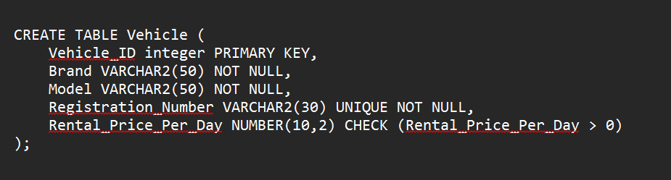
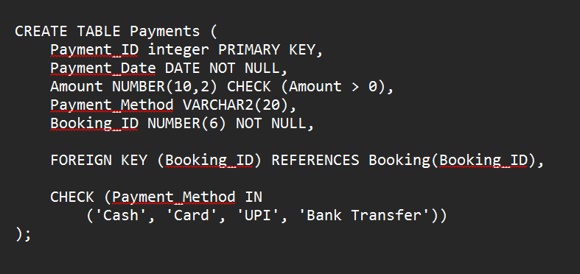
VEHICLES TABLE
PAYMENTS TABLE

Slide 10
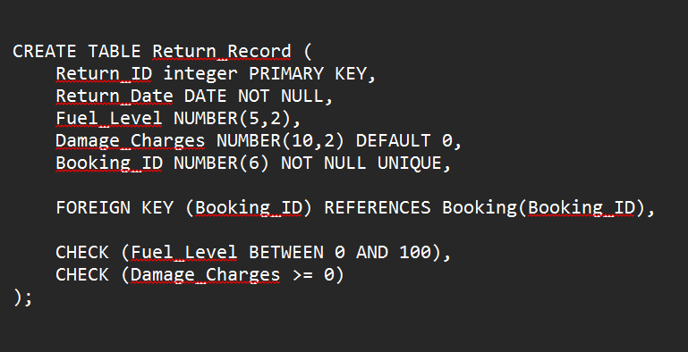
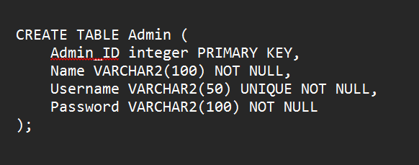
RETURNS TABLE
ADMIN TABLE

Slide 11
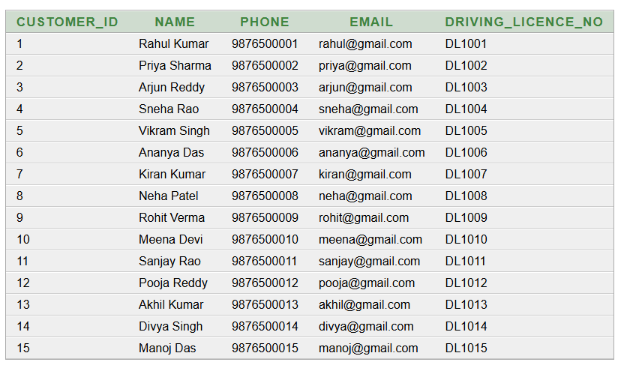
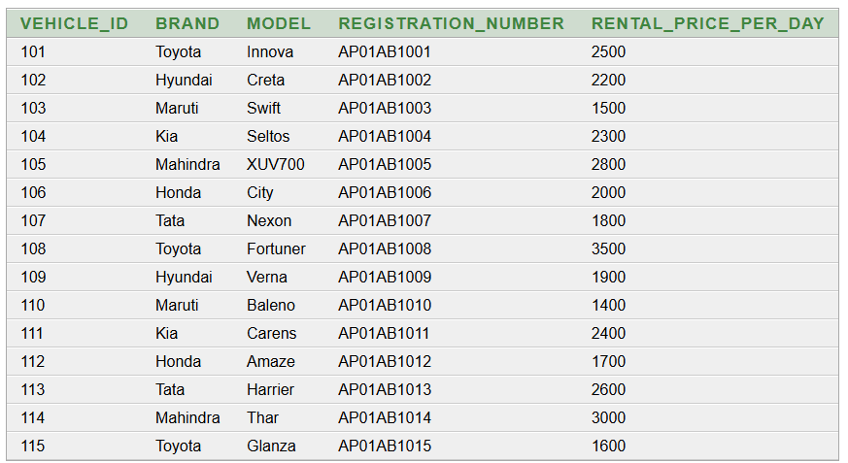
select * from customer
select * from vehicle

Slide 12
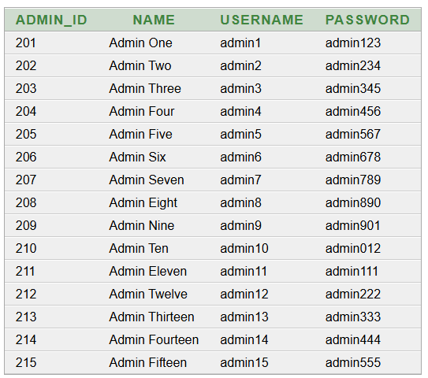
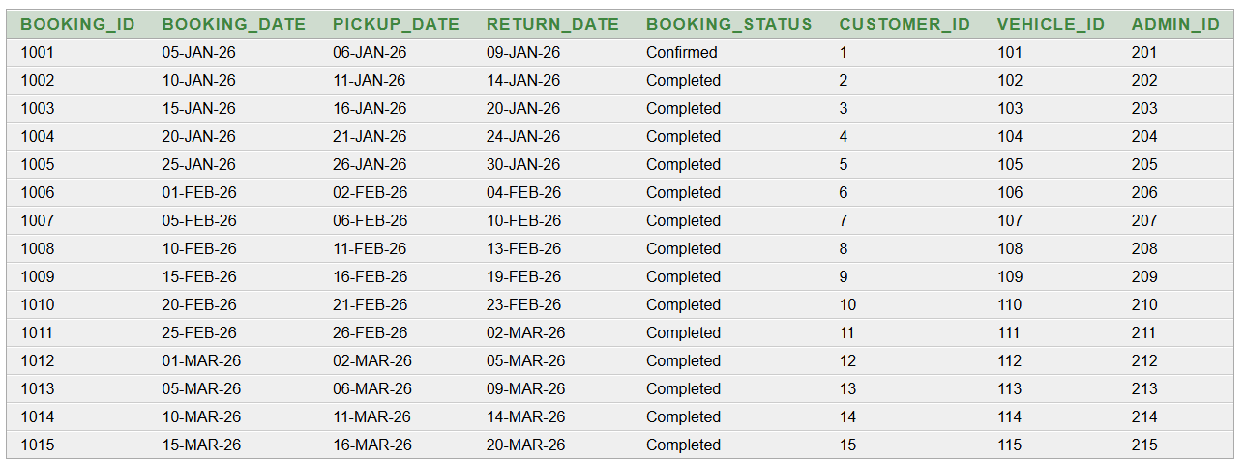
select * from booking
select * from admin

Slide 13
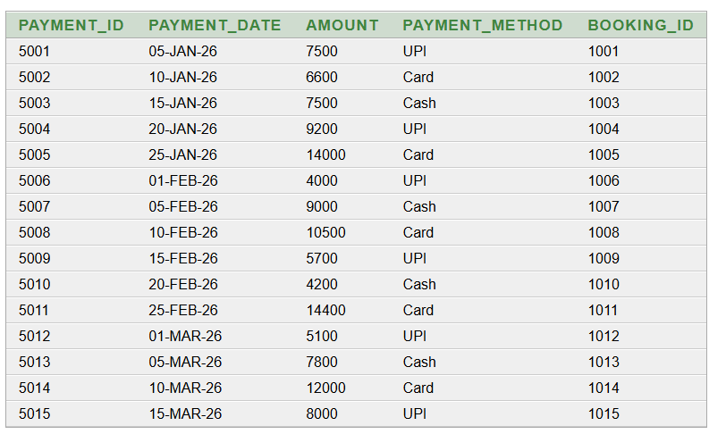
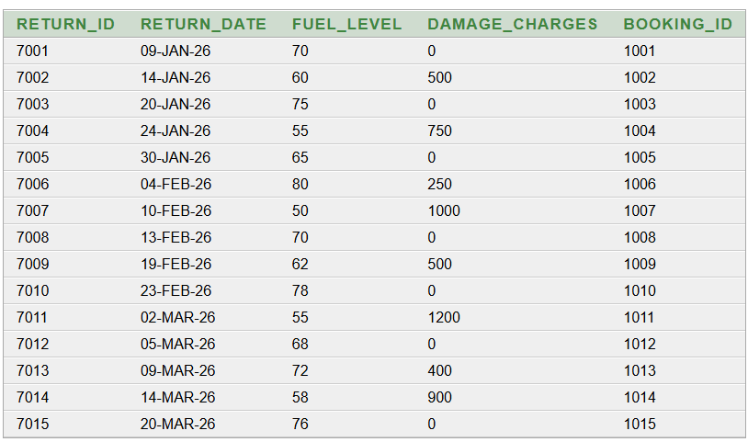
select * from payments
select * from Return_Record

Slide 14
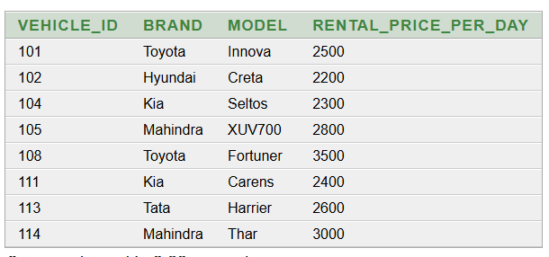
QUERIES
Query 1: Display all customers
SELECT *
FROM Customer;
Query 2: Find vehicles with rental price greater than ₹2000
SELECT Vehicle_ID, Brand, Model, Rental_Price_Per_Day
FROM Vehicle
WHERE Rental_Price_Per_Day > 2000;

Slide 15
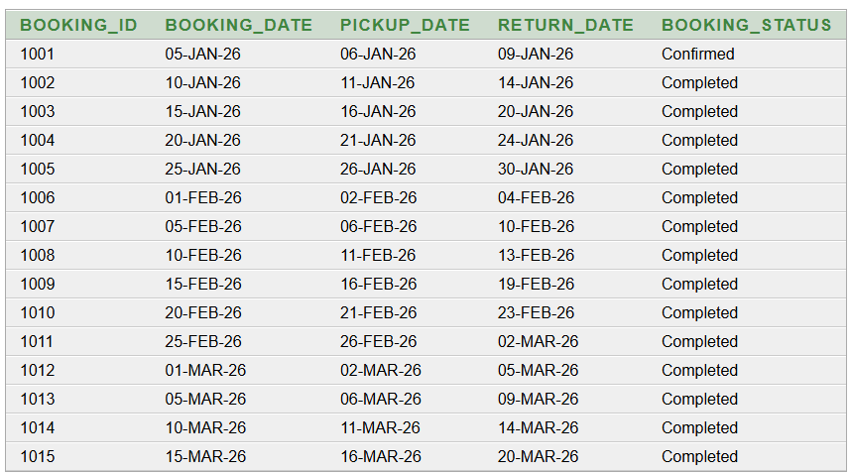
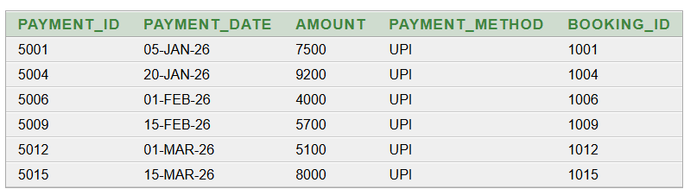
Query 3: Display confirmed and completed
bookings
SELECT Booking_ID, Booking_Date, Pickup_Date,
Return_Date, Booking_Status
FROM Booking
WHERE Booking_Status IN ('Confirmed', 'Completed');
Query 4: Display UPI payments
SELECT Payment_ID, Payment_Date,
Amount, Payment_Method, Booking_ID
FROM Payment
WHERE Payment_Method = 'UPI';

Slide 16
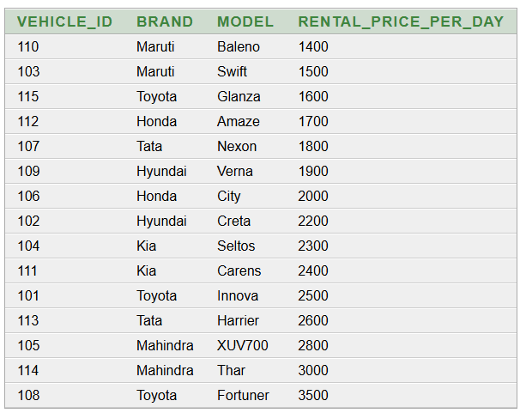
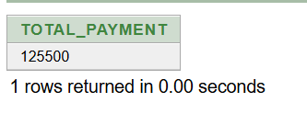
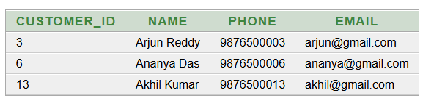
Query 5: Display vehicles in order of rental price
SELECT Vehicle_ID, Brand, Model, Rental_Price_Per_Day
FROM Vehicle
ORDER BY Rental_Price_Per_Day ASC;
Query 6: Calculate total payment amount
SELECT SUM(Amount) AS Total_Payment
FROM Payment;
Query 7: Find customers whose name starts with 'A'
SELECT Customer_ID, Name, Phone, Email
FROM Customer
WHERE Name LIKE 'A%';

Slide 17
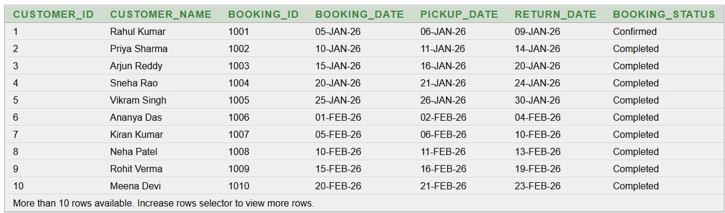
Advanced Query 1 — Customer and their bookings
SELECT
c.Customer_ID,
c.Name AS Customer_Name,
b.Booking_ID,
b.Booking_Date,
b.Pickup_Date,
b.Return_Date,
b.Booking_Status
FROM Customer c
JOIN Booking b
ON c.Customer_ID = b.Customer_ID
ORDER BY c.Customer_ID;

Slide 18
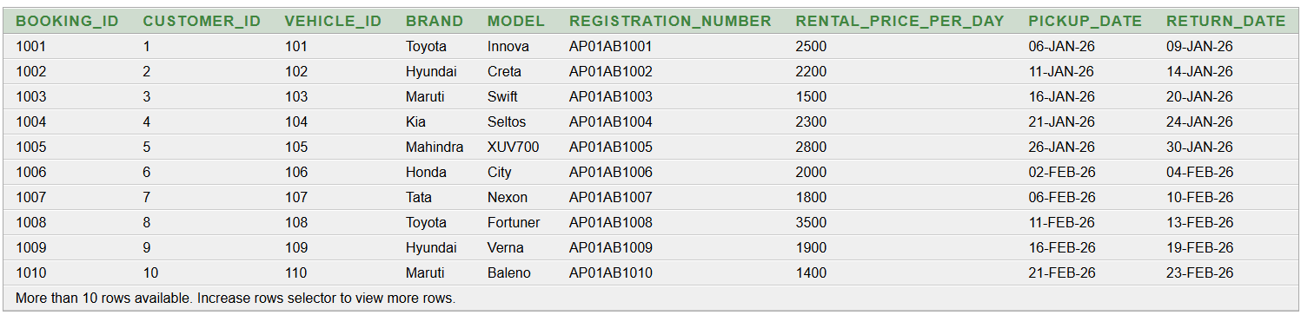
Advanced Query 2 — Booking and vehicle details
SELECT
b.Booking_ID,
b.Customer_ID,
v.Vehicle_ID,
v.Brand,
v.Model,
v.Registration_Number,
v.Rental_Price_Per_Day,
b.Pickup_Date,
b.Return_Date
FROM Booking b
JOIN Vehicle v
ON b.Vehicle_ID = v.Vehicle_ID
ORDER BY b.Booking_ID;

Slide 19
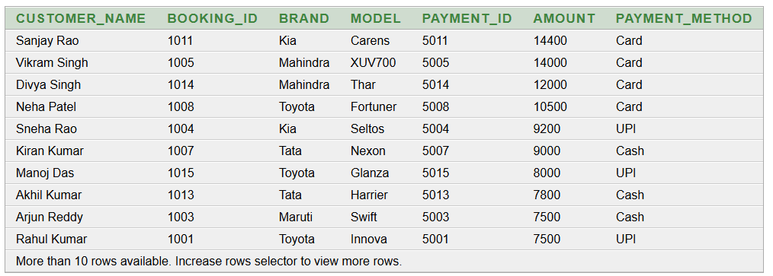
Advanced Query 3 — Customer, booking, vehicle and payment
SELECT
c.Name AS Customer_Name,
b.Booking_ID,
v.Brand,
v.Model,
p.Payment_ID,
p.Amount,
p.Payment_Method
FROM Customer c
JOIN Booking b
ON c.Customer_ID = b.Customer_ID
JOIN Vehicle v
ON b.Vehicle_ID = v.Vehicle_ID
JOIN Payment p
ON b.Booking_ID = p.Booking_ID
ORDER BY p.Amount DESC;

Slide 20
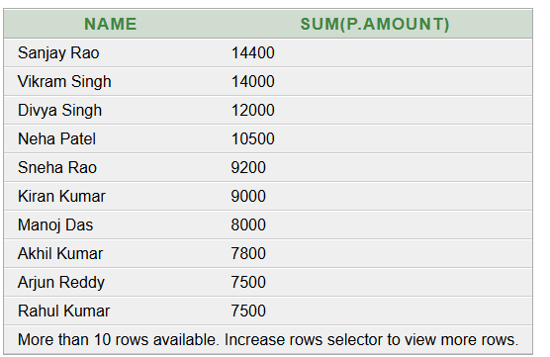
Advanced Query 4 — Total payment for each customer
SELECT c.Name,
SUM(p.Amount)
FROM Customer c, Booking b, Payment p
WHERE c.Customer_ID = b.Customer_ID
AND b.Booking_ID = p.Booking_ID
GROUP BY c.Name
ORDER BY SUM(p.Amount) DESC;

Slide 21
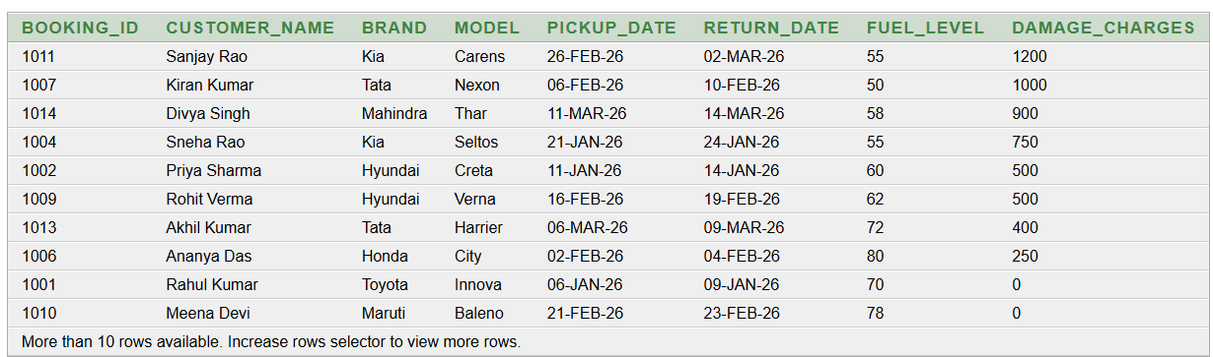
Advanced Query 5 — Booking and return information
SELECT
b.Booking_ID,
c.Name AS Customer_Name,
v.Brand,
v.Model,
b.Pickup_Date,
r.Return_Date,
r.Fuel_Level,
r.Damage_Charges
FROM Booking b
JOIN Customer c
ON b.Customer_ID = c.Customer_ID
JOIN Vehicle v
ON b.Vehicle_ID = v.Vehicle_ID
JOIN Return_Record r
ON b.Booking_ID = r.Booking_ID
ORDER BY r.Damage_Charges DESC;

Slide 22
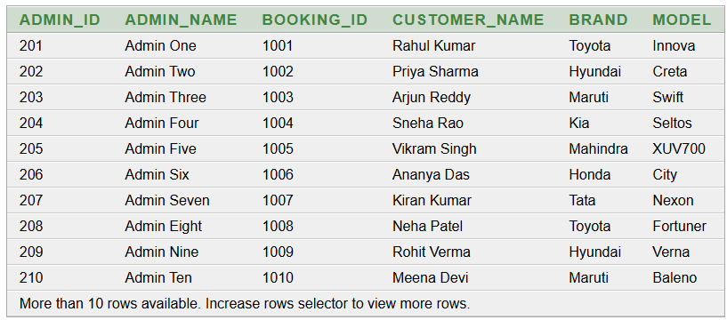
Advanced Query 6 — Bookings managed by administrators
SELECT
a.Admin_ID,
a.Name AS Admin_Name,
b.Booking_ID,
c.Name AS Customer_Name,
v.Brand,
v.Model
FROM Admin a
JOIN Booking b
ON a.Admin_ID = b.Admin_ID
JOIN Customer c
ON b.Customer_ID = c.Customer_ID
JOIN Vehicle v
ON b.Vehicle_ID = v.Vehicle_ID
ORDER BY a.Admin_ID;

Slide 23
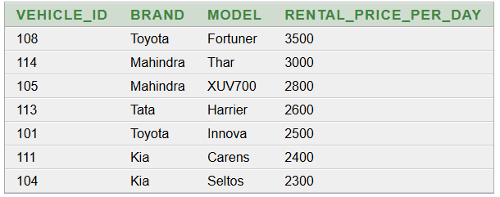
Advanced Query 7 — Find vehicles with rental price above average
SELECT
Vehicle_ID,
Brand,
Model,
Rental_Price_Per_Day
FROM Vehicle
WHERE Rental_Price_Per_Day >
(
SELECT AVG(Rental_Price_Per_Day)
FROM Vehicle
)
ORDER BY Rental_Price_Per_Day DESC;

Slide 24
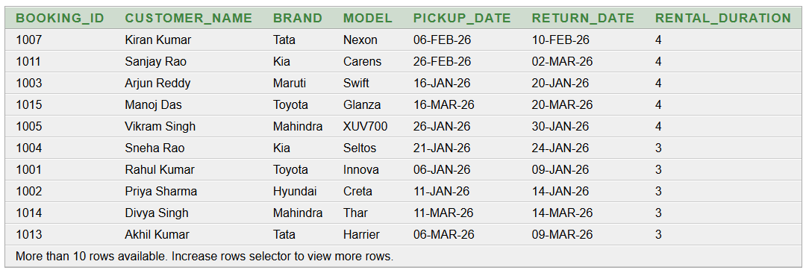
Advanced Query 8 — Calculate rental duration
SELECT
b.Booking_ID,
c.Name AS Customer_Name,
v.Brand,
v.Model,
b.Pickup_Date,
b.Return_Date,
(b.Return_Date - b.Pickup_Date) AS
Rental_Duration FROM Booking b
JOIN Customer c
ON b.Customer_ID = c.Customer_ID
JOIN Vehicle v
ON b.Vehicle_ID = v.Vehicle_ID
ORDER BY Rental_Duration DESC;

Slide 25

NORMALIZATION
Normalization organizes the rental data into related tables so that each fact is stored in the appropriate place.
Starting unnormalized relation (UNF)
RENTAL_RECORD(
Booking_ID, Customer_ID, Customer_Name, Customer_Phone,
Vehicle_ID, Brand, Model, Registration_Number, Rental_Price_Per_Day,
Booking_Date, Pickup_Date, Return_Date, Booking_Status,
Payment_ID, Payment_Date, Amount, Payment_Method,
Return_ID, Return_Date, Fuel_Level, Damage_Charges,
Admin_ID, Admin_Name, Admin_Username)
Goal: achieve 1NF → 2NF → 3NF.
UNF may contain repeated rental-related facts and duplicated customer, vehicle, payment and admin details.
Primary key used for the booking transaction: Booking_ID.
DBMS
K Vydehi, Asst Professor, CSE Dept.
25

Slide 26
1NF – FIRST NORMAL FORM
A relation is in 1NF when every attribute contains a single atomic value and there are no repeating groups or multivalued attributes.
Booking_ID | Customer_ID | Customer_Name | Vehicle_ID | Brand | Booking_Date | Pickup_Date | Return_Date
1001 | 1 | Rahul Kumar | 101 | Toyota | 05-Jan-26 | 06-Jan-26 | 09-Jan-26
1002 | 2 | Priya Sharma | 102 | Hyundai | 10-Jan-26 | 11-Jan-26 | 14-Jan-26
1003 | 3 | Arjun Reddy | 103 | Maruti | 15-Jan-26 | 16-Jan-26 | 20-Jan-26
1004 | 4 | Sneha Rao | 104 | Honda | 20-Jan-26 | 21-Jan-26 | 24-Jan-26
Primary Key: Booking_ID
All values are atomic; one customer, one vehicle and one date value are stored per row.
Functional dependency at this stage: Booking_ID → Customer_ID, Customer_Name, Vehicle_ID, Brand, Booking_Date, Pickup_Date, Return_Date.
DBMS
K Vydehi, Asst Professor, CSE Dept.
26

Slide 27
2NF – SECOND NORMAL FORM
2NF = 1NF + no partial dependency of a non-key attribute on part of a composite key.
For this project, Booking_ID is a single-attribute primary key.
Because the primary key has only one attribute, there is no 'part of the key'.
Therefore, partial dependency cannot occur.
After checking 1NF, the booking relation already satisfies 2NF.
Do NOT call Customer_ID → Customer_Name or Vehicle_ID → Brand a partial dependency; these are transitive dependencies and are handled in 3NF.
2NF result: No decomposition is required solely for 2NF.
DBMS
K Vydehi, Asst Professor, CSE Dept.
27

Slide 28
2NF – DEPENDENCY CHECK
Dependency | Type | 2NF issue?
Booking_ID → Booking_Date, Pickup_Date, Return_Date | Full dependency on single PK | No
Booking_ID → Customer_ID, Vehicle_ID, Admin_ID | Full dependency on single PK | No
Customer_ID → Customer_Name, Phone, Email, License_No | Transitive dependency | Not a 2NF issue
Vehicle_ID → Brand, Model, Registration_Number, Rental_Price_Per_Day | Transitive dependency | Not a 2NF issue
Correct conclusion
The project relations use single-column primary keys.
Therefore all project relations are already in 2NF once they are in 1NF.
The remaining redundancy is caused by transitive dependencies, which are removed in 3NF.
DBMS
K Vydehi, Asst Professor, CSE Dept.
28

Slide 29
3NF – THIRD NORMAL FORM
3NF = 2NF + no transitive dependency.
Booking_ID | Customer_ID | Customer_Name | Vehicle_ID | Brand | Booking_Date
1001 | 1 | Rahul Kumar | 101 | Toyota | 05-Jan-26
1002 | 2 | Priya Sharma | 102 | Hyundai | 10-Jan-26
1003 | 3 | Arjun Reddy | 103 | Maruti | 15-Jan-26
1004 | 4 | Sneha Rao | 104 | Honda | 20-Jan-26
Transitive dependencies
Booking_ID → Customer_ID → Customer_Name, Customer_Phone, Email, Driving_License_No
Booking_ID → Vehicle_ID → Brand, Model, Registration_Number, Rental_Price_Per_Day
Booking_ID → Admin_ID → Admin_Name, Username, Password
Booking_ID → Payment_ID → Payment_Date, Amount, Payment_Method
Booking_ID → Return_ID → Return_Date, Fuel_Level, Damage_Charges
DBMS
K Vydehi, Asst Professor, CSE Dept.
29

Slide 30
3NF DECOMPOSITION
Separate attributes so every non-key attribute depends on the key, the whole key, and nothing but the key.
CUSTOMER
Customer_ID (PK), Name, Phone, Email, Driving_License_No
VEHICLE
Vehicle_ID (PK), Brand, Model, Registration_Number, Rental_Price_Per_Day, Availability_Status
ADMIN
Admin_ID (PK), Name, Username, Password, Contact_Number
BOOKING
Booking_ID (PK), Booking_Date, Pickup_Date, Return_Date, Booking_Status, Customer_ID (FK), Vehicle_ID (FK), Admin_ID (FK)
PAYMENT
Payment_ID (PK), Payment_Date, Amount, Payment_Method, Payment_Status, Booking_ID (FK)
RETURN_RECORD
Return_ID (PK), Return_Date, Fuel_Level, Damage_Charges, Booking_ID (FK)
Each foreign key preserves the relationship between the decomposed relations.
DBMS
K Vydehi, Asst Professor, CSE Dept.
30

Slide 31
FINAL 3NF RELATIONS
Final schema used by the Vehicle Rental Management System
Relation | Primary Key | Important Foreign Keys
CUSTOMER | Customer_ID | —
VEHICLE | Vehicle_ID | —
ADMIN | Admin_ID | —
BOOKING | Booking_ID | Customer_ID, Vehicle_ID, Admin_ID
PAYMENT | Payment_ID | Booking_ID
RETURN_RECORD | Return_ID | Booking_ID
Customer, vehicle and admin descriptive data are stored once.
Booking stores transaction-specific data and references the related entities.
Payment and return details are separated into their own relations.
DBMS
K Vydehi, Asst Professor, CSE Dept.
31

Slide 32
3NF – FINAL RESULT
Relation | Sample PK | Example
CUSTOMER | 1 | Rahul Kumar
VEHICLE | 101 | Toyota Innova
ADMIN | 1 | Admin User
BOOKING | 1001 | Customer 1 + Vehicle 101
PAYMENT | 5001 | Booking 1001 – ₹7500 – UPI
RETURN_RECORD | 9001 | Booking 1001 – Fuel 80%
No partial dependency
No transitive dependency
Reduced redundancy and update anomalies
Better consistency and easier maintenance
3NF RESULT
DBMS
K Vydehi, Asst Professor, CSE Dept.
32

Slide 33
7. Relationships & Cardinality
• Customer → Booking = 1:M – one customer can make many bookings.
• Vehicle → Booking = 1:M – one vehicle can have many bookings over different dates.
• Booking → Payment = 1:1 – each booking has one payment record in this project model.
• Booking → Return = 1:1 – each completed booking has one return record.
• Admin → Operations = 1:M – one admin can manage many rental operations.
DBMS
Vehicle Rental Management System
8

Slide 34
8. Relation Schema
Relational tables derived from the ER model
CUSTOMER
Customer_ID (PK), Name, Phone, Email, Address, Driving_License_No
VEHICLE
Vehicle_ID (PK), Vehicle_Name, Brand, Model, Registration_Number, Rental_Price_Per_Day, Availability_Status
BOOKING
Booking_ID (PK), Booking_Date, Pickup_Date, Return_Date, Booking_Status, Customer_ID (FK), Vehicle_ID (FK)
PAYMENT
Payment_ID (PK), Payment_Date, Amount, Payment_Method, Payment_Status, Booking_ID (FK)
RETURN
Return_ID (PK), Return_Date, Fuel_Level, Damage_Charges, Booking_ID (FK)
ADMIN
Admin_ID (PK), Name, Username, Password, Contact_Number
PK = Primary Key FK = Foreign Key | Foreign keys establish relationships between related tables.
DBMS
Vehicle Rental Management System
9

Slide 35
9. Expected Outcome
• Centralized database for customers, vehicles, bookings, payments and returns.
• Faster vehicle availability checking and booking management.
• Reduced duplicate data and improved consistency.
• Easy retrieval of rental history and administrative information.
• A strong foundation for SQL queries, normalization, reports and future application development.
DBMS
Vehicle Rental Management System
10

Slide 36
10. Conclusion
• The Vehicle Rental Management System provides a structured way to manage rental operations.
• The ER model defines the required entities, attributes, keys, relationships and cardinalities.
• Primary keys and foreign keys keep the database organized and maintain valid relationships.
• The system can later be extended with online payments, mobile booking, notifications and analytics.
DBMS
Vehicle Rental Management System
11

Slide 37
THANK YOU
Questions & Answers

