Slide 1
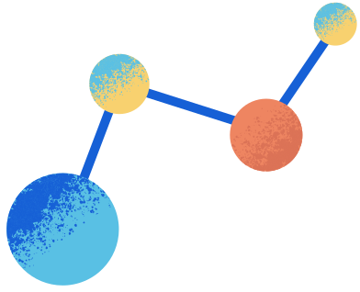

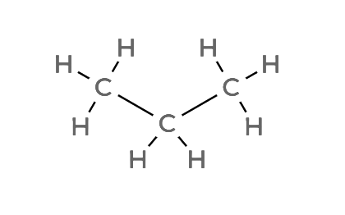

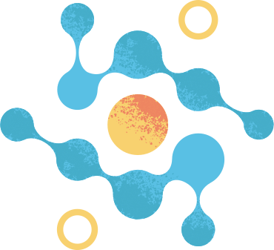

PROPANE
MOLECULAR FORMULA
LEWIS STRUCTURE
C₃H₈
CONDENSED STRUCTURAL FORMULA
BOND LINE FORMULA
CH₃CH₂CH₃
atom count verified
valence checked
bond order checked
same connectivity confirmed

Slide 2
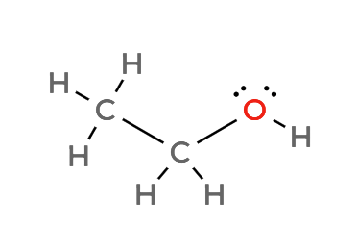

ETHANOL
MOLECULAR FORMULA
LEWIS STRUCTURE
C₂H₆O
CONDENSED STRUCTURAL FORMULA
BOND LINE FORMULA
CH₃CH₂OH
atom count verified
valence checked
bond order checked
same connectivity confirmed

Slide 3
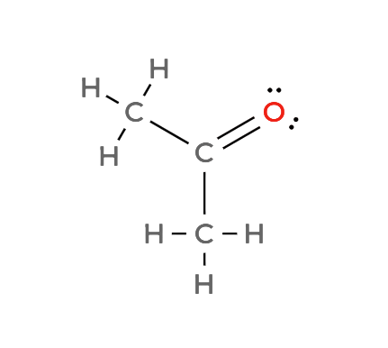

ACETONE
MOLECULAR FORMULA
LEWIS STRUCTURE
C₃H₆O
CONDENSED STRUCTURAL FORMULA
BOND LINE FORMULA
CH₃COCH₃
atom count verified
valence checked
bond order checked
same connectivity confirmed

Slide 4
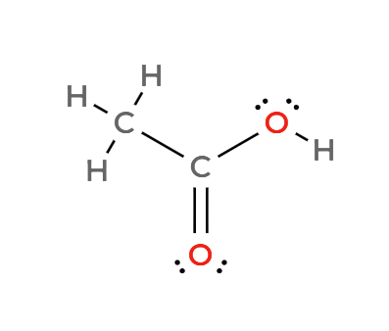

ACETIC ACID
MOLECULAR FORMULA
LEWIS STRUCTURE
C₂H₄O₂
CONDENSED STRUCTURAL FORMULA
BOND LINE FORMULA
CH₃COOH
atom count verified
valence checked
bond order checked
same connectivity confirmed

Slide 5
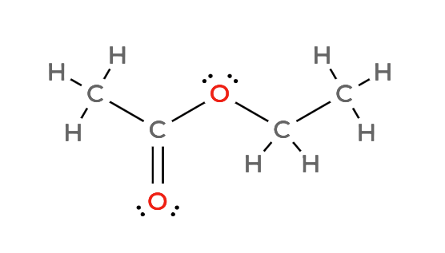

ETHYL ACETATE
MOLECULAR FORMULA
LEWIS STRUCTURE
C₄H₈O₂
CONDENSED STRUCTURAL FORMULA
BOND LINE FORMULA
CH₃COOCH₂CH₃
atom count verified
valence checked
bond order checked
same connectivity confirmed

Slide 6
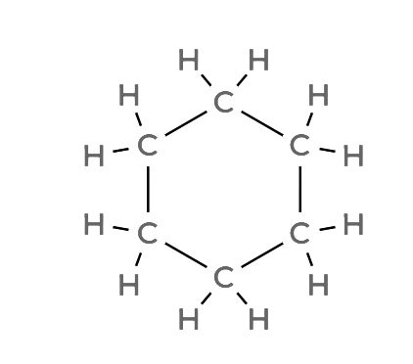

CYCLOHEXANE
MOLECULAR FORMULA
LEWIS STRUCTURE
C₆H₁₂
CONDENSED STRUCTURAL FORMULA
BOND LINE FORMULA
(CH₂)₆
atom count verified
valence checked
bond order checked
same connectivity confirmed

Slide 7
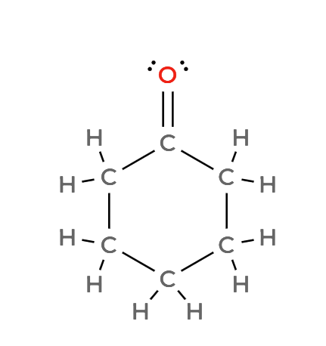

CYCLOHEXANONE
MOLECULAR FORMULA
LEWIS STRUCTURE
C₆H₁₀O
CONDENSED STRUCTURAL FORMULA
BOND LINE FORMULA
(CH₂)₅CO
atom count verified
valence checked
bond order checked
same connectivity confirmed

Slide 8
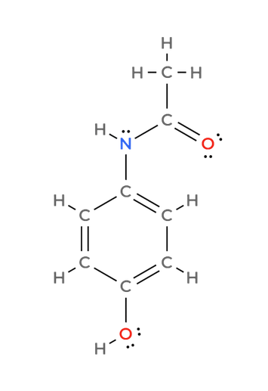
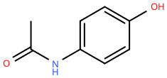
ACETAMINOPHEN
MOLECULAR FORMULA
LEWIS STRUCTURE
C₈H₉NO₂
CONDENSED STRUCTURAL FORMULA
BOND LINE FORMULA
HOC₆H₄NHCOCH₃
atom count verified
valence checked
bond order checked
same connectivity confirmed

Slide 9
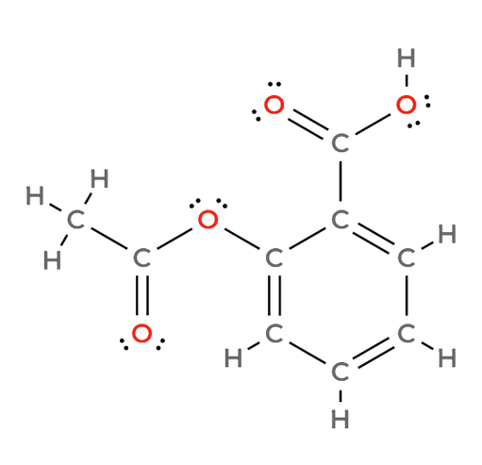
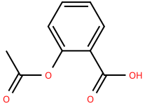
ASPIRIN
MOLECULAR FORMULA
LEWIS STRUCTURE
C₉H₈O₄
CONDENSED STRUCTURAL FORMULA
BOND LINE FORMULA
CH₃COOC₆H₄COOH
atom count verified
valence checked
bond order checked
same connectivity confirmed

Slide 10
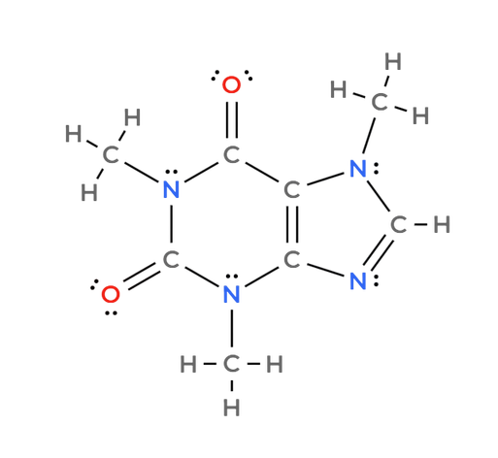
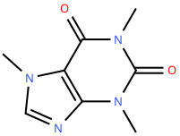
CaffeINE
MOLECULAR FORMULA
LEWIS STRUCTURE
C₈H₁₀N₄O₂
CONDENSED STRUCTURAL FORMULA
BOND LINE FORMULA
C₈H₁₀N₄O₂
(cannot be written as a simple, continuous linear condensed formula because caffeine consists of a bicyclic ring system )
atom count verified
valence checked
bond order checked
same connectivity confirmed

