Slide 2
Trivia (useless bullshit)

Slide 3
What was the first commercial video game?
Pong
Computer space
Gun Fight
Pac-man

Slide 4
In what game did Mario first appear?
Punch Out as the referee
Bowser’s Big Bean Burrito
Game & Watch as a jailer
Donkey Kong as the protagonist

Slide 5
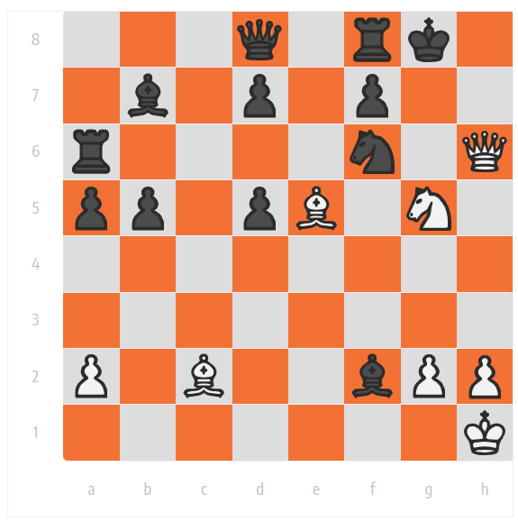
Solve this mate in 2

Slide 6
Board game with most units sold (excluding chess)
Checkers
Monopoly
Scrabble
Clue

