Slide 1

Terminate System
Premature game termination
View Rules
Human Players
User
Move specific robot
Initiate System
Shoot enemy robot
Choose number of players
Choose number of humans
Choose Board size
Computer AI Players

Slide 2
Register
Retrieve
Simulator
Revise
Robot Librarian
Enumerate
Update States
Download

Slide 3
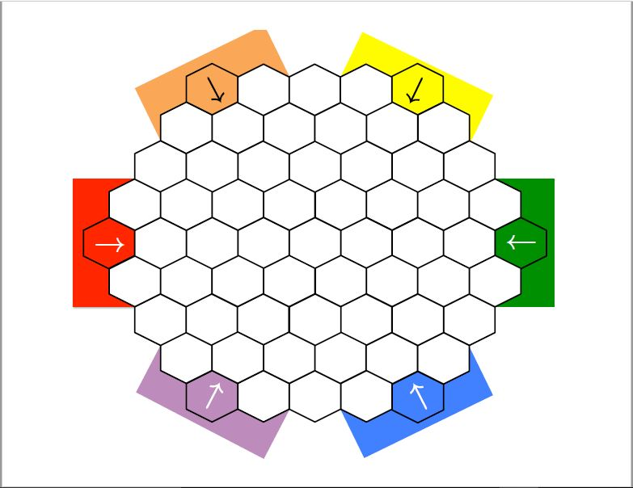
Welcome To Battle Bots!
Begin
Help
Quit

Slide 4
Help Section
Rules of the game will be listed here
Game Rules are listed on the right as well as how to navigate the menu. For other troubleshooting concerns, please contact us at www.troubleshoot.com
Back
Quit

Slide 5
Game properties
How many humans will be playing?
Board length on each side?
0 (AI simulation)
5
7
How many colors will be playing?
2
1
2
3
3
4
6
5
6
Quit
Back
Continue

Slide 6
Team Selection
Team 1
Team 2
Team 3
Team 4
Team 5
Team 6
Back
Quit
Continue

Slide 7
Team Red
Team Green
Scout
Sniper
Tank
Scout
Sniper
Tank
Team Orange
Scout
Sniper
Tank
Team Blue
Scout
Sniper
Tank
Team Yellow
Scout
Sniper
Tank
Team Purple
Scout
Sniper
Tank
Help
Current Robot:
Moves left:
Quit

Slide 8
Victory goes to Player: 1
Congratulations!
Play Again
Stats
Quit

Slide 9
Team | Wins | Losses | Ties | Scout kills | Sniper kills | Tank kills
Team1 | 1 | 3 | 0 | 1 | 0 | 2
Team2 | 3 | 0 | 0 | 2 | 3 | 3
Team3 | 1 | 1 | 0 | 1 | 0 | 0
Team4 | 2 | 1 | 0 | 2 | 2 | 0
Team5 | 0 | 0 | 0 | 0 | 0 | 0
Team6 | 0 | 0 | 0 | 0 | 0 | 0
Play Again
Quit

