Slide 1

INTERNAL DECISION MEMO
Partnership Value OS
Defensible partnership decisions when comparables are sparse
The Decision Problem: Valuing Product Partnerships When Comparables Are Sparse
Bottom-Line Questions
Three questions the deal lead must answer before entering negotiation:
Novel AI partnerships are structurally different from traditional software or data deals. They combine direct economics, product capability uplift, distribution reach, data uniqueness, strategic option value, implementation burden, exclusivity constraints, and asymmetric risk — often in a single term sheet. A single market multiple rarely captures this complexity with sufficient precision to carry into a negotiation.
Existing valuation heuristics — revenue multiples, comparable SaaS transactions, cost-of-acquisition proxies — were built for mature, liquid markets. When a partnership is genuinely novel, those anchors mislead as often as they inform. The discipline required is first-principles valuation: visible assumptions, explicit confidence levels, and a structured framework that surfaces disagreements before they become negotiating surprises.
1
What is it worth?
Across downside, base, and upside scenarios — confidence-adjusted.
2
How should it be structured?
Payment timing, usage components, exclusivity carve-outs, and termination rights.
Synthetic case — Atlas Knowledge Systems: Atlas proposes a three-year partnership combining a proprietary data license, API access, deep product integration, and joint enterprise distribution — with limited category exclusivity. Terms are undisclosed to the market; no clean comparable exists.
3
What does the deal lead carry in?
Opening position, target range, reservation value, and walk-away point — documented and approved.

Slide 2


VALUATION ARCHITECTURE
A Transparent Value Stack, Not a Black-Box Score
Sound partnership valuation requires separating value creation from value cost, then applying an explicit confidence haircut. The equation below is the backbone of every analysis in this framework. Each line item carries its own assumption register and evidence citation.
The Value Stack Equation
Five Confidence Dimensions
The confidence factor is not a gut-check discount. It is the product of five structured assessments, each scored independently and aggregated. A factor below 0.60 signals insufficient diligence to proceed.
Value Creation Components (+)
Direct financial value — contracted revenue, license fees, usage economics
Usage and customer value — incremental active users, engagement uplift, retention delta
Product capability value — capabilities acquired vs. build cost and timeline
Distribution value — incremental reach through partner enterprise channels
Strategic option value — future deal rights, preferred-partner provisions, renewal terms
Learning value — data uniqueness, model improvement, proprietary insight
Cash consideration — upfront payment, MGs, milestone payments received
Evidence Quality
Assumption Stability
Are the underlying data points auditable, primary, or inferred?
How sensitive is the valuation to changes in key assumptions?
Comparable Quality
Implementation Certainty
How structurally similar are available benchmarks?
Value Cost Components (–)
How well-defined is the integration scope and resource plan?
Implementation cost — engineering, legal, partnership management, opportunity cost of team
Exclusivity and opportunity cost — market foreclosed, alternative deals foregone
Expected risk cost — probability-weighted downside scenarios
Concentration and lock-in cost — single-partner dependency, switching cost
Partner Execution Confidence
What is the evidence base for partner delivery track record?
Gross Partnership Value × Confidence Factor = Confidence-Adjusted Partnership Value

Slide 3
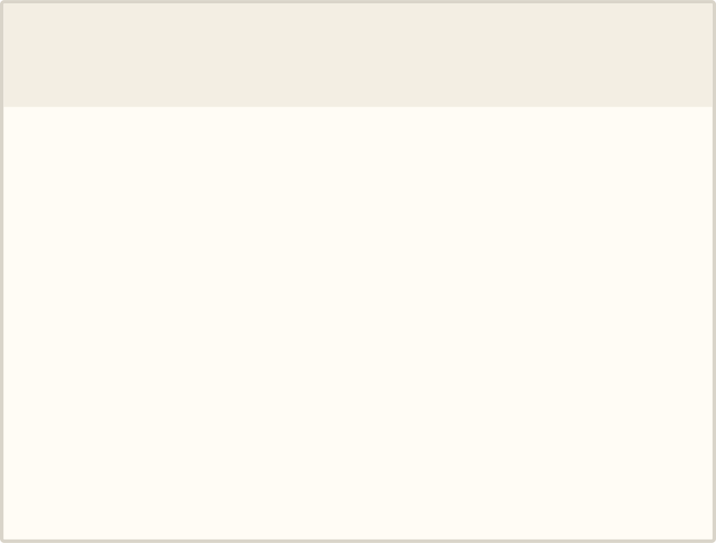

SYNTHETIC CASE — ATLAS KNOWLEDGE SYSTEMS
Atlas Proposal: Attractive Upside, Expensive Commitment
The Atlas proposal bundles four distinct partnership archetypes — data license, API integration, product integration, and enterprise distribution — into a single 36-month term. That bundling creates valuation complexity: each component carries different risk, different evidence quality, and different confidence levels. The total proposed economic cost to our organization over the term is $31.0M.
Synthetic Deal Terms
Four Unresolved Questions Before Proceeding
Term Element
Proposed Value
1
2
Contract term
36 months
Data Uniqueness & Replaceability
Enterprise Distribution Evidence
Upfront payment
$4.0M
Annual license fee
$6.0M / year
Is the Atlas dataset genuinely proprietary, or can it be replicated through alternative sources, synthetic generation, or public data assembly? The answer drives the learning value component significantly.
What verified evidence supports Atlas's claimed enterprise distribution capability? Pipeline data, existing channel partnerships, and customer reference calls are required before attributing distribution value.
Annual minimum usage
$3.0M / year
Implementation support
$1.5M (one-time)
Exclusivity
Limited category; 24 months
Distribution commitment
Joint enterprise GTM
3
4
Renewal option
Mutual; triggers at Month 33
Implementation Resource Commitment
Opportunity Cost of Exclusivity
Total proposed economic cost
$31.0M
What internal engineering, product, and legal bandwidth is required? Is the $1.5M support payment sufficient, or does it undercount the true internal cost of integration?
Which alternative partnerships are foreclosed by the category exclusivity? Has the strategy team mapped the competitive landscape of deals in the same category over a 24-month horizon?
All companies, terms, and economics in this case are fictional and used solely to demonstrate methodology. Synthetic case.

Slide 4

SCENARIO VALUATION — SYNTHETIC CASE
The Base Case Does Not Clear the Proposed Economics
Scenario analysis is not a formality — it is the primary tool for surfacing whether the deal makes sense across the realistic range of outcomes. In the Atlas case, only the upside scenario produces a confidence-adjusted value that exceeds the proposed economic cost of $31.0M. The base case shows a gap of –$5.8M. The deal requires either restructuring or material upside evidence before it can be recommended.
Scenario
Gross Value
Confidence Factor
Confidence-Adjusted Value
vs. $31.0M Cost
Downside
$14.0M
0.55
$7.7M
–$23.3M
Base
$35.0M
0.72
$25.2M
–$5.8M
Upside
$62.0M
0.78
$48.4M
+$17.4M
Base Case Value Waterfall — Synthetic
Confidence-Adjusted $25.2M
Gross Value $35M
Costs -$10M
Reading the waterfall: Capability, distribution, and learning value collectively drive approximately 60% of gross value in the base case. Cost deductions — implementation, exclusivity, risk, and lock-in — reduce gross value by $10M before the confidence haircut is applied. The 0.72 confidence factor reflects meaningful uncertainty in distribution evidence and data uniqueness claims. All figures synthetic.

Slide 5

COMPARABLE-TRANSACTION DISCIPLINE
Normalize Imperfect Comparables Instead of Pretending They Match
Comparable transactions in AI partnerships are rarely clean. Disclosed economics are partial; structural differences in exclusivity, integration depth, and term length make direct comparison unreliable. The discipline is systematic normalization — scoring each comparable on structural similarity and applying explicit adjustment notes rather than averaging raw numbers. The table below contains five synthetic comparables used to calibrate the Atlas valuation range.
Table 1: Deal Comparables
Deal Name
Archetype
Disclosed Economics
Term
Exclusivity
Comparability Score
Northstar Data License
Data license
$18M / 3yr
36 mo.
None
52/100
Meridian API Integration
API / product integration
$9M / 2yr
24 mo.
Partial
64/100
Harbor Enterprise Channel
Distribution alliance
Undisclosed
48 mo.
None
58/100
Keystone Strategic Alliance
Hybrid (data + distrib.)
$28M / 3yr
36 mo.
Full category
78/100
Pioneer Hybrid Agreement
API + data + channel
$22M / 3yr
36 mo.
Segment-limited
71/100
Table 2: Normalization Notes
Deal Name
Source Quality
Adjustment Note
Northstar Data License
Press release
No integration; adjust down for lower cost; no distribution premium
Meridian API Integration
Industry report
Shorter term; annualize and add distribution premium for Atlas
Harbor Enterprise Channel
Analyst estimate
No data or IP component; economics estimated; apply heavy discount to signal
Keystone Strategic Alliance
SEC filing
Full exclusivity vs. Atlas limited; adjust down economics; best structural comp
Pioneer Hybrid Agreement
Partner earnings call
Closest archetype match; integration burden lower than Atlas; adjust up slightly
Principle: Comparables inform the range; they do not replace first-principles valuation. A 52/100 comparable should widen the uncertainty band, not anchor the number. All deal names and economics above are synthetic.

Slide 6


NEGOTIATION RECOMMENDATION
Restructure Into a Staged Pilot Before a Three-Year Commitment
The base case valuation gap of –$5.8M is not a reason to walk away — it is a reason to restructure. A staged pilot resolves the four unresolved diligence questions (data uniqueness, distribution evidence, implementation scope, exclusivity cost) at lower committed cost, with defined go/no-go triggers before the full commitment is made.
Negotiation Position Map
Give / Get Matrix — Three Illustrative Trades
Position
Economics
Structure
We Give
We Get
Rationale
Opening position
$1.0M upfront; $3.0M annual
9-month pilot; usage-based; no exclusivity
Co-marketing and joint enterprise case study rights
Reduction of $1.0M in upfront payment; data audit rights
Atlas values reference credibility; we reduce committed cash and gain diligence leverage
Target range
$2.0M upfront; $4.5M annual
12-month pilot; milestone triggers; limited exclusivity
Preferred renewal rights and first-look on future Atlas data products
Exclusivity limited to two named verticals; milestone-based rather than time-based
We offer option value in exchange for reducing the exclusivity constraint that forecloses alternative deals
Reservation value
$3.0M upfront; $5.5M annual
Full 36 months with quality gates and termination rights
Walk-away point
>$4.0M upfront; >$6.0M annual
Full exclusivity without data audit or implementation plan
Joint product roadmap input and early access to our API enhancements
Integration support resources from Atlas engineering team; reduced implementation cost burden
Offsets internal engineering cost; Atlas gains product influence in exchange for meaningful resource contribution
Preferred Structure
9–12 Month Pilot
The give/get matrix should be prepared before the first substantive negotiation session and reviewed by Legal and Finance. All trades above are illustrative. Synthetic case.
Lower upfront; reduced annual fee; usage-based variable component tied to actual integration milestones.
Exclusivity Carve-Out
Limited by segment, geography, and milestone; expires if distribution targets are not met within 18 months.
Termination Rights
Tied to data quality SLAs, implementation progress, and usage metrics — not time alone.
Renewal Trigger
Full 36-month renewal triggered by mutually agreed usage and product adoption thresholds.

Slide 7

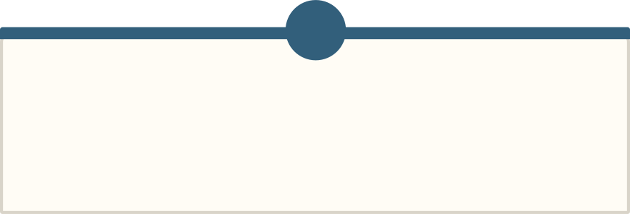
OPERATING SYSTEM
Turn One-Off Deal Analysis Into a Reusable Partnership System
The highest leverage opportunity is not executing one deal well — it is building an operating system that makes every subsequent deal faster, more consistent, and more defensible. The lifecycle below represents a repeatable workflow from inbound proposal to benchmark library update. Each stage has a defined owner, a defined output, and a clear designation of where Claude assists versus where human judgment is the required gate.
Inbound Proposal
Structured Term Extraction
Diligence Questions
Comparable Retrieval
Claude Assists — Acceleration Stages
Human Decision Gates — Mandatory Approval Points
Structured Term Extraction
1
2
Claude parses inbound proposals into a standardized term sheet format, flagging ambiguities and missing fields for human review. Output is a structured data record, not a recommendation.
Comparable Retrieval
Diligence Question Approval
Assumption Register Sign-Off
Claude surfaces structurally similar transactions from the benchmark library, applies comparability scoring, and flags source quality. Human reviewers validate the shortlist before it enters valuation.
Partnership lead and relevant SMEs (Product, Research, Legal) approve the diligence question set before external communication.
Finance and Strategy sign off on every assumption used in the valuation model. No scenario is generated from unapproved assumptions.
Valuation Scenarios
3
4
Claude populates the value stack framework across scenarios using the assumption register. Sensitivity tables and waterfall outputs are generated for human review, not issued as conclusions.
Benchmark Library Update
Red-Team Challenge
Approvals and Contracting
Claude extracts deal metadata from completed transactions and updates the library with normalized comparables, preserving source citations and comparability scores.
A designated internal challenger — independent of the deal team — stress-tests assumptions and flags motivated reasoning before the negotiation brief is finalized.
Final deal recommendation and term sheet approved by designated authority level (Finance, Legal, senior leadership) before any binding commitment.

Slide 8






RELIABILITY & TRACEABILITY
AI Accelerates the Work; It Does Not Own the Judgment
The governance design of this system is as important as the analytical design. In a context where AI-generated outputs inform material financial and strategic decisions, the controls architecture must be explicit, auditable, and robust to motivated reasoning. Six controls govern every analysis produced by this framework.
Six Structural Controls
Decision History Timeline — Illustrative
Every Assumption Visible
The assumption register and decision log create a traceable record of how recommendations evolve as evidence improves. The timeline below shows an illustrative assumption change and its downstream effect on the recommendation.
No assumption is embedded silently in a formula or model. Each assumption is surfaced in the assumption register with an owner, a source, and a confidence rating. Reviewers can challenge any individual assumption without re-running the entire analysis.
Week 1 — Initial Valuation
Every Benchmark Linked to Evidence
Distribution value assumed at $8M (base) based on Atlas stated pipeline. Confidence factor: 0.72. Base case confidence-adjusted value: $25.2M. Recommendation: proceed to pilot negotiation.
Comparable transactions are cited to their source (filing, press release, analyst report, earnings call). Inferred figures are labeled as estimates. Comparability scores are shown, not hidden.
Week 3 — Assumption Challenged
Synthetic Facts Separated from Public Facts
Strategy team requests evidence for Atlas enterprise channel. Atlas provides pipeline data; third-party reference calls incomplete. Distribution value revised to $4M. Confidence factor revised to 0.64.
All case economics used for methodology demonstration are labeled "Synthetic case." No AI-generated claims are presented as factual without a traceable primary source.
Week 4 — Recommendation Updated
Confidence Levels Explicit
Revised base case confidence-adjusted value: $19.8M. Gap to proposed cost widens to –$11.2M. Recommendation updated: pilot required before any full-term commitment; exclusivity must be milestone-gated.
Confidence factors are displayed alongside every scenario output. Outputs with confidence factors below 0.60 are flagged for additional diligence before proceeding to negotiation preparation.
Week 6 — Human Gate Approved
AI Drafts Labeled
Updated recommendation reviewed and approved by Finance and Partnership lead. Decision log entry created. Negotiation brief issued with revised position map reflecting updated valuation.
All Claude-generated outputs carry a "Draft — pending human review" label until explicitly approved by a designated human reviewer. Labels are not removable by the AI layer.
Final Recommendations Human-Approved and Auditable
The final negotiation brief and deal recommendation are approved by a named individual. The approval, rationale, and version of the underlying model are logged in the decision history.
Decision history logs are retained regardless of deal outcome and feed the benchmark library for future comparable retrieval. Illustrative only.

Slide 9
PROOF OF WORK
What the Prototype Demonstrates
A working model of the role, not a speculative essay.
This presentation — and the analytical system it describes — demonstrates that the role of an AI-enabled partnership function is not to replace judgment but to make judgment more transparent, more defensible, and more consistently applied at scale. The four capability domains below represent the working scope of the prototype.
Valuation Frameworks & Financial Modeling
Deal Support & Negotiation Strategy
A structured value stack with explicit positive and negative components; scenario analysis across downside, base, and upside cases; confidence-factor methodology with five scored dimensions; sensitivity analysis tied to the assumption register. All assumptions visible and challengeable.
Opening position, target range, reservation value, and walk-away point — documented before negotiation begins. Give/get matrix with pre-approved trades. Comparable-transaction normalization with explicit comparability scoring and adjustment notes. Pilot structure design with milestone-based triggers.
Cross-Functional Operating Systems
Claude-Enabled Analysis with Human Governance
A repeatable lifecycle from inbound proposal to benchmark library update. Defined handoffs between Claude-assisted stages and human decision gates. Assumption register sign-off protocol. Red-team challenge step built into the workflow before any negotiation brief is issued.
AI accelerates term extraction, comparable retrieval, scenario population, and library updates. Human approval is mandatory at assumption sign-off, red-team review, and final deal recommendation. All AI outputs labeled as drafts until approved. Decision history auditable and retained.
The system converts ambiguous partnership proposals into transparent assumptions, defensible valuation ranges, actionable negotiation positions, and reusable organizational learning — at a pace and consistency that one-off deal analysis cannot match.
All companies, deal names, and economics in this presentation — including Atlas Knowledge Systems and all synthetic comparables — are entirely fictional and used solely to demonstrate methodology. No factual claims are made about any real organization, partnership, or transaction.

