Slide 1
Who most likely needs a pod?
Lucy g. ng’ang’a

Slide 2
Outline
Context & Goal
Task
Challenges & Requirements
Data
Exploratory Data Analysis
Modelling
Data split
Feature selection
Feature Engineering
Discussion
Recommendation

Slide 3
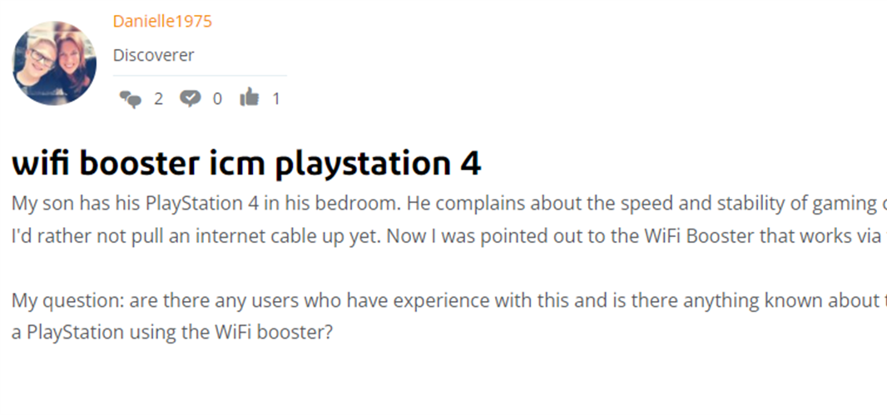
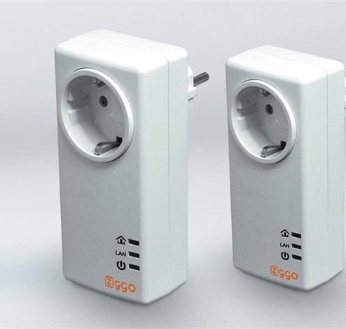
Context & Goal
Improve customer experience and satisfaction

Slide 4
Task
Identify customer in need of a pod, potentially…

Slide 5
Classify/recommend pod
Challenges/Requirements
Imbalanced classification
Use F1and/or balanced accuracy for model validation
Big data
Use eager learners which take long time to train but less time to predict
Regular prediction
Daily predictions should be done on only new customers or customers who have changed
Quarterly retraining

Slide 6
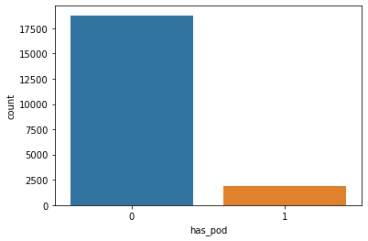
data
20627 unique customers
1862 ( 9.02%) customers with pods
Good quality data
No missing data
No duplicates
No mixed data types
22 features
10 : Devices
10 : Network
2 : Pod identifier and count

Slide 7
EDA

Slide 8
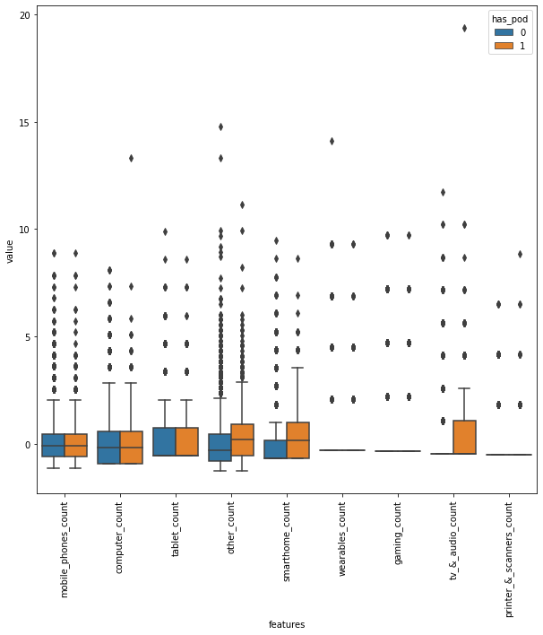
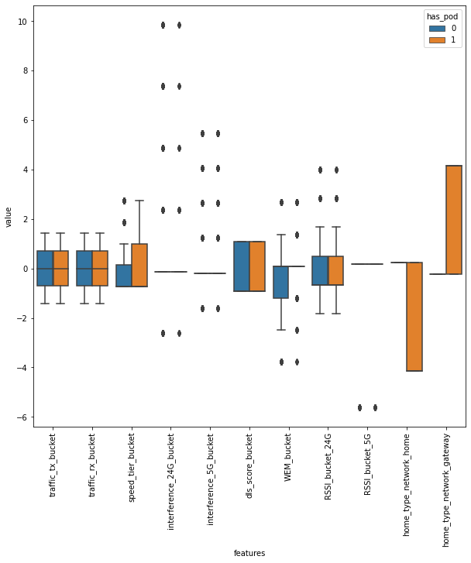
Boxplots

Slide 9
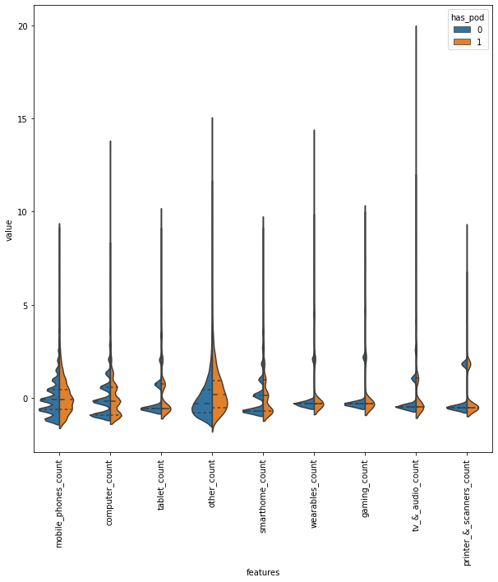
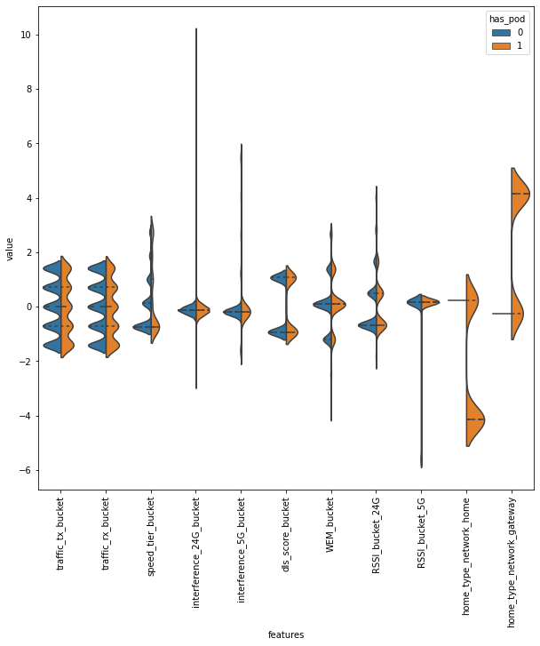
Violin plots

Slide 10
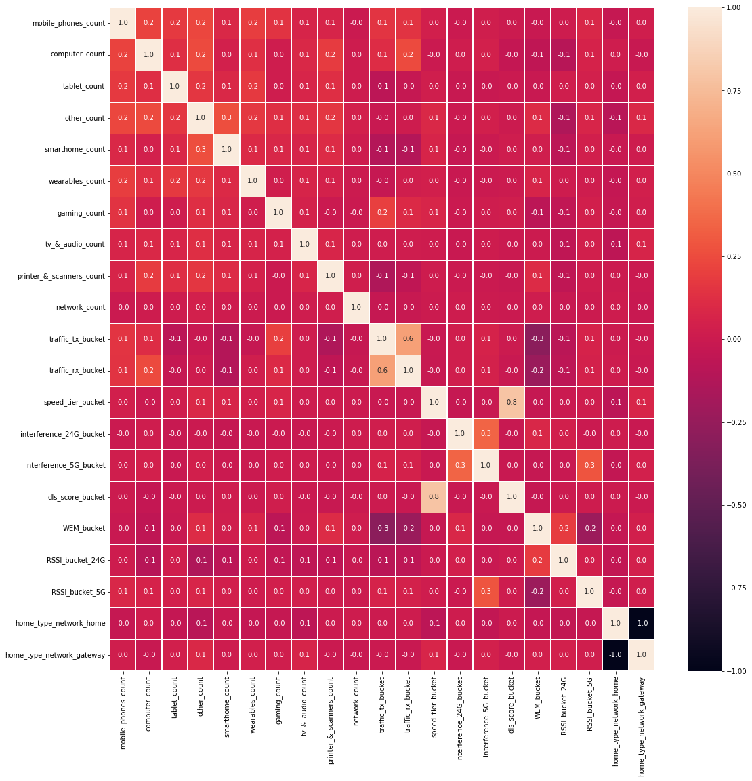
Pearson Correlation
Speed Tier Bucket highly correlated with DLS Score Bucket
Attributes dropped
Home Network Type Home
DLS Score Bucket
Traffic RX Bucket

Slide 11
Notable association with pods
Other count
Smart Home Presence
Speed Tier Bucket
Home Network Type Gateway

Slide 12
Modelling

Slide 13
Data Split

Slide 14
Feature selection (train subset)
Select Best –Chi Squared test
Recursive Feature Elimination
Because of a lot of count (nonnegative) the chi squared test is ideal to eliminate features based on accuracy
Done iteratively found that two best features
Other count
Home Network Type Gateway
Recursively removes attributes and builds a model on the remining attributes to maximize the balanced accuracy
Mobile Phone Count
Computer count
Other Count
Smart Home Count
Home Network Type Gateway
Devices Count

Slide 15
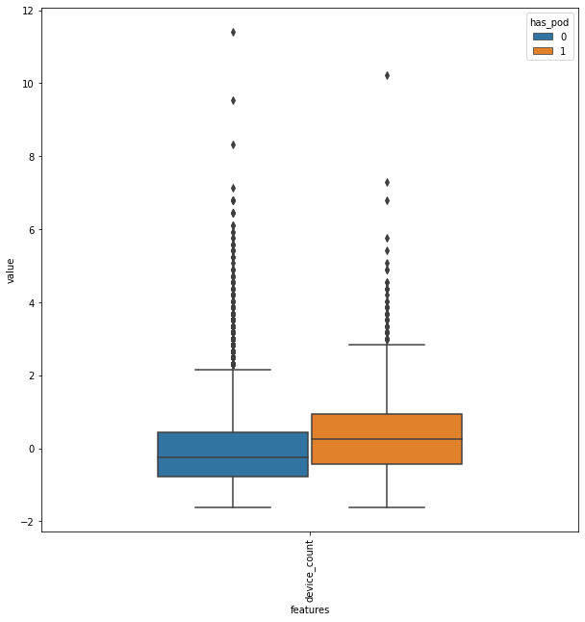
Feature Engineering
Device count = Sum of (mobile, computer, smarthome and other devices)
Home Network Type Gateway

Slide 16
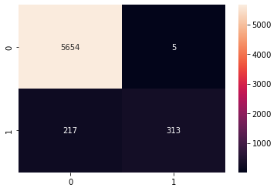

Models fitted
Decision Tree Classifier
Logistic Regression

Slide 17
Summary
 | Decision Tree Classifier | Logistic Regression
Test Size | 6189 (530 with Pod) | 6189 (530 with Pod)
True positive | 313 | 314
False positive | 5 | 0
True Negative | 5654 | 5659
False Negative | 217 | 216
True positive rate (recall) | 0.5905 | 0.5924
False positive rate | 0.0008 | 0.0
Precision | 0.9842 | 1.0
True Negative rate | 0.9991 | 1.0
F1 | 0.7382 | 0.7440
ROC - AUC | 0.7948 | 0.7962
MCC | 0.7474 | 0.7554

Slide 18
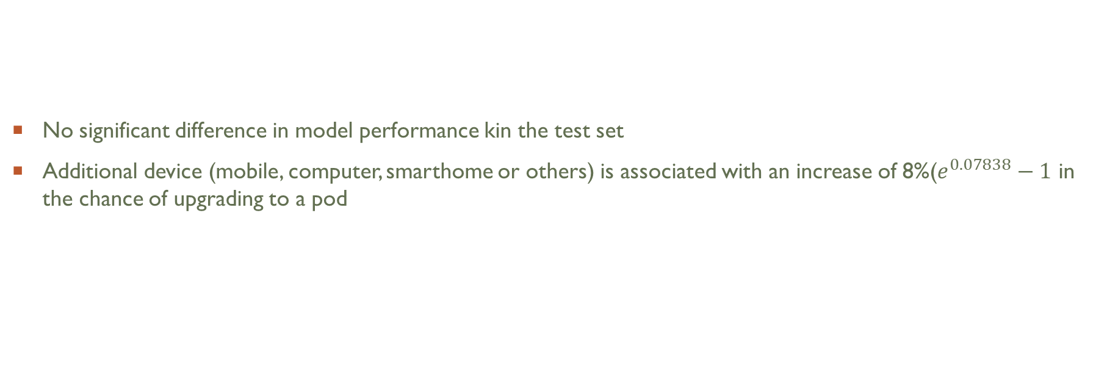
Discussion
No significant difference in model performance kin the test set
Additional device (mobile, computer, smarthome or others) is associated with an increase of 8%($e^{0.07838}−1$ in the chance of upgrading to a pod

Slide 19
Recommendation
Use logistic regression with two variables (see slide 14)
100% precise (0 false positives)
Fast prediction even with massive data
Less training time and expertise
Flexible – Based on the number of customers the marketing team can target, one can increase/decrease probability threshold

