Slide 1
This Presentation
includes first 5 pages
(of 27) for illustration purposes.
🍿🥤

Slide 2







Welcome to
Explore
Eat for Less
Online Shop
Sports and Taster Days

Slide 3


Who are we?
is a not-for-profit membership organisation founded in 1921.
Our aim is to promote fulfilling lifestyles by providing sport and leisure opportunities to our 120,000+ members.
Membership is open to the civil service and public sector.

Slide 4

Our aim is to encourage members to keep active and try something new so that they can achieve a healthy and fulfilling lifestyle.
What we do?
Promote fulfilling lifestyles
by providing sport and
leisure opportunities.

Slide 5

Whether you love sport, want to try something new, explore, have fun or enjoy great savings, CSSC is here for you.
Our Benefits

Slide 6
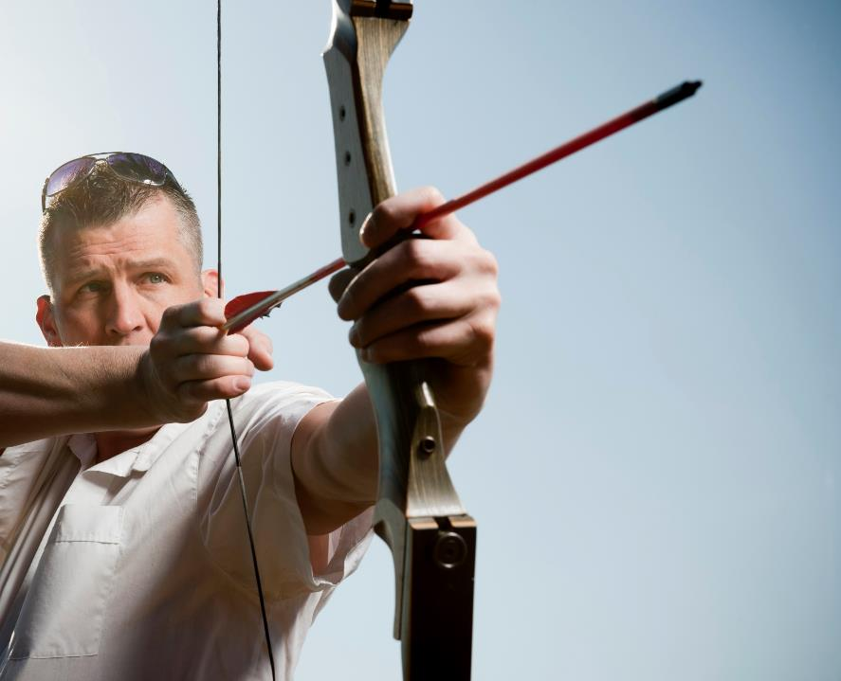
Sports
taster days
&
Take part
in our huge range of
SPORTING ACTIVITIES
for all abilities, with over 60 different sports to
choose from.
Our
TASTER DAYS
are the perfect way to try something new without spending too much
time or money.

Slide 7
Thank you
For watching.
😀

