Slide 1





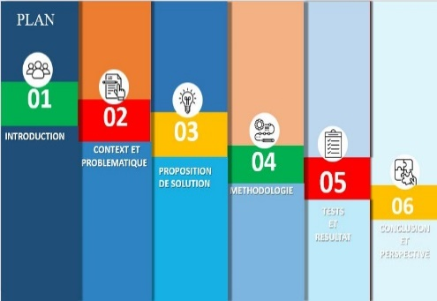

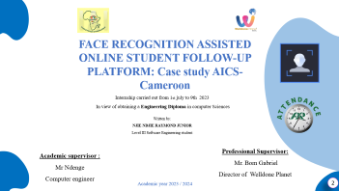
FACE TRACK
WELCOME TO MY PROJECT VALIDATION
1
Notes:
Merci monsieur le président du jury de me passer la parole.
Monsieur le président du jury, Honorable membre du jury, mesdames et messieurs; avant de commencer mon propos, je voudrais souhaiter à l’assemblée ici présente la bienvenue au sein de cette institution de l’excellence, comme son nom l’indique centre d’excellence technologie Paul Biya, pour la validation ou du moins la présentation de mon travail effectué durant ces 3 derniers mois en vue de l’obtention du DITI.

Slide 2



FACE RECOGNITION ASSISTED ONLINE STUDENT FOLLOW-UP PLATFORM: Case study AICS-Cameroon
Internship carried out from 1st july to 9th 2023
In view of obtaining a Engineering Diploma in computer Sciences
Written by:
NJIE NDJIE RAYMOND JUNIOR
Level III Software Engineering student
Professional Supervisor:
Mr. Bom Gabriel
Director of Welldone Planet
Academic supervisor :
Mr Ndenge
Computer engineer
Academic year 2023 / 2024
2

Slide 3






PLAN
01
02
03
INTRODUCTION
CONTEXT AND PROBLEMATIC
04
PROPOSED SOLUTION
05
METHODOLOGY
06
TESTS
AND RESULTS
CONCLUSION
AND PERSPECTIVE
3

Slide 4
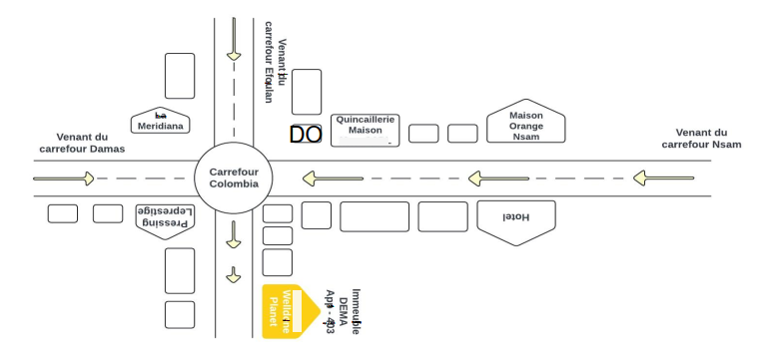


1
Introduction
2
About Welldone planet
3
Objectifs
4
services
OBJECTIFS
SERVICES
-Reduce poverty
- Mobile DEV
-Innovation
- Web DEV
-Train youths
-IOT
-BIG DATA…
c
LOGO
4

Slide 5
CONTEXT
STATISTICS
19,5%
80,65%
MANUAL GESTION
ASSISTANCE GESTION
Source: https://www.academia.edu/38191378/Circuler_et_stationner_%C3%A0_Yaound%C3%A9_parkings_publics_et_r%C3%A9gulation_de_la_mobilit%C3%A9_urbaine_Salifou_Ndam
5

Slide 6




Existant
6

Slide 7






Consequences
1-Inaccurate Attendance Records
2- Delayed Identification of Truancy
3- Inconsistent Exam Integrity
4- Ineffective Disciplinary Communication
5- Lack of Real-Time Parental Insight
Source capture: Vidéo GenKonnect orange
8
Notes:
Here are five consequences resulting from the issues in the current attendance and disciplinary management system at AICS-Cameroon:
1. **Inaccurate Attendance Records**:
- **Consequence**: Favoritism by class delegates can lead to inflated attendance records for absent students. This undermines the accuracy of attendance data and can affect academic and disciplinary evaluations.
2. **Delayed Identification of Truancy**:
- **Consequence**: Weekly attendance data is only updated and posted after a month, leading to a significant delay in identifying and addressing chronic absenteeism. Students can continue to skip classes without immediate consequences.
3. **Inconsistent Exam Integrity**:
- **Consequence**: The lack of robust identity verification during exams may lead to academic dishonesty, such as students having others write exams on their behalf. This compromises the fairness and credibility of the examination process.
4. **Ineffective Disciplinary Communication**:
- **Consequence**: Students often inform their parents about disciplinary actions rather than the school administration. This can result in poor communication and delayed responses from parents, potentially exacerbating behavioral issues.
5. **Lack of Real-Time Parental Insight**:
- **Consequence**: Parents only receive attendance and fee status information at the end of the academic year, which prevents them from taking timely action to address their child's academic and behavioral issues. This lack of real-time updates can lead to increased student failures and unresolved issues.

Slide 8

problematic
How can we design and implement an enhanced facial recognition-based attendance system to improve student experience and ensure reliable, secure attendance tracking at AICS Cameroun?"
9

Slide 9
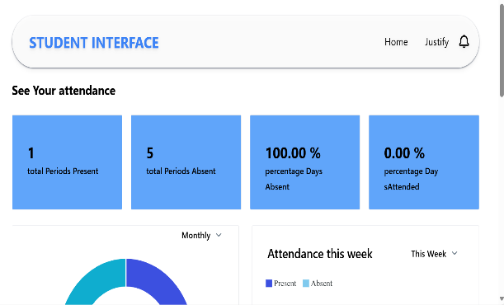
Face Track
10

Slide 10
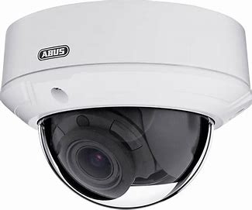


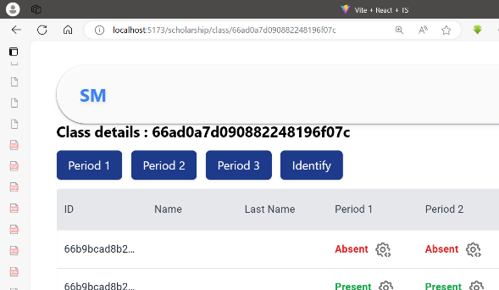
From a simple click

Slide 11



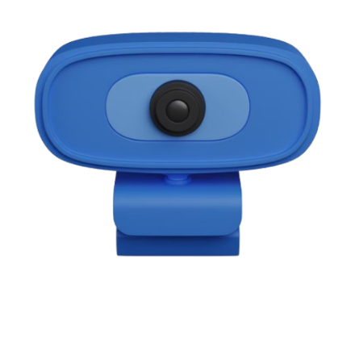
PROPOSED SOLUTION
Real Time Attendance Tracking
Regular Updates
Enhanced verification
Parental Involvement
Remote troubleshooting
Digital Attendance System
web application
11

Slide 12







Advantages of Face Track
ACCESSIBILITY
DATA STATS
TIME AND COST SAVING
Enhanced Security and Fraud Prevention
Scalability and Flexibility
Improved Accuracy and Reliability
12
Notes:
Here are five short points on the advantages of a face recognition system for attendance:
1. **Improved Accuracy and Reliability**: Face recognition systems offer a more accurate and reliable method of tracking attendance compared to traditional manual sign-in or card-based systems. They can precisely identify individuals and eliminate the possibility of proxy attendance or buddy punching.
2. **Increased Efficiency and Time Savings**: Automated face recognition eliminates the need for manual attendance tracking, streamlining the process and reducing the time spent on administrative tasks. This can lead to significant time savings and increased productivity.
3. **Enhanced Security and Fraud Prevention**: Face recognition systems can help prevent attendance-related fraud, as they can accurately identify individuals and prevent unauthorized access or proxy attendance.
4. **Scalability and Flexibility**: Face recognition systems can be easily scaled to handle large numbers of employees or students, making them suitable for organizations of various sizes. They can also be integrated with other systems, such as HR or payroll, for seamless data management.
5. **Improved Attendance Monitoring and Analysis**: Face recognition systems can provide detailed attendance data, allowing organizations to monitor and analyze attendance patterns, identify trends, and make informed decisions about workforce management or academic performance.

Slide 13

Approach:UML(Unified Modeling Language)
Static view
Dynamic view
Usecase diagram
Communication diagram
Package diagrams
Version 2.5
Sequence diagram
Objet diagram
State Machine diagram
Why UML?
Class diagram
Activity diagram
Driven by user needs
Component diagram
Formal and standardized language
Deployment diagram
Support de communication performant
13

Slide 14
METHODOLOGY:2TUP(Two Track Unified Process)
Functional branch
Technical branch
Why 2TUP?
Capture of business requirements
Capture of technical requirement
Driven by user requirements
Analysis
Generic design
Driven by risks
Centered on architecture
Component-oriented
Preliminary design
Detailed design
Coding;test and recipe
Realization branch
14

Slide 15
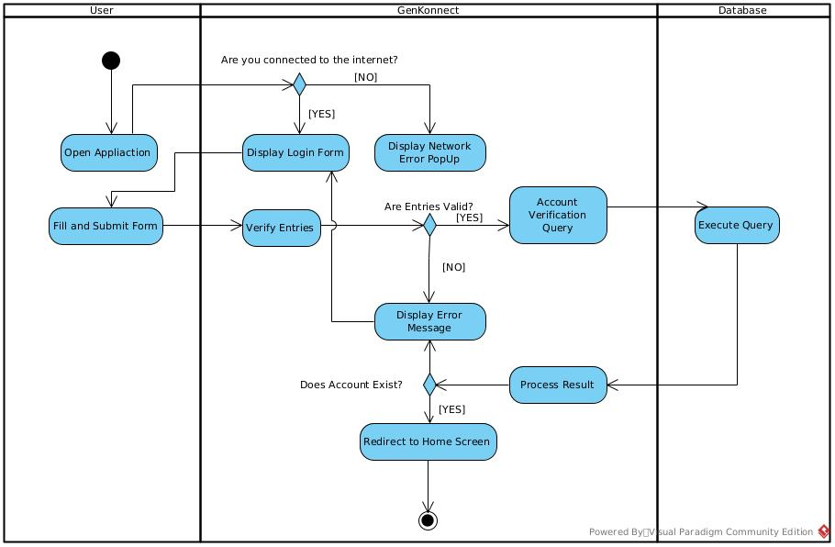
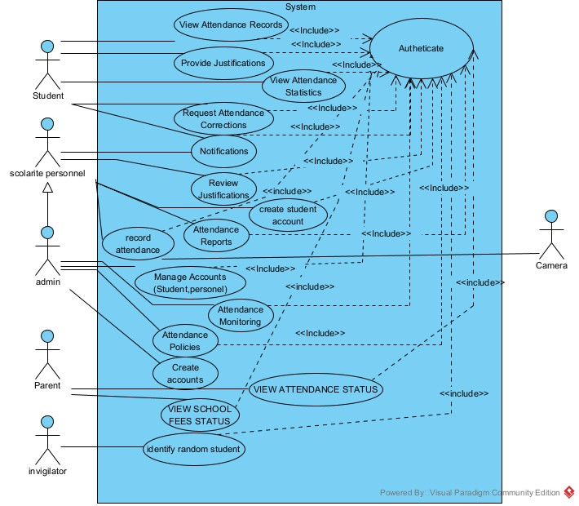
METHODOLOGY:
Functionnal branch
Capture of business requirements
Analysis
Usecase diagram
Activity diagram
15
6

Slide 16
METHODOLOGY: SEQUENCE DIAGRAM
Preliminary design
Detailed design
Sequence diagram
16
6

Slide 17
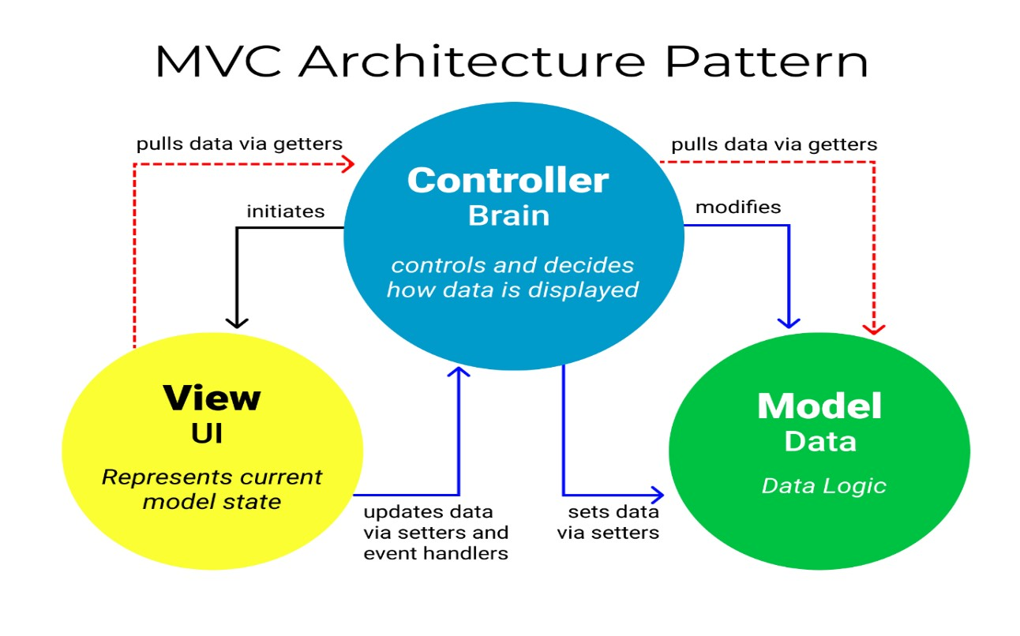
Logical architecture

Slide 18
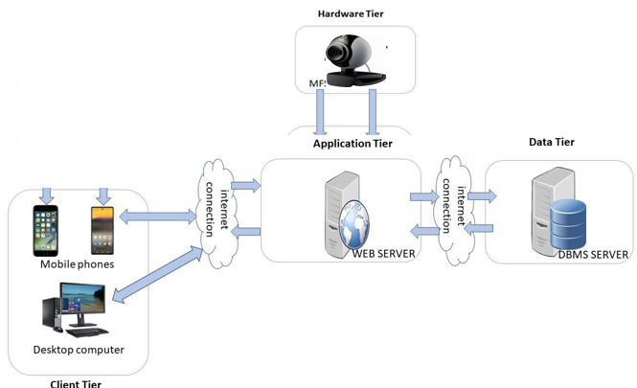
Physical architecture
17

Slide 19








Software and languages used
Backend(API)
web programing
Schemas and diagrams
Organisation
20

Slide 20
DEMONSTRATION
23

Slide 21
6
CONCLUSION: perspectives; percentages
We estimate our work at: 60%
We have as perspectives:
Implement an parent side interfaces
60%
50%
Ensure appropriate registering of parent numbers
analysis
conception
Implement strict class policy
50%
80%
implementation
report
24

Slide 22
CONCLUSION
25

