Slide 1

Exploratory Data Analysis On IMDb Website

Slide 2


Slide 3
Background ? (B-tech or M-tech)
I am from a Computer Engineering Background, which has given me a background in both Hardware concepts and software development.
This combination helps me approach problems from a technical and analytical perspective.
LinkedIn:-
  https://www.linkedin.com/feed/?trk=guest_homepage-basic_nav-header-signin
GitHub:-
https://github.com/Lucy-star-144

Slide 4
Why you want to learn Data Science ?
I want to learn Data Science because it combines my interest in programming, mathematics, and real-world problem solving. With the rapid growth of data in every field—business, healthcare, technology, and beyond—being able to extract meaningful insights has become one of the most valuable skills.
Learning Data Science will help me bridge the gap between raw data and actionable decisions, and open opportunities in AI, predictive analytics, and intelligent systems.
Ultimately, I see Data Science as a way to turn data into impact, whether it’s improving business strategies, building smarter applications, or contributing to research that benefits society.

Slide 5
Agenda
Business Problem and Use case domain understanding(If Required)
Objective of the Project
Web Scraping – Details (Websites, Processor you followed)
Summary of the Data
Exploratory Data Analysis:
Data Cleaning Steps
Data Manipulation Steps
Univariate Analysis Steps
Bivariate Analysis Steps
Key Business Question
Conclusion (Key finding overall)
Q&A Slide
Your Experience/Challenges working on Web Scraping – Data Analysis Project.

Slide 6
Business Problem
Streaming platforms and content producers need to understand:
Which genres are most popular and highly rated by audiences.
Whether ratings are influenced by factors such as runtime, release year, critic scores (Metascore), and audience votes.
Which content certifications (PG, PG-13, TV-MA, etc.) attract higher audience engagement.
What characteristics are associated with highly rated titles.
How audience ratings and critic scores vary across different genres.

Slide 7
Use Case Domain Understanding
Domain: Entertainment / Media Analytics
The entertainment industry generates large amounts of data related to movies and TV shows, including ratings, audience votes, genres, runtime, release year, certifications, and critic scores.
Analyzing this data helps streaming platforms, production houses, and content creators understand audience preferences and content performance.
Use Case
A streaming platform or content provider wants to understand:
Which genres are most popular among viewers.
What factors contribute to higher IMDb ratings.
Whether critic scores (Metascore) align with audience ratings.
Which certifications (PG, PG-13, TV-MA, etc.) attract more audience engagement.
How runtime, genre, and release year influence ratings and popularity.

Slide 8
Objective
Analyze IMDb ratings and audience engagement.
Identify top-performing genres.
Study relationships among ratings, votes, runtime, year, and metascore.
Compare content performance across certification categories.
Generate insights to understand audience preferences and content success.

Slide 9
Web Scraping – Details (Websites, Process followed)

Slide 10
Data Source
Website: IMDb
Data Collected: Movies and TV Shows information
Extraction Method: Web Scraping using Python
Tools & Libraries Used
Python
Requests
BeautifulSoup
Pandas
Information Extracted
Title
Release Year
Genre
IMDb Rating
Runtime
Certificate
Metascore
Number of Votes
Purpose
To build a structured dataset for analyzing audience preferences, ratings, and content characteristics.

Slide 11
Workflow
Data Cleaning Performed
Removed duplicates
Handled missing values
Converted data types
Extracted numerical values from text fields
Standardized Genre and Certificate fields
Created derived columns such as Votes_K
Challenges Encountered
Missing Metascore values
Missing Runtime values
Multiple genres stored together
Different formats for vote counts and ratings
IMDb Website
↓
Send HTTP Request
↓
Retrieve HTML Content
↓
Parse HTML using BeautifulSoup
↓
Extract Required Fields
↓
Store Data in Pandas DataFrame
↓
Data Cleaning & Preprocessing
↓
Exploratory Data Analysis

Slide 12
Problem Understanding
↓
Web Scraping
↓
Data Cleaning
↓
Feature Engineering
↓
Exploratory Data Analysis
↓
Insights & Conclusions

Slide 13
Summary of the Data
Dataset Summary
Source: IMDb Website (Web Scraping)
Dataset Size: ~500 Movies and TV Shows
Features: Title, Year, Genre, Rating, Runtime, Metascore, Votes, Certificate
Numerical Variables: Year, Rating, Runtime, Metascore, Votes_K
Categorical Variables: Genre, Certificate
Data Pre-processing: Missing value handling, data type conversion, genre normalization, feature engineering
Focus Areas: Rating Analysis, Genre Analysis, Audience Engagement Analysis
Key Observation: The dataset is largely concentrated in recent years (2025–2026) and contains a mix of audience ratings, critic scores, and engagement metrics.

Slide 14
Data Cleaning Steps
Checked dataset shape and data types.
Identified and handled missing values.
Removed duplicate records (if any).
Standardized column formats.
Converted Year, Rating, Runtime, Metascore, and Votes into appropriate data types.
Created an "Unknown" category for missing certificates where required.
Data Manipulation and Feature Engineering
Extracted and cleaned Genre information.
Split multiple genres and exploded them into individual records for genre-level analysis.
Converted vote counts into a numerical format (Votes_K).
Created pivot tables and cross-tabulations for comparative analysis.
Grouped data by Genre, Certificate, and Year to derive insights.

Slide 15
Univariate Analysis
Numerical Variables
Year
Rating
Runtime
Metascore
Votes_K
Techniques Used:
Descriptive statistics
Histograms
KDE plots
Boxplots
Categorical Variables
Genre
Certificate
Techniques Used:
Frequency counts
Countplots
Percentage distribution analysis
Bivariate Analysis
Numerical vs Numerical
Correlation Analysis (Pearson, Spearman, Kendall)
Scatter Plots
Line Plots
Pairplots
Examples:
Rating vs Votes_K
Runtime vs Rating
Metascore vs Votes_K
Categorical vs Numerical
GroupBy Analysis
Boxplots
Violin Plots
Examples:
Genre vs Rating
Genre vs Runtime
Certificate vs Rating
Categorical vs Categorical
Crosstabs
Heatmaps
Stacked Bar Charts
Clustermaps
Examples:
Genre vs Certificate
Genre vs Year
Certificate vs Year

Slide 16
Key Business Questions
Which genres receive the highest IMDb ratings?
Which genres attract the highest audience engagement (Votes)?
Is there a relationship between IMDb ratings and audience votes?
How do runtime and release year influence ratings?
Do critic scores (Metascore) align with audience ratings?
Which certification categories (PG, PG-13, TV-MA, etc.) perform best in terms of ratings and popularity?
Which Genre–Certificate combinations receive the highest ratings and audience engagement?
What characteristics are commonly associated with highly rated titles?

Slide 17
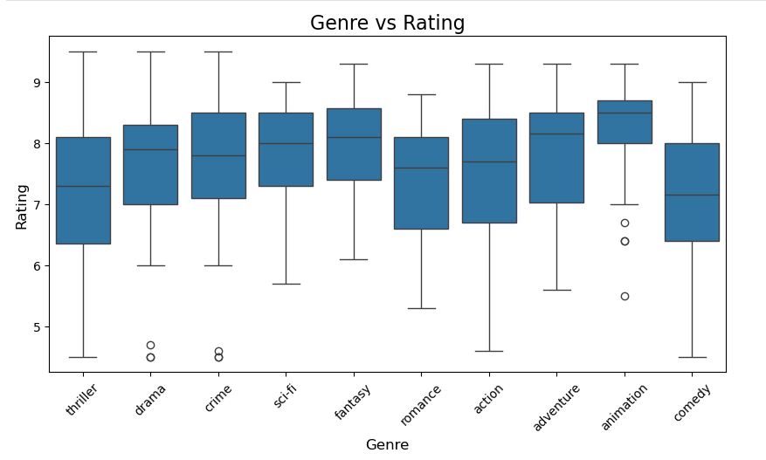
Which genres receive the highest IMDb ratings?
Insights
Which genre has the highest median rating?
Which genre has the widest spread of ratings?
Which genre is most consistent?
Which genres contain exceptionally high rated titles(outliers)?

Slide 18
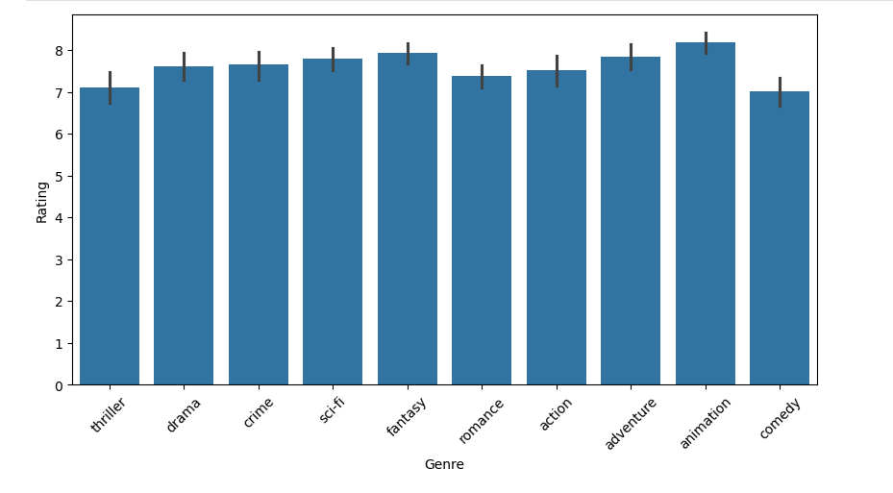
Observations
Animation has the highest median rating (around 8.5), indicating that animated titles tend to receive the strongest audience ratings.*
Comedy and Thriller have comparatively lower median ratings, suggesting these genres receive lower audience ratings on average.
Action and Thriller show the widest spread of ratings (largest overall range), indicating greater variability in audience reception.
Animation has a relatively narrow box (small IQR), making it one of the most consistent genres in terms of ratings.
Most genres have median ratings above 7.0, indicating generally positive audience reception across the dataset.
Drama, Crime, and Adventure contain a few unusually low-rated titles, visible as outliers below the lower whiskers.
Several genres reach ratings above 9.0, showing that highly rated titles are present across multiple genres.
Conclusion
Animation emerges as the highest-rated and most consistent genre, while Action and Thriller exhibit greater variation in ratings. Overall, most genres receive favorable ratings, with median ratings generally above 7.0.

Slide 19
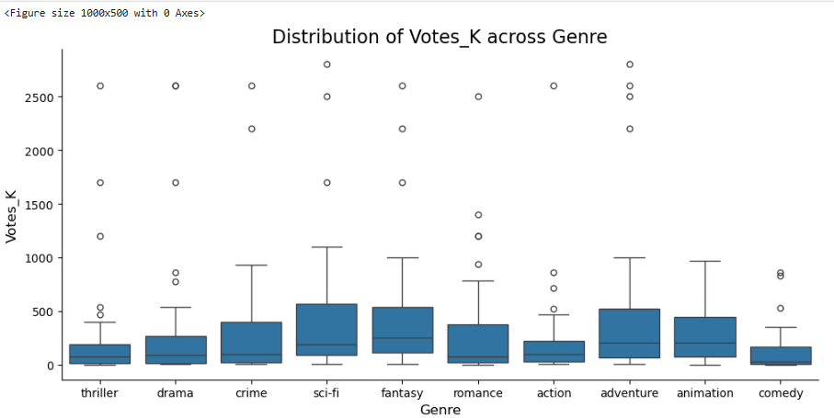
Which genres attract the highest audience engagement (Votes)?
Observations-
Fantasy, Sci-fi, Adventure, and Animation have the highest median vote counts, indicating that these genres generally attract greater audience engagement.
Comedy, Drama, and Thriller show comparatively lower median vote counts, suggesting lower audience engagement on average.
Sci-fi, Fantasy, and Adventure exhibit a wider spread of votes (larger IQRs), indicating substantial variation in popularity among titles within these genres.-
Most genres contain several high-vote outliers, showing that a few exceptionally popular titles attract significantly more audience attention than the majority of titles.-
The highest outliers (above 2,000K votes) are observed in genres such as Crime, Fantasy, and Adventure indicating the presence of extremely popular titles.
Comedy has one of the lowest median vote counts and a relatively compact distribution, suggesting more consistent but lower audience engagement.
Conclusion
Audience engagement varies across genres, with Fantasy, Sci-fi, Adventure , and Animation generally attracting higher vote counts.
While most genres contain a few exceptionally popular titles, Comedy, Drama, and Thriller tend to receive lower audience engagement overall.The presence of several extreme outliers suggests that a small number of highly popular titles significantly influence audience participation within certain genres.

Slide 20
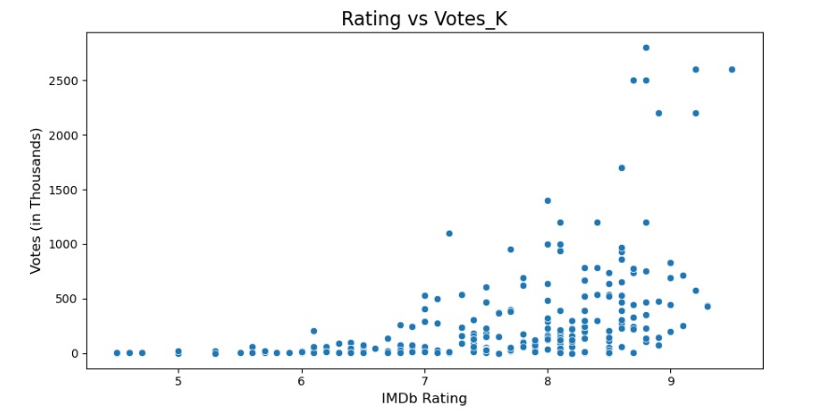
Is there a relationship between IMDb ratings and audience votes?
Observations:
The scatter plot shows a moderate positive relationship between IMDb Rating and Votes_K.
In general, titles with higher ratings tend to attract a larger number of audience votes.
Most titles are concentrated in the rating range of 7 to 9, indicating that the majority of movies/shows in the dataset are fairly well-rated.
A few titles have exceptionally high vote counts (above 2000K votes), appearing as outliers in the dataset.
The spread of vote counts increases as ratings increase, suggesting that highly rated titles can vary greatly in popularity.
While higher-rated titles generally receive more votes, the relationship is not perfect.
Some titles with similar ratings have significantly different vote counts. The presence of several high-vote outliers contributes to the positive correlation observed between Rating and Votes_K.
Conclusion
The scatter plot indicates a moderate positive association between IMDb ratings and audience engagement.
Titles with higher ratings tend to receive more votes, suggesting that well-received content often attracts greater
audience attention and participation.

Slide 21
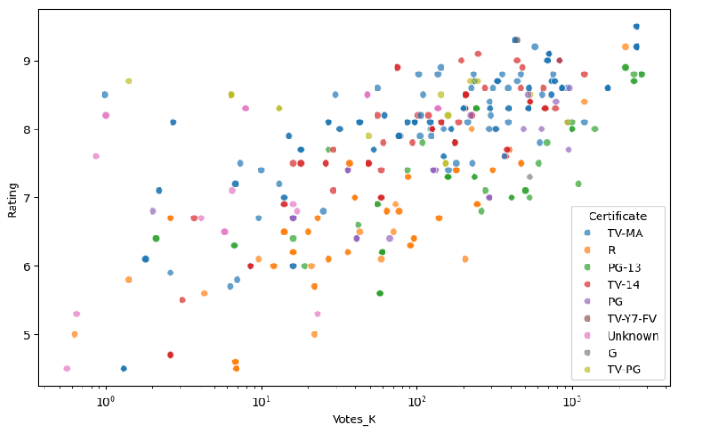
Which certification categories (PG, PG-13, TV-MA, etc.) perform best in terms of ratings and popularity?
Observations-
A moderate positive relationship exists between audience votes and IMDb ratings.
Titles with higher ratings generally tend to receive more audience votes.
Several highly voted titles have ratings above 8.0, indicating strong audience engagement.
TV-MA titles are frequently observed in the higher-rating region of the plot.
Lower-rated titles generally receive fewer votes, although some exceptions are present.
Overall, audience engagement tends to increase as ratings increase.
Conclusion
The analysis suggests a positive relationship between IMDb ratings and audience engagement.
Titles with higher ratings generally attract more audience votes, while certificate categories
such as TV-MA contain several highly rated and highly engaged titles.

Slide 22
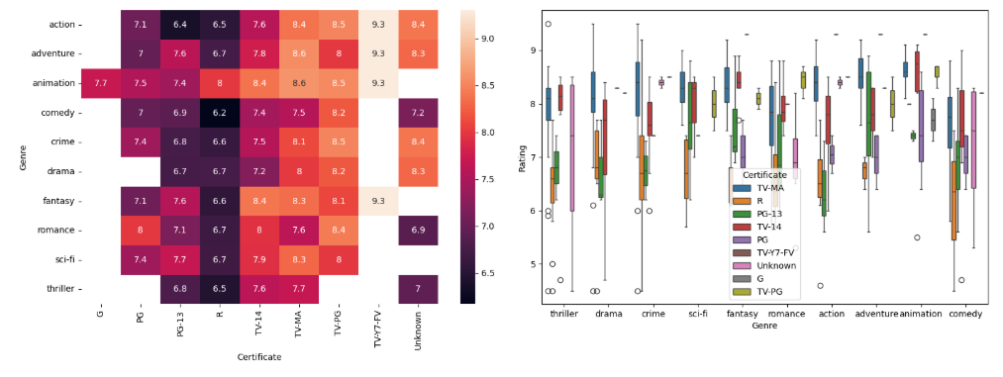
Which Genre–Certificate combinations receive the highest ratings and audience engagement?

Slide 23
Heatmap (Genre × Certificate × Rating)
Observations
Average ratings vary across both genres and certificate categories.-
TV-MA consistently shows high ratings across most genres, generally above 8.0.
Animation records some of the highest average ratings across multiple certificate categories.
Adventure, Fantasy, and Sci-fi maintain strong ratings irrespective of certification.
R-rated titles generally have lower average ratings compared to TV-14 and TV-MA titles.
The TV-Y7-FV category shows exceptionally high ratings (9.3), though this may be due to a limited number of observations.
The heatmap indicates that both genre and certification influence audience ratings.
Conclusion
Genres such as Animation, Adventure, Fantasy, and Sci-fi perform strongly across several certification categories, while TV-MA certified titles generally receive the highest audience ratings.
Grouped Boxplot (Genre vs Rating by Certificate)
Observations
Rating distributions vary considerably across genres and certificate categories.
TV-MA titles generally exhibit higher median ratings than PG and R-rated titles
Animation, Adventure, and Fantasy show relatively high median ratings across multiple certificates.- Several genres contain outliers, indicating the presence of exceptionally high- or low-rated titles.
Rating variability differs across genres, suggesting differences in audience reception.- PG and R categories generally display lower median ratings compared to TV-14 and TV-MA.
Conclusion
The distribution of ratings suggests that both genre and certification influence audience perception, with TV-MA titles generally receiving stronger ratings.

Slide 24
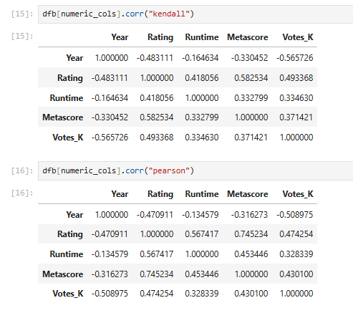
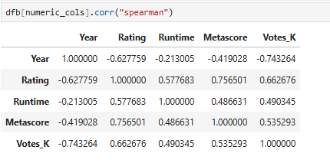
How do runtime and release year influence ratings?
Do critic scores (Metascore) align with audience ratings?
Observations
Rating and Metascore show the strongest positive correlation, indicating that highly rated titles generally receive better critic reviews.
Rating and Runtime have a moderate positive relationship, suggesting that longer titles tend to receive slightly higher ratings.
Rating and Votes_K are moderately positively correlated, indicating that highly rated titles often attract more audience engagement.
Year shows a negative correlation with both Rating and Votes_K, suggesting that older titles generally have higher ratings and more accumulated votes.
Runtime and Metascore exhibit a moderate positive relationship, while Runtime and Votes_K show a weak-to-moderate positive association.
Metascore and Votes_K are moderately positively correlated, indicating that critically acclaimed titles tend to attract greater audience attention.
Similar patterns across Pearson, Spearman, and Kendall correlations suggest consistent relationships among the variables.
Overall Insight
Spearman correlations are generally stronger than Pearson correlations, indicating that many relationships in the dataset are monotonic in nature and not strictly linear.

Slide 25
Conclusion
The analysis identified significant differences in ratings, audience engagement, and critic scores across genres and certification categories.
Animation, Fantasy, and Adventure generally received higher ratings, while Comedy and Thriller showed comparatively lower ratings.
A positive relationship was observed between IMDb Ratings and Votes, indicating that highly rated titles tend to attract greater audience engagement.
Runtime showed a moderate positive association with ratings, with longer titles generally receiving better audience ratings.
Metascore and Rating exhibited a positive relationship, suggesting some alignment between critic and audience opinions.
Genre–Certificate combinations revealed variations in both ratings and popularity, highlighting the importance of content type and target audience.
The dataset was heavily concentrated in recent years, so findings related to release year should be interpreted with caution.

Slide 26
Final Takeaway
Audience ratings and engagement are influenced by a combination of genre, runtime, critic scores, and certification. Understanding these factors can help streaming platforms and content creators make more informed content and recommendation decisions.

Slide 27


Slide 28
Experience Gained
Challenges Faced
Extracting data from complex HTML structures during web scraping.
Handling missing values in Runtime, Metascore, and Certificate fields.
Cleaning and transforming data into a usable format.
Managing multiple genres associated with a single title.
Interpreting trends when the dataset was heavily concentrated in recent years.
Choosing the most appropriate visualizations to represent different types of relationships in the data.
Learned how to collect real-world data using web scraping.
Gained hands-on experience with Python libraries such as BeautifulSoup, Requests, Pandas, Matplotlib, and Seaborn.
Improved skills in data cleaning, preprocessing, and exploratory data analysis.
Learned how to derive meaningful insights from raw data using statistical and visual analysis.
Understood the complete data analytics workflow from data collection to insight generation.

Slide 29
Key Learning
The project provided practical experience in converting unstructured web data into actionable insights through data cleaning, analysis, and visualization, highlighting the importance of data quality and proper analytical techniques.

Slide 30

THANK YOU

