Slide 1

Library Management System

Slide 2


Slide 3
Background And URLs
I am from a Computer Engineering Background, which has given me a background in both Hardware concepts and software development.
This combination helps me approach problems from a technical and analytical perspective.
LinkedIn:-
  https://www.linkedin.com/feed/?trk=guest_homepage-basic_nav-header-signin
GitHub:-
https://github.com/Lucy-star-144

Slide 4
Why Data Science?
I want to learn Data Science because it combines my interest in programming, mathematics, and real-world problem solving. With the rapid growth of data in every field—business, healthcare, technology, and beyond—being able to extract meaningful insights has become one of the most valuable skills.
Learning Data Science will help me bridge the gap between raw data and actionable decisions, and open opportunities in AI, predictive analytics, and intelligent systems.
Ultimately, I see Data Science as a way to turn data into impact, whether it’s improving business strategies, building smarter applications, or contributing to research that benefits society.

Slide 5
Objective of the Project
The objective of this project is to design and implement a Library Management System using MySQL that effectively manages and organizes information related to books, authors, publishers, library branches, borrowers, book loans and the copies of books available.
The system aims to streamline library operations by providing functionalities for tracking book availability, managing multiple copies across branches, maintaining borrower records, and monitoring loan and due dates.
This database structure ensures data integrity, easy retrieval, and efficient updates through the use of relational tables and foreign keys, ultimately improving operational efficiency and reducing manual errors in library management.

Slide 6
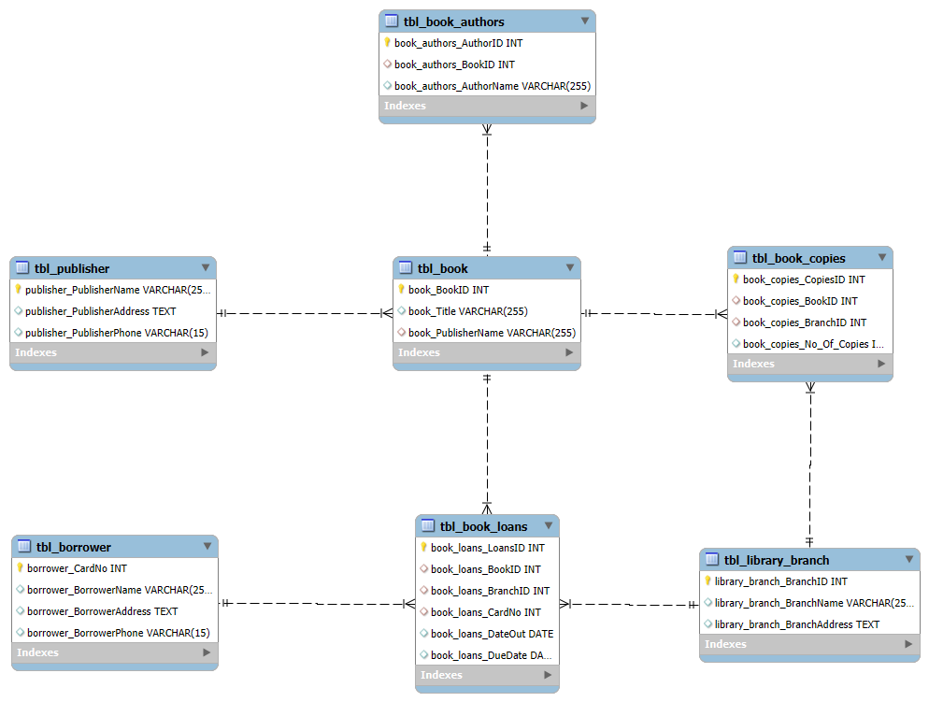
ER Diagram

Slide 7
Schema Explanation
Tables Used:-
tbl_publisher
tbl_book
tbl_book_authors
tbl_library_branch
tbl_book_copies
tbl_borrower
tbl_book_loans

Slide 8
Publisher Table
This is the tbl_publisher table, which stores information about publishers in the library system.
This table keeps track of publisher details like their name, address, and phone number, with the publisher name being unique (primary key).
It has three columns:
publisher_PublisherName → This is the primary key, meaning it uniquely identifies each publisher. No two publishers can have the same name.
2. publisher_PublisherAddress → This column stores the address of the publisher.
3. publisher_PublisherPhone → This column stores the phone number of the publisher, with a limit of 15 digits.

Slide 9
Book Table
This is the tbl_book table, which stores information about books in the library system.
This table stores books with their ID, title, and publisher name. The publisher field is a foreign key, so each book is linked to a publisher from the publisher table.
It has the following columns:
book_BookID → This is the primary key, a unique ID number for each book.
book_Title → This stores the title (name) of the book.
book_PublisherName → This stores the publisher of the book.
    It is a foreign key that connects to the publisher_PublisherName column in the tbl_publisher table.
    This means every book must be linked to an existing publisher in the publisher table

Slide 10
Author_Book_Table
This is the tbl_book_authors table, which stores information about the authors of books.
This table keeps track of book authors. Each author is linked to a book through the BookID (foreign key).
It has the following columns
1. book_authors_AuthorID → This is the primary key and is set to auto-increment, meaning it will automatically generate a unique ID for every author
2. book_authors_BookID → This is a foreign key that links to the book_BookID in the tbl_book table. It shows which book the author has written.
3. book_authors_AuthorName → This column stores the author’s name.

Slide 11
Library Branch Table
This is the tbl_library_branch table, which stores details about different library branches.
This table stores library branch details such as branch ID, branch name, and address.
It has the following columns
library_branch_BranchID → This is the primary key, set to auto-increment, so each branch will automatically get a unique ID.
library_branch_BranchName → This column stores the name of the library branch.
library_branch_BranchAddress → This column stores the address of the library branch

Slide 12
Book Copies Table
This is the tbl_book_copies table, which stores information about how many copies of a particular book are available in each library branch.
This table keeps track of how many copies of each book are available in different library branches, linking books with branches
It has the following columns
book_copies_CopiesID → Primary Key, auto-incremented, uniquely identifies each record.
Book_copies_No_of_Copies → Stores the number of copies that book in the branch
Book_copies_BranchID → Foreign Key , links to tbl_library_branch(library_branch_BranchID) to show in which branch the copies are available.
Book_copies_BookID → Foreign Key , links to tbl_book(book_BookID) to show which book the copies belong to
book_copies_No_Of_Copies → Stores the number of copies of that book in the branch.

Slide 13
Borrower Table
This is the tbl_borrower table, which stores information about people who borrow books from the library.
This table keeps details of borrowers, such as their card number, name, address, and phone number.
It has the following columns
borrower_CardNo → Primary Key, a unique card number assigned to each borrower
borrower_BorrowerName → Stores the name of the borrower
borrower_BorrowerAddress → Stores the address of the borrower.
borrower_BorrowerPhone → Stores the borrower’s phone number.

Slide 14
Book Loans Table
This is the tbl_book_loans table, which stores details of book borrowing transactions.
This table records borrowing transactions — which borrower took which book, from which branch, and the issue/return dates
It has the following columns
book_loans_LoansID → Primary Key, auto-incremented, uniquely identifies each loan record.
book_loans_BookID → Foreign Key, links to tbl_book(book_BookID) to show which book is borrowed.
Book_loans_BranchID → Foreign key links to tbl_library_branch(library_branch_branchID) to show from which brand the book was borrowed
Book_loans_CardNo → Foreign Key, links to tbl_borrower(borrower_CardNo) to identify who borrowed the book
Book_loans_DateOut → Stores the date when the book was issued
Book_loans_DueDate → Storesthe due date when the book should be returned

Slide 15
Relationship Between tables
One publisher → many books (1-to-Many)
One book → many authors (1-to-Many)
One book → many branches (via tbl_book_copies) (Many-to-Many)
One borrower → many loans (1-to-Many)
One book →many book loans (1 – to –Many)
One branch →many book loans(1 – to – Many)
One branch →many book copies(1 – to –Many)
One book →many book copies (1 – t –Many)

Slide 16
Workflow
Publishers → provide Books
Books → can have multiple Authors
Books → stored in Branches (via tbl_book_copies)
Borrowers → borrow Books from Branches (recorded in tbl_book_loans)
Loans → keep track of issue date and due date
Books → can have multiple copies

Slide 17
Constraints and integrity
Primary Keys → ensure uniqueness.
Foreign Keys → maintain relationships between tables.
Auto Increment → automatically generates IDs.
Referential Integrity → ensures a book loan cannot exist without a valid borrower, branch, and book.

Slide 18
Use Cases
The use cases of this Library Management System are managing books, branches, borrowers, and loans — making it easy to issue, track, and return books efficiently.
1. Book Management
Add new books into the system.
Update book details (title, publisher, authors).
Track which publisher and authors are linked to which books.
2. Branch & Copies Management
Manage different library branches.
Keep track of how many copies of each book are available in each branch.
Identify which branch has a required book.
3. Borrower Management
Register new borrowers (with name, address, phone).
Assign unique card numbers to each borrower.
Maintain borrower contact information for communication.

Slide 19
Use cases
4. Book Borrowing & Loans
Record when a borrower issues a book from a branch.
Track due dates for returning books.
Prevent loans of non-existent books or invalid borrowers (via foreign keys).
5. Reports & Queries
Find how many copies of a specific book are available in all branches.
List all books borrowed by a particular borrower.
Check which books are overdue.
Generate a report of the most borrowed books.
6. System Benefits / Outcomes
Saves time for librarians and borrowers.
Reduces errors compared to manual record-keeping.
Ensures data consistency with primary/foreign keys.
Makes searching fast (e.g., “Which branch has Book X?”).

Slide 20
SQL QUERIES

Slide 21
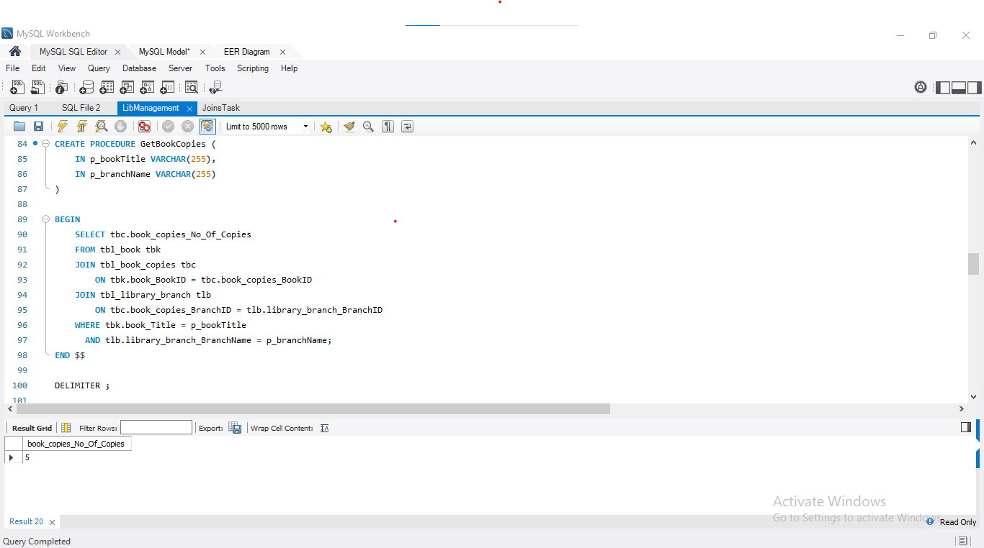
How many copies of the book titled "The Lost Tribe" are owned by the library branch whose name is "Sharpstown"?

Slide 22
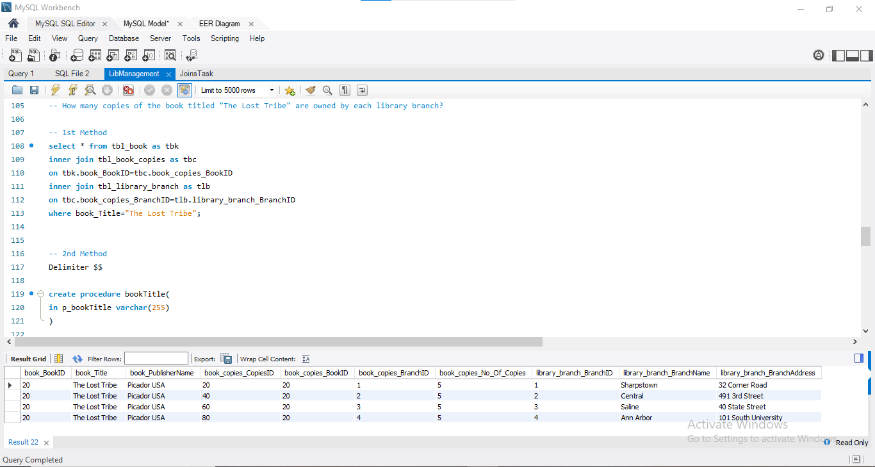
How many copies of the book titled "The Lost Tribe" are owned by each library branch?

Slide 23
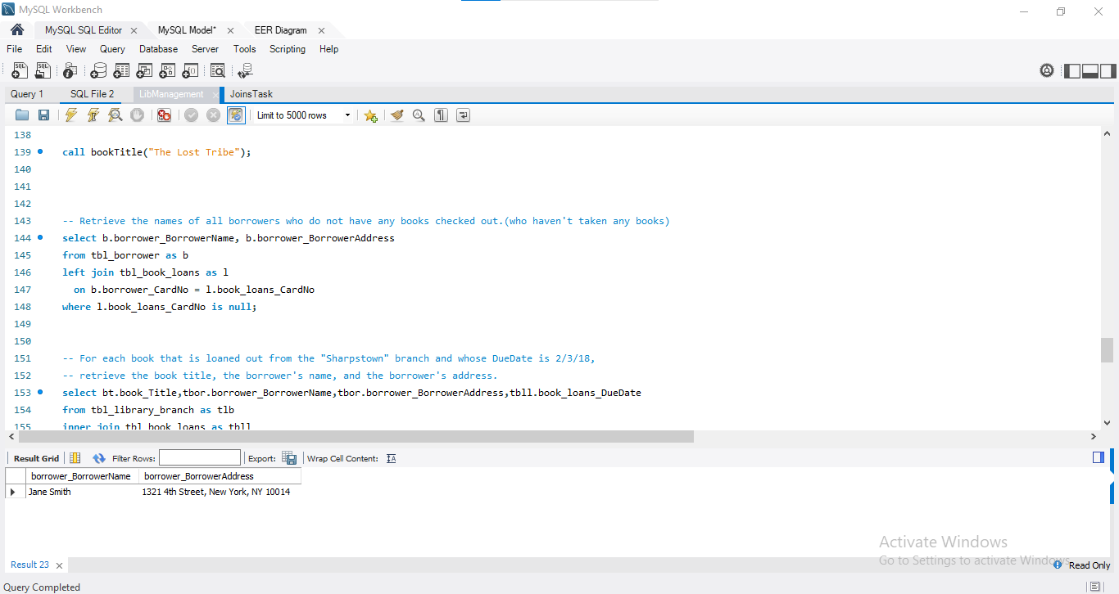
Retrieve the names of all borrowers who do not have any books checked out.

Slide 24
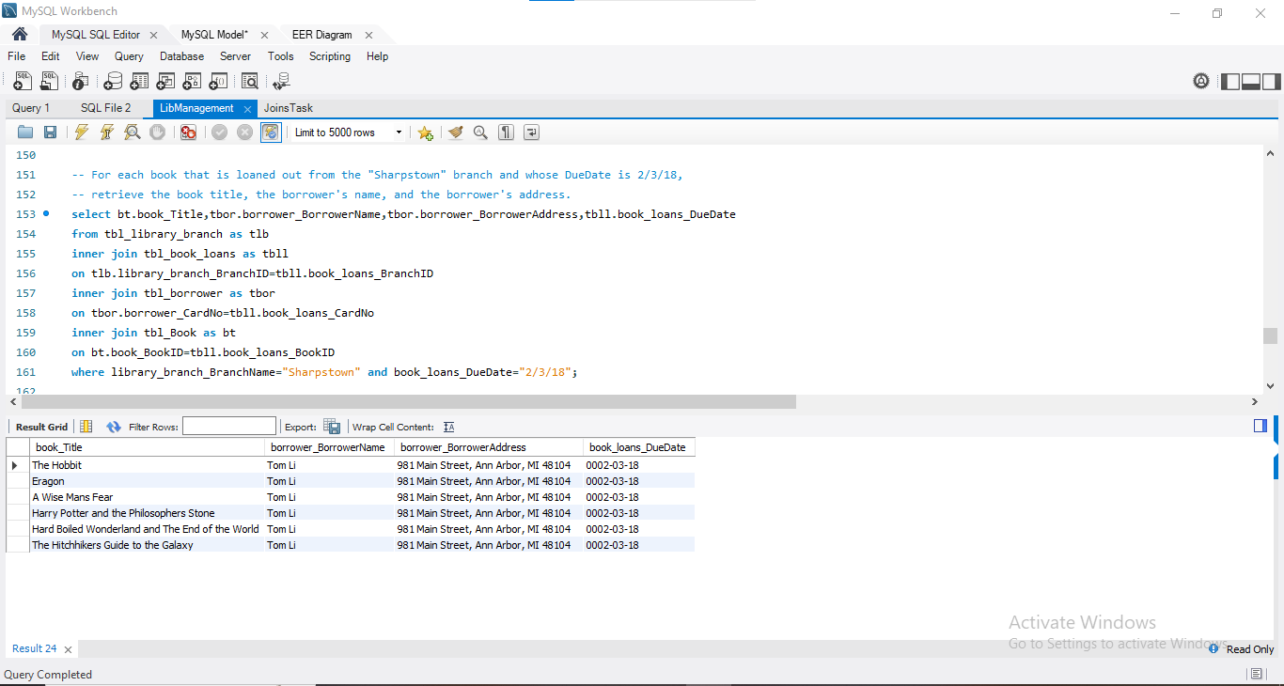
For each book that is loaned out from the "Sharpstown" branch and whose DueDate is 2/3/18, retrieve the book title, the borrower's name, and the borrower's address.

Slide 25
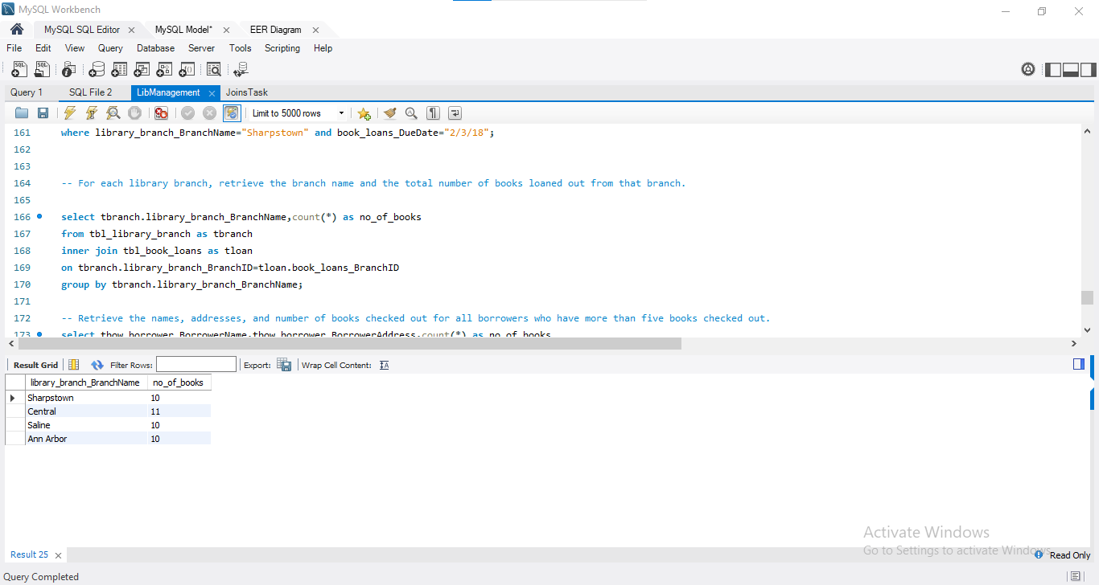
For each library branch, retrieve the branch name and the total number of books loaned out from that branch.

Slide 26
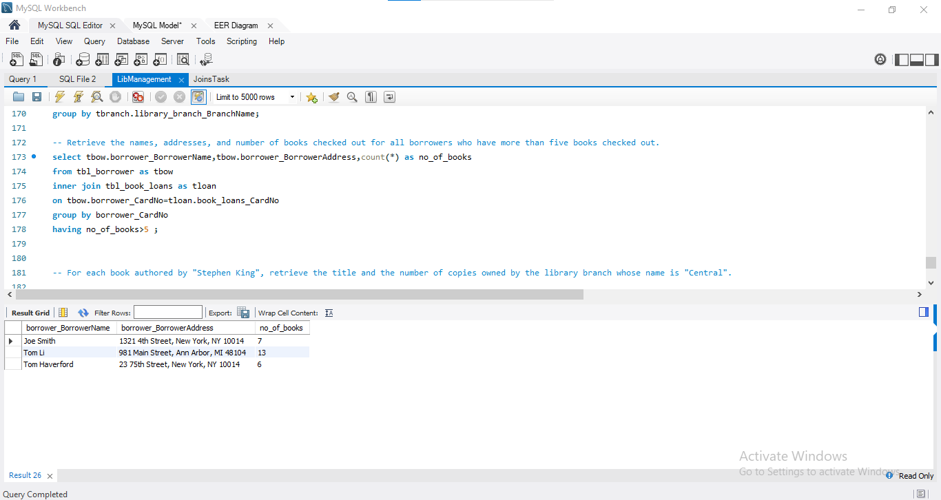
Retrieve the names, addresses, and number of books checked out for all borrowers who have more than five books checked out.

Slide 27
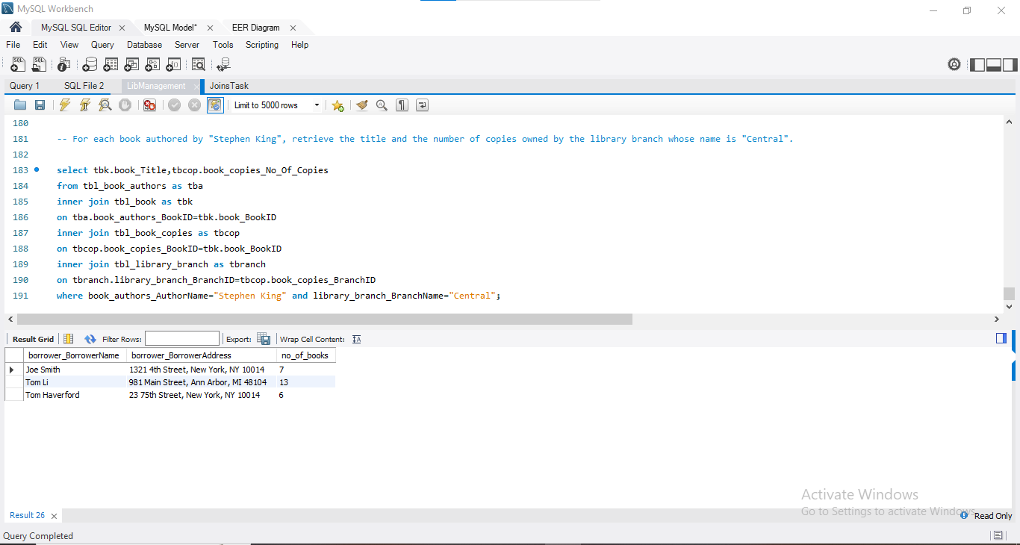
For each book authored by "Stephen King", retrieve the title and the number of copies owned by the library branch whose name is "Central".

Slide 28
Final business Insights
Centralized Data → All information about books, publishers, authors, branches, borrowers, and loans is stored in one structured system.
Efficient Tracking → The schema makes it easy to track which borrower has which book, from which branch, and when it’s due.
Resource Optimization → Helps librarians know the availability of books and the distribution of copies across branches.
Reduced Errors → Primary and foreign key relationships ensure accuracy (e.g., no loan for a non-existent borrower/book).
Better Decision-Making → Reports like most borrowed books, overdue books, or least-used branches help in planning purchases and services.

Slide 29
Recommendations
Add Fine Management → Extend the schema with a fine/penalty table to automatically calculate late fees.
User Roles & Authentication → Add tables for librarian/staff login to secure the system.
Digital Integration → Provide an online portal for borrowers to search, reserve, or renew books.
Analytics & Reports → Implement dashboards (using SQL + visualization tools) to see trends in borrowing and popular books.
Scalability → Make the system cloud-ready so it can handle multiple branches and larger user bases efficiently.

Slide 30
Conclusion
In conclusion, this Library Management System schema provides a solid foundation for managing library operations digitally. With further enhancements like fine management, user authentication, and reporting, it can evolve into a complete end-to-end solution for modern libraries

Slide 31


Slide 32
Your Experience/Challenges working on SQL – Data Analysis Project
While working on my SQL Data Analysis project, I gained hands-on experience in database design and queries.
The main challenge I faced was managing relationships and writing complex joins, but this helped me improve my problem-solving skills.
I also learned the importance of constraints, normalization, and data integrity for building a reliable database system.

Slide 33

THANK YOU

