Slide 1

Telecom Revenue & Profitability Dashboard

Slide 2


Slide 3
Background ? (B-tech or M-tech)
I am from a Computer Engineering Background, which has given me a background in both Hardware concepts and software development.
This combination helps me approach problems from a technical and analytical perspective.
LinkedIn:-
  https://www.linkedin.com/feed/?trk=guest_homepage-basic_nav-header-signin
GitHub:-
https://github.com/Lucy-star-144

Slide 4
Why you want to learn Data Science ?
I want to learn Data Science because it combines my interest in programming, mathematics, and real-world problem solving. With the rapid growth of data in every field—business, healthcare, technology, and beyond—being able to extract meaningful insights has become one of the most valuable skills.
Learning Data Science will help me bridge the gap between raw data and actionable decisions, and open opportunities in AI, predictive analytics, and intelligent systems.
Ultimately, I see Data Science as a way to turn data into impact, whether it’s improving business strategies, building smarter applications, or contributing to research that benefits society.

Slide 5
Agenda
1.Business Problem and Domain Understanding
Objective of the Project
Project Workflow and Tools Used
Summary of the Dataset
Data Preparation and Transformation
  Data Cleaning
  Data Transformation using Power Query
  Handling Missing Values and Data Types
Data Modelling
  Data Model and Table Relationships
  Schema and Calendar Table
DAX Measures and KPI Development
  Key Business Metrics
  Calculated Columns vs. Measures
Dashboard Development and Visualization
  Dashboard Pages and Design
  KPIs, Charts, Slicers, and Drill-through
Key Business Questions and Insights
Conclusion and Recommendations
Challenges Faced and Learnings
Q&A

Slide 6
Business Problem And Domain Understanding
Domain: Telecommunications
Business Problem
Telecom businesses generate large volumes of customer, usage, billing, and service-ticket data.
Analyzing these data separately makes it difficult to identify revenue trends, profitability gaps, payment delays, and customer service issues.
A consolidated view is needed to monitor business performance and support data-driven decisions.
Use Case
Develop an interactive Power BI dashboard to analyze telecom revenue, profitability, customer behavior, collections, and service performance.

Slide 7
Objective
To develop an interactive Power BI dashboard that enables management to:
Monitor overall revenue and profitability.
Compare performance across markets, regions, plans, and customer segments.
Analyze payment behavior and delinquency patterns.
Evaluate customer service performance using ticket activity and CSAT.
Identify customers exhibiting potential churn-risk signals.
Discover trends and areas requiring further business investigation.

Slide 8
Project Workflow And Tools Used
Project Workflow
Imported and explored telecom customer, usage, and ticket datasets.
Cleaned and transformed data using Power Query.
Built relationships between tables and created a Calendar table.
Developed DAX measures and calculated columns for key business metrics.
Designed interactive dashboards using KPIs, charts, slicers, and drill-through.
Analyzed business performance and derived actionable insights.
Tools Used
Power BI Desktop: Data modelling, DAX calculations, and dashboard development.
Power Query: Data cleaning and transformation.
DAX: KPI calculations and customer churn-risk classification.

Slide 9
Summary Of The Dataset
Summary of the Dataset
The project uses a telecom dataset containing customer, usage, billing, service-ticket, regional, and calendar information. The data is organised into separate tables to analyse business performance, customer behaviour, and service activity.
Table | Description
Telecom_Customers | Contains customer-level information and supports customer-level metrics such as ticket count, average CSAT, and average days to pay.
Telecom_Usage_Fact | Contains customer usage and billing-related transaction data used to analyse revenue, profit, minutes, SMS, data usage, and payment-related metrics.
Telecom_Tickets | Contains customer service ticket information used to analyse ticket activity, ticket resolution, and customer satisfaction.
RegionalPeople | Contains regional information used to support regional-level analysis.
Calendar | Date dimension used for time-based analysis and time-intelligence calculations.

Slide 10
Data Preparation And Transformation
1. Data Type Management
Reviewed numeric, decimal, date, and text data types.
Corrected a decimal data-type issue to ensure values were imported accurately.
2. Missing Value Handling
Reviewed missing values across the datasets.
Retained missing CloseDate values where they represented tickets without a recorded closure date.
3. Column and Data Transformations
Reviewed columns and retained relevant fields for analysis.
Removed unnecessary data where required to prepare datasets for modelling.
4. Data Validation
Verified that CustomerID was unique in the Customers table.
Checked numeric values and customer record counts.
Validated table relationships and customer-level data consistency in Power BI.

Slide 11
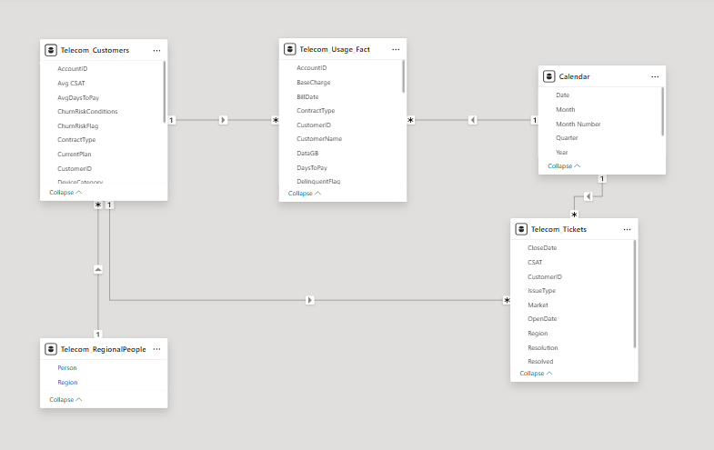
Data Modelling
Data Model
Connected customer, usage, ticket, regional, and calendar tables using relevant keys.
Established relationships using CustomerID, Region, and Date → BillDate.
Created a Calendar table with Year, Quarter, Month, and YearMonth fields for time-based analysis.
Relationship Validation
Checked cardinality, active relationships, and cross-filter direction.
Validated customer counts using Telecom_Customers[CustomerID] to avoid counting transactional records as unique customers.
Reviewed relationships to avoid unintended many-to-many connections.

Slide 12
DAX Measures and KPIs
Key DAX Measures
Revenue and Profitability
Total revenue = SUM(Telecom_Usage_Fact[TotalCharge])
Total profit = SUM(Telecom_Usage_Fact[Profit])
Total Profit Margin Pct = DIVIDE([Total profit], [Total revenue], 0)
Customer and Time-Based Metrics
ARPU = DIVIDE( [Total revenue], COUNTROWS(Telecom_Customers), 0 )
Time Intelligence
Used CALCULATE() and SAMEPERIODLASTYEAR() to calculate previous-year revenue and YoY growth.
Other KPIs: Average Days to Pay, Payment Delayed %, Tickets Resolved %, Average CSAT, Total Minutes, Total SMS, and Total Data Usage.

Slide 13
Calculated Columns vs Measures
Calculated Columns
Calculated for individual rows and stored in the data model.
Used to create classifications and transaction-level attributes.
Examples: DaysToPay, DelinquentFlag, and ChurnRiskFlag.
Measures
Calculated dynamically according to the current filter context.
Used for aggregations and KPIs in dashboard visuals.
Examples: Total Revenue, Profit Margin %, ARPU, YoY Growth %, and Churn Risk %.
Customer Churn-Risk Logic
Ticket count ≥ 3
Average days to pay ≥ 7
Average CSAT between 1 and 2.5
Moderate Risk and High Risk customers are included in the churn-risk customer count.
Note: Churn risk is a rule-based proxy, not actual observed customer churn.

Slide 14
Dashboard Development and Visualization
Dashboard Pages
Main Dashboard: Overall revenue, profitability, and business performance.
Market and Regional Analysis: Compare revenue, profit, and performance across regions and markets.
Customer and Retention Analysis: Explore customer details and rule-based churn risk.
Collections and Payment Analysis: Examine payment behaviour and collection performance.
Tickets and CSAT Analysis: Monitor ticket resolution and customer satisfaction.
Plans and Devices Analysis: Compare plan performance, usage, and profitability.
Discounts and Margins: Analyse discount patterns and their relationship with profitability.
Design Approach
Organised information into dedicated pages based on business questions.
Used KPI cards and charts to present key metrics and trends.
Applied consistent filters to support interactive analysis.

Slide 15
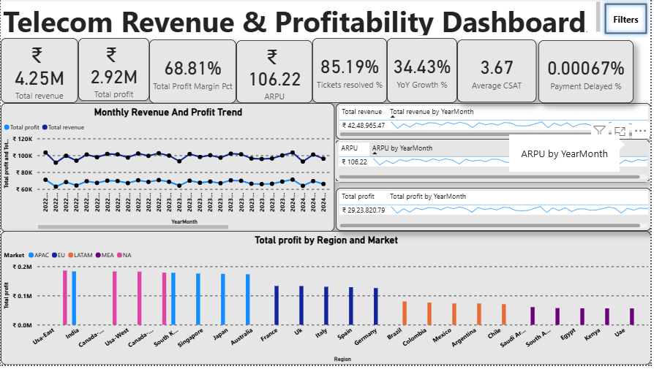

Slide 16
Interactive Features and Visualizations
Interactive Features and Visualizations
KPIs
Total Revenue, Total Profit, Profit Margin %, ARPU, YoY Growth %, Tickets Resolved %, Average CSAT, and Payment Delayed %.
Visualizations
Trend charts for revenue and profit over time.
Comparisons across markets, regions, plans, and devices.
Tables and charts for customer, collection, ticket, and satisfaction analysis.
Interactivity
Slicers: Filter analysis by year, region, customer segment, plan, device, and other business attributes.
Drill-through: Navigate to detailed market, customer, and plan views.
Tooltips and tables: Support closer examination of business metrics and individual records.

Slide 17
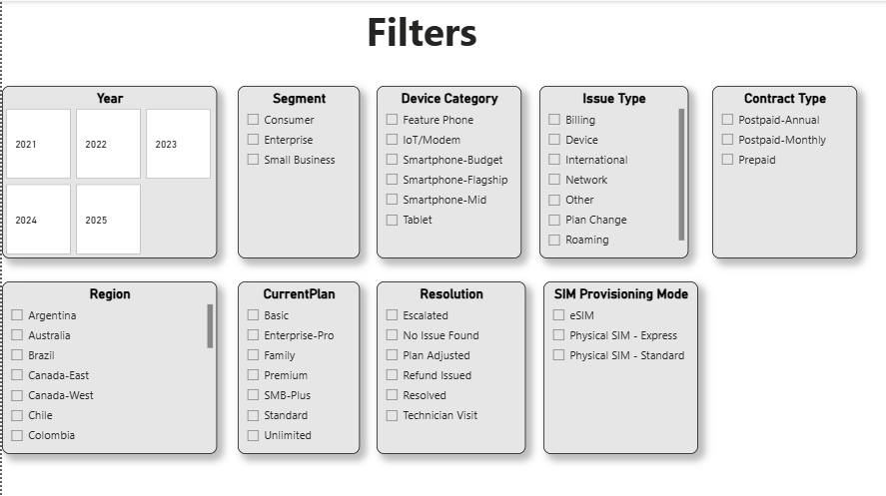
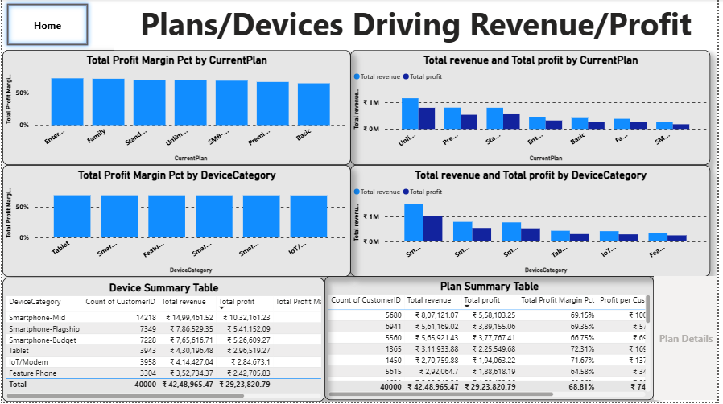
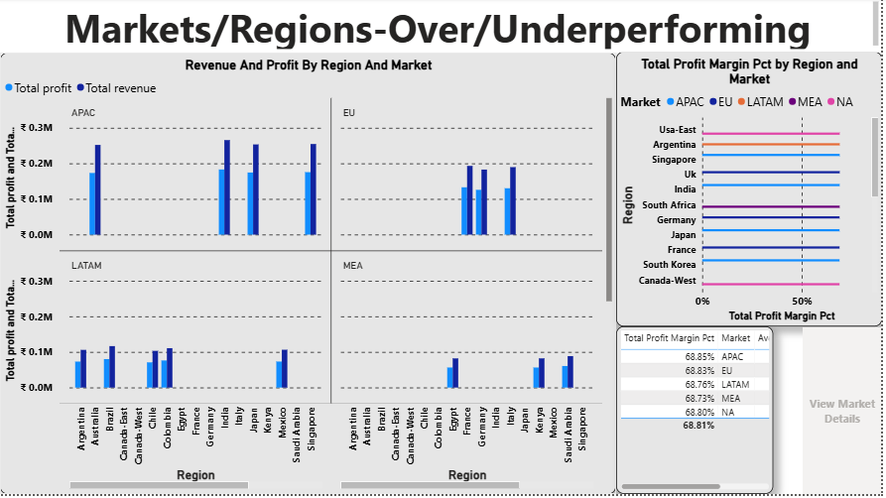
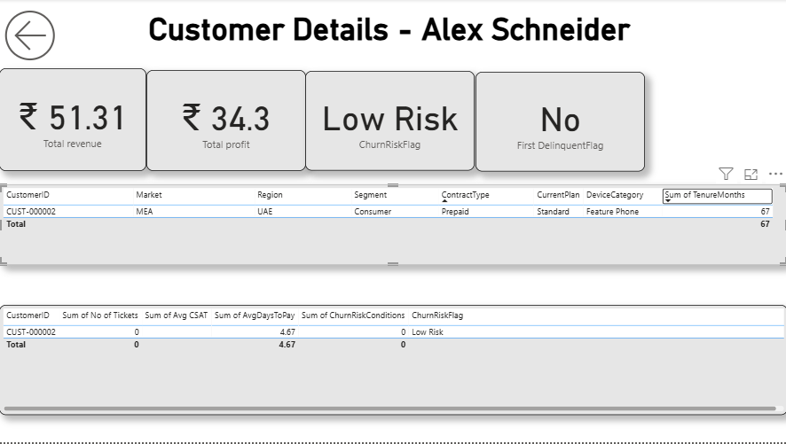

Slide 18
Key Business Questions And Insights
Business Question | Key Insight | Recommendation
Why is one region generating high revenue but low profit? | Regional profit margins remain broadly similar at around 68–69%, with no significant high-revenue/low-margin outlier. | Investigate plan mix, discounts, and customer composition to identify opportunities for margin improvement.
Are high discount campaigns improving retention or just lowering margins? | Basic has the highest discount rate (19.12%) and lowest profit margin (64.60%), while Enterprise-Pro has the lowest discount rate (4.35%) and highest margin (72.32%). All plans show the same rule-based churn-risk rate. | Review broad discounting and evaluate targeted offers while monitoring retention and profitability.
Which segments should be prioritized for upselling? | 1,460 Small Business customers are already on SMB-Plus, while other Small Business customers may be suitable for upgrades. | Identify suitable customers on lower-tier plans for targeted SMB-Plus offers based on usage and plan suitability.
Do certain device categories correlate with higher network costs or churn? | Average network costs range from 8,879 for Feature phones to 90,152 for Tablets. Churn risk is approximately 8% across device categories. | Investigate costs associated with Tablets and IoT/Modem devices, and focus churn initiatives on other customer risk signals.
What strategies can improve ARPU and profit margins? | ARPU ranges from ₹100.25 in the UAE to ₹109.82 in Brazil, while profit margins remain broadly stable. | Study high-ARPU regions for pricing, plan-mix, and upselling practices that could be adapted elsewhere without eroding margins.

Slide 19
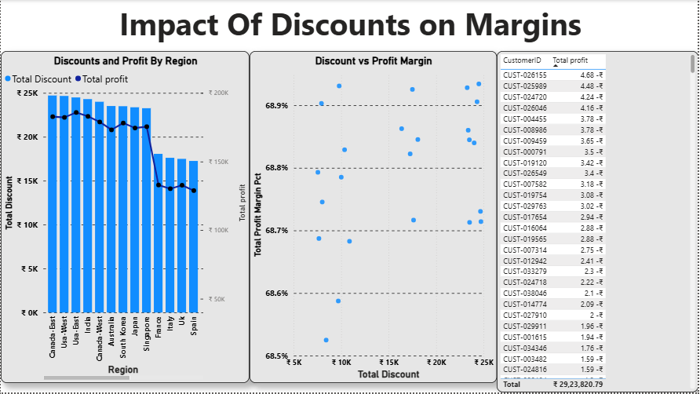
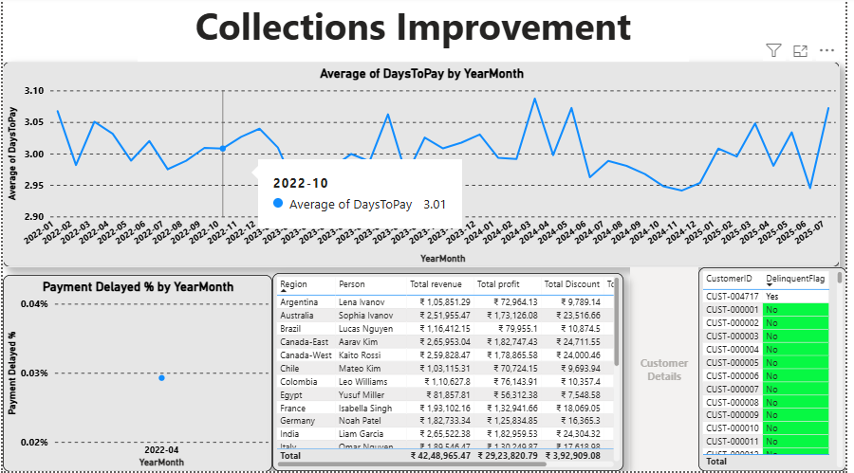
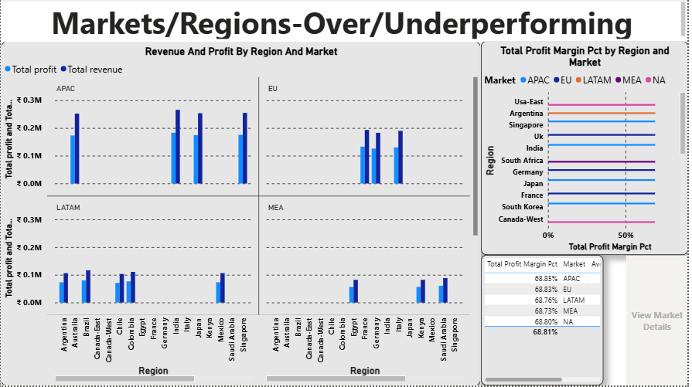
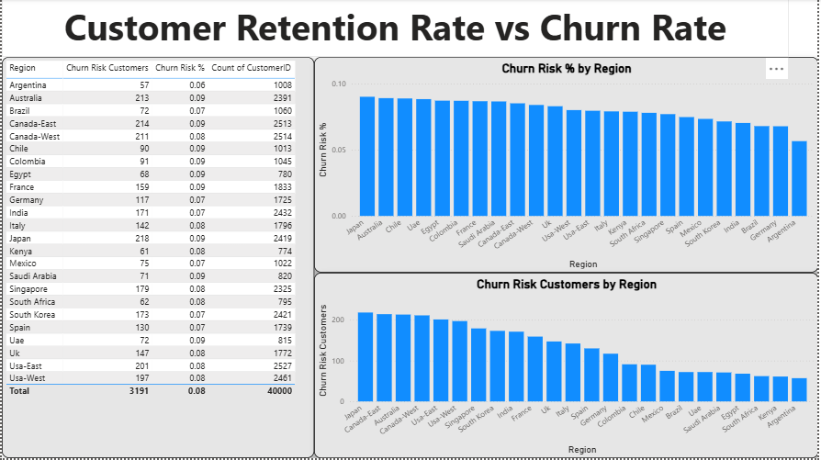

Slide 20
Conclusion and Recommendations
Conclusion
Developed an interactive Power BI dashboard integrating customer, usage, billing, regional, and service-ticket data.
Enabled monitoring of revenue, profitability, customer service, payment behaviour, and customer churn risk.
Identified opportunities to review discount strategies, improve ARPU, optimise network costs, and target suitable customers for upselling.
Key Recommendations
Review discount strategies to balance profitability and customer retention.
Explore targeted upselling and higher-value plan opportunities.
Investigate high network costs across device categories.
Monitor payment behaviour and customer service performance.
Refine churn-risk analysis using additional customer behaviour signals.
Overall Outcome: A consolidated dashboard that supports data-driven performance monitoring and business decision-making.

Slide 21
Challenges Faced and Learnings
Challenges Faced
Data Cleaning: Handling data type issues and missing values across multiple datasets.
Data Modelling: Establishing correct relationships between customer, usage, ticket, regional, and calendar tables.
DAX Calculations: Developing measures for revenue, profitability, YoY growth, and customer churn risk.
Filter Context: Ensuring slicers and relationships influenced visuals as intended.
Business Interpretation: Translating dashboard metrics into meaningful business insights and recommendations.
Key Learnings
Understood the importance of data quality and a well-structured data model.
Improved practical knowledge of Power Query, DAX, and Power BI visualizations.
Learned the difference between calculated columns and measures.
Gained experience validating KPIs and troubleshooting filter-related issues.
Learned to interpret data from a business perspective and communicate actionable insights.

Slide 22


Slide 23

THANK YOU

