Slide 1
Volcanoes
Guaranteed to blow your mind

Slide 2
Talk Content
Data used
Questions
1.
2.
3.
Summary
Problems

Slide 3
Data Sources
Primarily from a Tidy Tuesday set - a weekly data project aimed at the R ecosystem
Tidy Tuesday Data:
Eruptions
Events
Sulfur
Tree rings
Volcano
Other Data:
Explanation of the VEI scale
Number of recorded deaths from eruptions

Slide 4
Data Cleaning
The Tidy Tuesday datasets were very clean to begin with so little cleaning was needed – a few unnecessary fields were removed
The VEI (Volcanic Explosive Index) table needed a little formatting so it could be matched to the other datasets.
The death database needed a lot of editing to match volcano names

Slide 5
Questions
Where are volcanic eruptions likely to occur
Which volcanoes are likely to cause the most damage if they blow?
Why do people live near volcanoes when they are so lethal?
Geographic location
Elevation

Slide 6
Question One

Slide 7

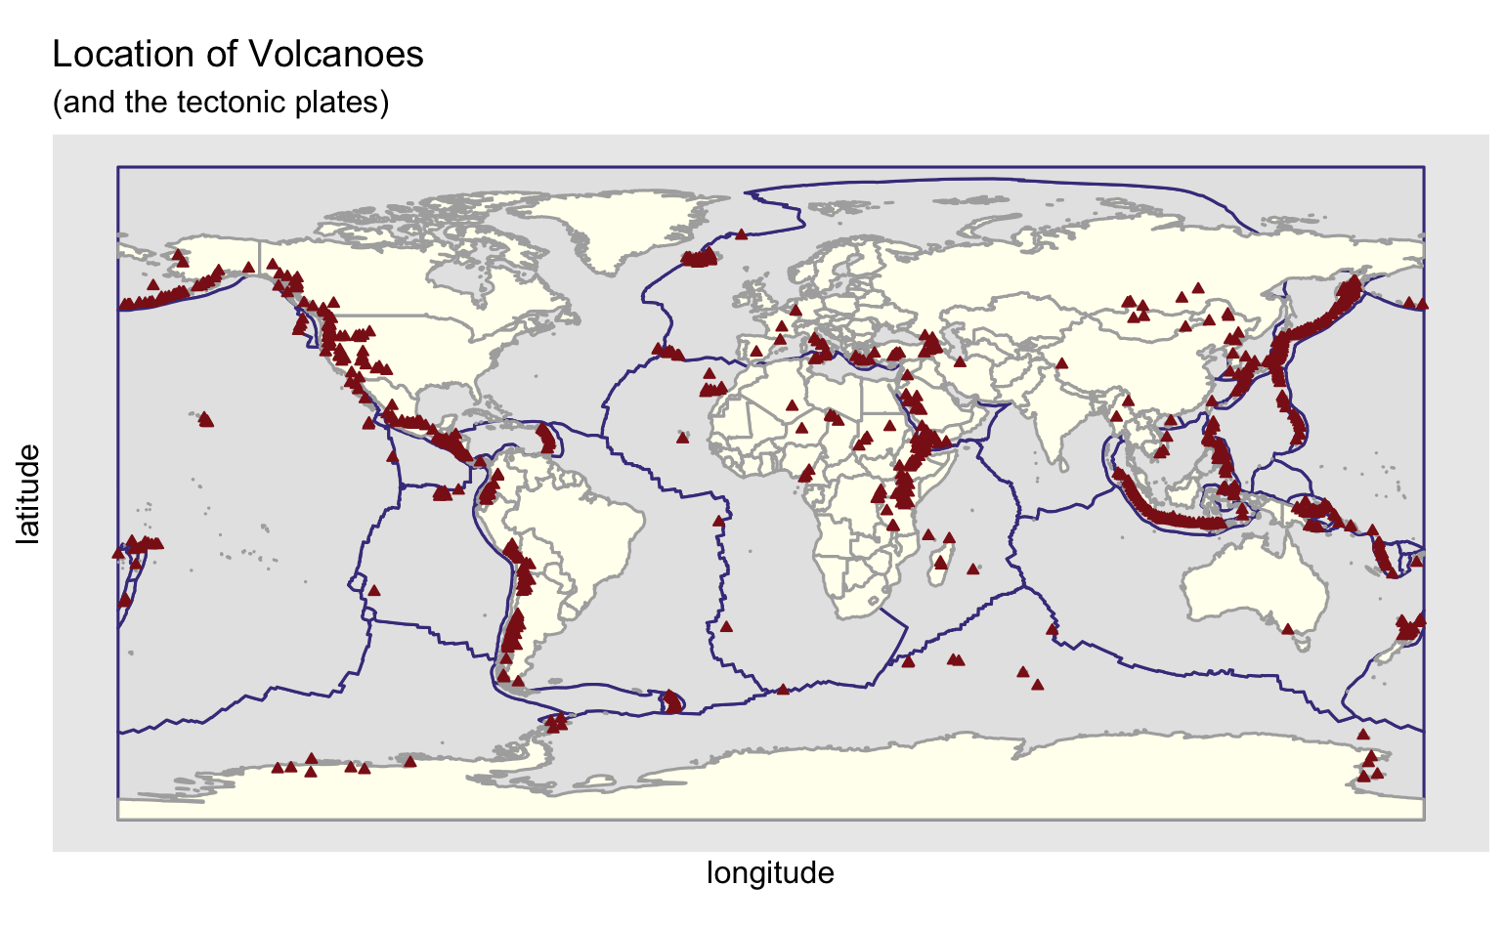

Slide 8
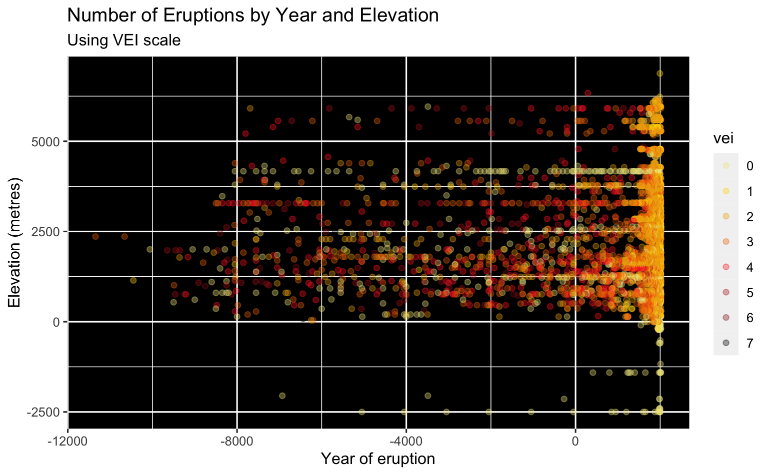

Slide 9
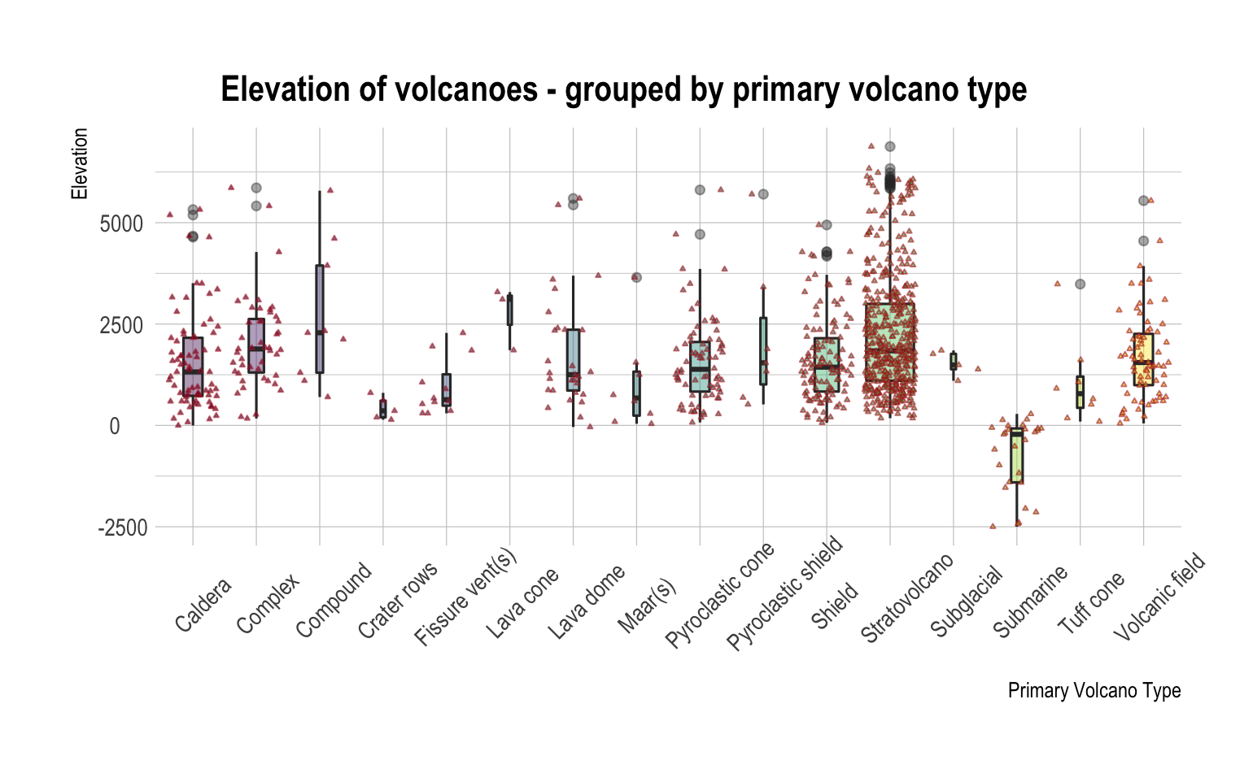

Slide 10
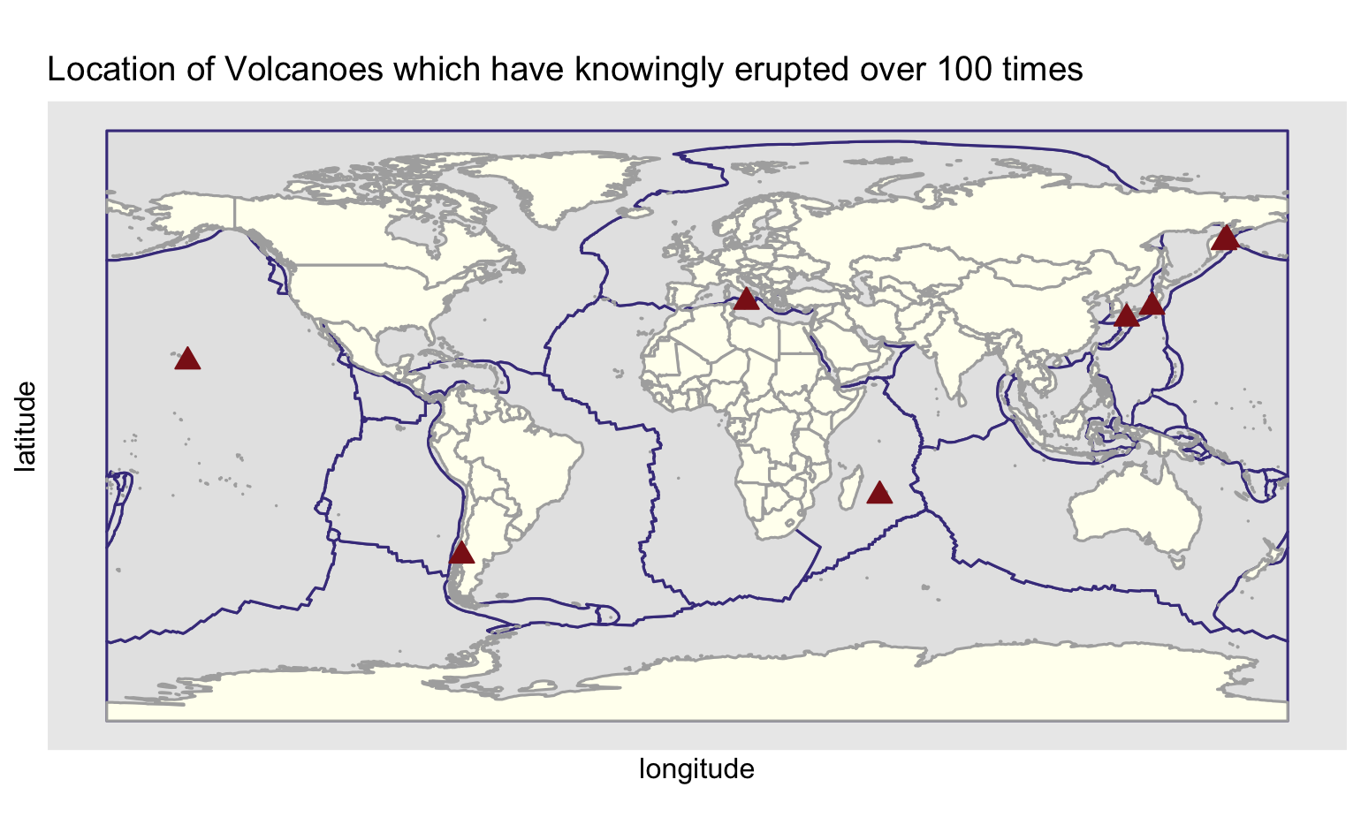
No. Eruptions | Volcano | Last Eruption | Country
182 | Piton de la Fournaise | 2020 | France
178 | Asosan | 2020 | Japan
171 | Etna | 2020 | Italy
152 | Villarrica | 2020 | Chile
127 | Asamayama | 2019 | Japan
110 | Mauna Loa | 1984 | US
103 | Klyuchevskoy | 2020 | Russia
102 | Sheveluch | 2020 | Russia
Notes:
8 volcanoes have known to have erupted 100 times or more:

