Slide 1
Using ILOSTAT’s SMART tool and DSD Constructor
Indicator 1-2-1

Slide 2
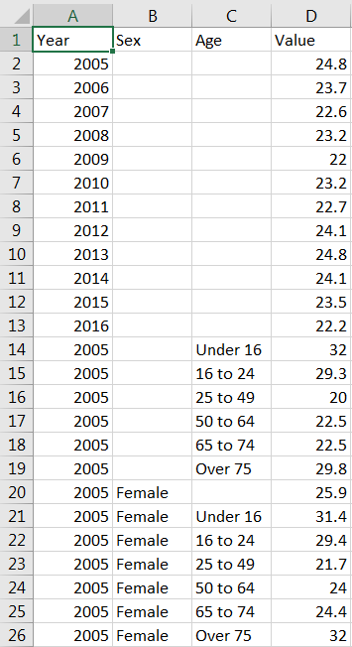
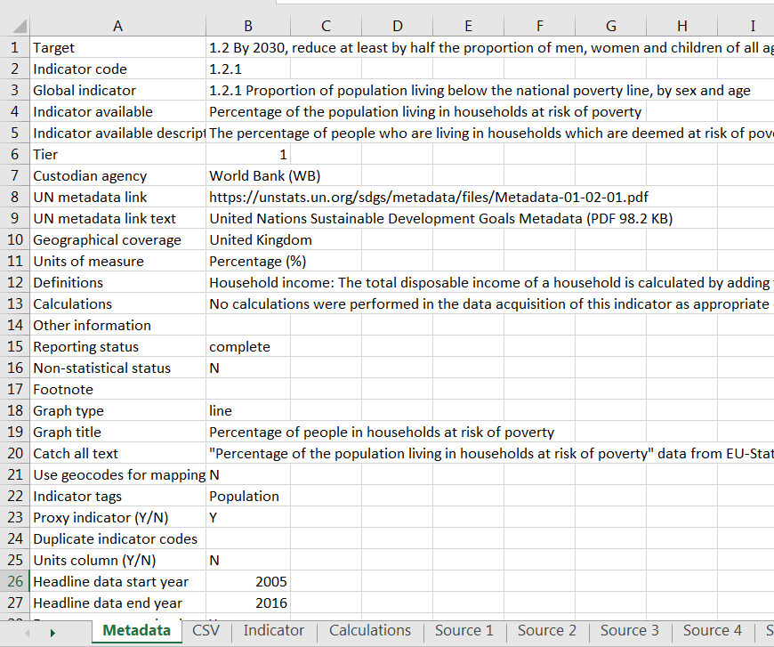
Preview of indicator 1.2.1
4 columns: Year (2005-2016), Sex (Male, Female), Age (Under 16, 16 to 24, 25 to 49, 50 to 64, 65 to 74, Over 75) and Value
Annual
Percentage

Slide 3
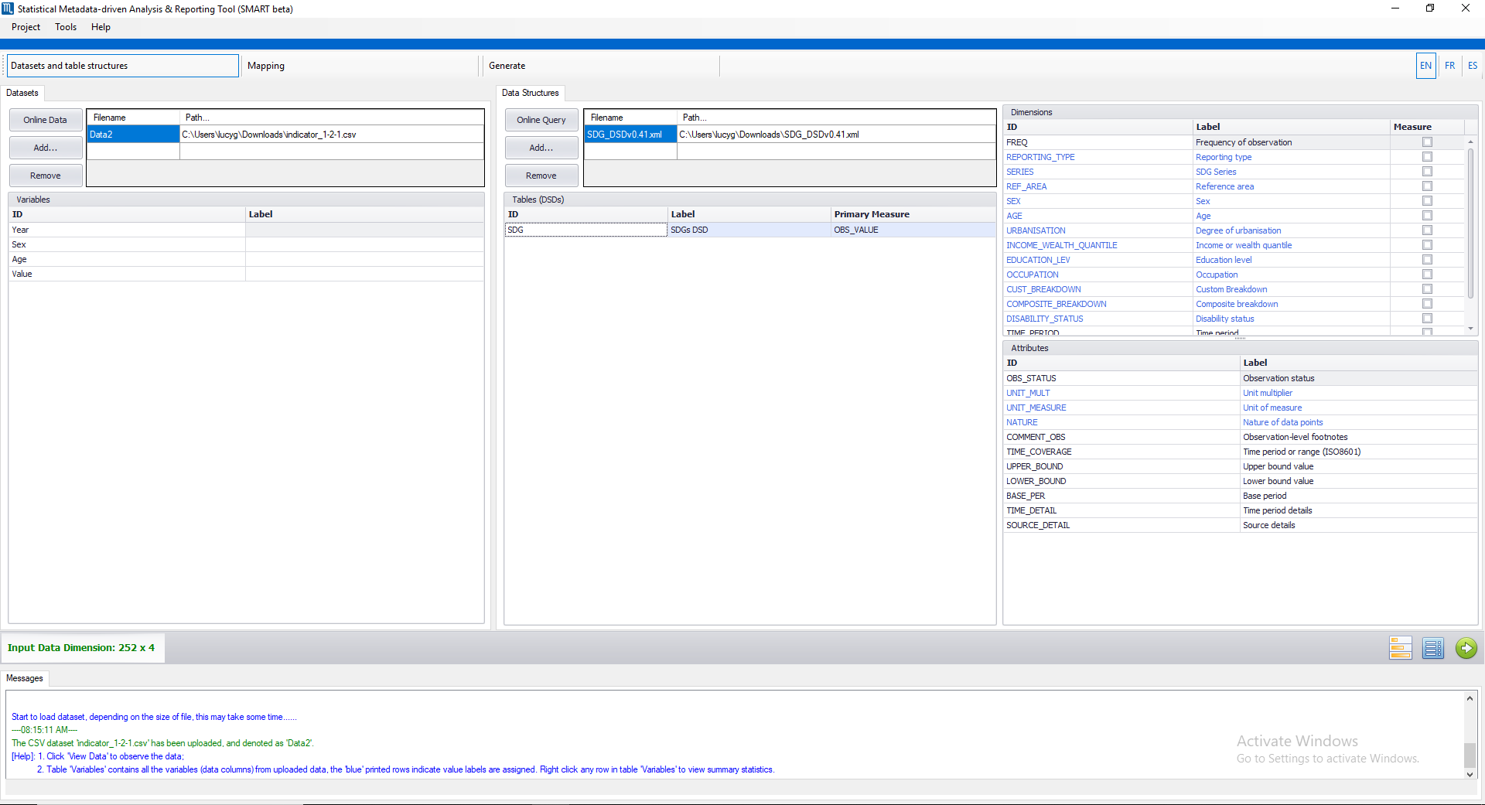
First thing to do is upload the indicator csv file and the DSD (data structure definition) that you wish to use.
Then click the arrow to go to the ‘Mapping’ stage

Slide 4
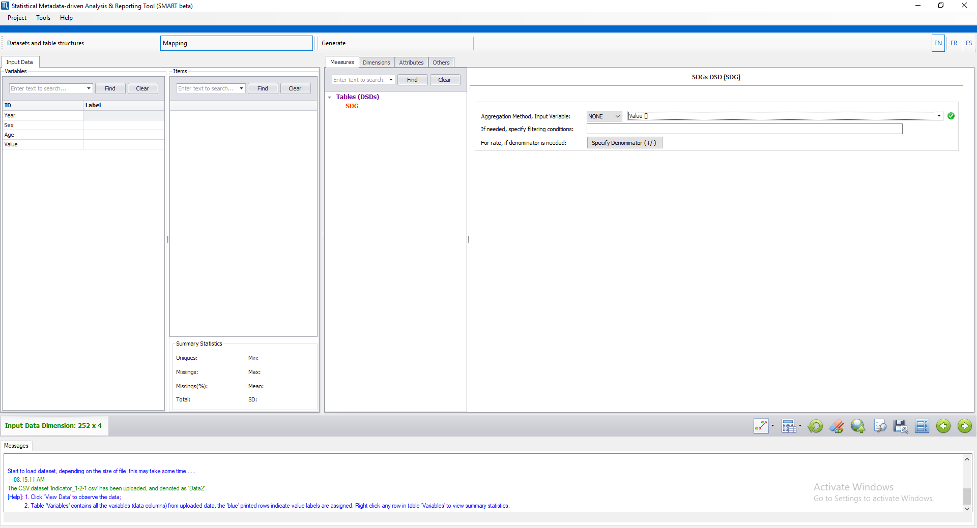
For the ‘Measures’ tab you just need to specify how your data is aggregated so ‘COUNT’, ‘SUM’, ‘MEAN’ or ‘NONE’ and select from which of the columns is the value column.
Now go through each of these tabs to assign the correct values relating to your dataset.

Slide 5
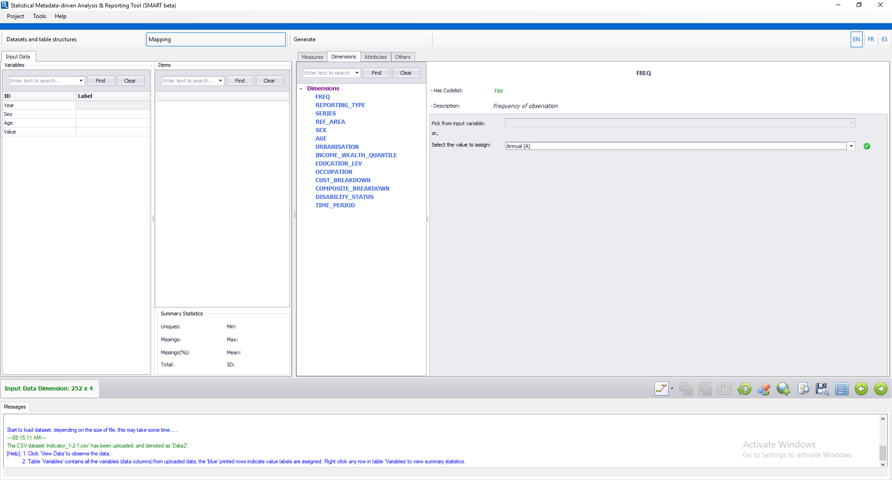
We have no column for frequency so we select the correct value from the dropdown list
For the ‘Dimensions’ tab we go through each of the dimensions and specify which column they link to and encode the diaggregations

Slide 6
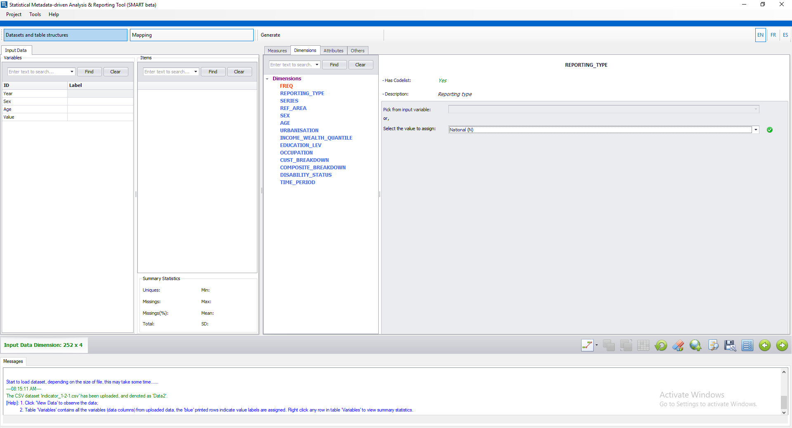
We also don’t have a column for reporting type but since the data covers the UK we select ‘National (N)’ from the dropdown list

Slide 7

We don’t have a series column so we can just select the indicator name from the dropdown list

Slide 8
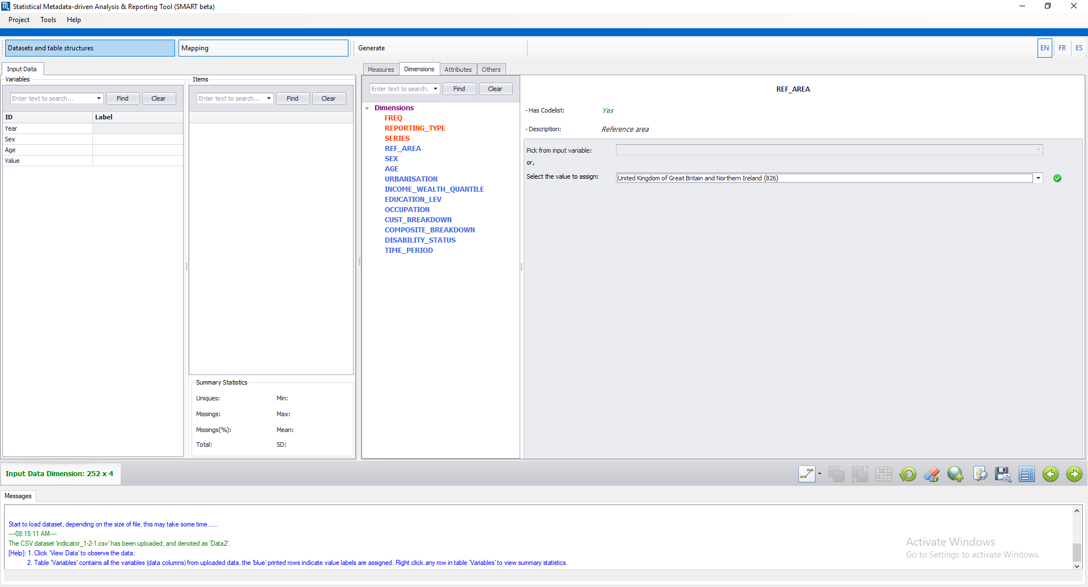
We don’t have a reference area column so just select the country that the data covers from the drop down list (UK)

Slide 9
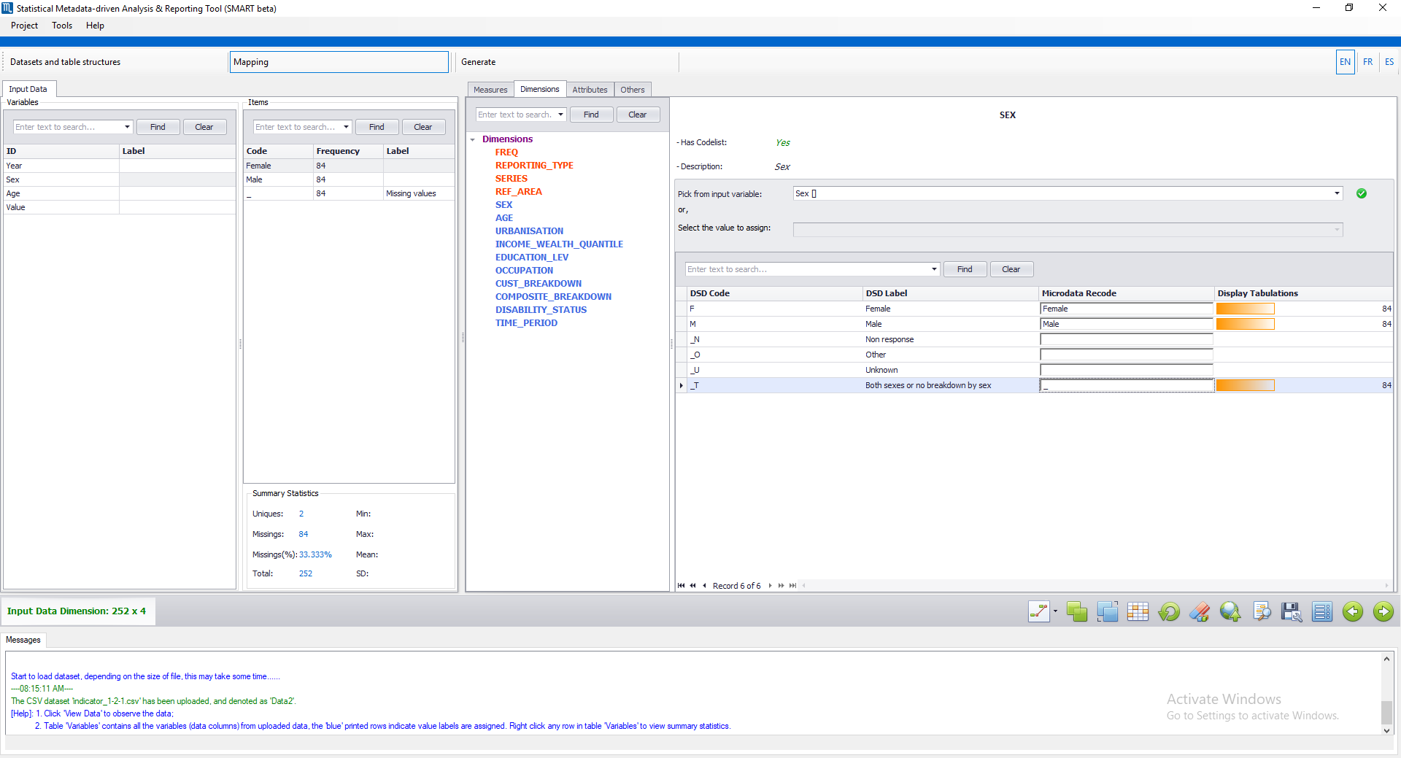
We have a ‘Sex’ column so we select the corresponding column from the dropdown list
We then look at the items here and enter our corresponding values here

Slide 10
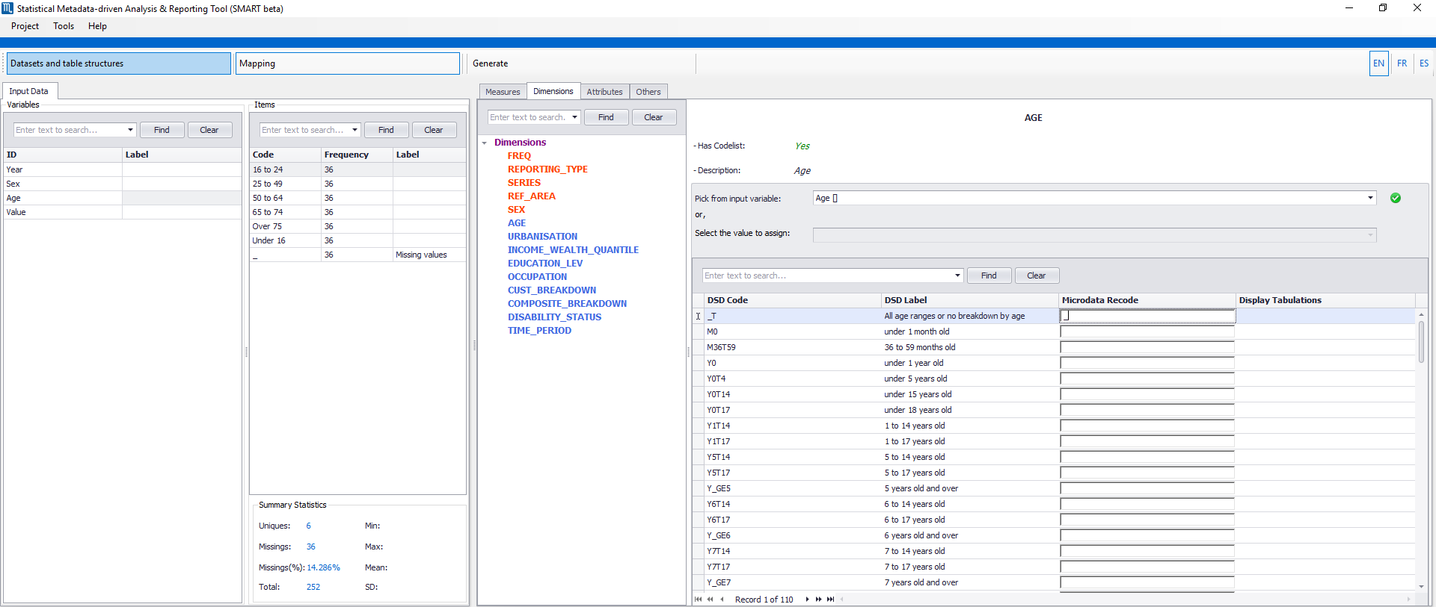
Age is slightly more confusing as there’s a bigger code list to sift through to recode the values
We have an age column so select that from the dropdown list

Slide 11
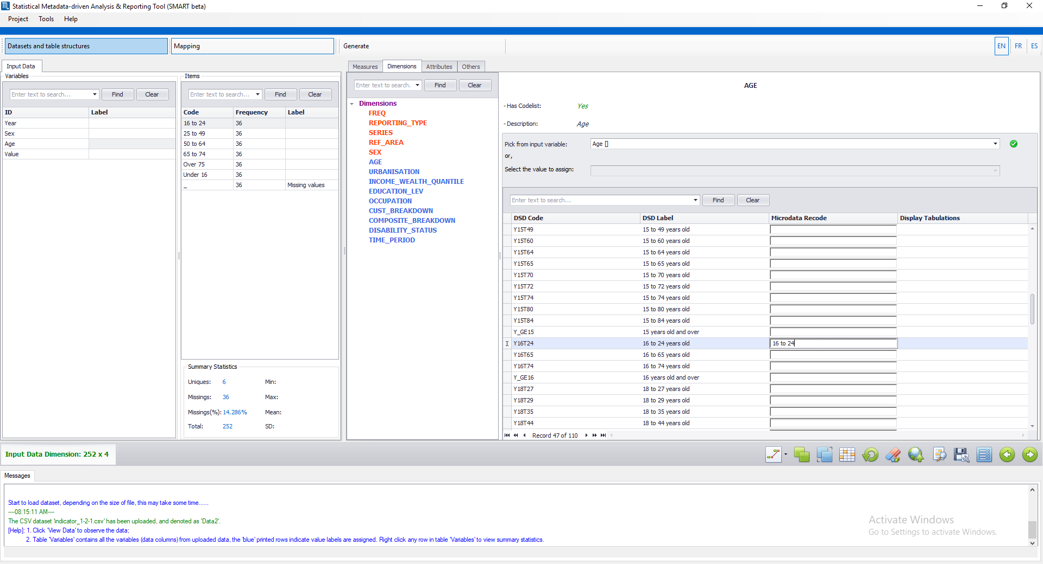

Slide 12
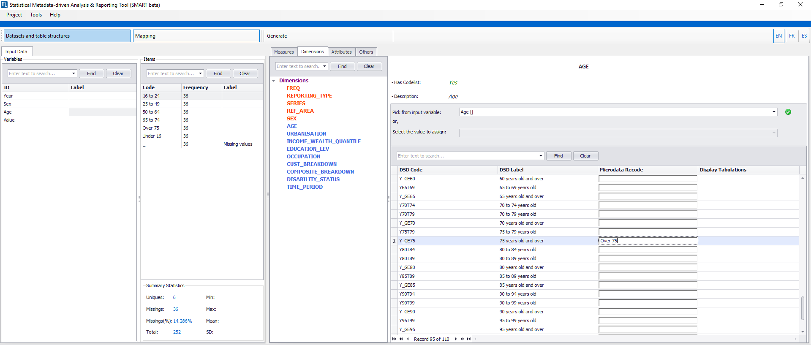

Slide 13
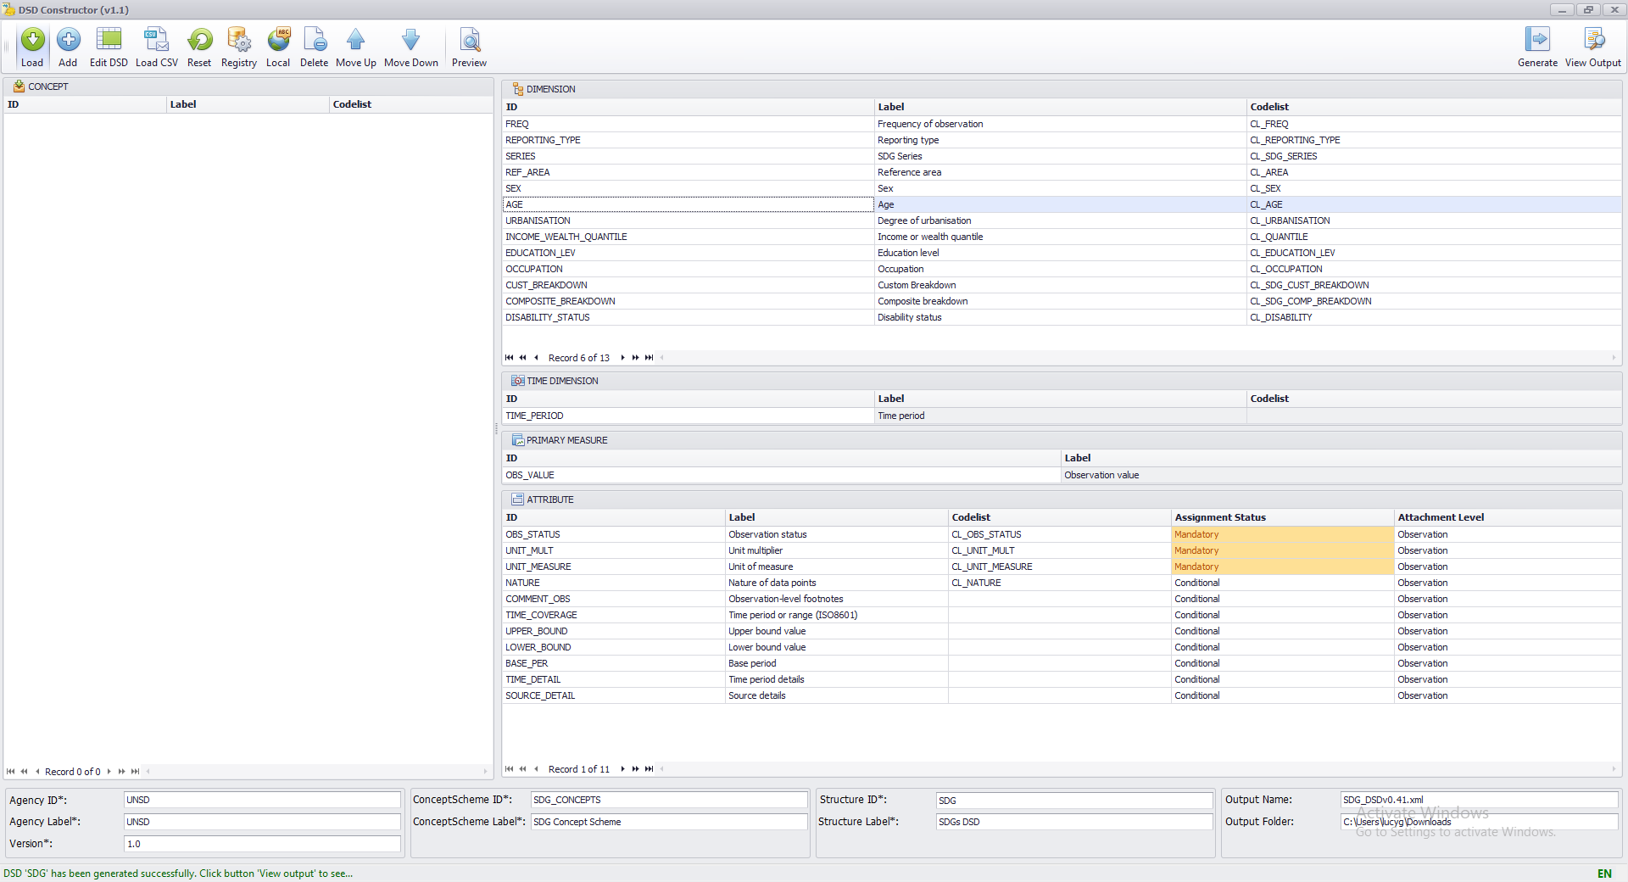
To open the age code list double click on the age dimension
So after sifting through the age code list I realised that there’s no values for our remaining items:
25 to 49
50 to 64
65 to 74
Under 16
To add these to the code list I need to load the DSD into ILOSTATS’s DSD Constructor

Slide 14
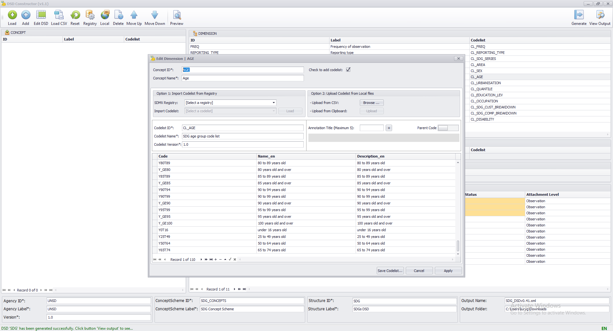
Following the format of the existing codes I added codes for the remaining items by clicking the ‘+’ and filling out each of the three columns
After you have finished adding the new codes, click ‘Apply’, then ‘Generate’

Slide 15
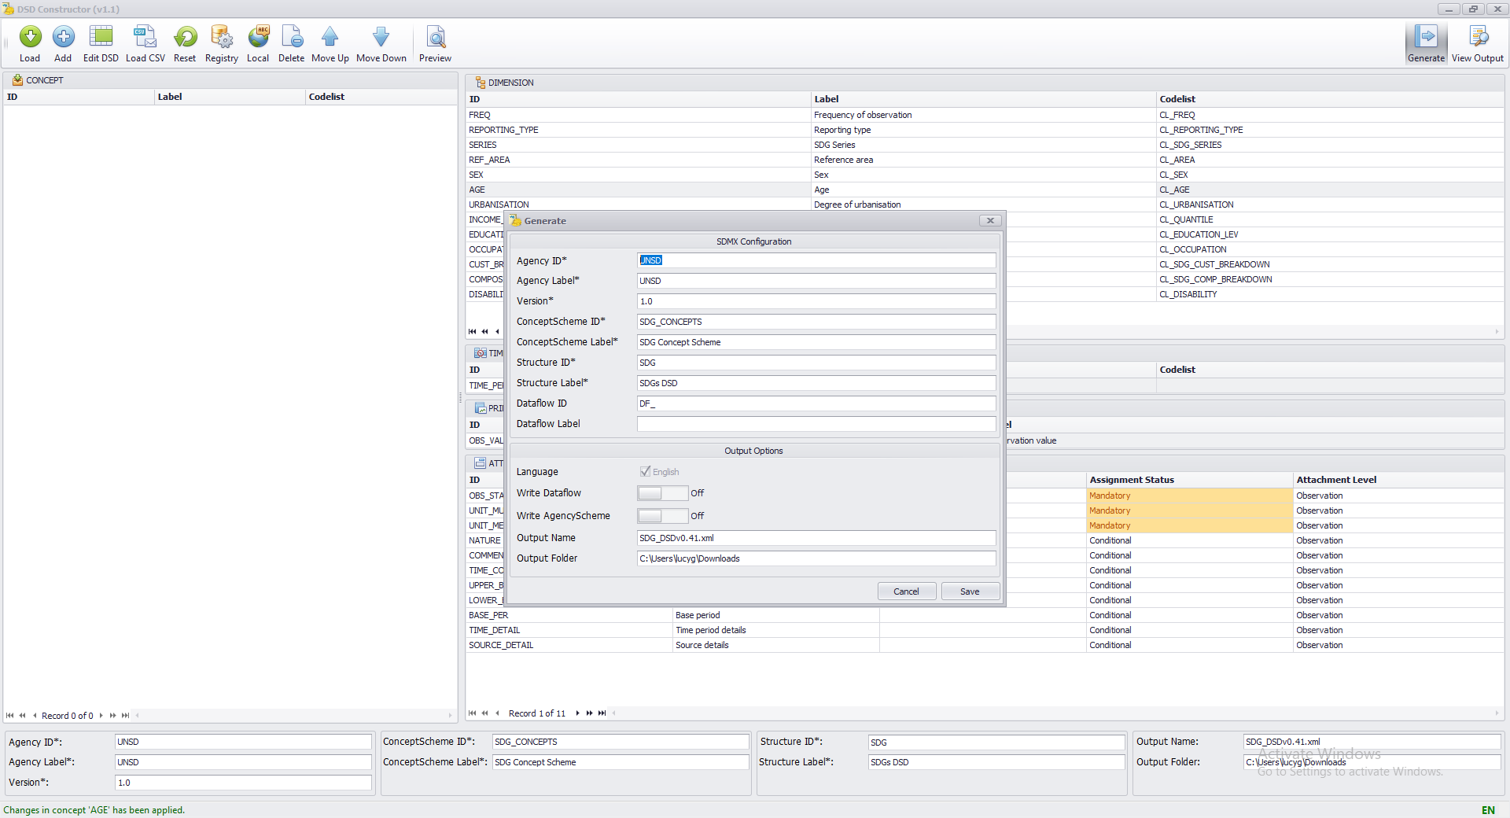
Change the output name if you don’t want to overwrite the existing DSD
Once you have saved the new DSD, make sure you load it into the SMART tool so you use the new features

Slide 16
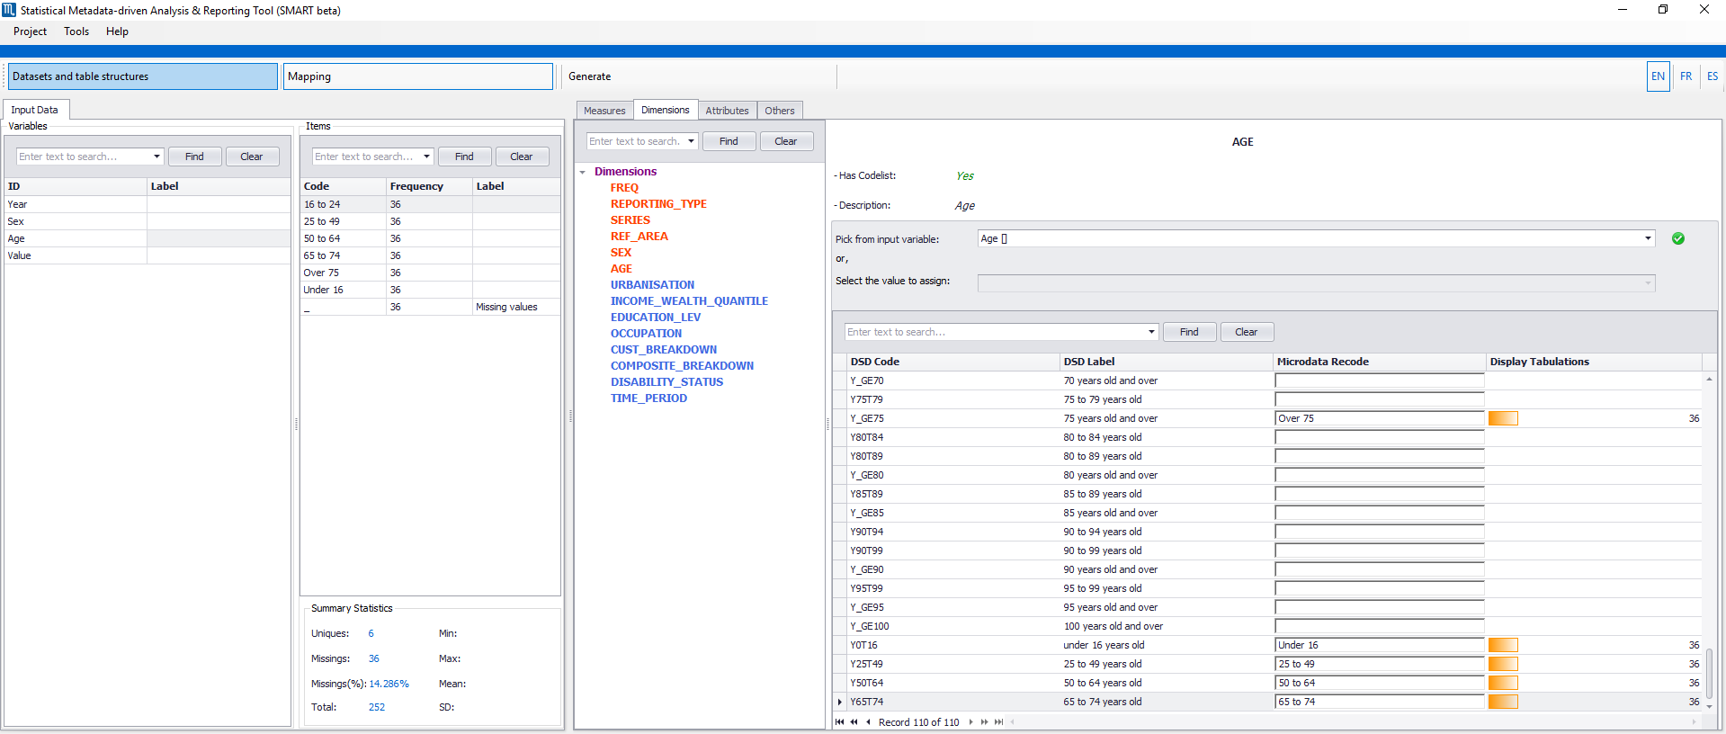
Now that the codes have been added to the age code list, I can finish recoding

Slide 17
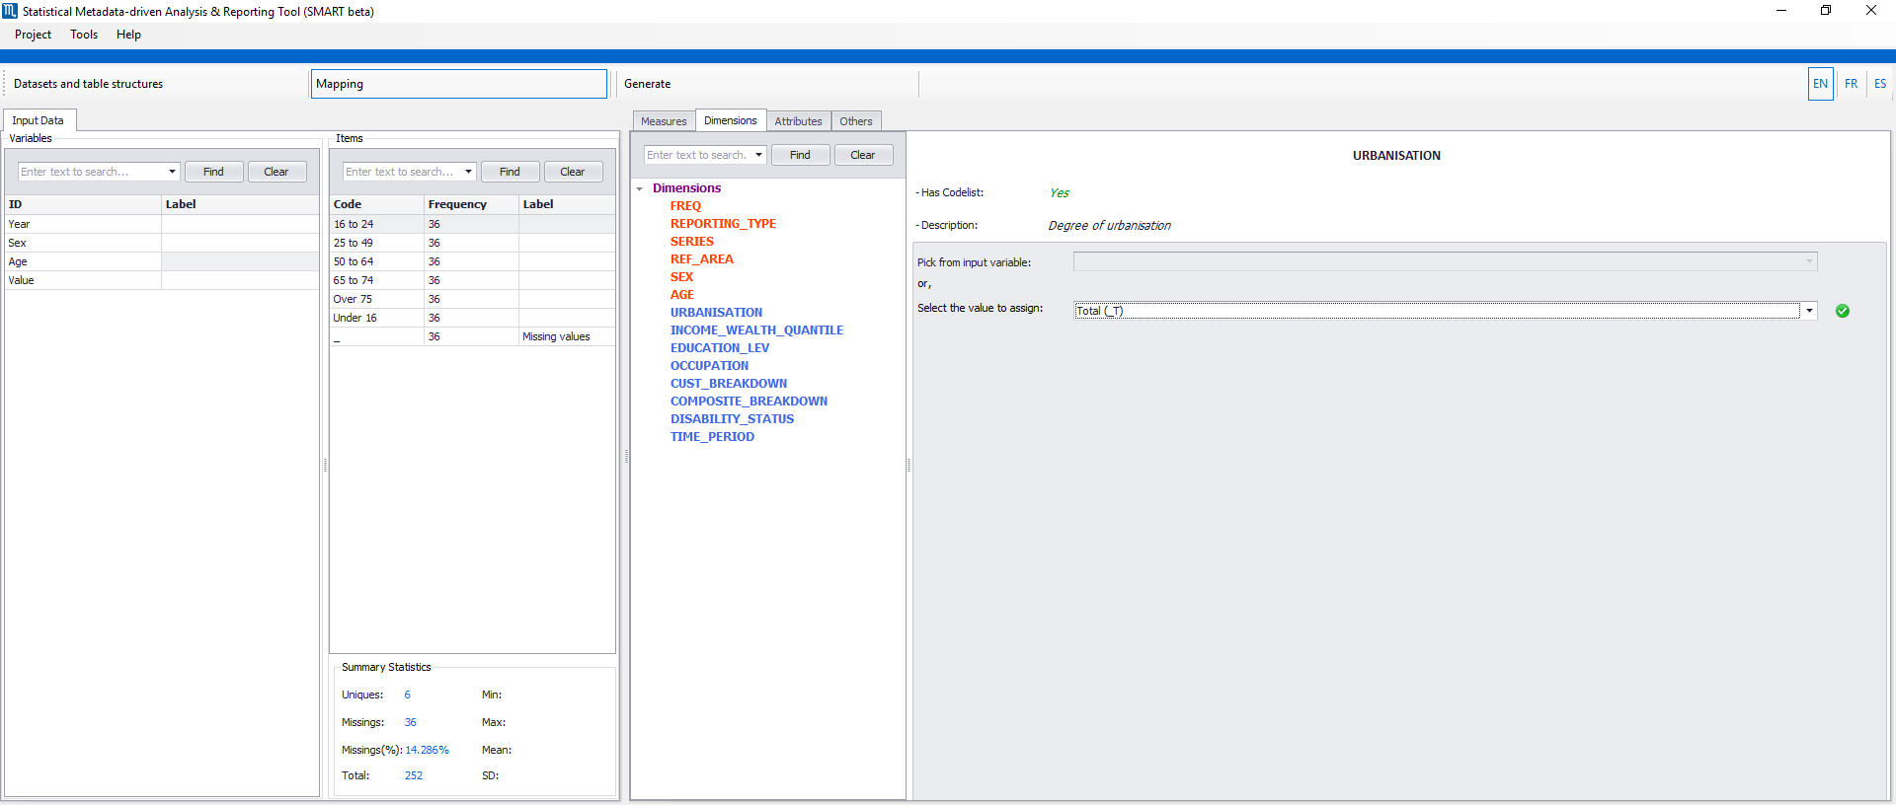
If you don’t have a column that corresponds to one of the dimensions, just select the ‘(_T)’ value from the dropdown list.
We don’t have columns corresponding to these dimensions so I’ll select ‘(_T)’ for these and then move on to TIME_PERIOD

Slide 18
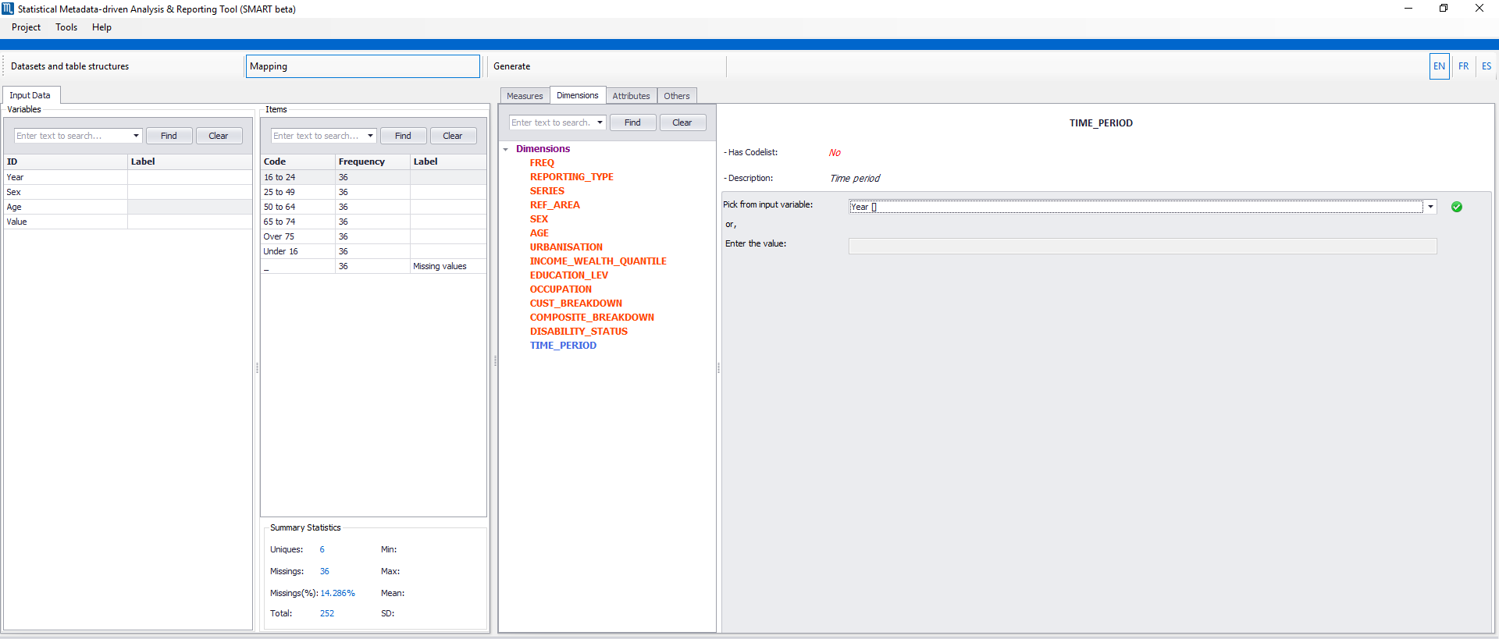
For the time period dimension we just select the year column from the dropdown list

Slide 19
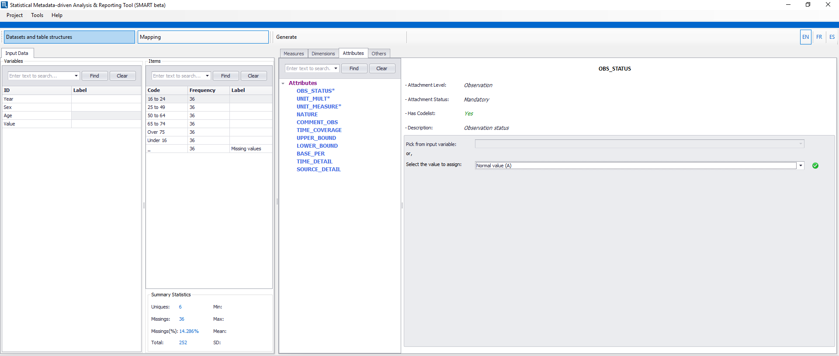
The dropdown list has things such as ‘Time series break (B)’, ‘Estimated value (E)’, ‘Experimental value (G)’, etc. In this case we will just select ‘Normal value (A)’
Now we move on to the Attributes column – we will only complete the required attributes as we don’t have columns for the others.

Slide 20
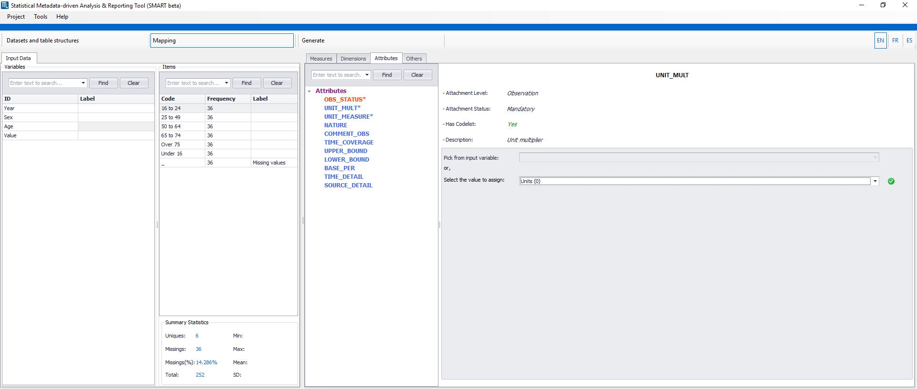
This drop down list has things like ‘Units (0)’, ‘Hundreds (2)’, ‘Hundred of thousands (5)’ but as we don’t have a multiplier in this case we just select ‘Units (0)’

Slide 21
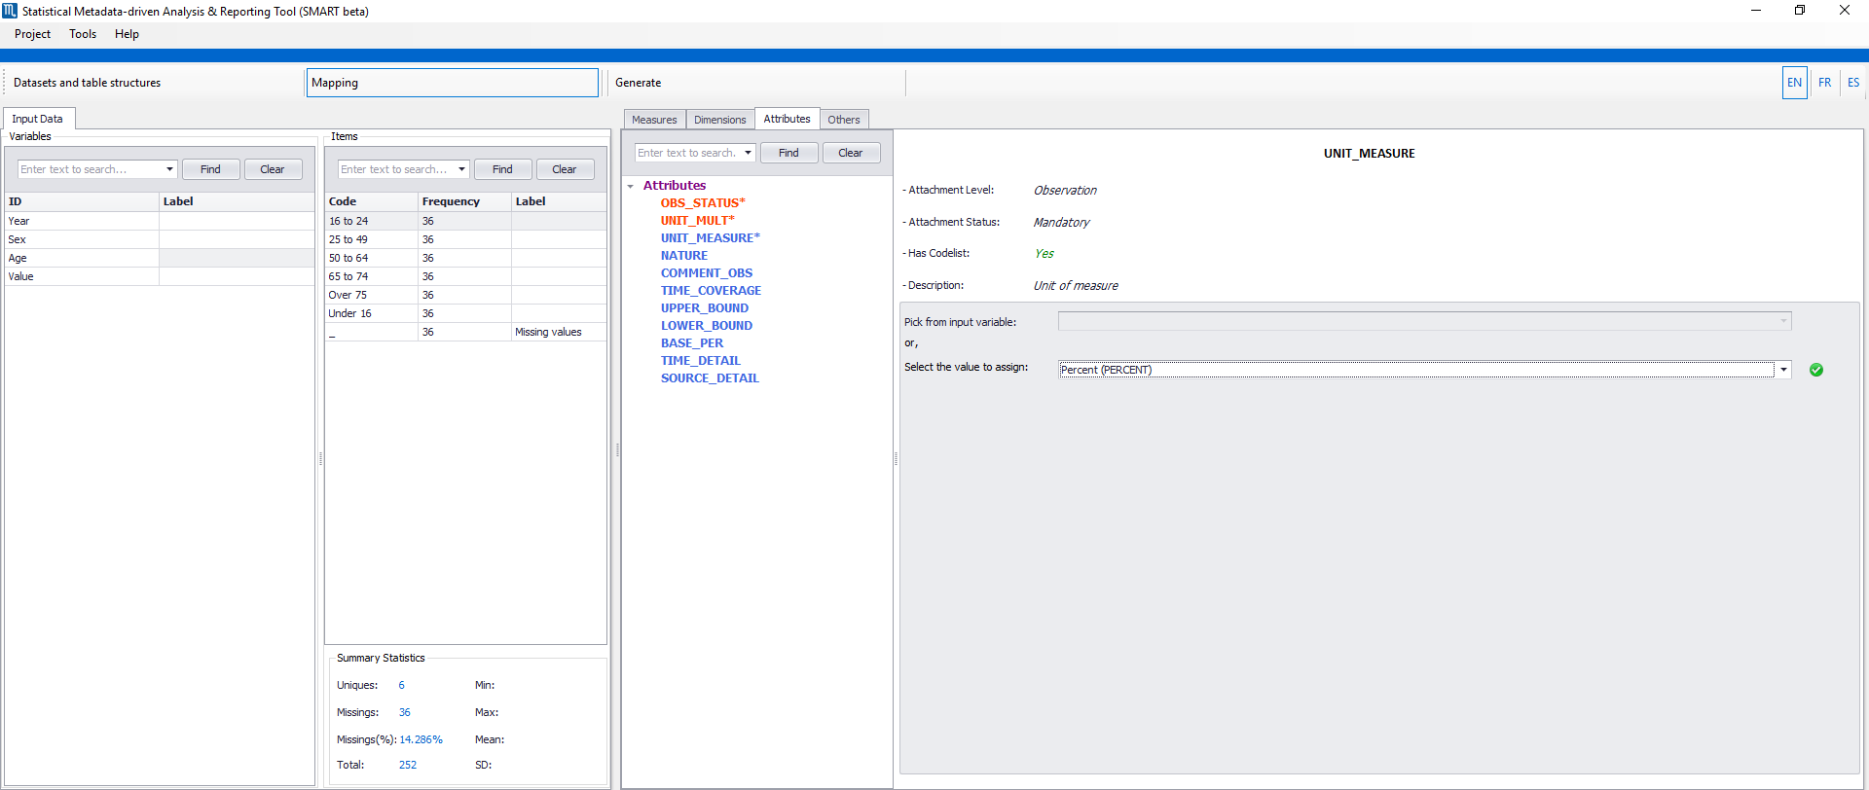
We select ‘Percent (PERCENT)’ from the dropdown list in this case as our values are percentages. There are also things like ‘Per 100,000 live births’ and ‘Per 100,000 population’ in this dropdown list

Slide 22
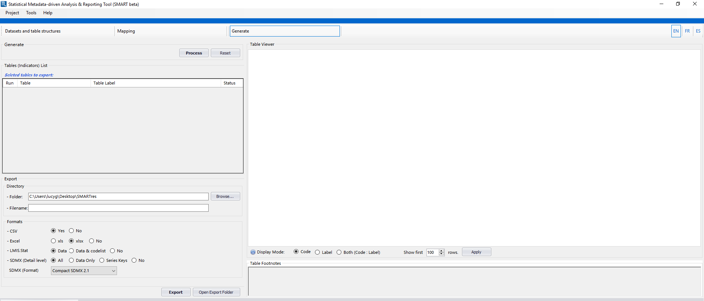
We now move on to the ‘Generate’ stage where we will generate a few outputs inc. an SDMX (xml) formatted file.
We start by clicking process

Slide 23
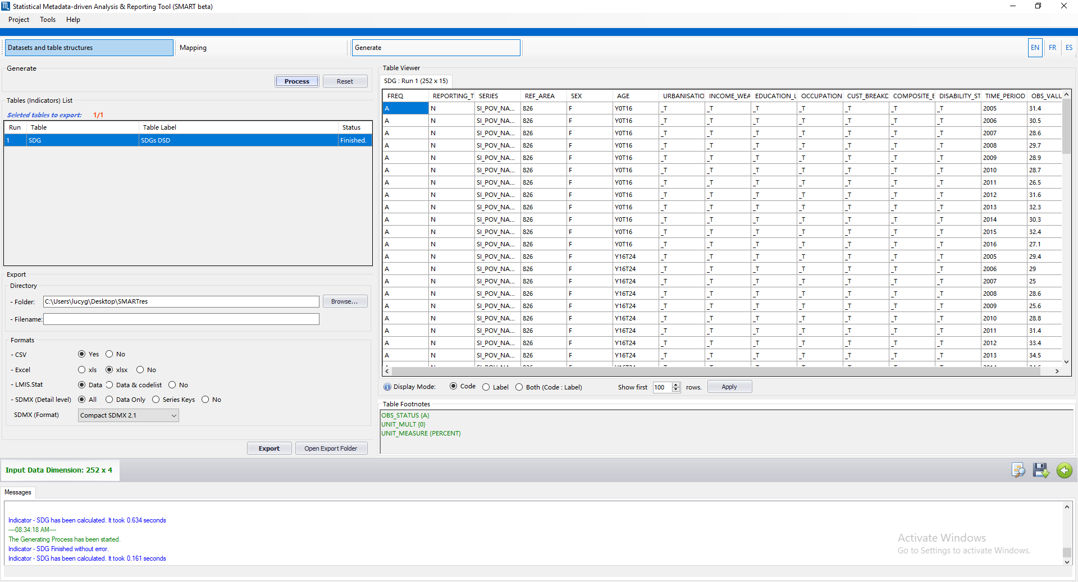
Once you have clicked ‘Process’, a preview of your new table will be shown here
To save the files so they can be used elsewhere, enter a folder and filename and click ‘Export’

Slide 24
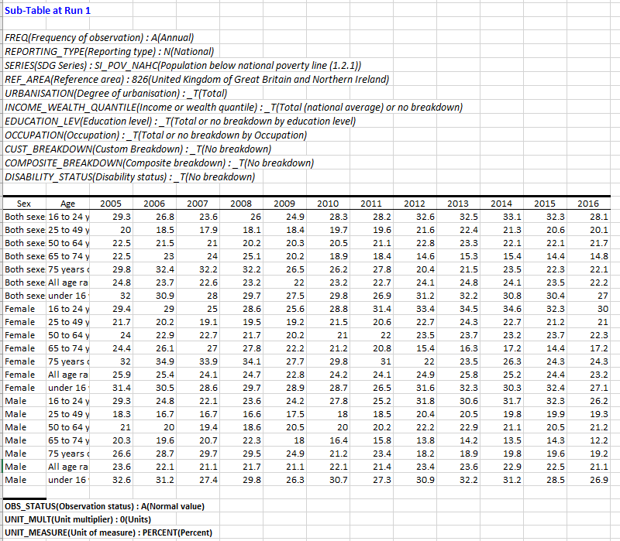
One output is this table which contains all the information we inputted into SMART including the data, dimensions and attributes

Slide 25
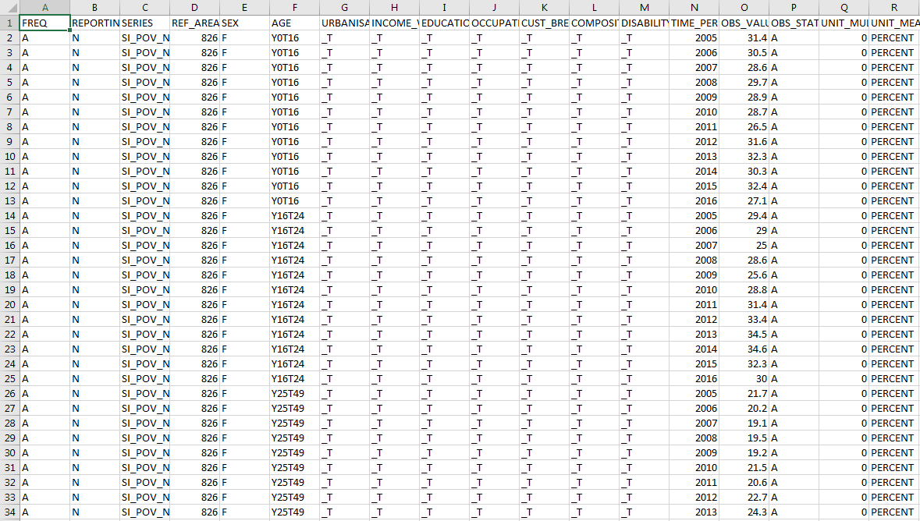
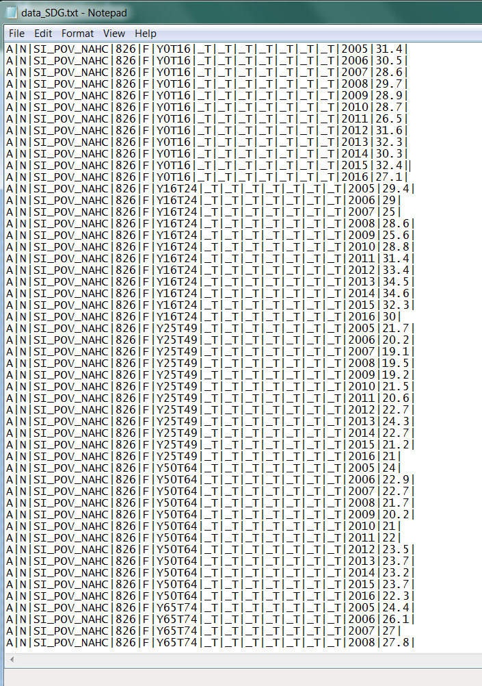
Another output is this CSV file which has a column for every dimension and attribute for each observation value.
This also comes in .txt format

Slide 26
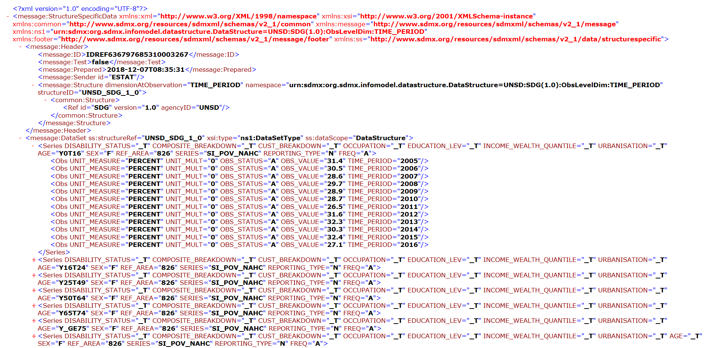
The final output is this xml file (required for SDMX), which is split by each disaggregation, then gives values for each year
E.g. these are the values for each year for females who are under 16

