Slide 1


G2M Strategy Analysis of Cab Company
Preliminary Analysis
Presented by Xiaoqing (Lucy) Leng

Slide 2
Business Objectives
Decide which cab company to invest
Based on the investment decision, showcase more patterns and provide possible marketing strategy.

Slide 3
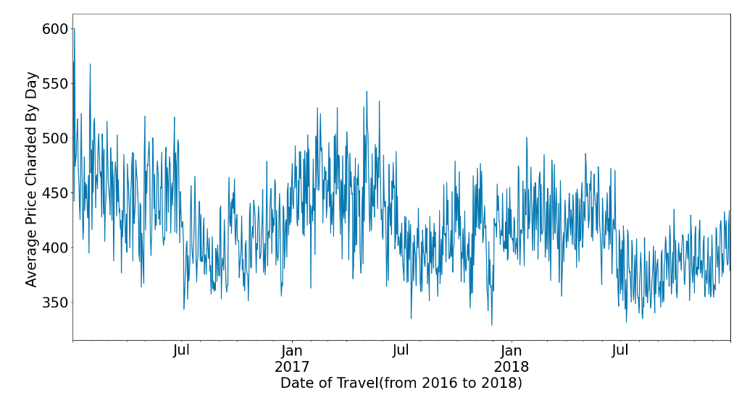
Seasonality
The plot above does show some seasonality trend as we can observe from the time series plot. THe average daily price charge seems to drop down after July every year, and reaches the peak before July.

Slide 4
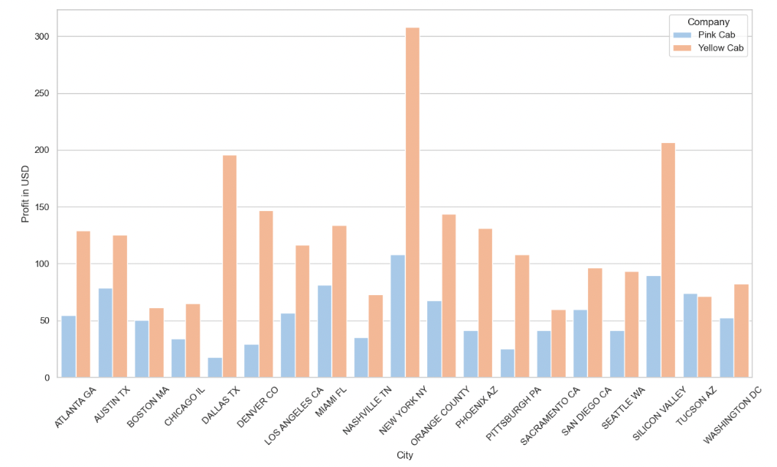
Profit

Slide 5
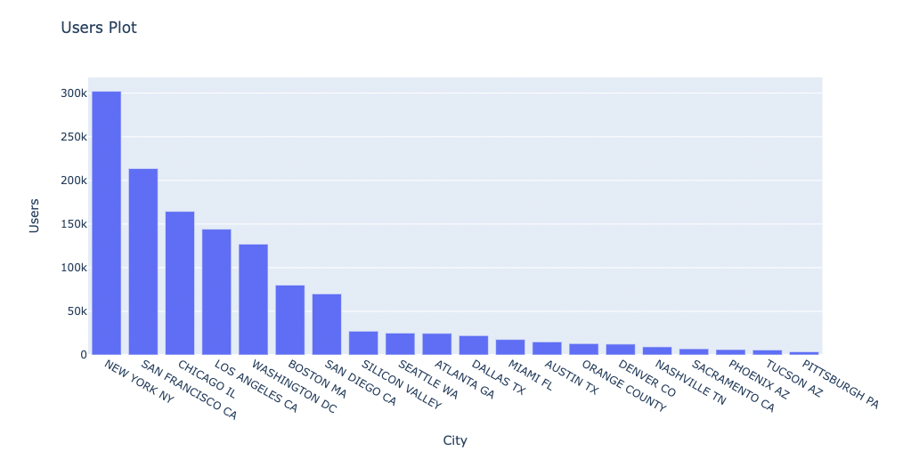
Users Plot

Slide 6
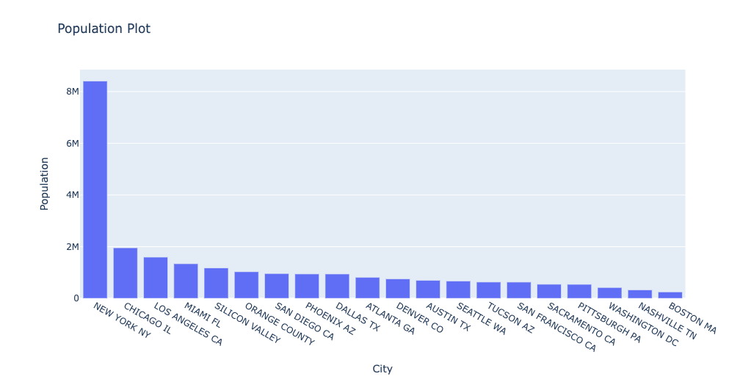
Population

Slide 7
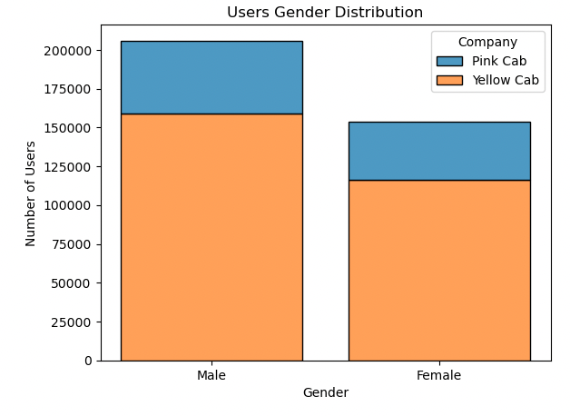
Gender

Slide 8
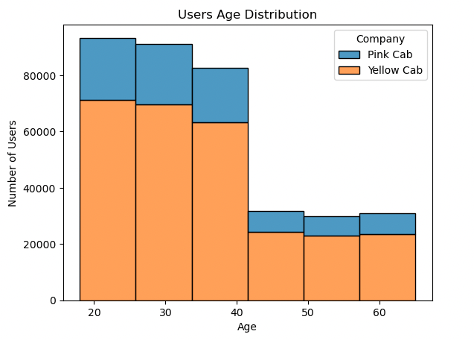
Age

Slide 9
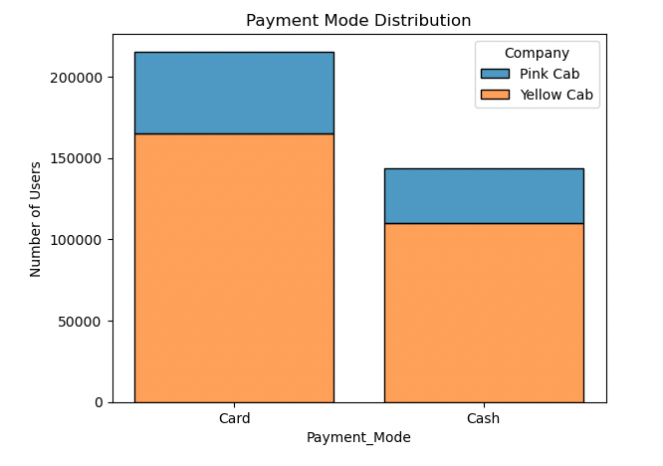
Payment Mode

Slide 10
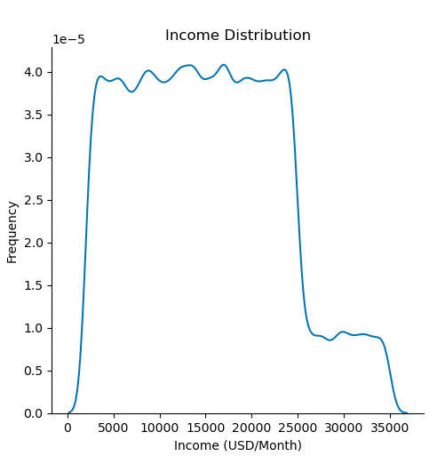
Income distribution

Slide 11
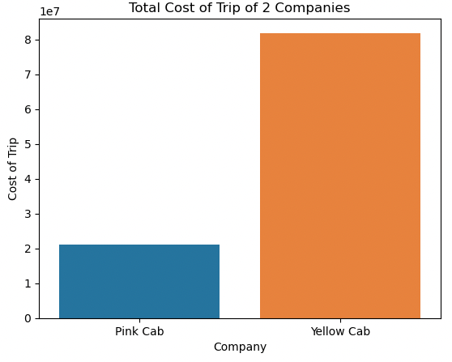

Slide 12
