Slide 1
GIT

Slide 2
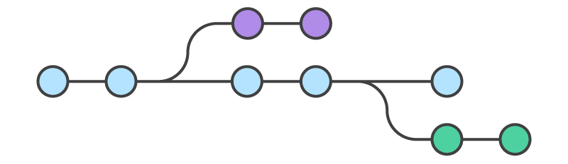
WHAT IS IT?

Slide 3
WHAT IS IT?
// A version control system
// A series of snapshots (commits) of your code
// Runs locally on your machine but you can connect it to remote git repository’s by using:
// GitHub
// Bitbucket
// Or creating your own
GREAT GUIDE: https://www.atlassian.com/git/tutorials/setting-up-a-repository/

Slide 4
USING GIT WITH TERMINAL

Slide 5
CREATING A REPO method one
// Create a new remote repo & copy the repo’s URL
// Open Terminal
// Move to the folder you wish to clone your repo to
$ cd path/to/folder
// Clone remote repo to current folder (creating your local repo)
$ git clone <remote-repo-url>

Slide 6
STAGING & COMMITING
// To check status of the repo
$ git status
// To add changes to be staged for commit
$ git add <file> //or// $ git add .
// Commit changes
$ git commit –m “commit message”
Notes:
After you’ve made some changes and you want to commit that change you need to let git know you want to commit those changes to the repo history
Then you can push the new code / version to the remote repo

Slide 7
PUSHING TO THE REMOTE REPO
// Make sure you have committed any changes
$ git status
// Make sure you are up to date with the remote repo
$ git fetch origin //just downloads
$ git pull origin master //download & merge
// Push to the remote repo
$ git push origin master
Notes:
Origin refers to the remote repo
Master refers to the branch

Slide 8
CREATING A REPO method two
// Create a remote repo with the name of your project & copy the URL
// Open Terminal and move to the root of your project folder
$ cd path/to/project
// Initialize local git repo
$ git init
// Stage your project files to be committed
$ git add .
$ git commit –m “commit message”
// Connect the Remote repo with the local repo
$ git remote add origin <remote-repo-url>
// Push your local committed files to the remote repo
$ git push origin master
Notes:
Origin refers to the remote repo
Master refers to the branch

Slide 9
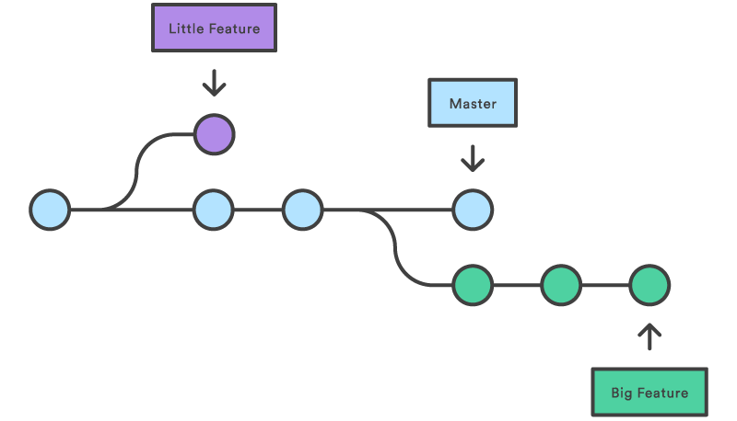
BRANCHES

Slide 10
CREATE A BRANCH
// Show Branches
$ git branches
// Create a new branch but don’t checkout to it
$ git branch <name-of-branch>
// Checkout another branch (move to another branch)
$ git checkout <branch-name>
// Create a new branch and checkout to it
$ git checkout –b <new-branch-name>
// To push a branch to the remote repo
$ git push origin <branch-name>
Notes:
Origin refers to the remote repo
Master refers to the branch

Slide 11
MERGING BRANCHES
// Checkout to the branch you want to merge TO
$ git checkout <branch-name-merge-destination>
// Merge the branches
$ git merge <branch-to–merge-with>
// You may get a merge conflict so you will need to open up your files and look for the conflicts in your code and resolve them
// Then you need to commit the merge changes
$ git add .
$ git commit –m “commit message”

Slide 12

REVERTING TO PREVIOUS VERSIONS

Slide 13
LOOKING AT PAST COMMITS
// To view a list of commits
$ git log -–oneline
// To change view a previous commit
$ git checkout <commit-number> //or//
$ git checkout <commit-number> <filename>
// To return to the head of your repo aka the most recent commit
$ git checkout <branch-you-are-on>
// To revert to a previous commit
$ git revert <commit-number> //or//
$ git revert <commit-number> <filename>
Notes:
Reverting:
It creates a new commit, it doesn’t effect any of the history of commits. Git figures out the changes needed to make it revert to the specified commit & makes the changes and merges those changes. It doesn’t delete anything.
Conflicts if vim editor comes up:
“a” to start typing
“esc” to go back to commands mode
“:wq” to write and quit

