Slide 1
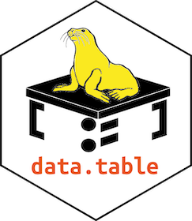
Data Manipulation with data.table in R
R-Ladies Abuja
March 19, 2022

Slide 2
Overview
Introduction/Getting started
Brief: Difference between dataframes and data.tables objects
Data manipulation:
Assessing the structure of a data.table object
How to sort and order rows
How to remove information
How to add information
How to reduce information
How to combine information
* Reshaping data
* Other useful data.table functionalities

Slide 3

HELLO!
I am Njoki Njuki
A second-year student at Hasselt University, pursuing MSc Statistics and Data Science specialising in Biostatistics.
I am also a trainer of Data Management and Analysis, and Basic Statistics at Training Center in Communication, located at the University of Nairobi.
I am the organiser of R-Ladies Nairobi (part of the R-Ladies Global).
I also love reading books, blogs about advances in scientific research. Currently part of a book club under R4DS community studying the “R for Data Science” book.
Let’s connect via:
Twitter: @lucy_njokinjuki
LinkedIn: Njoki Njuki Lucy
Email: lucynjokinjuki@gmail.com

Slide 4
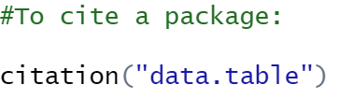
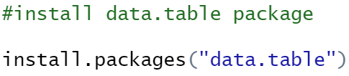
Introduction
data.table package is an extension of a dataframe.
Authored by Matt Dowle and Arun Srinivasan.
Syntax like base R.
To install the package:

Slide 5
Getting started?
Introduction to data.table vignette
Getting stared wiki page
Examples → example(data.table)
Cheatsheet
dtplyr: Data Table Back-End for 'dplyr’
Towards data science article: data.table: R’s Best Data Object by Wicaksono Wijono

Slide 6
Brief: Difference between dataframes and data.tables objects
dataframe:
Considerably slower
Doesn’t name the rows
data.table:
Faster
Names the rows

Slide 7
Let’s move to R!

Slide 8
Credits
Special thanks to all the people who made this tutorial a success:
@R-Ladies Abuja organisers
Dr Shannon Pileggi (@PipingHotData)
Shelmith Kariuki (@shel_kariuki)
Feedback from Jim Rothstein, member of R4DS Learning community (@R4DScommunity)
Presentation template by SlidesCarnival

Slide 9
THANK YOU!
Any questions?

